Slide 1
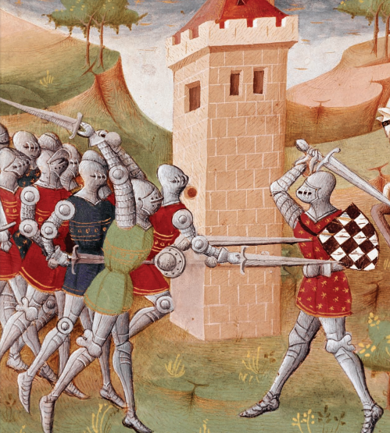
The Middle Ages Core Knowledge Unit
Year 4
Slide deck made by Lauren Van Dongen based on FREE Core Knowledge Foundation resources

Slide 2
Knowledge Unit: The Middle Ages Year 4
Lesson # | Lesson Title | Learning Objective | Big Question | Vocabulary | Embedded Writing Task
1 | Welcome to the Middle Ages Part 1 | I can describe what happened when the Roman Empire broke apart into the eastern and western parts. | What happened when the Roman Empire broke apart into the eastern and western parts? | infamous | Because, but, so sentence stems
2 | Welcome to the Middle Ages Part 2 | I can compare and contrast some features of life in the Middle Ages to life now. | What are some of the similarities and differences between life in the Middle Ages and life now? | adorn | Generate sentences using subordinating conjunctions showing comparison, concession or contrast,
3 | To The Manor Born | I can describe differences between the lives of serfs and the lives of lords. | What are the differences between the lives of serfs and the lives of lords? | rival | SPO on differences between lives of lords and serfs
4 | Jousting Knights | I can describe the purpose of knights in the Middle Ages. | What was the purpose of knights in the Middle Ages? | influential | Read, write, discuss revise cycle Convert fragments to sentences
5 | Gloomy Castles | I can describe the features of castles in the Middle Ages | What were the features of castles in the Middle Ages? | siege | SPO on the features of castles
6 | Merchants, Markets and Mud | I can explain how trade contributed to the development of the middle class and medieval towns. | How did trade contribute to the development of the middle class and medieval towns? | thrive | Sentence Combining
7 | Towns in the Middle Ages and Women in the Middle Ages | I can identify features of medieval towns. | What are some of the features of medieval towns? | discard | SPO on features of medieval towns

Slide 3
Knowledge Unit: The Middle Ages Year 4
Lesson # | Lesson Title | Learning Objective | Big Question | Vocabulary | Embedded Writing Task
8 | The Power of the Church | I can describe how the Christian Church influence the daily lives of people in medieval Europe. | How did the Christian Church influence the daily lives of people in medieval Europe? | summon | Co-ordinating conjunctions
9 | 1066: The Battle that Changed History | I can recall who won the Battle of Hastings and how they won. | Who won the Battle of Hastings and how did they win? | defeat | Generate sentences using subordinating conjunctions showing time and place.
10 | Henry II and Law and Order | I can recall important changes that King Henry II made to the laws of England? | What important changes did King Henry II make to the laws of England? | acquire | Sentence summary (TWR)
11 | The Wayward King: King John and Magna Carta Part 1 | I can recall reasons why King John and his nobles ended up in conflict | For what reasons did King John and his nobles end up in conflict? | inevitable | SPO on why King John and his nobles ended up in conflict (TWR)
12 | The Wayward King: King John and Magna Carta Part 2 | I can explain what the Magna Carter is and what it changed. | What is the Magna Carter and what did it change? | consult | Because, but, so sentence stems
13 | A Changing World Part 1 | I can recall key details of The Hundred Years’ War and identify how Joan of Arc was involved. | What are the key details of The Hundred Years’ War and how was Joan of Arc involved? | encounter | Read, Write, Discuss cycles Correct run on sentences
14 | A Changing World Part 2 | I can identify key developments in the Middle Ages that effect our lives today. | What key developments in the Middle Ages effect our lives today? | unravel | SPO on key developments that affect our lives today

Slide 4
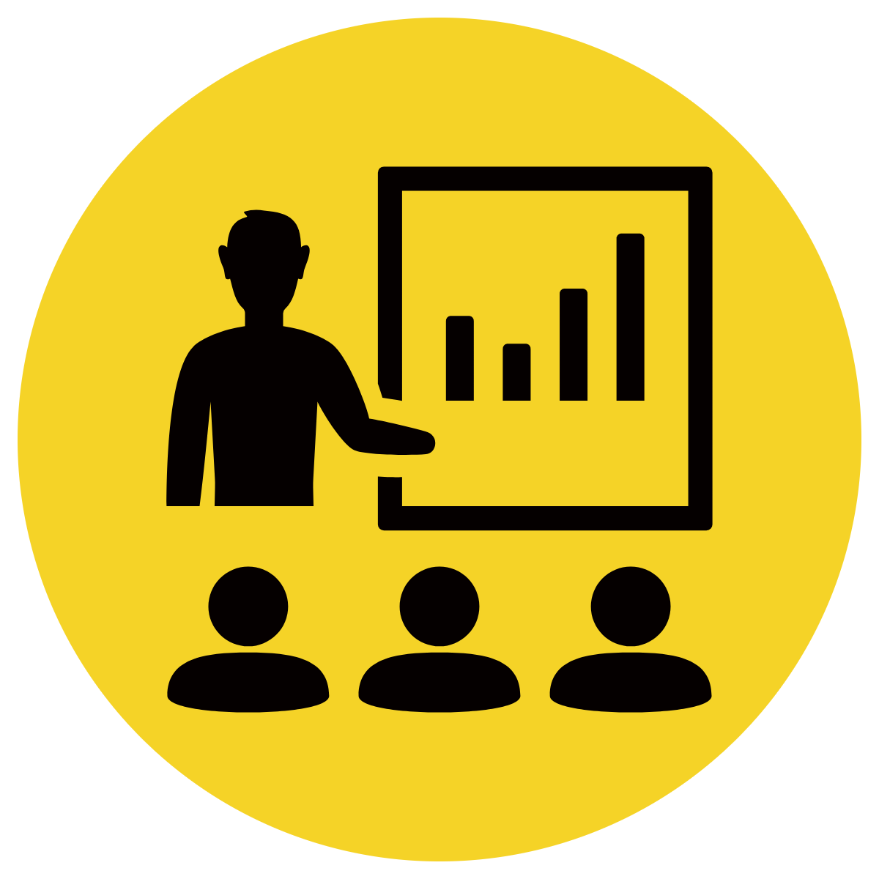
Century Gothic
Arial Rounded MT
Multiple Choice
Pair Share
Track with me
Pick a Stick/Answer (non-volunteer)
Whiteboards
Vote
Read with me
In Your Workbook
Icons by Brad Nguyen & Nathaniel Swain

Slide 5
Lesson 1
Welcome to the Middle Ages
Part 1.(A)
The Big Question:
What happened when the Roman Empire broke apart into the eastern and western parts?

Slide 6
Vocabulary

Slide 7
definition:
Track with me
Vocabulary
Read with me
Choral Reversal
infamous
well-known for being bad.

Slide 8
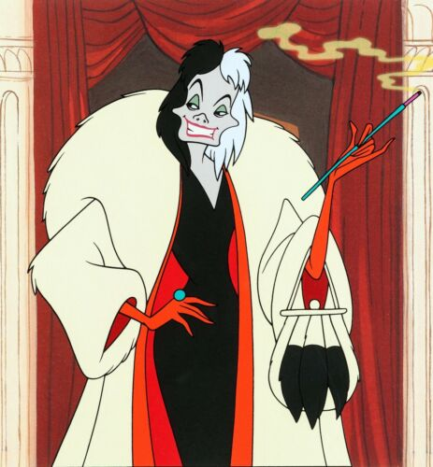
Why is this picture an example/not an example of a infamous? How do you know?
Vocabulary
is/is not an example of infamous because .
Insert image
Insert image
infamous
not infamous

Slide 9
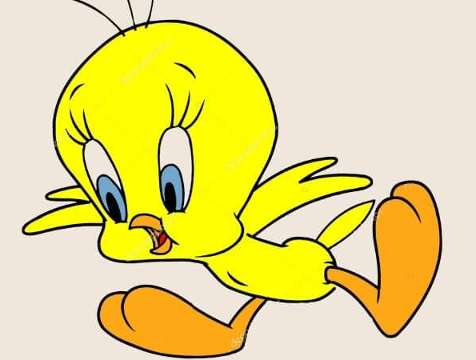
Why is this picture an example/not an example of infamous? How do you know?
Vocabulary
is/is not an example of infamous because .
Example or Non-Example?
Insert image
Notes:
We Do
*Replace happy with vocab word

Slide 10
Track with me
Vocabulary
sentences:
Read with me
Scar, the infamous lion, wanted to be King.
There is a university in England that is infamous for poorly behaved students.
Some people say Ned Kelly is infamous, but some think he is a hero.
Notes:
Senior
*vocab word in red

Slide 11
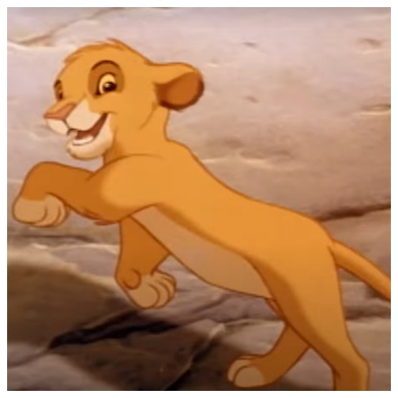
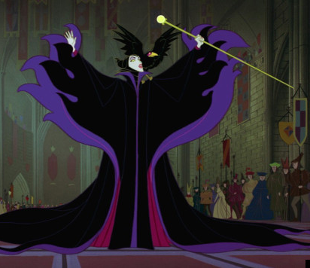
Why is this picture an example/not an example of infamous? How do you know?
Vocabulary
Insert image
Insert image
is/is not an example of infamous because .
A
B
Insert image
Insert image
C
D
Notes:
Senior You do
*Replace happy with vocab word

Slide 12
Which sentence is a correct example of infamous? How do you know?
Vocabulary
is an example of infamous because .
A
The man was infamous for committing a horrific crime.
B
Taylor Swift is infamous for her singing and song writing.
Since the back roads are infamous for flooding in the winter, I suggest you stick to the highways on your trip.
C
Notes:
Senior You do
*Replace happy with vocab word

Slide 13
Put infamous in a sentence.
Vocabulary
Word Origin & Morphographs
infamous
in/fam/ous
merging of two Middle English words, with the form of infamous "not well-known" (early 15c.) and the sense of infamis (late 14c.), "of ill repute, famous for badness."
Adjective well-known for being bad
Synonyms: notorious, disreputable
Notes:
Senior Review Slide
*Include synonyms where appropriate
Word Origin information (https://www.etymonline.com/)

Slide 14
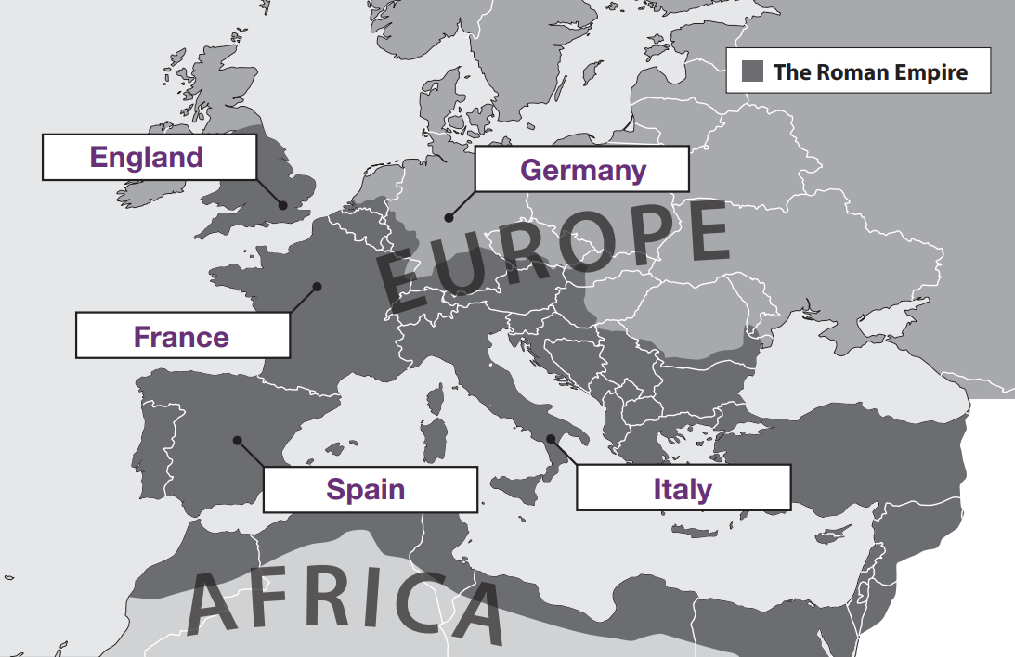
Read Passage
Discuss and Read Question
Teacher and students read together.
APK
Where did the Middle Ages take place?
The Middle Ages took place in .
The Middle Ages took place in Europe.
People use the phrase “Middle Ages” to describe the period of European history between the fall of Rome and the beginning of the Renaissance.

Slide 15
I can describe what happened when the Roman Empire broke apart into the eastern and western parts.
Teacher and students read together.
TODAY’S LEARNING GOAL

Slide 16
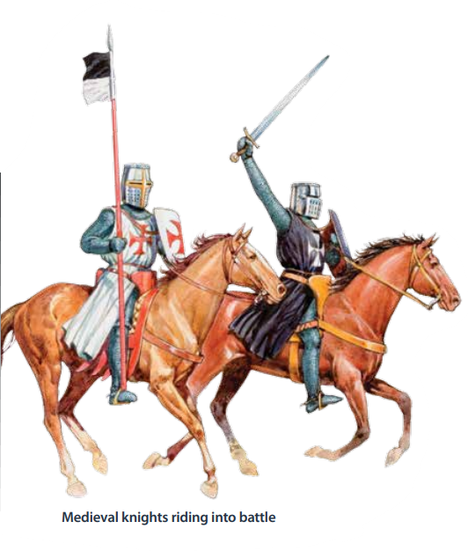
Read Vocabulary
Read Passage
Discuss and Read Question
Teacher and students read together.
Body
If you know anything about knights, castles, or Robin Hood, then you already know something about the Middle Ages in Europe. The Middle Ages may seem to be an unusual name for a historical period— especially one that lasted for more than 1,000 years. People in the Middle Ages did not know they were in the middle of anything. They thought they were modern—just as you and I do today. In fact, the Middle Ages was not a phrase used by the people who lived during that time period. It is a term modern historians use today to refer to that time period between ancient and modern times.

Slide 17
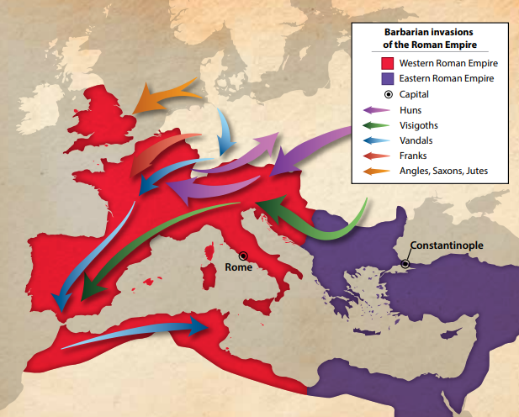
Read Vocabulary
Read Passage
Discuss and Read Question
Teacher and students read together.
Body
We begin our journey into medieval Europe—another name for the Middle Ages—by examining some key events that happened long before this age began. The first major event that helped to transform western Europe occurred when the mighty Roman Empire, having grown too big for one emperor to rule, broke apart into the eastern and western parts of the empire.
This division had a major impact on western Europe. With the Roman Empire split into two parts, different tribes took the opportunity to seize some of its lands. Some of these people were given the name barbarian from the Latin word barbarus, meaning foreigner, or not Roman. The Romans may have considered these people to be uncivilized because they did not speak Latin, the language of the Roman Empire.
What was the first major event that helped to transform western Europe leading to the Middle Ages?
The first major event that led to the middle ages was .
The first major event that led to the middle ages was that the Roman Empire grew too big for one emperor to rule, so it broke into two parts.
Vocabulary
medieval (adjective) of or relating to the middle ages.
empire (noun) a group of countries or regions controlled by one ruler or one government.
seize (noun) to take.

Slide 18
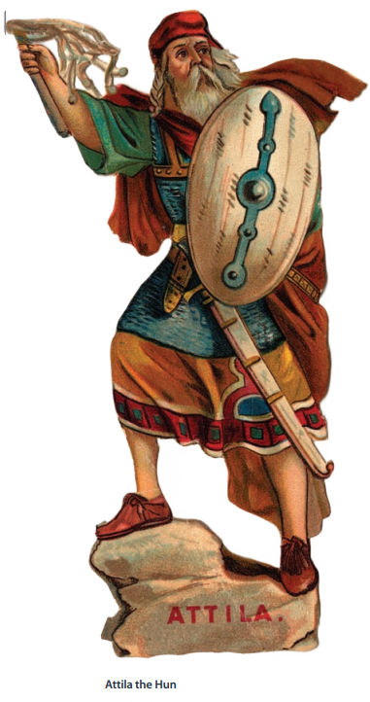
Read Vocabulary
Read Passage
Discuss and Read Question
Teacher and students read together.
Body
What was the second major event that helped to transform western Europe leading to the Middle Ages?
Some of the most successful barbarian invaders were Germanic tribes, such as the Franks, the Visigoths, and the Vandals. These tribes lived on the edges of the empire. As the Romans became unable to defend their borders, these tribes pushed farther to the west. The Vandals looted towns and villages so badly that today we use the word vandalism to describe the destruction of property. The most infamous so-called barbarians were the Huns from central Asia. Attila the Hun led this nomadic tribe as they invaded parts of Europe in the 400s. As the Huns conquered, they drove the once dominant Germanic tribes even farther into the Western Roman Empire. This was the second major event that led to the Middle Ages.
The second major event that led to the middle ages was .
The second major event that led to the middle ages was the invasion of parts of the Roman Empire, and the Huns, led by Attila, pushed the Germanic tribes farther into the Western Roman Empire.
Vocabulary
loot (verb) to steal things by force, often after a war or destruction (looted)
infamous (adjective) well known for being bad.

Slide 19
Read Vocabulary
Read Passage
Discuss and Read Question
Teacher and students read together.
Body
Why did many people turn to the church?
As warlike tribes swept across western Europe, and powerful kings emerged, another transforming force appeared—the Christian Church. Throughout these years of change, many people turned to the Church because it offered them a sense of stability and hope. The heart, or centre, of the Church was in Rome, the seat of the papacy. Slowly, more and more groups of people became Christians, including the Germanic tribes. Over time, the Church became even richer and more powerful than many kings and queens.
It is this time—when the Roman Empire was no longer the only powerful force in Europe—that many historians consider to be the start of the Middle Ages. Roman, Germanic, and Christian ideas, as well as powerful kings, began to shape western Europe.
Many people turned to the church because __________
Many people turned to the church because it offered them stability and hope.
Vocabulary
papacy (noun) the office or the position of the pope

Slide 20
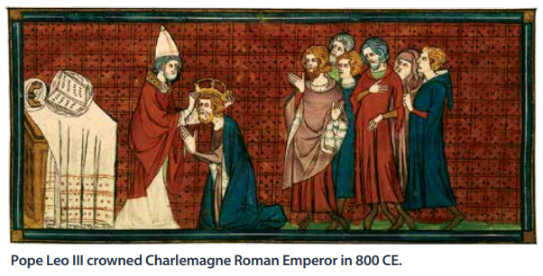
Pair share and discuss
Lesson Closure
Ask question
Discuss answers
Our Big Question:
What happened when the Roman Empire broke apart into the eastern and western parts?
INITIATING QUERIES
FOLLOW-UP QUERIES
SUMMARISING
PREDICTING
Notes:
INITIATING QUERIES
What have we discussed today?
What was this all about?
What do we know so far?
FOLLOW-UP QUERIES
How does this relate to what we have learnt before?
What can we learn about the middle ages?
SUMMARISING
What are some of the big events that led to the middle ages?
PREDICTING
What do you think we will be learning about

Slide 21
In your workbook
Activity
In your book, complete because, but, so sentence stems.
The Roman Empire broke into east and west parts because ________________________________ .
The Roman Empire broke into east and west parts, but ___________________________________.
The Roman Empire broke into east and west parts, so _____________________________________.
At this time, people turned to the Catholic Church because ______________________________ .
At this time, people turned to the Catholic Church , but __________________________________ .
At this time, people turned to the Catholic Church, so ____________________________________ .

Slide 22
Lesson 2
Welcome to the Middle Ages
Part 2
The Big Question:
What are some of the similarities and differences between life in the Middle Ages and life now?

Slide 23
Vocabulary
adorn

Slide 24
definition:
Track with me
Vocabulary
Read with me
Choral Reversal
adorn
to decorate or add beauty to something.

Slide 25
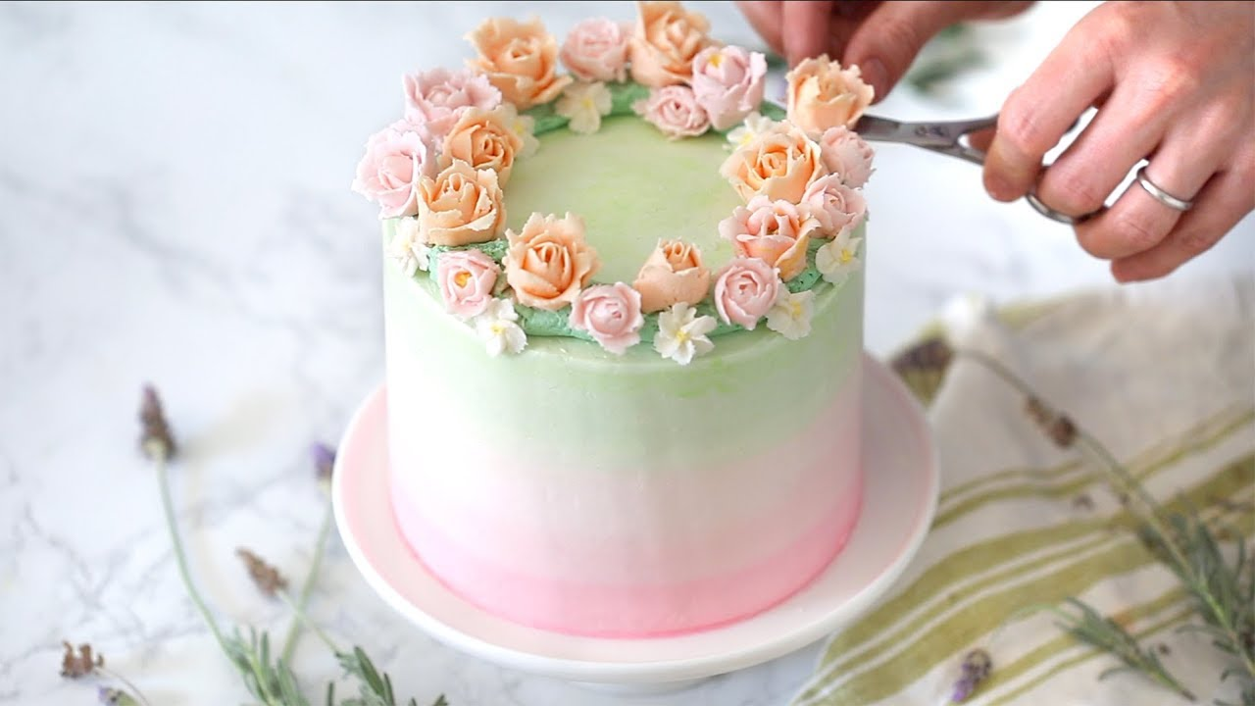
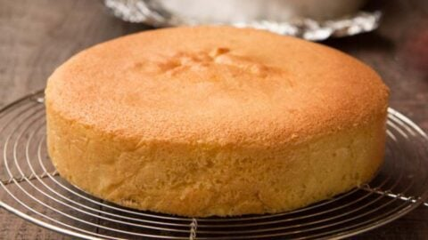
Why is this picture an example/not an example of a adorn? How do you know?
Vocabulary
is/is not an example of adorn because .
Insert image
Insert image
adorn
not adorn

Slide 26
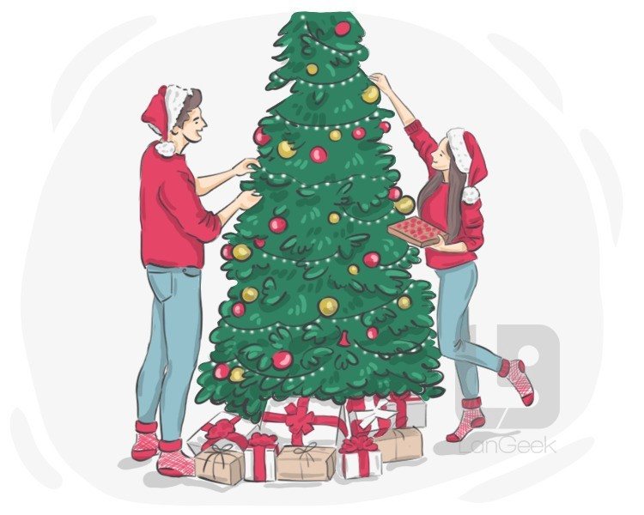
Why is this picture an example/not an example of adorn? How do you know?
Vocabulary
is/is not an example of adorn because .
Example or Non-Example?
Insert image
Notes:
We Do
*Replace happy with vocab word

Slide 27
Track with me
Vocabulary
sentences:
Read with me
Sarah loves to adorn her hair with colourful ribbons and bows.
Jake's room is adorned with posters of his favorite superheroes.
The knight's shield was adorned with a fierce dragon design.
Notes:
Senior
*vocab word in red

Slide 28
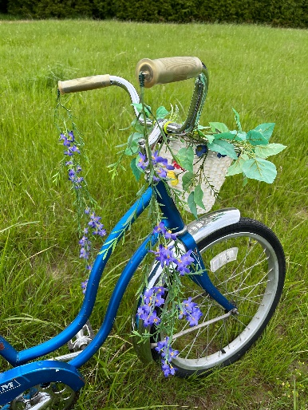
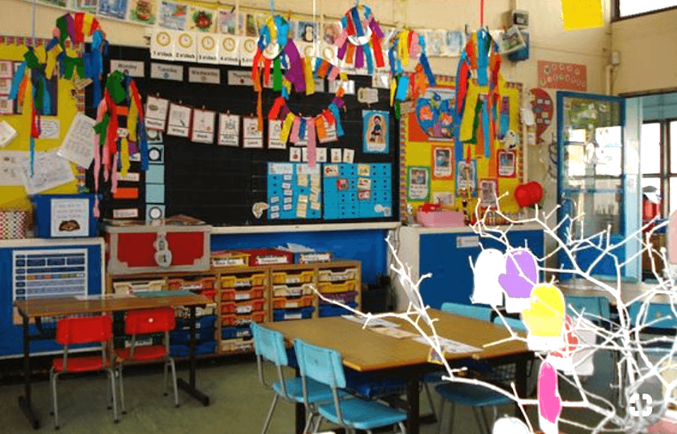
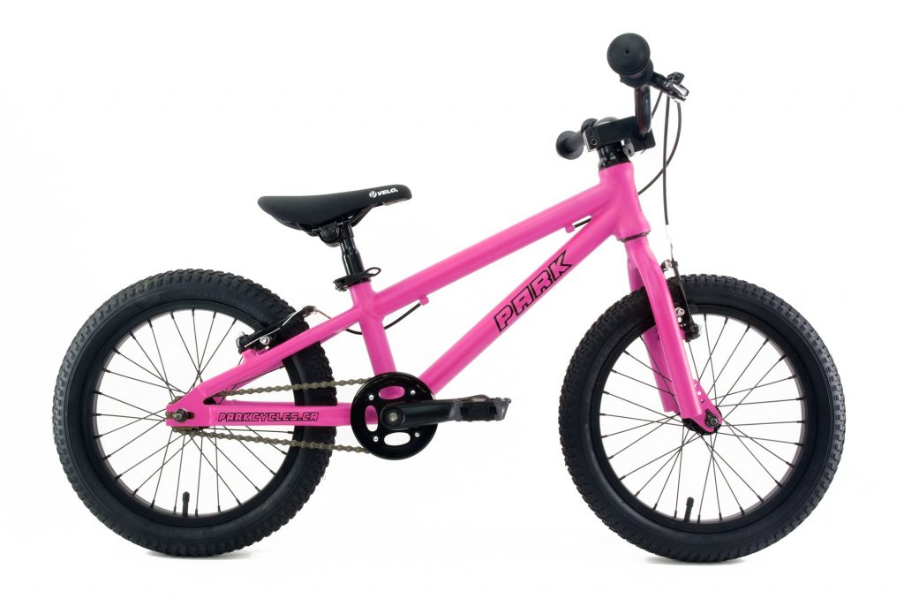
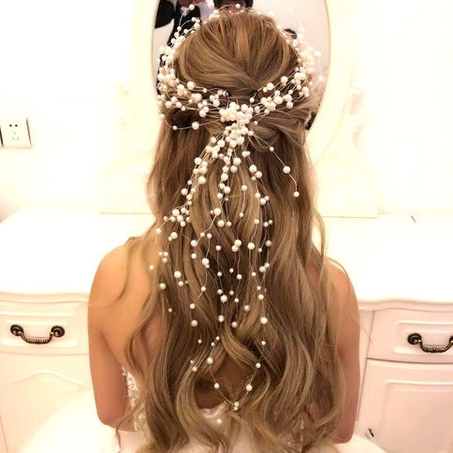
Why is this picture an example/not an example of adorned? How do you know?
Vocabulary
Insert image
Insert image
is/is not an example of adorned because .
A
B
Insert image
Insert image
C
D
Notes:
Senior You do
*Replace happy with vocab word

Slide 29
Which sentence is a correct example of adorn? How do you know?
Vocabulary
is an example of adorn because .
A
The classroom was adorned with colourful artwork made by the students.
B
The little girl wanted to adorn her cake with icing flowers and sprinkles for her birthday party.
C
Juliet adorned the dishes and put them away, or she would’ve been grounded.
Notes:
Senior You do
*Replace happy with vocab word

Slide 30
Put adorn in a sentence.
Vocabulary
Word Origin & Morphographs
adorn
a/dorn
late 14c., from the word aournen, later adornen, meaning "to decorate, embellish,"
Verb to decorate or add beauty to something
Synonyms: decorate, embellish
Notes:
Senior Review Slide
*Include synonyms where appropriate
Word Origin information (https://www.etymonline.com/)

Slide 31
Read Passage
Discuss and Read Question
Teacher and students read together.
APK
Where did the Middle Ages take place?
The Middle Ages took place in .
The Middle Ages took place in Europe.
People use the phrase “Middle Ages” to describe the period of European history between the fall of Rome and the beginning of the Renaissance.

Slide 32
I can compare and contrast some features of life in the Middle Ages to life now.
Teacher and students read together.
TODAY’S LEARNING GOAL

Slide 33
Read Vocabulary
Read Passage
Discuss and Read Question
Teacher and students read together.
Body
In one of the Germanic regions, a great ruler emerged. His name was Charles, and he took control of much of the land that later became France. Charles ruled for more than 45 years. He increased the size of his empire by gaining land in areas that are now part of Germany, Austria, Italy, and Spain. As king, Charles defended the authority of the Church. He promoted the spread of Christianity. On Christmas Day, in 800 CE, he was crowned Roman emperor by the pope in Rome. His reputation was so great that, later, writers called him Charlemagne, which means “Charles the Great.”
Why do you think Charlemagne became known as Charles the Great?
Charlemagne became known as Charles the Great because .
Charlemagne became known as Charles the Great because he accomplished things people approved of and many believed him to be a great man.
Vocabulary
authority (noun) the power to give orders and make decisions
promoted (verb) support or actively encourage

Slide 34
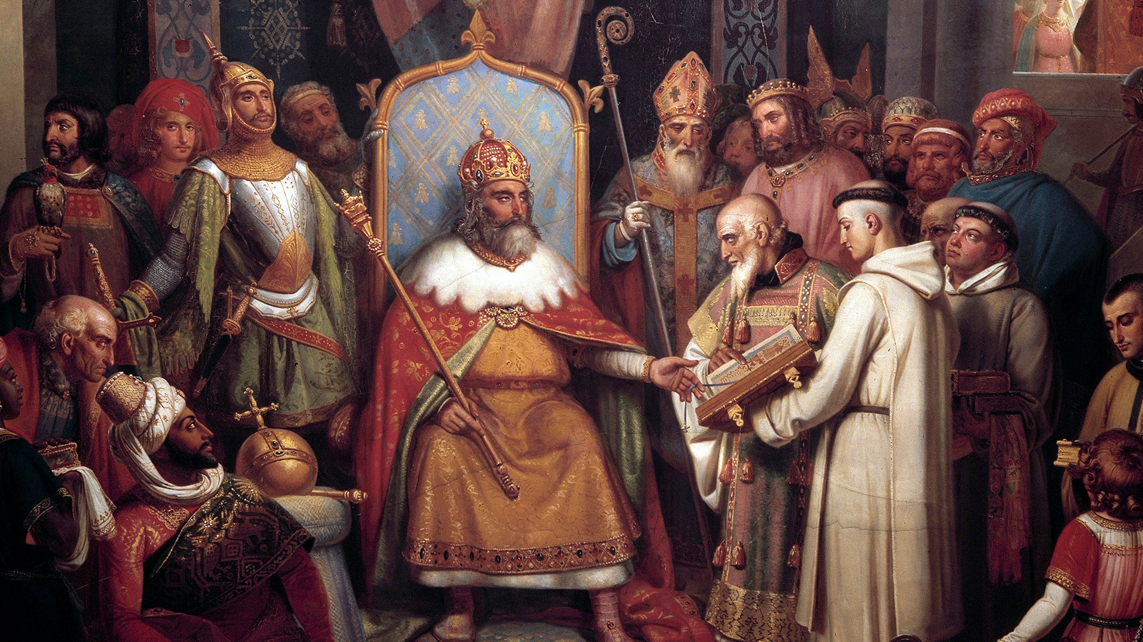
Charlemagne was a medieval emperor who ruled much of Western Europe from 768 to 814.

Slide 35
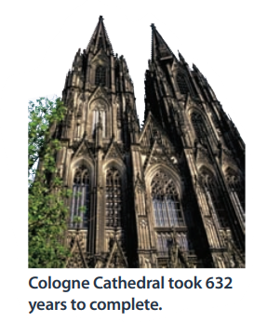
Read Vocabulary
Read Passage
Discuss and Read Question
Teacher and students read together.
Body
Charles encouraged new ideas and promoted an interest in education and art. To help him rule his empire, Charlemagne also encouraged a system of government that we now call feudalism. He gave land, instead of money, to those who worked for him in the military or government. The practice of paying men with land spread throughout other countries in western Europe.
Life in the Middle Ages was not the same as it is now. For one thing, people who lived back then probably thought about time differently. Many people measured time by the rising and setting of the sun and the passing of the seasons. For this reason, life likely had a slower, steadier pace. In addition, there was a strong desire to honour God that appeared to transcend time. As a result, people undertook impressive, long term projects such as building magnificent cathedrals that took centuries to complete.
What is feudalism?
Feudalism is ___________.
Feudalism is the act of paying people with land instead of money.
How is the way that people thought about time in the Middle Ages different to how people think about time now?
In the Middle Ages, people measured time ___________. Now, people measure time _____________.
In the Middle Ages, people measured time by the rising and setting of the sun and passing of the seasons. Now, people measure time using clocks in minutes and hours, as well as days, weeks, months and years.
Vocabulary
transcend (verb) to rise above or go beyond the limits of.

Slide 36
Read Vocabulary
Read Passage
Discuss and Read Question
Teacher and students read together.
Body
Language and location helped shape people’s lives, too. Because travel was so difficult, many people didn’t do it. Generally, only rich, educated people in Europe travelled. Almost everyone else stayed close to home. Although Latin was the language of both the Church and government, only select members of society could understand that language. Most people lived an isolated existence. They did not travel far from home. As a result, most people communicated using the language, or dialect, spoken in the place of their birth. As strange as it may seem to us, in certain parts of Europe villagers from places just 30 miles apart could not easily understand each other. For this reason, most people during the Middle Ages were concerned with the affairs of their village, what they owed the local lord in the way of payment, and how to ensure their place in heaven.
How is the variety of languages spoken in the Middle Ages similar to the variety of languages spoken by Indigenous Australians pre-European settlement?
The variety of languages spoken is similar because .
The variety of languages spoken is similar because pre-European settlement, Indigenous Australians spoke 250 languages in over 700 nations.
Vocabulary
isolated (verb) separate and alone, apart from others.
affairs (noun) events, matters or happenings

Slide 37
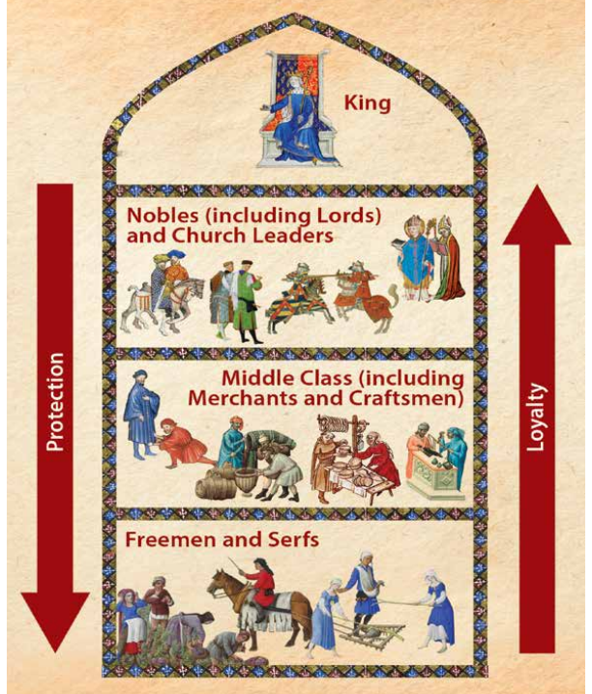
Teacher and students read together.
Body
Read Vocabulary
Read Passage
Discuss and Read Question
What does the arrow ‘protection’ show?
The ‘protection’ arrow shows ___________ .
The ‘protection’ arrow shows that people higher on the chart offered protection to those below,
Medieval Feudal Society
Although this diagram does not include every aspect of medieval feudal society, it does show the people with the most power at the top, and the people with the least power at the bottom.
What does the arrow ‘loyalty’ show?
The ‘loyalty’ arrow shows that people lower on the chart were loyal to those who were above them.
The ‘loyalty’ arrow shows ___________ .
We will learn more about these people in the next few lessons.

Slide 38
Read Vocabulary
Read Passage
Discuss and Read Question
Teacher and students read together.
Body
There was another force that had a huge impact on western European society during the Middle Ages. This force came in the form of a deadly disease. The disease, called the Black Death or plague, certainly made its mark upon medieval Europe. This dreadful plague first appeared in the 500s. In the second half of the 1300s it swept through Europe once again. Spread by infected fleas that lived on rodents, the Black Death probably killed one-third of the population of western Europe.
Why was the Black Death so devastating?
The Black Death was so devastating because it killed probably one-third of the population of western Europe.
The Black Death was so devasting because .
Vocabulary
plague (noun) a disease caused by bacteria.

Slide 39
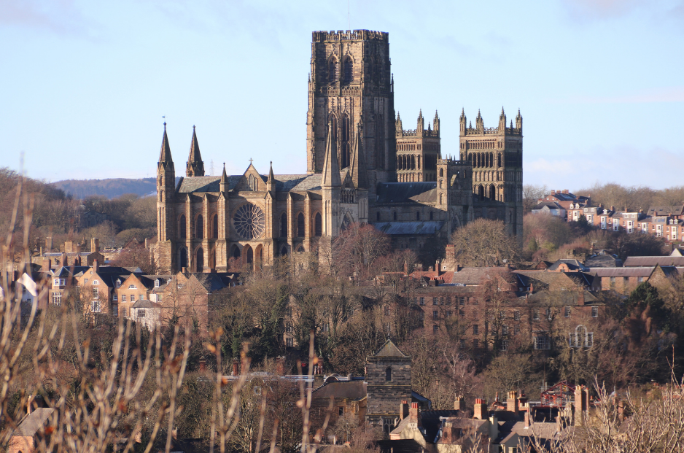
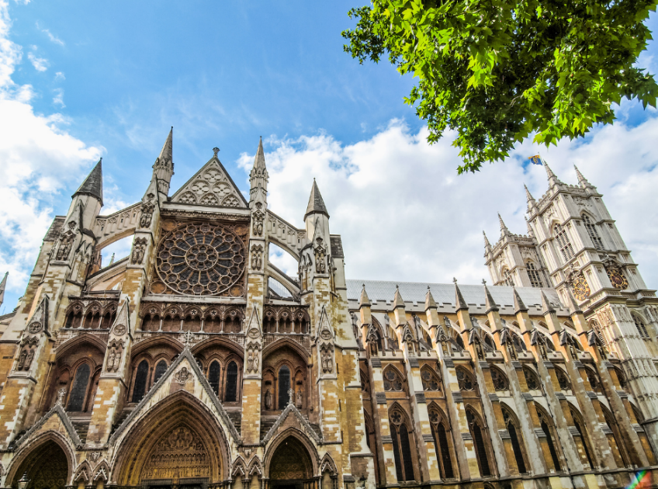
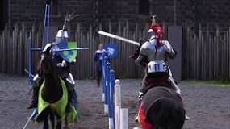
Read Vocabulary
Read Passage
Discuss and Read Question
Teacher and students read together.
Body
Despite conflicts and hardships, this period in history was also a time when people created impressive and inspiring architecture. Great castles and churches began to adorn the landscape. Kings, queens, and noblemen held jousts, and court jesters entertained noble families.
Why do you think the building of impressive and inspiring architecture was positive?
I think the building of impressive and inspiring architecture was positive because ______
I think the building of impressive and inspiring architecture was positive because it provided beautiful buildings to adorn the landscape during the Middle Ages.
Vocabulary
joust (noun) when two knights, fully decked out in very heavy armour, charge at each other on horseback with big sticks called lances
court jester (noun) an entertainer
Durham Cathedral
Westminster Abby

Slide 40
Pair share and discuss
Lesson Closure
Ask question
Discuss answers
Our Big Question:
What are some of the similarities and differences between life in the Middle Ages and life now?
INITIATING QUERIES
FOLLOW-UP QUERIES
SUMMARISING
PREDICTING
Notes:
INITIATING QUERIES
What have we discussed today?
What was this all about?
What do we know so far?
FOLLOW-UP QUERIES
How does this relate to what we have learnt before?
What can we learn about the middle ages?
SUMMARISING
What are some of the big events that led to the middle ages?
PREDICTING
What do you think we will be learning about

Slide 41
In your workbook
Activity
In your book, complete the subordinating conjunction stems on the following slides.
Slide 1
Select an independent clause, to add to a sentence stem beginning with a subordinating conjunction, to create a complex sentence.
Slide 2
Generate an independent clause, to add to a sentence stem beginning with a subordinating conjunction, to create a complex sentence.
Teachers to use discretion as to which slide is more appropriate for your students

Slide 42
As we are focusing on the similarities and differences between life in the Middle Ages and life now, we will create sentences using sub-ordinating conjunctions that show concession, contrast and comparison.

Slide 43
Skill development: You do
Read the sentence stem (subordinating conjunction with dependent clause)
Select the appropriate independent clause
Use this to complete the sentence.
Although today we measure time using clocks,________.
in Medieval Europe they used the movement of the sun.
sometimes children can’t read the time properly.
Rather than define seasons by changes in the weather,___ .
people don’t agree about seasons.
we no longer have seasons.
we now define them by months.
Even though people worked for the government in Medieval Europe, _____________________.
they all made lots of money and were rich.
they were paid with land rather than money.

Slide 44
Skill development: You do
Read the sentence stem (subordinating conjunction with dependent clause)
Decide what the subordinating conjunction is depicting.
Generate an independent clause that relates to the dependent clause
Use this to complete the sentence.
1. Rather than build architecture for money in Medieval Europe,_____________.
2. Although life has a fast pace today, ________________.
3. Rather than pay people with land today, _____________.
4. Although people in Medieval Europe didn’t travel very much,_______________.

Slide 45
Lesson 3
To the Manor Born
The Big Question:
What are the differences between the lives of serfs and the lives of lords?

Slide 46
Vocabulary
rival

Slide 47
definition:
Track with me
Vocabulary
Read with me
Choral Reversal
rival
a person or thing that tries to defeat or be more successful than another.

Slide 48
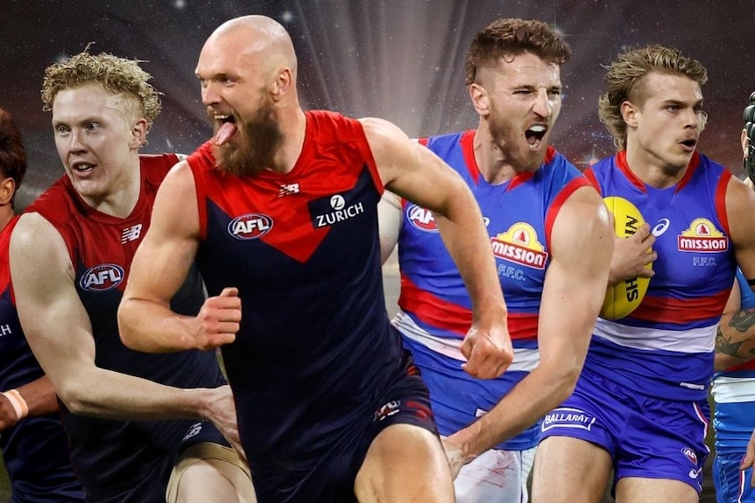
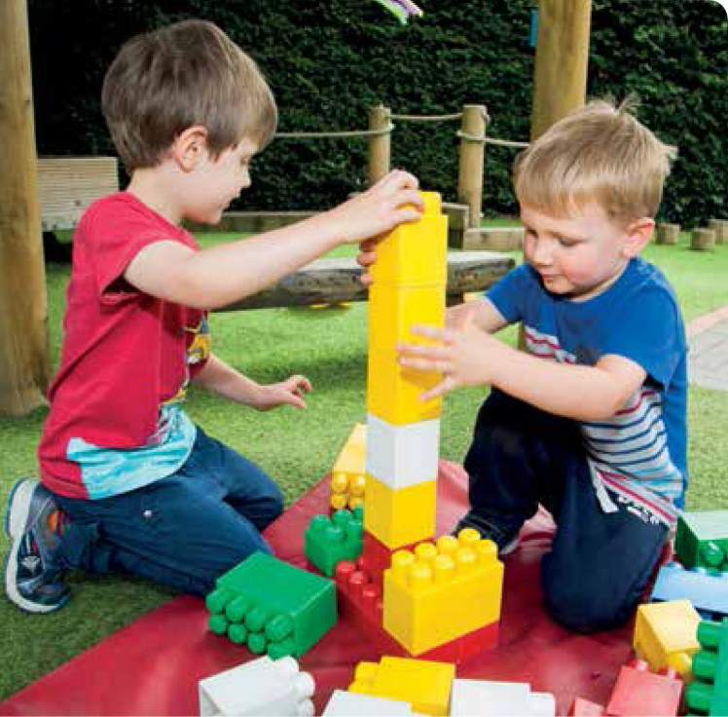
Why is this picture an example/not an example of a rival? How do you know?
Vocabulary
is/is not an example of rival because .
Insert image
Insert image
rival
not rival

Slide 49
Why is this picture an example/not an example of rival? How do you know?
Vocabulary
is/is not an example of rival because .
Example or Non-Example?
Insert image
Notes:
We Do
*Replace happy with vocab word

Slide 50
Track with me
Vocabulary
sentences:
Read with me
She competed with her rival for a prize.
The teams playing in the grand final had been long term rivals.
Jack and his rival, Tim, always compete in the school's spelling bee.
Notes:
Senior
*vocab word in red

Slide 51
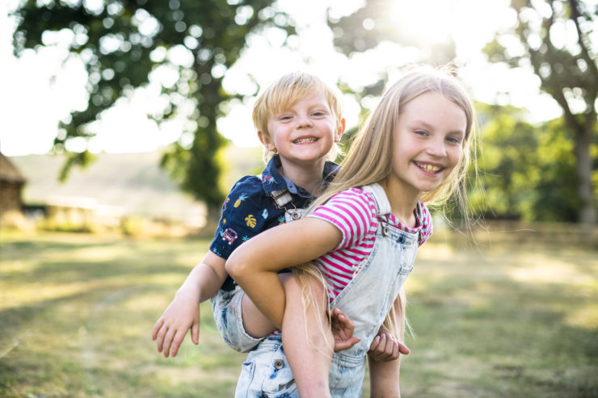
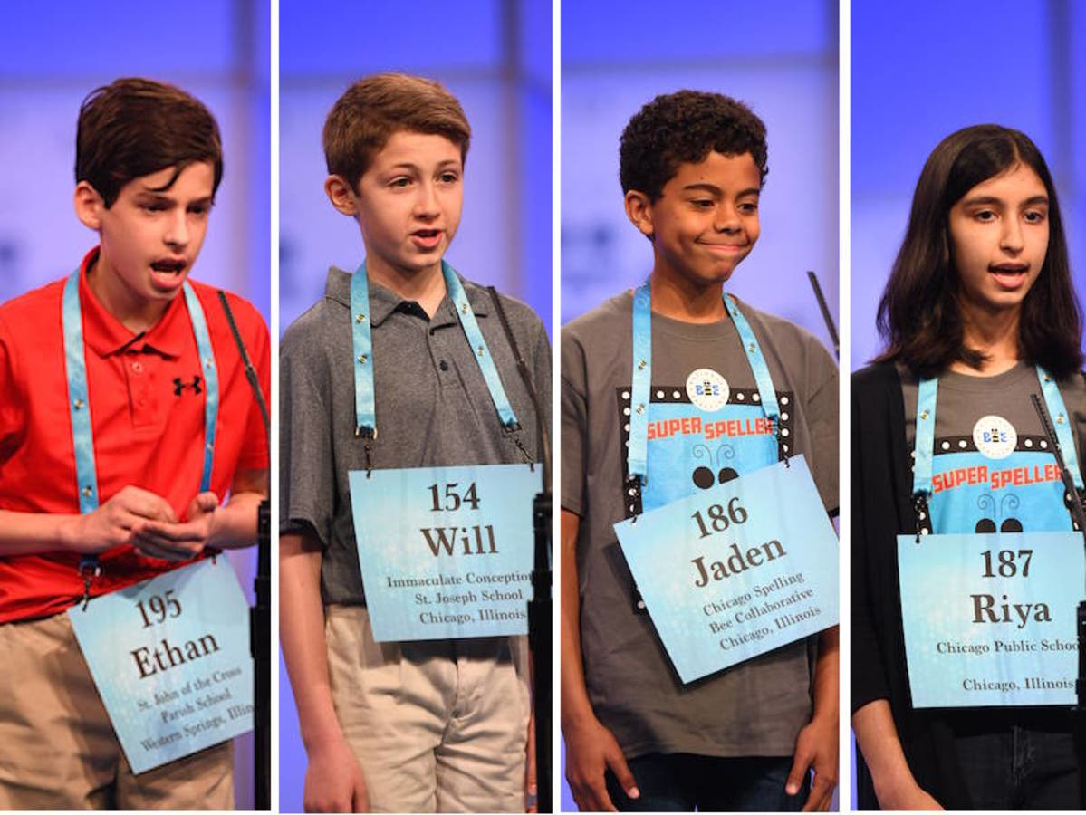
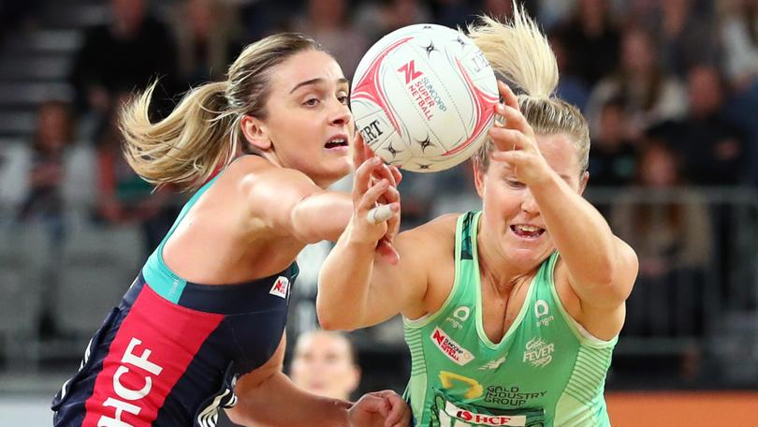
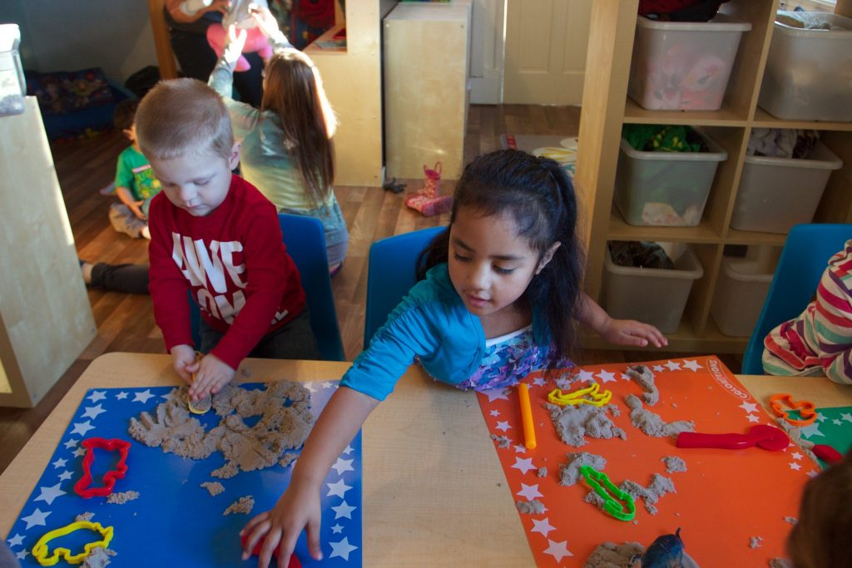
Why is this picture an example/not an example of rival? How do you know?
Vocabulary
Insert image
Insert image
is/is not an example of rival because .
A
B
Insert image
Insert image
C
D

Slide 52
Which sentence is a correct example of rival? How do you know?
Vocabulary
is an example of rival because .
A
On a Friday afternoon, I took the dog for a walk to the rival dog park.
B
Lisa and her rival, Amy, always try to get the highest grades in their class.
C
The two teams were fierce rivals, always trying to win the baseball championship.
Notes:
Senior You do
*Replace happy with vocab word

Slide 53
Put rival in a sentence.
Vocabulary
Word Origin & Morphographs
rival
ri/val
from 1570s, meaning "one who is in pursuit of the same object as another;
Noun a person whom one tries to be better than
Synonyms: competitor, opposition
Notes:
Senior Review Slide
*Include synonyms where appropriate
Word Origin information (https://www.etymonline.com/)

Slide 54
APK
Who had the most power in feudal society?
The King had the most power in feudal society.
The had the most power in feudal society.
Medieval Feudal Society
Although this diagram does not include every aspect of medieval feudal society, it does show the people with the most power at the top, and the people with the least power at the bottom.

Slide 55
I can describe differences between the lives of serfs and the lives of lords.
Teacher and students read together.
TODAY’S LEARNING GOAL

Slide 56
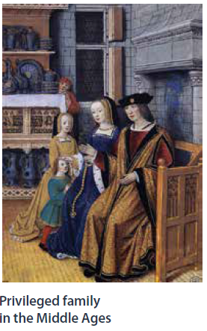
Read Vocabulary
Read Passage
Discuss and Read Question
Teacher and students read together.
Body
What were some of the things privileged boys and girls learned to do?
If you lived during the Middle Ages, your life followed one of a few set paths. If you were the child of a king and a queen or a lord and a lady, you lived a privileged life. You had enough food to eat and clothes to wear. You lived in a relatively nice house. You had servants, too. You may have been one of the few who learned to read and write. You even learned to ride a horse. If you were a boy, you learned to become a skilled swordsman. Privileged girls may have learned to embroider, to dance, and to play a musical instrument. Occasionally girls, too, learned to read. As a privileged child, you likely grew up to become a king or a queen, or a lord or a lady, yourself.
Privileged boys and girls learned to .
Privileged boys and girls both learned to ride horses. Some privileged boys and girls also learned to read and write. Privileged boys also learned to become swordsmen, while girls learned instead to embroider, dance, and play an instrument.
Vocabulary
lord (noun) a man in the upper class who ruled over a large area of land.
lady (noun) a female member of the nobility.
privileged (adjective) having more advantages, opportunities, or rights than most people.

Slide 57
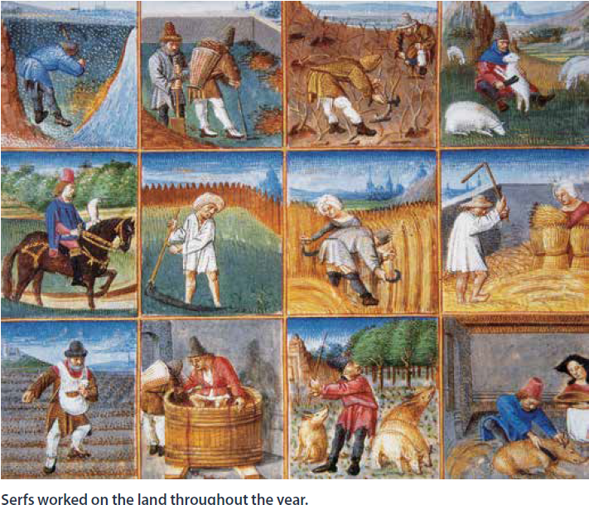
Read Vocabulary
Read Passage
Discuss and Read Question
Teacher and students read together.
Body
But most people in the Middle Ages were not privileged. In the early Middle Ages, nearly everyone in Europe worked on the land. Most farmworkers were called serfs. Serfs grew the food and tended to the livestock, or animals that fed the people. Some had more freedom than others and were called freemen. Serfs were at the bottom of the social order and had the least amount of power.
Who had more power, a serf or a lord?
A lord had more power.
A _____ had more power.
What was the relationship between a serf and a lord?
Serfs usually spent their entire lives working on a landowner’s or lord’s estate. In return for the work they did, the lord allowed serfs to use some of the land to grow their own food. The lord lived in his castle or manor house. He owned all the land around his home and often the nearby towns and villages, too. The lord also controlled the lives of most of the people who worked for him.
The relationship between a serf and a lord was _______.
The relationship between a serf and a lord was that the lord controlled the lives of those that worked from him, which included the serfs.
Vocabulary
tended (verb) managed, run or looked after.

Slide 58
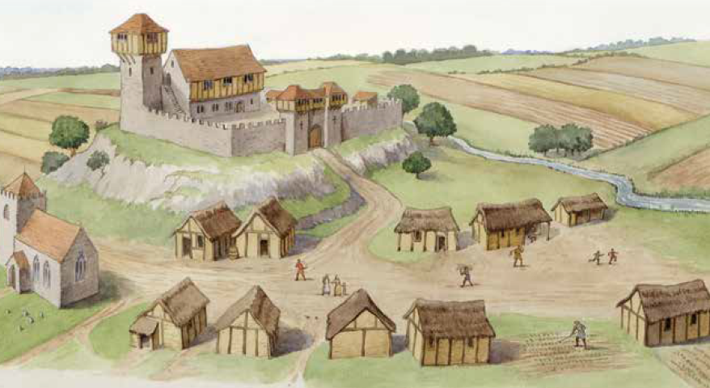
Read Vocabulary
Read Passage
Discuss and Read Question
Teacher and students read together.
Body
Did serfs or lords have more power in the Middle Ages? How do you know?
Serfs were not educated. They did not learn to read or write. If serfs wanted to travel to a nearby town, they needed permission from the lord. When serfs wanted to marry, the lord had the right to approve or disapprove of the match. When serfs had children, those children usually grew up to work as serfs for the same lord. In the Middle Ages, serfs worked on farmland that was divided into strips. The serfs spent about half of their time working for the lord. The rest of the time, they worked on the strips of land where their own crops were grown.
I know that lords had more power because serfs had to get permission from lords to do many things, such as to travel to a nearby town or to get married, but lords did not. Lords also owned and controlled the land, and often the nearby towns and villages, but serfs did not own or control any of their own land.
I know that had more power because .
Most serfs lived in small, simple houses in or near a village. Their houses were made from wood and mud. The roofs were thatched, meaning they were made from rushes, or straw. They usually had just one room. Serfs slept on straw beds. Inside each house was a small fireplace for cooking. Smoke from the fire escaped through a hole in the roof.

Slide 59
Read Vocabulary
Read Passage
Discuss and Read Question
Teacher and students read together.
Body
Did severe punishment stop serfs from hunting in the lord’s forests to avoid starving? Why not?
The lord increased his wealth in many different ways. In addition to working the farmland for the lord, serfs paid taxes to the lord in the form of money, crops, and livestock. Sometimes the lord ran a mill and even charged his serfs a fee to grind their grain into flour.
If crops failed or illness struck, people during the Middle Ages struggled to survive. In times of hardship, the lord did not always come to the aid of his serfs. Even when food supplies were low, serfs were not allowed to hunt in the lord’s forests. However, to avoid starving, people sometimes hunted illegally. This was called poaching, and serfs who were caught poaching were severely punished.
Some farmworkers were freemen. Freemen were not under the same strict control of the lord. If a serf ran away from his home, and managed to live for a year and a day in a town without being found, he could become a freeman, too.
I know that severe punishment did/didn’t stop serfs from hunting because .
I know that severe punishment didn’t stop serfs from hunting because they had to poach to avoid starvation.
Vocabulary
hardship (noun) suffering.
illegally (adverb) against the law

Slide 60
Read Vocabulary
Read Passage
Discuss and Read Question
Teacher and students read together.
Body
Why do you think the lords required the freemen to fight if he needed to put together an army for the king and not the serfs?
The Middle Ages was a violent time compared to how we live today. There were frequent wars and uprisings, including rebellions against the king by rival nobles. The need for armed protection shaped medieval society. Usually, high-ranking nobles swore their loyalty to the king and lords swore their loyalty to higher-ranking nobles. Freemen and serfs had to be loyal to their lord. In exchange for their loyalty, the lord offered his protection. If the lord needed to raise an army, he would require freemen on his estates to serve as foot soldiers.
The lords required the freemen to fight if he needed to put together an army for the king and not the serfs because .
The lords required the freemen to fight if he needed to put together an army for the king and not the serfs because they needed the serfs to fight for them.
Vocabulary
rival (adjective) competing
loyal (adjective) showing complete faithfulness and support (loyalty)

Slide 61
Pair share and discuss
Lesson Closure
Ask question
Discuss answers
Our Big Question:
What are the differences between the lives of serfs and the lives of lords?
INITIATING QUERIES
FOLLOW-UP QUERIES
SUMMARISING
PREDICTING
Notes:
INITIATING QUERIES
What have we discussed today?
What was this all about?
What do we know so far?
FOLLOW-UP QUERIES
How does this relate to what we have learnt before?
What can we learn about the middle ages?
SUMMARISING
What are some of the big events that led to the middle ages?
PREDICTING
What do you think we will be learning about

Slide 62
In your workbook
Activity
In your book, complete the because but so sentence.
Serfs were important to medieval society because .
Serfs were important to medieval society but .
Serfs were important to medieval society so .
In this section, we learn about the differences between lords and serfs.
Complete the table comparing the lives of lords and lives of serfs.
Use this table to complete a plan (using the template provided) for an SPO about the difference between lords and serfs.
Use this SPO plan to write a paragraph about the differences between lords and serfs.
Options:
Complete sections as a class/individually.

Slide 63
Complete as a class on the board
Activity
 | Serfs | Lords
Housing
Employment
Children
Education
Freedom

Slide 64
Complete as a class on the board
Activity
 | Serfs | Lords
Housing | Lived in small simple houses made of mud and wood | Lived in a castle or manor house
Employment | Farmed the land of the Lords | Owned the land around them and made money from the serfs farming this
Children | Grew up to be serfs | Lived a privileged life
Education | Were not educated | Educated
Freedom | Needed permission from the lord to travel or marry. | Had power to make decisions.

Slide 65
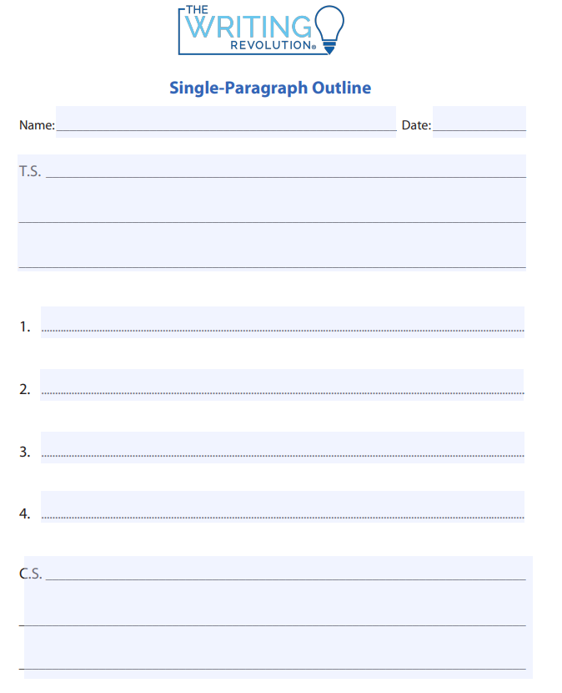
SKILL/CONCEPT CLOSURE
Lords and serfs in Medieval Europe lived very different lives. Whilst Lords lived in castles or manors, serfs lived in small houses made of mud and wood. Lords owned the land, whilst serfs farmed this land and worked for the lords. The children of a lord were born privileged meaning they were always looked after and never went without. However the children of a serf grew up to become serfs so they could survive. Lords were educated, whereas serfs were not. It is clear that in Medieval Europe, lords had much more power than serfs.
Lords and serfs in Medieval Europe lived very different lives.
lords live in castle/manors, serfs in small houses
lords own land; serfs work for them
lord’s children privileged; serfs are serfs
lords educated; serfs not educated.
It is clear that in Medieval Europe, lords had much more power than serfs.
Notes:
INITIATING QUERIES
What is being discussed here
What is this all about
What do we know so far
FOLLOW-UP QUERIES
What do they really mean here?
Why did the author/filmmaker say/show that?
How does this relate to what we have learnt?

Slide 66
Lesson 4
Jousting Knights
The Big Question:
What was the purpose of knights in the Middle Ages?

Slide 67
Vocabulary
influential

Slide 68
definition:
Track with me
Vocabulary
Read with me
Choral Reversal
influential
having power to change or affect important things or people.

Slide 69
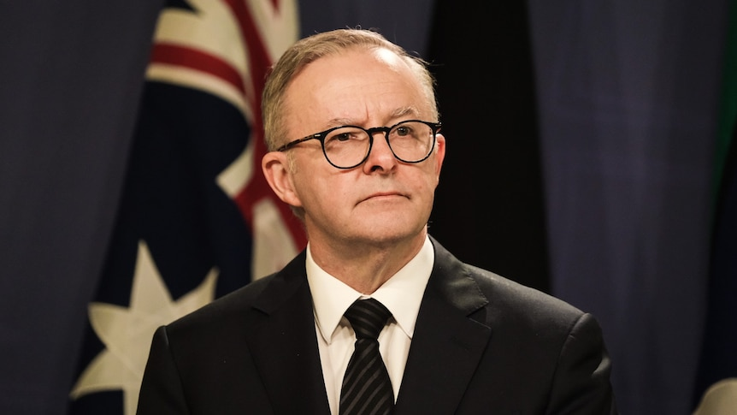
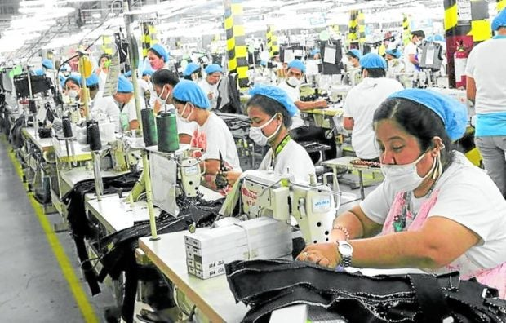
Why is this picture an example/not an example of a influential? How do you know?
Vocabulary
is/is not an example of influential because .
Insert image
Insert image
influential
not influential

Slide 70
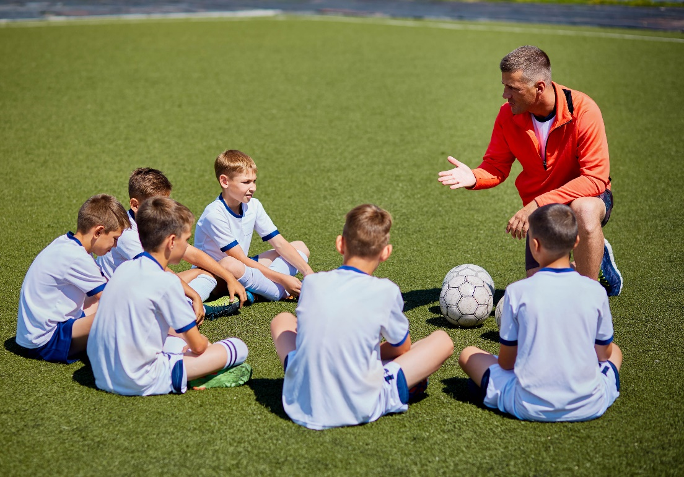
Why is this picture an example/not an example of influential? How do you know?
Vocabulary
is/is not an example of influential because .
Example or Non-Example?
Insert image
Notes:
We Do
*Replace happy with vocab word

Slide 71
Track with me
Vocabulary
sentences:
Read with me
Influential athletes like Usain Bolt inspire many kids to pursue their dreams in sport.
Books can be influential because they teach us new things and open our minds to different ideas.
Amelia Earhart was an influential pilot who showed that women can do anything they set their minds to.
Notes:
Senior
*vocab word in red

Slide 72
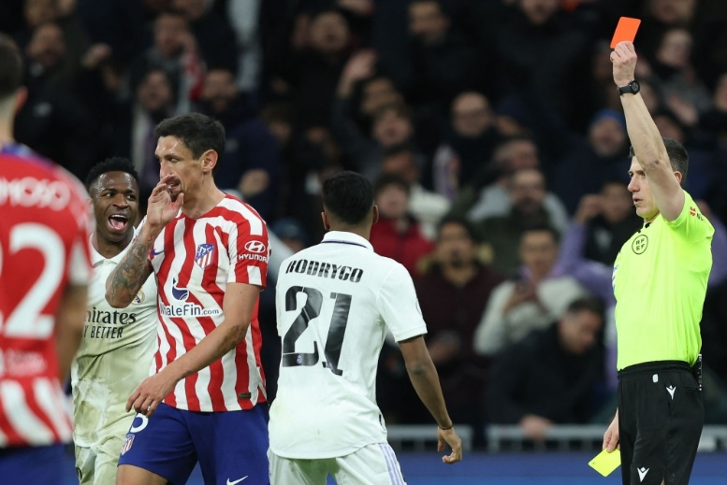
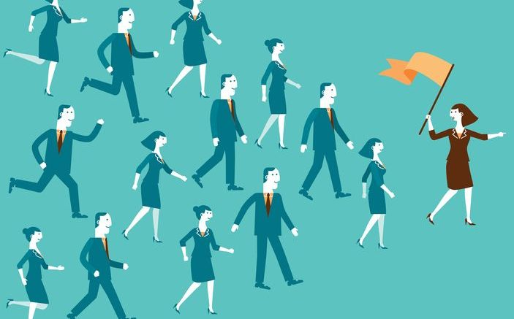
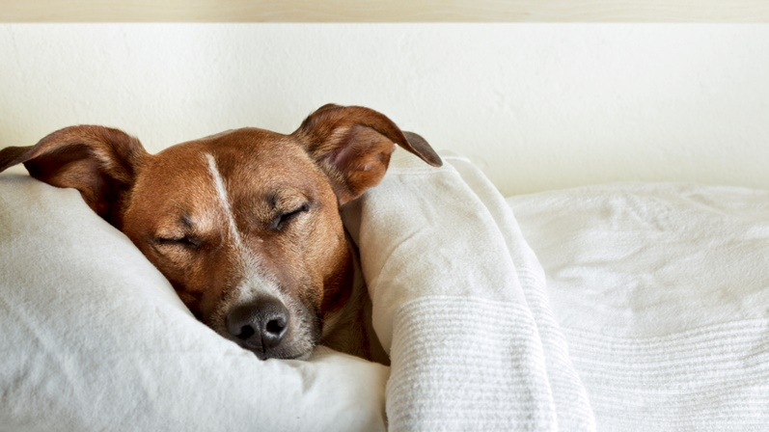
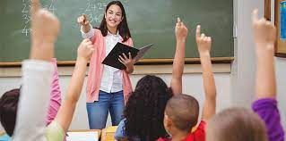
Why is this picture an example/not an example of influential? How do you know?
Vocabulary
Insert image
Insert image
is/is not an example of influential because .
A
B
Insert image
Insert image
C
D
Notes:
Senior You do
*Replace happy with vocab word

Slide 73
Which sentence is a correct example of influential? How do you know?
Vocabulary
is an example of influential because .
A
Technology, like smartphones or computers, can be influential because it allows us to connect with others and learn new things.
B
Looking up at the stars always makes me feel so small and influential.
C
Parents can be influential because they guide us, love us, and help us grow into happy and responsible individuals.
Notes:
Senior You do
*Replace happy with vocab word

Slide 74
Put influential in a sentence.
Vocabulary
Word Origin & Morphographs
influence + tial
in/flu/en/tial
late 14c., an astrological term, "streaming ethereal power from the stars"
suffix: of; relating to
Adjective having power to change or affect important things or people
Synonyms: powerful, dominant, controlling
Notes:
Senior Review Slide
*Include synonyms where appropriate
Word Origin information (https://www.etymonline.com/)

Slide 75
APK
 | Serfs | Lords
Housing | Lived in small simple houses made of mud and wood | Lived in a castle or manor house
Employment | Farmed the land of the Lords | Owned the land around them and made money from the serfs farming this
Children | Grew up to be serfs | Lived a privileged life
Education | Were not educated | Educated
Freedom | Needed permission from the lord to travel or marry. | Had power to make decisions.

Slide 76
I can describe the purpose of knights in the Middle Ages.
Teacher and students read together.
TODAY’S LEARNING GOAL

Slide 77
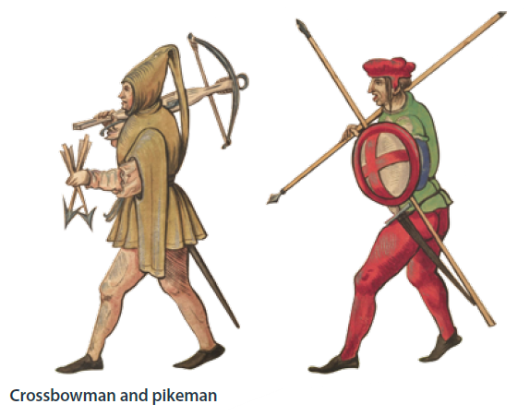
Read Vocabulary
Read Passage
Discuss and Read Question
Teacher and students read together.
Body
What was happening in the Middle Ages that often required young men to become fighters?
Whether rich or poor, young men in the Middle Ages learned how to use a weapon of some kind. Rivalries between nobles, wars with other nations, even violence between neighbours required that they be able to fight. When a lord needed to raise an army, he turned to those he governed.
In the Middle Ages, ordinary foot soldiers were trained to fight with an axe and a long spear called a pike. Others were trained to be skilful archers and crossbowmen. Some foot soldiers might have worn chainmail, an early form of metal armour, but most had padded coats and carried daggers. However, the most esteemed soldiers were knights.
Young men were required to become fighters because .
Young men were required to become fighters because there were rivalries between nobles, wars with other nations, and violence between neighbours.
Vocabulary
governed (verb) ruled, controlled
armour (noun) a protective metal covering used to keep a person safe from injury during battle.
esteemed (adjective) highly regarded; admired.

Slide 78
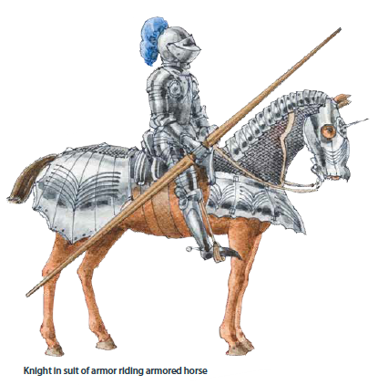
Read Vocabulary
Read Passage
Discuss and Read Question
Teacher and students read together.
Body
What are two differences between foot soldiers and knights?
Knights were soldiers who fought on horseback, and sometimes on foot, for their lord. If you wanted to be a knight, you had to be able to afford horses and armour. You also had to find someone willing to train you. Because it was very expensive to become a knight, these mounted warriors were usually sons of wealthy, influential members of society.
Being a knight was one way of making a fortune. If you were involved in successful battles and wars, you might receive money or land as payment for your services. Sometimes a king might also reward you with a title. Having a title usually meant that you were an influential member of society. Knights also made money by looting and by holding certain people for ransom.
Two differences between foot soldiers and knights are .
Two differences between foot soldiers and knights are foot soldiers did not fight on horseback but knights did, most foot soldiers had padded coats but knights wore armour and foot soldiers did not receive much training but knights were better trained.
Vocabulary
influential (adjective) having power to change or affect important things or people.
title (noun) highly regarded; admired.
ransom (noun) money that is paid to free someone who was captured.

Slide 79
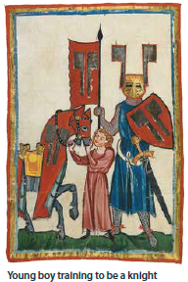
Read Vocabulary
Read Passage
Discuss and Read Question
Teacher and students read together.
Body
What are some differences between a page and a squire?
If you were a Knight
Your training to become a knight begins at a young age. You leave home to live with a family friend or relative who has agreed to train you. In the first several years of your training, you help to dress and to serve the lord. You are known as a page. During these early years as an aspiring knight, you probably learn to use a sword, to ride a horse, and to wield a lance, or long wooden pole with a metal tip. Later, when you are ready to learn more challenging skills, you become a squire.
Some of the differences between a page and a squire are .
Some of the differences between a page and a squire are a squire has more responsibility than a page and he learns more challenging skills.
Vocabulary
aspiring (adjective) hoping to be or become something.
wield (verb) hold and use

Slide 80
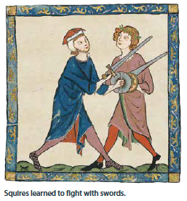
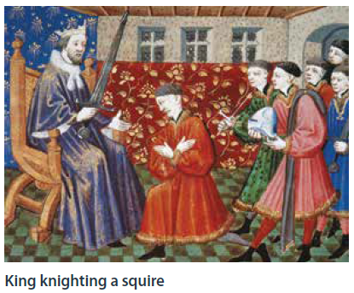
Read Vocabulary
Read Passage
Discuss and Read Question
Teacher and students read together.
Body
What was the purpose of the dubbing ceremony and what took place during it?
Although you are still a servant, as a squire you are now responsible for grooming and saddling the lord’s horses. You are also responsible for cleaning and polishing his armour. You learn how to fight while riding a horse. You learn to use other weapons, including a heavier lance. This part of your training lasts for several years.
The purpose of the dubbing ceremony is .
The purpose of the dubbing ceremony is a ceremony during which a young man became a knight. The lord would tap the knight on the shoulder with the flat part of his sword, and a priest might bless the knight with a prayer.
If you are a successful squire, you might be knighted by the lord. In what is called the dubbing ceremony, the lord taps you on the shoulder with the flat part of his sword. Then, a priest might bless you with a prayer.
Vocabulary
priest (noun) minister of the church
prayer (noun) a request for help or expression of thanks to God or another deity

Slide 81
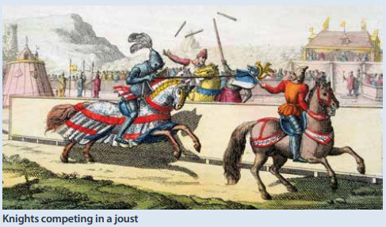
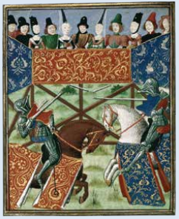
Read Vocabulary
Read Passage
Discuss and Read Question
Teacher and students read together.
Body
What was the purpose of a jousting match?
Knights could prove their strength and abilities by taking part in jousting matches. Jousting matches were mock, or pretend, battles between two or more knights. Knights rode horses, wore full armour, and carried lances. Those who took part in jousts did so to gain respect and possibly a generous prize. For the privileged, attending the jousting matches was considered to be a day of excitement and entertainment. It was very much like watching a football or baseball game today. When the joust began, the knights charged at each other. With the aid of a lance, each knight attempted to knock his opponent off his horse.
The purpose of a jousting match was to .
The purpose of a jousting match was to knock the opposing knight off their horse.

Slide 82
Pair share and discuss
Lesson Closure
Ask question
Discuss answers
Our Big Question:
What was the purpose of knights in the Middle Ages?
INITIATING QUERIES
FOLLOW-UP QUERIES
SUMMARISING
PREDICTING
Notes:
INITIATING QUERIES
What have we discussed today?
What was this all about?
What do we know so far?
FOLLOW-UP QUERIES
How does this relate to what we have learnt before?
What can we learn about the middle ages?
SUMMARISING
What are some of the big events that led to the middle ages?
PREDICTING
What do you think we will be learning about

Slide 83
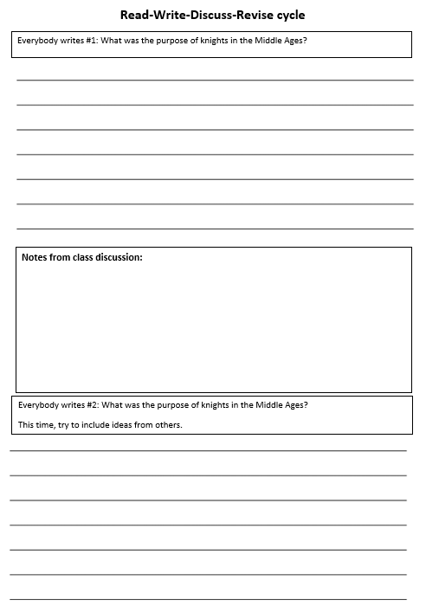
In your workbook
Activity

Slide 84
Concept Development
A sentence must contain at least one clause.
A clause must contain a subject and a verb.
Subject:
Tells WHO or WHAT the sentence is about.
Predicate:
Tells what the subject DOES or IS and contains the verb.

Slide 85
Skill development: You
Convert the fragment into a complete sentence.
Edit for correct punctuation
CFU:
Why is it a fragment? What’s missing?
foot soldiers
needed horse and armour
to ride a horse
as a squire
dubbing ceremony
jousting matches

Slide 86
Lesson 5
Gloomy Castles
The Big Question:
What were the features of castles in the Middle Ages?

Slide 87
Vocabulary
siege

Slide 88
definition:
Track with me
Vocabulary
Read with me
Choral Reversal
siege
a situation in which soldiers or police officers surround a city or building to try to take control of it

Slide 89
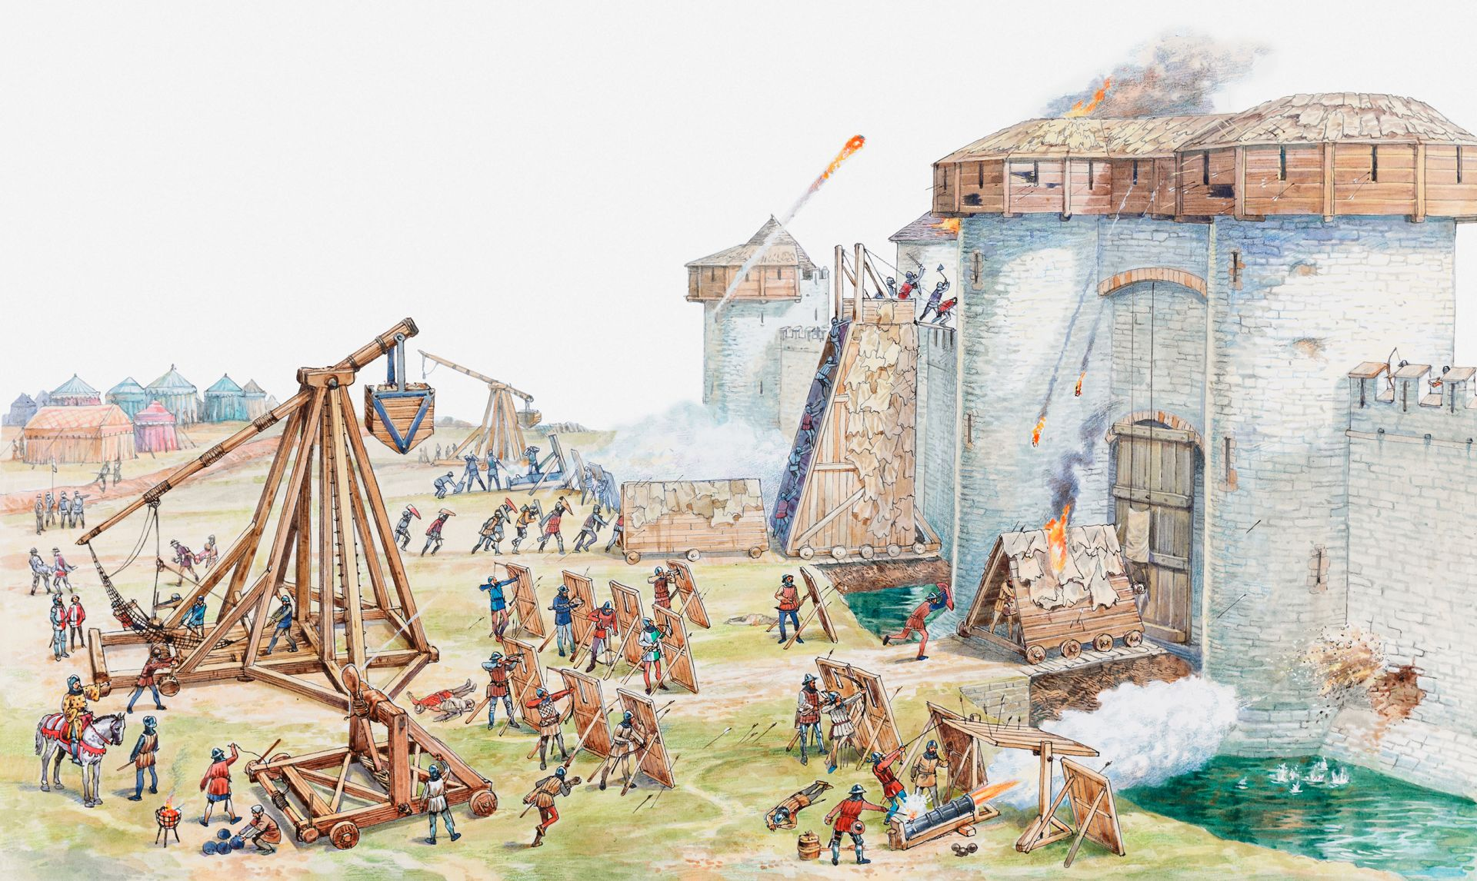
Why is this picture an example/not an example of a siege? How do you know?
Vocabulary
is/is not an example of siege because .
Insert image
Insert image
siege
not siege

Slide 90
Why is this picture an example/not an example of siege? How do you know?
Vocabulary
is/is not an example of siege because .
Example or Non-Example?
Insert image
Notes:
We Do
*Replace happy with vocab word

Slide 91
Track with me
Vocabulary
sentences:
Read with me
During a siege, people inside a castle stay safe and protect themselves from the bad guys outside.
The castle was like a big fortress, and it was built strong so it could withstand a long siege.
Once upon a time, there was a brave knight who defended his castle during a great siege.
Notes:
Senior
*vocab word in red

Slide 92
Why is this picture an example/not an example of siege? How do you know?
Vocabulary
Insert image
Insert image
is/is not an example of siege because .
A
B
Insert image
Insert image
C
D
Notes:
Senior You do
*Replace happy with vocab word

Slide 93
Which sentence is a correct example of siege? How do you know?
Vocabulary
is an example of siege because .
A
The princess and her friends hid in the castle's secret rooms to stay safe during the siege.
B
After many days, the siege was finally over, and the castle's defenders celebrated their victory.
C
I needed to use a siege to sift the flour when I made a sponge cake.
Notes:
Senior You do
*Replace happy with vocab word

Slide 94
Put siege in a sentence.
Vocabulary
Word Origin & Morphographs
siege
siege
from c. 1300; the notion is of an army "sitting down" before a place.
Noun a situation in which soldiers or police officers surround a city or building to try to take control of it
Synonyms: barricade, blockage
Notes:
Senior Review Slide
*Include synonyms where appropriate
Word Origin information (https://www.etymonline.com/)

Slide 95
APK
What do knights do?
Knights were soldiers who fought on horseback, and sometimes on foot, for their lord. If you wanted to be a knight, you had to be able to afford horses and armour. You also had to find someone willing to train you. Because it was very expensive to become a knight, these mounted warriors were usually sons of wealthy, influential members of society.
Being a knight was one way of making a fortune. If you were involved in successful battles and wars, you might receive money or land as payment for your services. Sometimes a king might also reward you with a title. Having a title usually meant that you were an influential member of society. Knights also made money by looting and by holding certain people for ransom.

Slide 96
I can describe the features of castles in the Middle Ages
Teacher and students read together.
TODAY’S LEARNING GOAL

Slide 97
Read Vocabulary
Read Passage
Discuss and Read Question
Teacher and students read together.
Body
Cold, Dark and Gloomy
Many kings and nobles lived in castles. Castles provided the inhabitants, or people who lived there, with a certain amount of protection from the enemy. They were also fairly safe places to store weapons and food supplies. The first castles were wooden forts. Later, people built stronger castles made of stone.
Find three pieces of evidence from the text that demonstrate how a castle might protect its inhabitants from an enemy siege.
Evidence that shows how a castle might protect its inhabitants from an enemy siege is .
Evidence that shows how a castle might protect its inhabitants from an enemy siege is a castle had its own water supply; a drawbridge could be raised to prevent enemies from entering the castle, and a moat, often filled with water, would be difficult to cross to reach the castle.
Castle walls sometimes enclosed a series of small buildings, like a little town. The castle had a water supply within the walls. Residents also needed a good supply of food inside so they could withstand a siege. For added protection, some castles were surrounded by moats. The moat was a deep trench, often filled with water. Sometimes there was a drawbridge that could be raised or lowered. Over time, castles became more elaborate with interior courtyards, living quarters for soldiers, and stables.
Vocabulary
enclose (verb) to surround; close in (enclosed)

Slide 98
Read Vocabulary
Read Passage
Discuss and Read Question
Teacher and students read together.
Body
Do you think castles were built more for comfort or for protection? Cite evidence from the text to support your response.
By today’s standards, life in a castle was not very pleasant. Castles were cold and gloomy. They were designed for protection, not comfort. Most castles had only a few rooms. There was typically a Great Hall, a kitchen, and two or three private chambers, or rooms, for the lord and his family. There was no bathroom, just a tiny alcove that jutted out of the castle wall. The contents of the toilet emptied into the moat or a pit directly below. Can you imagine the smell?
I think castles were built more for because .
I think castles were built more for protection because they were often made of stone, which was strong but not comfortable, and many of the features of a castle were meant for protection, including a moat and a drawbridge.
Vocabulary
alcove (noun) a small section of a room set back from the rest of it.
jutted (verb) stick out, up or forward

Slide 100
Read Vocabulary
Read Passage
Discuss and Read Question
Teacher and students read together.
Body
What took place in the Great Hall in a castle?
The Great Hall was where family members and their guests gathered. Meals were served in the Great Hall. Entertainers performed there, and guests and even servants slept there. Buckets of hot coals or fireplaces provided the fire needed for heat and cooking. Small windows and candles offered little light.
In the Great Hall in a castle family members and guests gathered for meals and entertainment, and servants slept there.
In the Great Hall in a castle .

Slide 101
Read Vocabulary
Read Passage
Discuss and Read Question
Teacher and students read together.
Body
Based on what you learned in previous lessons why do you think serfs and their children would likely not have been able to enjoy music and dancing?
Traveling storytellers, minstrels, and troupes of actors often visited a castle. Quite often, jesters lived in the castle, ready to perform whenever requested. Noble children and adults in the Middle Ages enjoyed music and dancing. They played outdoor sports as well. Tennis, croquet, and bowling all began as lawn games during this period in history.
I think serfs and their children would not have been able to enjoy music and dancing because __ .
I think serfs and their children would not have been able to enjoy music and dancing because they would have been too busy completing work for the lords.
Vocabulary
minstrel (noun) a musician or poet
troupe (noun) group
jester (noun) comic entertainer
croquet (noun) a game in which the players use mallets to drive wooden balls through a series of wickets set out on a lawn.

Slide 102
Pair share and discuss
Lesson Closure
Ask question
Discuss answers
Our Big Question:
What were the features of castles in the Middle Ages?
INITIATING QUERIES
FOLLOW-UP QUERIES
SUMMARISING
PREDICTING
Notes:
INITIATING QUERIES
What have we discussed today?
What was this all about?
What do we know so far?
FOLLOW-UP QUERIES
How does this relate to what we have learnt before?
What can we learn about the middle ages?
SUMMARISING
What are some of the big events that led to the middle ages?
PREDICTING
What do you think we will be learning about

Slide 103
Your task today: Today we will be deciding on which sentences to use if we wanted to create a paragraph about the features of castles in the Middle Ages.
SKILL/CONCEPT CLOSURE
What were the features of castles in the Middle Ages?
YOUR BIG QUESTION
Notes:
INITIATING QUERIES
What is being discussed here
What is this all about
What do we know so far
FOLLOW-UP QUERIES
What do they really mean here?
Why did the author/filmmaker say/show that?
How does this relate to what we have learnt?

Slide 104
SKILL/CONCEPT CLOSURE
What were the features of castles in the Middle Ages?
YOUR BIG QUESTION
Identify the best topic sentence.
Castles in the Middle Ages has a variety of features that were made for specific purposes.
There were castles in the Middle Ages.
Castles in the Middle Ages had a variety of features that were made for specific purposes.
Traveling storytellers, minstrels, and troupes of actors often visited a castle.
Castles had a great hall.
Notes:
INITIATING QUERIES
What is being discussed here
What is this all about
What do we know so far
FOLLOW-UP QUERIES
What do they really mean here?
Why did the author/filmmaker say/show that?
How does this relate to what we have learnt?

Slide 105
SKILL/CONCEPT CLOSURE
What were the features of castles in the Middle Ages?
YOUR BIG QUESTION
What 4 supporting details could we use?
Castles in the Middle Ages had a variety of features that were made for specific purposes.
stone walls → protection, not comfort
knights fought on horseback
stone walls → protection, not comfort
sometimes surrounded by moats → protection
sometimes surrounded by moats → protection
serfs worked for lords
Few rooms inc. kitchen & private chambers
Kings = most power
Great Hall → gatherings and meals
Few rooms inc. kitchen & private chambers
Jesters often live there
Great Hall → gatherings and meals
Notes:
INITIATING QUERIES
What is being discussed here
What is this all about
What do we know so far
FOLLOW-UP QUERIES
What do they really mean here?
Why did the author/filmmaker say/show that?
How does this relate to what we have learnt?

Slide 106
SKILL/CONCEPT CLOSURE
What were the features of castles in the Middle Ages?
YOUR BIG QUESTION
Concluding statements in paragraphs
Castles in the Middle Ages had a variety of features that were made for specific purposes.
Look at your topic sentence and supporting details, as well as the kind of topic sentence you have used.
Select a different sentence type for your concluding sentence. Command, question, exclamation and statement.
Select your sentence type based on the kind of information that you will be writing about.
stone walls → protection, not comfort
sometimes surrounded by moats → protection
Few rooms inc. kitchen & private chambers
Castles in the Middle Ages were fascinating!
Great Hall → gatherings and meals
Castles in the Middle Ages were fascinating!
Notes:
INITIATING QUERIES
What is being discussed here
What is this all about
What do we know so far
FOLLOW-UP QUERIES
What do they really mean here?
Why did the author/filmmaker say/show that?
How does this relate to what we have learnt?

Slide 107
SKILL/CONCEPT CLOSURE
A mountain is a geological landform that rises above the surrounding land.
made from rocks and earth
steep sloping sides, sharp or rounded ridges
High point: a peak or summit. Low point: base
Generally higher then 600m or it is a hill
It is amazing how different mountains can look, depending on their height and location!
Notes:
INITIATING QUERIES
What is being discussed here
What is this all about
What do we know so far
FOLLOW-UP QUERIES
What do they really mean here?
Why did the author/filmmaker say/show that?
How does this relate to what we have learnt?

Slide 108
Lesson 6
Merchants, Markets and Mud
The Big Question:
How did trade contribute to the development of the middle class and medieval towns?

Slide 109
Vocabulary
thrive

Slide 110
definition:
Track with me
Vocabulary
Read with me
Choral Reversal
thrive
to grow and succeed

Slide 111
Why is this picture an example/not an example of a thrive? How do you know?
Vocabulary
is/is not an example of thrive because .
Insert image
Insert image
thrive
not thrive

Slide 112
Why is this picture an example/not an example of thrive? How do you know?
Vocabulary
is/is not an example of thrive because .
Example or Non-Example?
Insert image
Notes:
We Do
*Replace happy with vocab word

Slide 113
Track with me
Vocabulary
sentences:
Read with me
In a supportive and encouraging environment, children can thrive and reach their full potential.
Plants and animals thrive in the rainforest because it provides them with the perfect habitat.
When you eat healthy foods and exercise regularly, your body will thrive, and you'll feel strong and energetic.
Notes:
Senior
*vocab word in red

Slide 114
Why is this picture an example/not an example of thrive? How do you know?
Vocabulary
Insert image
Insert image
is/is not an example of thrive because .
A
B
Insert image
Insert image
C
D
Notes:
Senior You do
*Replace happy with vocab word

Slide 115
Which sentence is a correct example of thrive? How do you know?
Vocabulary
is an example of thrive because .
A
“Did you hear that thrive?” the child asked her older cousin.
B
Birds thrive when they have plenty of food and a safe place to build their nests.
C
In order to thrive in school, it's important to listen to your teacher and complete your homework.
Notes:
Senior You do
*Replace happy with vocab word

Slide 116
Put thrive in a sentence.
Vocabulary
Word Origin & Morphographs
thrive
thrive
c. 1200, from a Scandinavian source "to thrive”
Verb to grow and succeed
Synonyms: flourish, prosper
Notes:
Senior Review Slide
*Include synonyms where appropriate
Word Origin information (https://www.etymonline.com/)

Slide 117
APK

Slide 118
I can explain how trade contributed to the development of the middle class and medieval towns.
Teacher and students read together.
TODAY’S LEARNING GOAL

Slide 119
Read Vocabulary
Read Passage
Discuss and Read Question
Teacher and students read together.
Body
If you were in the streets in Medieval Europe, what are some of the things you would see and hear?
It is raining again! You stand in a puddle on the edge of a narrow street. You have just entered town through one of two gates. The gates are the only ways in and out of this walled town. Inside the walls, tiny townhouses stand side-by-side. As you move through the crowd, you spot rats scurrying about, feeding on discarded trash. Nearby, you hear the varied cries of people selling fruits, vegetables, eggs, and pies. It is market day and people have set up their stalls in the town square. As you make your way through the muddy streets, you hear the sound of church bells. They ring out to sound the hour and to call people to church.
You have just caught a glimpse of a town in Europe during the late Metalworker’s stall in medieval market Middle Ages.
Some of the things I would see and hear on the streets of Medieval Europe are gates; walls; small houses; crowds of people; rats; discarded trash; people selling food; mud and church bells
Some of the things I would see and hear on the streets of Medieval Europe are .
Vocabulary
glimpse (noun) a partial view
scurrying (verb) moving quickly with short, quick steps

Slide 120
Read Vocabulary
Read Passage
Discuss and Read Question
Teacher and students read together.
Body
In the early part of the Middle Ages, most people lived in the countryside. Between the years 1000 and 1350 CE, fuelled by trade, towns began to grow. New jobs emerged, and, as a result, more and more people left the countryside to live and work in towns.
With this growth in trade, an increased number of people became involved in commerce, or business. As a result, a class of people, called the middle class, grew in importance. Merchants and craftsmen were part of the middle class. Towns grew as the middle class created successful businesses, and therefore jobs. Some merchants became rich and influential members of town communities.
How did trade cause the growth of the middle class?
Trade caused the growth of the middle class because as trade grew, more people became involved in commerce. The merchants and craftsmen who were involved in trade were no longer as poor as serfs or peasants. But, they were still not as wealthy or powerful as lords, therefore the middle class grew in number.
Trade caused the growth of the middle class because __________
Vocabulary
fuelled (verb) powered
emerged (verb) became apparent
merchants (noun) a person involved in wholesale trade

Slide 121
Read Vocabulary
Read Passage
Discuss and Read Question
Teacher and students read together.
Body
What types of craftsmen existed in the Middle Ages?
To protect their businesses, merchants established guilds in towns throughout Europe. Guilds were organizations made up of merchants. Guilds controlled wages as well as the price and quality of the goods the merchants sold.
Types of craftsmen that existed in the Middle Ages were _______________
Types of craftsmen that existed in the Middle Ages were carpenters, papermakers, glassmakers, blacksmiths, tailors, armorers, and tanners.
Not only did merchants thrive, so too did skilled craftsmen, such as carpenters, papermakers, glassmakers, and blacksmiths. Skilled craftsmen were also important members of town communities. They made and sold their goods in the towns in which they lived and worked. Just like merchants, skilled craftsmen protected their businesses by forming guilds. Only highly skilled craftsmen were invited to join these guilds. Many years of training went into becoming a skilled craftsman.
Vocabulary
established (verb) created, made

Slide 122
Read Vocabulary
Read Passage
Discuss and Read Question
Teacher and students read together.
Body
Why would pickpockets and purse snatchers be afoot in the towns?
There was a certain pattern to daily life in towns in the Middle Ages. From Monday to Saturday, towns were busy with the hustle and bustle of street vendors, shopkeepers, craftsmen, and market sellers. Pickpockets and purse snatchers were afoot, too. Shops opened as early as 6:00 a.m. Most towns held markets two or three times a week. Local farmers sold produce and animals.
Pickpockets and purse snatchers would be afoot in the towns because .
Pickpockets and purse snatchers would be afoot in the towns because they are people who steal valuable things from someone else. They might be in the town because the people walking around the town might have valuable possessions with them.
Vocabulary
hustle and bustle busy, noisy activity of a lot of people in one place
afoot (adjective) on foot

Slide 123
Pair share and discuss
Lesson Closure
Ask question
Discuss answers
Our Big Question:
How did trade contribute to the development of the middle class and medieval towns?
INITIATING QUERIES
FOLLOW-UP QUERIES
SUMMARISING
PREDICTING
Notes:
INITIATING QUERIES
What have we discussed today?
What was this all about?
What do we know so far?
FOLLOW-UP QUERIES
How does this relate to what we have learnt before?
What can we learn about the middle ages?
SUMMARISING
What are some of the big events that led to the middle ages?
PREDICTING
What do you think we will be learning about

Slide 124
Skill development: I do
Identify the subject
Change the repeated subject to the appropriate pronoun
Combine these sentences using a conjunction (delete unneeded words)
Punctuate as needed
CFU:
What is the subject?
What pronoun would be appropriate?
What conjunction would be appropriate?
Towns were the site of trade between 1000 and 1350 CE.
Towns began to grow in size.
They
Towns were the site of trade between 1000 and 1350 CE, therefore, they began to grow in size.
What other conjunction could you use?

Slide 125
Skill development: We do
Identify the subject
Change the repeated subject to the appropriate pronoun
Combine these sentences using a conjunction (delete unneeded words)
Punctuate as needed
People started to leave the countryside.
People moved to towns where trade was happening.
They
People started to leave the countryside because they moved to towns where trade was happening.
What other conjunction could you use? Could you order the sentence differently?

Slide 126
Skill development: You do
Identify the subject
Change the repeated subject to the appropriate pronoun
Combine these sentences using a conjunction (delete unnecessary words)
Punctuate as needed
F | A | N | B | O | Y | S
For | And | Nor | But | Or | Yet | So
People became more involved in trade.
People became part of the middle class.

Slide 127
Skill development: You do
Identify the subject
Change the repeated subject to the appropriate pronoun
Combine these sentences using a conjunction (delete unnecessary words)
Punctuate as needed
F | A | N | B | O | Y | S
For | And | Nor | But | Or | Yet | So
The Middle Class lived in towns.
The Middle Class included craftsmen and merchants.

Slide 128
Skill development: You do
Identify the subject
Change the repeated subject to the appropriate pronoun
Combine these sentences using a conjunction (delete unnecessary words)
Punctuate as needed
F | A | N | B | O | Y | S
For | And | Nor | But | Or | Yet | So
The Middle Class were not as powerful as lords.
The Middle Class had more power than serfs.

Slide 129
Skill development: You do
Identify the subject
Change the repeated subject to the appropriate pronoun
Combine these sentences using a conjunction (delete unnecessary words)
Punctuate as needed
F | A | N | B | O | Y | S
For | And | Nor | But | Or | Yet | So
Merchants needed to protect their businesses.
Merchants established guilds.

Slide 130
Skill development: You do – Extension: Combine 3 sentences.
Identify the subject
Change the repeated subject to the appropriate pronoun
Combine these sentences using a conjunction (delete unnecessary words)
Punctuate as needed
F | A | N | B | O | Y | S
For | And | Nor | But | Or | Yet | So
Craftsmen included carpenters and papermakers.
Craftsmen were important members of towns.
Craftsmen made and sold their goods in town.

Slide 131
Skill development: You do – Extension: Combine 3 sentences.
Identify the subject
Change the repeated subject to the appropriate pronoun
Combine these sentences using a conjunction (delete unnecessary words)
Punctuate as needed
F | A | N | B | O | Y | S
For | And | Nor | But | Or | Yet | So
Towns had a pattern of daily life.
Towns were busy from Monday to Friday.
Towns had pickpockets and purse snatchers.

Slide 132
Lesson 7
Towns in the Middle Ages and Women in the Middle Ages
The Big Question:
What are some of the features of medieval towns?

Slide 133
Vocabulary
discard

Slide 134
definition:
Track with me
Vocabulary
Read with me
Choral Reversal
discard
to throw out or away as it is no longer useful

Slide 135
Why is this picture an example/not an example of a discard? How do you know?
Vocabulary
is/is not an example of discard because .
Insert image
Insert image
discard
not discard

Slide 136
Why is this picture an example/not an example of discard? How do you know?
Vocabulary
is/is not an example of discard because .
Example or Non-Example?
Insert image
Notes:
We Do
*Replace happy with vocab word

Slide 137
Track with me
Vocabulary
sentences:
Read with me
Sally decided to discard her broken toy car because it couldn't be fixed.
Sarah helped her dad discard the empty cardboard boxes after they unpacked their new furniture.
It's important to discard any spoiled or expired food from the refrigerator.
Notes:
Senior
*vocab word in red

Slide 138
Why is this picture an example/not an example of discard? How do you know?
Vocabulary
Insert image
Insert image
is/is not an example of discard because .
recycled paper
A
B
Insert image
Insert image
C
D
Notes:
Senior You do
*Replace happy with vocab word

Slide 139
Which sentence is a correct example of discard? How do you know?
Vocabulary
is an example of discard because .
A
Jake decided to discard the broken pieces of his jigsaw puzzle and start a new one.
B
James ran at discard of 10 kilometres while he was training for the cross country.
C
Grandma showed Emily how to carefully discard the eggshells into the compost bin to help their garden grow.
Notes:
Senior You do
*Replace happy with vocab word

Slide 140
Put discard in a sentence.
Vocabulary
Word Origin & Morphographs
dis + card
dis/card
prefix - away
card
1590s, "to throw a card away"
Verb to throw out or away
Synonyms: throw out, get rid of
Notes:
Senior Review Slide
*Include synonyms where appropriate
Word Origin information (https://www.etymonline.com/)

Slide 141
I can identify features of medieval towns.
Teacher and students read together.
TODAY’S LEARNING GOAL

Slide 142
Read Vocabulary
Read Passage
Discuss and Read Question
Teacher and students read together.
Body
If towns were making their own laws, would the power of the lords increase or decrease?
Towns were not outside the control of the local lord. Merchants and craftsmen usually paid lords in the form of money or goods. However, in exchange for money or goods, many lords granted towns special charters. The charters allowed wealthy and influential townspeople the right to make their own laws. Over time, this new decision-making process changed the feudal system.
The power of the lords would .
The power of the lords would decrease.
With a growing economy, a banking system began to develop. The increasingly wealthy churches in towns created schools called universities. Places such as Oxford and Cambridge in England, and Paris in France, became important centres of learning.
Vocabulary
charter (noun) a document that gives certain rights to a group of people. In this situation, the charter was given to a group of people to start a new town and to allow the wealthy and influential people in that town to make their own laws.

Slide 143
Read Vocabulary
Read Passage
Discuss and Read Question
Teacher and students read together.
Body
The Black Death was first mentioned in Lesson 2. What animal was responsible for the Black Death?
It was not long before many European towns and cities became terribly overcrowded. People lived in small houses crowded together. The towns and cities were also disease ridden. Rats scurrying about helped spread disease. Unless you lived in a castle, you did not have a toilet inside your home. Instead, people used chamber pots and threw the contents into the streets! Local water supplies, polluted with the waste that was discarded daily, carried disease. Sickness and disease were common. The Black Death spread easily in such conditions.
The ______ was responsible for the Black Death.
The rat was responsible for the Black Death.
Vocabulary
scurrying (verb) move quickly with short, quick steps

Slide 144
Read Vocabulary
Read Passage
Discuss and Read Question
Teacher and students read together.
Body
As they did in the countryside, people in towns cooked on small fires inside their homes. Fires frequently broke out and were difficult to control. Townspeople were required to keep buckets of water outside their homes—just in case.
Many Middle Age towns were walled. People entering or leaving did so through gates. Often a toll, or fee, was charged to enter a town. A toll collector stood at the gate to collect the fee. The tolls were either paid in money or in goods. Gates were designed to keep criminals out, or if necessary, to lock criminals in so that they could be caught. There was no organized police force, but instead there were watchmen. Any member of the public could be asked to help catch an escaping criminal. The town gates were locked at night when the curfew bell sounded. Originally, curfew bells rang to inform those in the taverns that it was time to leave. However, they soon became a signal to everyone that it was time to go home.
What does the author say about the reason there were gates and walls around medieval cities?
The author says there were gates and walls around medieval cities because .
The author says there were gates and walls around medieval cities because they were used to keep criminals out, or, if criminals were inside the city, to keep them in until they could be caught
From looking at this picture, why do you think fires spread so quickly in houses and towns in the Middle Ages?
Vocabulary
curfew (noun) an order or law requiring people to be in their homes at a certain time, usually at night
tavern (noun) a place where people can get drinks and a meal or sleep while traveling

Slide 145
Read Vocabulary
Read Passage
Discuss and Read Question
Teacher and students read together.
Body
What are some of the roles that women had during the Middle Ages?
Some of the roles women had during the Middle Ages were __ .
Some of the roles women had during the Middle Ages were being queens, being the widow of a lord, being merchants or trained in craft, becoming nuns or working with their husbands in the fields.
Women in the Middle Ages
Women in the Middle Ages had few legal rights. However, a small number of women in positions of power had significant influence. For example, women who became queens were often in a position to advise their husbands and sons, the kings and princes. A lord’s widow who did not have sons could manage her deceased husband’s land, and make important decisions. Women could become skilled in a particular craft, and some trained to be merchants. Other women joined the Church and became nuns. Many women worked alongside their husbands in the fields. Regardless of whether they were part of the privileged class or were serfs, as important members of their households, women managed their families’ daily needs.
Vocabulary
significant (adjective) important
advise (verb) to give a suggestion about how something should be done

Slide 146
Read Vocabulary
Read Passage
Discuss and Read Question
Teacher and students read together.
Body
Do you think Empress Matilda was privileged? Why or why not?
Two interesting women from this time period were Empress Matilda and Abbess Hildegard of Bingen.
I think Empress Matilda was/was not privileged because _____________ .
I think Empress Matilda was/was not privileged because she is the daughter of a king. Also, in the picture she is wearing a crown and fancy clothes.
Empress Matilda lived during the 1100s and was the daughter of King Henry I of England. She was involved in leading an army against an English king. She escaped capture and went to France. She was also the mother of King Henry II of England.
Abbess Hildegard was a writer and composer who lived during the 1100s. She wrote about many different subjects, including philosophy, science, and medicine. She also developed an alternative English alphabet.
Vocabulary
alternative (noun) something different

Slide 147
Pair share and discuss
Lesson Closure
Ask question
Discuss answers
Our Big Question:
What are some of the features of medieval towns?
INITIATING QUERIES
FOLLOW-UP QUERIES
SUMMARISING
PREDICTING
Notes:
INITIATING QUERIES
What have we discussed today?
What was this all about?
What do we know so far?
FOLLOW-UP QUERIES
How does this relate to what we have learnt before?
What can we learn about the middle ages?
SUMMARISING
What are some of the big events that led to the middle ages?
PREDICTING
What do you think we will be learning about

Slide 148
Your task today: Today we will be deciding on which sentences to use if we wanted to create a paragraph about the features of medieval towns.
SKILL/CONCEPT CLOSURE
What are some of the features of medieval towns?
YOUR BIG QUESTION
Notes:
INITIATING QUERIES
What is being discussed here
What is this all about
What do we know so far
FOLLOW-UP QUERIES
What do they really mean here?
Why did the author/filmmaker say/show that?
How does this relate to what we have learnt?

Slide 149
SKILL/CONCEPT CLOSURE
What are some of the features of medieval towns?
YOUR BIG QUESTION
Identify the best topic sentence.
Medieval towns had several features that were common across all locations.
There were towns in the Middle Ages.
Medieval towns were often still under the control of the lords.
The Middle Class lived in towns.
Medieval towns had a several features that were common across all locations.
Notes:
INITIATING QUERIES
What is being discussed here
What is this all about
What do we know so far
FOLLOW-UP QUERIES
What do they really mean here?
Why did the author/filmmaker say/show that?
How does this relate to what we have learnt?

Slide 150
SKILL/CONCEPT CLOSURE
What are some of the features of medieval towns?
YOUR BIG QUESTION
What 4 supporting details could we use?
Medieval towns had several features that were common across all locations.
serfs were uneducated
walled → entry through gate
walled → entry through gate
privileged people had wealth
curfew bell = gates closing
curfew bell = gates closing
overcrowding → disease
overcrowding → disease
house fires spread quickly
knights were trained
house fires spread quickly
King was top of social order
Notes:
INITIATING QUERIES
What is being discussed here
What is this all about
What do we know so far
FOLLOW-UP QUERIES
What do they really mean here?
Why did the author/filmmaker say/show that?
How does this relate to what we have learnt?

Slide 151
SKILL/CONCEPT CLOSURE
What are some of the features of medieval towns?
YOUR BIG QUESTION
Concluding statements in paragraphs
Medieval towns had several features that were common across all locations.
Look at your topic sentence and supporting details, as well as the kind of topic sentence you have used.
Select a different sentence type for your concluding sentence. Command, question, exclamation and statement.
Select your sentence type based on the kind of information that you will be writing about.
walled → entry through gate
curfew bell = gates closing
overcrowding → disease
Would you want to live in a medieval town?
house fires spread quickly
Would you want to live in a medieval town?
Notes:
INITIATING QUERIES
What is being discussed here
What is this all about
What do we know so far
FOLLOW-UP QUERIES
What do they really mean here?
Why did the author/filmmaker say/show that?
How does this relate to what we have learnt?

Slide 152
SKILL/CONCEPT CLOSURE
What are some of the features of medieval towns?
YOUR BIG QUESTION
Castles in the Middle Ages has a variety of features that were made for specific purposes.
Look at your topic sentence and supporting details, as well as the kind of topic sentence you have used.
Select a different sentence type for your concluding sentence. Command, question, exclamation and statement.
Select your sentence type based on the kind of information that you will be writing about.
stone walls → protection, not comfort
sometimes surrounded by moats → protection
Few rooms inc. kitchen & private chambers
Great Hall → gatherings and meals
Notes:
INITIATING QUERIES
What is being discussed here
What is this all about
What do we know so far
FOLLOW-UP QUERIES
What do they really mean here?
Why did the author/filmmaker say/show that?
How does this relate to what we have learnt?

Slide 153
SKILL/CONCEPT CLOSURE
A mountain is a geological landform that rises above the surrounding land.
made from rocks and earth
steep sloping sides, sharp or rounded ridges
High point: a peak or summit. Low point: base
Generally higher then 600m or it is a hill
It is amazing how different mountains can look, depending on their height and location!
Notes:
INITIATING QUERIES
What is being discussed here
What is this all about
What do we know so far
FOLLOW-UP QUERIES
What do they really mean here?
Why did the author/filmmaker say/show that?
How does this relate to what we have learnt?

Slide 154
Up to here

Slide 155
Lesson 8
The Power of the Church
The Big Question:
How did the Christian Church influence the daily lives of people in medieval Europe?

Slide 156
Vocabulary
summon

Slide 157
definition:
Track with me
Vocabulary
Read with me
Choral Reversal
summon
to call or send for someone

Slide 158
Why is this picture an example/not an example of a summon? How do you know?
Vocabulary
is/is not an example of summon because .
Insert image
Insert image
summon
not summon

Slide 159
Why is this picture an example/not an example of summon? How do you know?
Vocabulary
is/is not an example of summon because .
Example or Non-Example?
Insert image
Notes:
We Do
*Replace happy with vocab word

Slide 160
Track with me
Vocabulary
sentences:
Read with me
The brave knight blew into his horn to summon his loyal horse, who came running to his side.
Jimmy could summon his friends by calling them on his walkie-talkie.
During playtime, the teacher would summon the students to line up and return to the classroom.
Notes:
Senior
*vocab word in red

Slide 161
Why is this picture an example/not an example of summon? How do you know?
Vocabulary
Insert image
Insert image
is/is not an example of summon because .
A
B
Insert image
Insert image
C
D
Notes:
Senior You do
*Replace happy with vocab word

Slide 162
Which sentence is a correct example of summon? How do you know?
Vocabulary
is an example of summon because .
A
During summon, I love going to the beach and body surfing on the waves.
B
Amy used her special whistle to summon her pet parrot, Polly, whenever it flew away.
C
The sound of the dinner bell would summon the family to the dining table for a delicious meal.
Notes:
Senior You do
*Replace happy with vocab word

Slide 163
Put summon in a sentence.
Vocabulary
Word Origin & Morphographs
summon
sum/mon
c. 1200, "call, send for, ask the presence of," especially "call, cite, or notify by authority to be at a certain place at a certain time"
Verb to call or send for someone
Synonyms: send for, call for
Notes:
Senior Review Slide
*Include synonyms where appropriate
Word Origin information (https://www.etymonline.com/)

Slide 164
I can give examples of how the Christian Church influenced the daily lives of people in medieval Europe.
Teacher and students read together.
TODAY’S LEARNING GOAL

Slide 165
Read Vocabulary
Read Passage
Discuss and Read Question
Teacher and students read together.
Body
It is 6:00 a.m. The church bells are ringing to welcome the day and to summon you to church. The early morning sunlight illuminates the stained glass windows. Sometimes, at daybreak, you attend a church service before starting work. You pray often and your life is anchored to the Church.
How did many people begin their day during the Middle Ages?
Many people began their day by .
Many people began their day by attending a church service and then going to work.
The word church is written in this chapter with either a lowercase ‘c’ or an uppercase ‘C’.
When it is written with a lowercase ‘c’, it means the actual church building.
When it is written with an uppercase ‘C’, it is referring to the Church as an institution or organisation made up of all the church buildings as well as all the leaders of the Church.
Vocabulary
illuminate (verb) light up
anchored (verb) strongly connected

Slide 166
Read Vocabulary
Read Passage
Discuss and Read Question
Teacher and students read together.
Body
The second and third paragraphs tell a little about the early days of Christianity. How do these paragraphs support what the author stated in the first paragraph on this page?
It may be impossible for us to understand just how important the Christian Church was to most Europeans in the Middle Ages. Not only did the local lords have great influence over people’s lives, but the Church did, too. The power of the Church had grown gradually over a long period of time.
Christianity is based on the teachings of a man named Jesus who lived hundreds of years before the Middle Ages began. Jesus’s followers were known as Christians.
In the first three hundred years after Jesus’s life, Christianity grew slowly. In fact, in the early years of the ancient Roman civilization, Romans were not permitted to practice the Christian faith. Later, Christianity was tolerated as one religion among several. Eventually, it became the official religion of the Roman Empire. Christianity spread throughout the Empire. As it spread, the power and influence of the Church in Rome grew. The pope was the leader of the western Church.
These paragraphs support what the author said in the first paragraph because .
These paragraphs support what the author said in the first paragraph because they tell how the power of the Church grew slowly over a long period of time.
Vocabulary
gradually (adverb) slowly
tolerated (verb) willing to respect and accept what is different in others

Slide 167
Read Vocabulary
Read Passage
Discuss and Read Question
Teacher and students read together.
Body
When the Christian Church split into two parts, one part was called the Orthodox Church and one was called the Catholic Church. What do the words orthodox and catholic mean?
As time went on, during the Middle Ages, conflicts developed between the eastern followers of the Church, who spoke Greek, and the western followers, who spoke Latin. Finally, in 1054 CE, the two sides split over differing beliefs. The eastern Church was called Orthodox. Members of the Orthodox Church thought their beliefs were orthodox, or correct. The western Church, based in Rome, was called Catholic. Members of the Catholic Church thought their beliefs were catholic, or universal.
The two Christian Churches that emerged during the Middle Ages still exist today.
Orthodox means _______ and catholic means _______.
Orthodox means correct and catholic means universal.
Vocabulary
conflict (verb) disagreement
universal (adjective) for everything or everyone

Slide 168
Read Vocabulary
Read Passage
Discuss and Read Question
Teacher and students read together.
Body
What was the difference between feast and fasting?
In western Europe, almost every village and town had a church. Most people attended church on Sunday. In addition, certain days were considered holy days to mark important events in the life of Jesus and his followers. People did not work on these days, but instead went to church. Some holy days were feast days and other holy days were days of fasting. Christmas, an important Christian holiday, was a time of feasting, or celebration. The forty days before Easter, another Christian holiday, were a time of fasting called Lent.
The difference between feast and fasting is _____
The difference between feast and fasting is during a feast, people would eat and drink lots, whereas during a fast, people consumed little or no food.
Vocabulary
fast (verb) to eat little or no food (fasting)
Christmas in medieval Europe

Slide 169
Read Vocabulary
Read Passage
Discuss and Read Question
Teacher and students read together.
Body
Why do you think it took so many years to complete a great medieval cathedral?
Architects and craftsmen in the Middle Ages built beautiful churches to express their love for God. New engineering skills enabled stonemasons to create a style of architecture that later became known as Gothic. They built tall towers, arches, rose windows, and spires. Sometimes it took hundreds of years to complete a great medieval cathedral.
I think it took so many years to complete a great medieval cathedral because ________
I think it took so many years to complete a great medieval cathedral because of the elaborate nature of the buildings’ features, the immense size of the buildings, and the unavailability of certain equipment and machines that exist today.
Answers may vary
Vocabulary
rose window (noun) a circular stained-glass window in a church that contains a pattern near the centre
spire (noun) a tall, cone-shaped structure at the top of a building

Slide 170
Read Vocabulary
Read Passage
Discuss and Read Question
Teacher and students read together.
Body
As the Church grew in power and influence, it became very wealthy. The Church raised taxes and it owned land. People who held powerful positions within the Church often came from wealthy noble families. They gave large amounts of money to the Church. The Church also influenced political decisions and supported or opposed kings.
Not only powerful people gave money to the Church. All Christians were required to pay one-tenth of their earnings to the Church. This payment was known as a tithe.
However, there was a troubling side to this deeply religious period in history. Some people expressed ideas with which the pope and other Church leaders disagreed. Church leaders called these contradictory opinions heresy, and the people who held them were called heretics. Heretics were treated cruelly.
How did the church become wealthy?
The church became wealthy by .
The church became wealthy by raising taxes and owning land. Also influential people within the church often came from wealthy families who gave large amounts of money to the church. The church also collected tithes from all Christians.
Vocabulary
opposed (verb) to think, act or be against
contradictory (adjective) one that says two things that cannot both be true. An example: My sister is jealous of me because I'm an only child.

Slide 171
Pair share and discuss
Lesson Closure
Ask question
Discuss answers
Our Big Question:
How did the Christian Church influence the daily lives of people in medieval Europe?
Canterbury Cathedral
INITIATING QUERIES
FOLLOW-UP QUERIES
SUMMARISING
PREDICTING
Notes:
INITIATING QUERIES
What have we discussed today?
What was this all about?
What do we know so far?
FOLLOW-UP QUERIES
How does this relate to what we have learnt before?
What can we learn about the middle ages?
SUMMARISING
What are some of the big events that led to the middle ages?
PREDICTING
What do you think we will be learning about

Slide 172
In your workbook
Activity
Complete the sentence stems that use coordinating conjunctions on the following slides.

Slide 173
Skill development: I do
Select the appropriate coordinating conjunction
Write the first independent clause and the conjunction
Punctuate with a comma
Write the remainder of the sentence
CFU:
Which conjunction is most suitable?
Not only did lords have power over people’s lives, _______ the church did too.
or
but
so
Not only did lords have power over people’s lives, but the church did too.
F | A | N | B | O | Y | S
For | And | Nor | But | Or | Yet | So

Slide 174
Skill development: We do
Select the appropriate coordinating conjunction
Write the first independent clause and the conjunction
Punctuate with a comma
Write the remainder of the sentence
Christianity spread through Europe,_________ the power and influence of the Church in Rome grew.
but
so
nor
Christianity spread through Europe, so the power and influence of the Church in Rome grew.
F | A | N | B | O | Y | S
For | And | Nor | But | Or | Yet | So

Slide 175
Skill development: You do
Select the appropriate coordinating conjunction to complete the sentence.
F | A | N | B | O | Y | S
For | And | Nor | But | Or | Yet | So
or
1. People could support the eastern Church, ____ they could support the western Church.
but
2. Christianity grew slowly, ____ it eventually became the official religion of the Roman Empire.
for
3. In 1054 CE, the two sides of the church split, _____ they had different beliefs.
so
4. Architects designed beautiful buildings, ____ they could express their love for God.

Slide 176
Skill development: I do
Read the first independent clause and conjunction.
Finish the sentence with a second independent clause that matches with the meaning of the conjunction.
CFU:
Which second independent clause matches best with the conjunction and the first independent clause so the sentence makes complete sense?
In the morning the church bells ring, for …
they summon you to church.
someone didn’t stop them.
the sun is rising.
In the morning the church bells ring, for they summon you to church.

Slide 177
Skill development: We do
Read the first independent clause and conjunction.
Finish the sentence with a second independent clause that matches with the meaning of the conjunction.
The eastern followers of the Church spoke Greek, yet …
there were conflicts.
the western followers spoke Latin.
Christianity grew slowly.
The eastern followers of the church spoke Greek, yet the western followers spoke Latin

Slide 178
Skill development: You do
Read the sentence stem (subordinating conjunction with dependent clause)
Select the appropriate independent clause
Use this to complete the sentence.
Some church celebrations involved feasting, and_______.
the Church grew over time.
some celebrations involved fasting.
lords still had some power.
Heretics had different opinions to the Church, so _______.
they worked as serfs.
they went to the eastern Church.
they were treated cruelly.
Great cathedrals took hundreds of years to build, for ___
the buildings were complex.
people were lazy.
no one wanted to build them.

Slide 179
Skill development: You do - extension
Read the first independent clause and conjunction.
Finish the sentence with a second independent clause that matches with the meaning of the conjunction.
1. There was originally only one Church, but ____________
2. The church raised taxes, so __________________________
3. There were certain holy days, and ________________
4. In the very early years, Romans were not permitted to practice the Christian faith, yet _____________

Slide 180
Lesson 9
1066: The Battle that Changed History
The Big Question:
Who won the Battle of Hastings and how did they win?

Slide 181
Vocabulary
defeat

Slide 182
definition:
Track with me
Vocabulary
Read with me
Choral Reversal
defeat
win a victory over (someone) in a battle or other contest; overcome or beat.

Slide 183
Why is this picture an example/not an example of a defeat? How do you know?
Vocabulary
is/is not an example of defeat because .
Insert image
Insert image
defeat
not defeat

Slide 184
Why is this picture an example/not an example of defeat? How do you know?
Vocabulary
is/is not an example of defeat because .
Example or Non-Example?
Insert image
Notes:
We Do
*Replace happy with vocab word

Slide 185
Track with me
Vocabulary
sentences:
Read with me
The brave knight fought to defeat the fire-breathing dragon and save the kingdom.
Sally felt disappointed, but she knew she could learn from her defeat and try again.
In the story, the underdog team worked hard and overcame their initial defeat to win the championship.
Notes:
Senior
*vocab word in red

Slide 186
Why is this picture an example/not an example of defeat? How do you know?
Vocabulary
Insert image
Insert image
is/is not an example of defeat because .
A
B
Insert image
Insert image
C
D
Notes:
Senior You do
*Replace happy with vocab word

Slide 187
Which sentence is a correct example of defeat? How do you know?
Vocabulary
is an example of defeat because .
A
The superhero used her superpowers to defeat the evil villain and protect the city from harm.
B
“Would you like to defeat to my house after school?” James asked his friend.
C
Remember, it's not always about winning or losing; it's about how you handle defeat and show sportsmanship.
Notes:
Senior You do
*Replace happy with vocab word

Slide 188
Put defeat in a sentence.
Vocabulary
de/feat
Verb win a victory in a battle or contest
Synonyms: beat, conquer
Source: https://www.etymonline.com/word/defeat#etymonline_v_900
Notes:
Senior Review Slide
*Include synonyms where appropriate
Word Origin information (https://www.etymonline.com/)

Slide 189
I can recall the who won the Battle of Hastings and how they won.
Teacher and students read together.
TODAY’S LEARNING GOAL

Slide 190
Read Vocabulary
Read Passage
Discuss and Read Question
Teacher and students read together.
Body
Why were the English soldiers already tired?
On October 14, in the year 1066 CE, near the small coastal town of Hastings, England. At the top of a rolling hill known as Senlac Hill, thousands of foot soldiers stood in a line. At around 9:00 a.m. on this autumn day hundreds of years ago, English soldiers prepared to battle an invading army. What happened next changed the course of English history.
The English soldiers were already tired because .
The English soldiers were already tired because they had just finished fighting in the north of England.
The English soldiers, led by their king, Harold, stood at least 7,000 strong. However, these brave and loyal soldiers had recently marched about 200 miles. They came from the north of England where they had already fought an invading force. Though victorious, these soldiers were tired.
Vocabulary
foot soldiers (noun) a soldier that fights on foot
victorious (adjective) having won in victory

Slide 191
Read Vocabulary
Read Passage
Discuss and Read Question
Teacher and students read together.
Body
How was the composition of the English army different to the Norman army?
As they stood on the hill, the English soldiers could see that they faced a large, well-equipped Norman army. The Normans, who came from a region of France, had approximately 10,000 men. They had thousands of skilled archers. They also had thousands of foot soldiers and knights who fought on horseback. The English, however, had mostly foot soldiers armed with simple weapons, such as bows and arrows, axes, spears, swords, and daggers.
The Norman army was made up of ; whereas the English army was made up of ________.
The Norman army was made up of skilled archers, thousands of foot soldiers, and knights on horseback; whereas the English army was made up of mostly foot soldiers armed with simple weapons, such as bows and arrows, axes, spears, swords, and daggers.
Nevertheless, the English line was strong. What they lacked in energy, they made up for in determination. They stood with their shields raised, creating a strong shield wall. From their position on top of Senlac Hill, they made it almost impossible for the Norman archers to penetrate this wall.
Vocabulary
penetrate (verb) to go through or into something
determination (noun) a quality that makes you keep trying to do something difficult

Slide 192
Read Vocabulary
Read Passage
Discuss and Read Question
Teacher and students read together.
Body
What happened after the Norman knights retreated?
The Normans needed to change their tactics. William, Duke of Normandy and leader of the invading army, sent his knights charging up the hill. The English responded with arrows, spears, and even stones. They forced the Norman knights to retreat.
The English soldiers once again defended their position. Still unable to break the wall, the Norman knights retreated. Seeing this, some English soldiers broke the wall and pursued the fleeing knights. This proved to be a fatal mistake. The English shield wall now had gaps in it.
After the Norman knights retreated ___ .
After the Norman knights retreated the English knights pursued them, creating a break in the wall and forming gaps in the Norman defence.
Vocabulary
tactics (noun) a planned action or method used to achieve a particular goal
retreat (verb) to back away from danger
pursue (verb) to follow to capture; try to accomplish
fatal (adjective) causing death

Slide 193
Read Vocabulary
Read Passage
Discuss and Read Question
Teacher and students read together.
Body
Which king was killed?
Throughout the day, Norman attacks and retreats drew the English soldiers out of their positions. As more and more English soldiers left their positions on Senlac Hill, they encountered Norman knights on horseback. The knights surrounded them. Then King Harold was killed. Although the English soldiers fought bravely, the Norman knights charged up the hill. Without a strong defensive line, the Norman knights were able to overwhelm the English soldiers. What was ultimately an eight-hour bloody battle ended with a Norman victory. The Duke of Normandy and his army had defeated the English.
King Harold was killed.
___________ was killed
Vocabulary
drew (noun) to take something out of a container, pocket, or safe place
encounter (verb) meet unexpectedly
overwhelm (verb) defeat completely

Slide 194
Read Vocabulary
Read Passage
Discuss and Read Question
Teacher and students read together.
Body
Which of the following lines of text provides the best evidence for why the Battle of Hastings took place?
On Christmas Day in Westminster Abbey, in the year 1066 CE, the Norman duke was crowned King William I of England. From that moment on, he became known as William the Conqueror.
Why did the Battle of Hastings take place? It took place because Harold and William each believed he was the true king of England. There could be only one victor, and, in the end, it was William.
On Christmas Day in Westminster Abbey, in the year 1066, the Norman duke was crowned King William I of England.
What happened next changed the course of English history.
They forced the Norman knights to retreat.
It took place because Harold and William each believed he was the true king of England.

Slide 195
Pair share and discuss
Lesson Closure
Ask question
Discuss answers
Our Big Question:
Who won the Battle of Hastings and how did they win?
INITIATING QUERIES
FOLLOW-UP QUERIES
SUMMARISING
PREDICTING
Notes:
INITIATING QUERIES
What have we discussed today?
What was this all about?
What do we know so far?
FOLLOW-UP QUERIES
How does this relate to what we have learnt before?
What can we learn about the middle ages?
SUMMARISING
What are some of the big events that led to the middle ages?
PREDICTING
What do you think we will be learning about

Slide 196
In your workbook
Activity
In your book, complete the subordinating conjunction stems on the following slides.
Slide 1
Select an independent clause, to add to a sentence stem beginning with a subordinating conjunction, to create a complex sentence.
Slide 2
Generate an independent clause, to add to a sentence stem beginning with a subordinating conjunction, to create a complex sentence.
Teachers to use discretion as to which slide is more appropriate for your students

Slide 197
As we are focusing on the what happened at the Battle of Hastings and who won, we will create sentences using sub-ordinating conjunctions that show time and place.

Slide 198
Skill development: You do
Read the sentence stem (subordinating conjunction with dependent clause)
Select the appropriate independent clause
Use this to complete the sentence.
After the English army created a shield wall on Senlac Hill,__.
the Norman archers couldn’t penetrate it.
they won the war.
As soon as the Normans went charging up Senlac Hill,___ .
they fired their guns.
the English threw arrows and spears.
cannons fired in the distance.
Once the Norman knights had retreated __________
they left Senlac Hill for home.
they lost the war.
the English soldiers pursued them.

Slide 199
Skill development: You do
Read the sentence stem (subordinating conjunction with dependent clause)
Decide what the subordinating conjunction is depicting.
Generate an independent clause that relates to the dependent clause
Use this to complete the sentence.
1. Since the English soldiers left the wall to purse the Normans, _____________.
2. When the English soldiers approached the Normans after leaving the wall, _______________.
3. Now that the English defence line was weakened, ____.
4. After a bloody 8 hour battle, _____________.

Slide 200
Lesson 10
Henry II and Law and Order
The Big Question:
What important changes did King Henry II make to the laws of England?

Slide 201
Vocabulary
acquire

Slide 202
definition:
Track with me
Vocabulary
Read with me
Choral Reversal
acquire
to buy, get or obtain for oneself

Slide 203
Why is this picture an example/not an example of a acquire? How do you know?
Vocabulary
is/is not an example of acquire because .
Insert image
Insert image
acquire
not acquire

Slide 204
Why is this picture an example/not an example of acquire? How do you know?
Vocabulary
is/is not an example of acquire because .
Example or Non-Example?
Insert image
Notes:
We Do
*Replace happy with vocab word

Slide 205
Track with me
Vocabulary
sentences:
Read with me
Mark worked hard to acquire a shiny new bicycle for his birthday.
The explorers were thrilled to acquire a treasure map that led them on an exciting adventure.
The students were eager to acquire new knowledge and skills in their science class.
Notes:
Senior
*vocab word in red

Slide 206
Why is this picture an example/not an example of acquire? How do you know?
Vocabulary
Insert image
Insert image
is/is not an example of acquire because .
A
B
Insert image
Insert image
C
D
Notes:
Senior You do
*Replace happy with vocab word

Slide 207
Which sentence is a correct example of acquire? How do you know?
Vocabulary
is an example of acquire because .
A
Sarah's dad helped her acquire a new soccer ball so she could practice her favourite sport.
B
I went to the music room, so that I could listen to acquire practise for One Big Voice.
C
Amy and her family went to the farm to acquire fresh eggs from the chickens.
Notes:
Senior You do
*Replace happy with vocab word

Slide 208
Put acquire in a sentence.
Vocabulary
Word Origin & Morphographs
acquire
ac/quire
mid-15c., acqueren, from Old French aquerre, meaning to "acquire, gain, earn, procure"
Verb to get
Synonyms: obtain, get, gain
Notes:
Senior Review Slide
*Include synonyms where appropriate
Word Origin information (https://www.etymonline.com/)

Slide 209
I can recall important changes that King Henry II made to the laws of England.
Teacher and students read together.
TODAY’S LEARNING GOAL

Slide 210
Read Vocabulary
Read Passage
Discuss and Read Question
Teacher and students read together.
Body
What was the shield tax and what did Henry II do with this money?
Finally, in 1154 CE, 67 years after William’s death, his great-grandson, Henry II, became king. Just like his great-grandfather, Henry II became the Duke of Normandy. Bright and determined, he made major reforms in justice, finance, and the armed forces. The first thing he did was to challenge the nobles who had been fighting among themselves for years. By this time, many nobles had acquired great wealth. They built castles for themselves. They formed their own armies, led by knights. Henry II ordered that all castles built without royal approval be torn down. He also imposed a tax on the nobles. This tax, known as the shield tax, had been used before by Henry I. Instead of asking the nobles to provide soldiers for his army, the king asked for money. With this money, Henry II was able to hire soldiers for his own army. The king treated anyone who questioned his authority mercilessly.
The shield tax was imposed by Henry II on the nobles. He asked for money from the nobles that he used to hire soldiers for his own army.
The shield tax was .
Vocabulary
reform (verb) change
impose (verb) force on someone
mercilessly (adverb) done with cruelty or harshness

Slide 211
Read Vocabulary
Read Passage
Discuss and Read Question
Teacher and students read together.
Body
Do you think trial by ordeal was a good way to prove someone’s innocence? Why or why not?
Next, Henry II turned his attention to law and order. England had different courts assigned to deal with various crimes. For example, local lords held manor courts to deal with local affairs. There were also Church courts. The king’s court took care of serious crimes such as murder and treason.
In the Middle Ages, there was a method of proof called trial by ordeal. This meant that the accused might be asked to prove his innocence by going through a certain ordeal. For example, the accused might have to pick up a piece of red-hot metal, be tossed into a pond, or fight an opponent. People believed that if the accused survived the ordeal, it was a sign from God that he was innocent.
I think trial by ordeal was/was not a good way to prove someone’s innocence because _____
I think trial by ordeal was/was not a good way to prove someone’s innocence because the ordeals had nothing to do with proof of the crime but with physical strength and endurance. As a result, stronger people who were guilty may be found innocent and weaker people who were innocent might be found guilty.
Answers may vary
Vocabulary
treason (verb) the crime of being disloyal to ones country
innocent (adjective) not guilty of a crime or other bad act

Slide 212
Read Vocabulary
Read Passage
Discuss and Read Question
Teacher and students read together.
Body
The text says Henry did a lot to restore the power and authority of the English monarchy. Based on the meaning of the word restore, what does this sentence mean?
Henry II set up a fairer legal system. He created a circuit court system. This meant that royal justices or judges went out into the countryside to hear cases. Their decisions helped decide future cases and ultimately became the basis of common law, or the law of the land. By the time he died in 1189 CE, Henry II had done a lot to restore the power and authority of the English monarchy.
This sentence means Henry brought back the power and authority that had been lost after William the Conqueror died.
The sentence means .
Vocabulary
restore (verb) to give back or put back into existence

Slide 213
Read Vocabulary
Read Passage
Discuss and Read Question
Teacher and students read together.
Body
Why was Eleanor put under house arrest and how was she finally released?
A Most Extraordinary Queen
In 1153 CE, Henry II married a woman named Eleanor of Aquitaine. Eleanor came from a noble family who controlled Aquitaine, one of the richest regions of France. She had been married previously to the king of France. Henry and Eleanor had eight children. In 1173 CE, two of their sons plotted against Henry.
Henry believed Eleanor had been involved in the plot to overthrow him, so he had her placed under house arrest. When Henry died in 1189 CE, Eleanor was released by her oldest son, Richard I. Richard was crowned king after the death of his father, Henry II. Eleanor helped to govern England during the years King Richard was away fighting in the wars known as the Crusades. Eleanor of Aquitaine is thought to have been one of the more influential women of her time.
Eleanor was put under house arrest because ______. She was released from house arrest when ____________
Eleanor was put under house arrest because her husband, Henry II, thought she has been part of a plot to kill him. She was released from house arrest when Henry died and Richard (her son) became king.
Vocabulary
plotted (verb) secretly make plans to carry out an illegal or harmful action
house arrest (noun) being kept as a prisoner in one’s own house

Slide 214
Read Vocabulary
Read Passage
Discuss and Read Question
Teacher and students read together.
Body
Which armies captured the holy city of Jerusalem, prompting the start of the Crusades?
The Crusades
A series of wars that became known as the Crusades helped to define and shape the Middle Ages. The origin of these wars began in 638 CE when Arab armies captured the holy city of Jerusalem. Despite this conquest, Jerusalem remained open to travellers, traders, and pilgrims. The city was, after all, sacred to Jewish people, Muslims, and Christians.
Arab armies captured the holy city of Jerusalem
________ armies captured the holy city of Jerusalem.
Vocabulary
origin (noun) the point or place where something begins
pilgrim (noun) someone who travels for religious reasons

Slide 215
Read Vocabulary
Read Passage
Discuss and Read Question
Teacher and students read together.
Body
What were the crusades?
The Crusades
Then, in 1095 CE, Muslim Turks took control of Jerusalem. This time the city was closed to Jewish and Christian pilgrims. The pope commanded that the kings of Europe raise an army to reclaim Jerusalem. Between 1095 and 1291 CE, there were nine crusades, or attempts to recapture Jerusalem. Despite these periods of confrontation, trading relationships developed between Europe and the Middle East. In addition to trading goods, people exchanged knowledge of science and mathematics, as well as views on art and architecture.
The crusades were attempts by people in Europe, commanded by the pope and kings in Europe, to reclaim the holy city of Jerusalem from the Muslims.
The crusades were _____
Vocabulary
reclaim (verb) obtain the return of
confrontation (noun) a hostile or argumentative situation or meeting between opposing parties

Slide 216
Pair share and discuss
Lesson Closure
Ask question
Discuss answers
Our Big Question:
What important changes did King Henry II make to the laws of England?
INITIATING QUERIES
FOLLOW-UP QUERIES
SUMMARISING
PREDICTING
Notes:
INITIATING QUERIES
What have we discussed today?
What was this all about?
What do we know so far?
FOLLOW-UP QUERIES
How does this relate to what we have learnt before?
What can we learn about the middle ages?
SUMMARISING
What are some of the big events that led to the middle ages?
PREDICTING
What do you think we will be learning about

Slide 217
In your workbook
Activity
In this lesson, there are three main topics – King Henry and the laws of England; Eleanor of Aquitaine and the Crusades. We will write a sentence summary for each of the three topics.
Slides 1 & 2
Sentence summary on King Henry and the laws of England (Slide 2 – extension as has no detail)
Slides 3 & 4
Sentence summary on Eleanor of Aquitaine (Slide 4 – extension as has no detail)
Slide 5 & 6
Sentence summary on the Crusades (Slide 6 – extension as has no detail)
Teachers to use discretion as to which slide is more appropriate for your students

Slide 218
Slide 1: King Henry and the Laws of England (with scaffolding)
In your workbook
Activity
Write a summary sentence using the notes provided.
King Henry II
created a circuit court system
Between 1154 and 1189
England
to establish laws
by having royal justices or judges hear cases in the countryside

Slide 219
Slide 2: King Henry and the Laws of England (no scaffolding)
In your workbook
Activity
Write a summary sentence using the notes provided.
King Henry II
created a circuit court system

Slide 220
Slide 3: Eleanor of Aquitaine
(with scaffolding)
In your workbook
Activity
Write a summary sentence using the notes provided.
Elanor of Aquitaine
helped govern England
King Richard was away at war
England
she was King Richard’s mother
with influence and power

Slide 221
Slide 4: Eleanor of Aquitaine
(no scaffolding)
In your workbook
Activity
Write a summary sentence using the notes provided.
Eleanor of Aquitaine
helped govern England

Slide 222
Slide 5: The Crusades
(with scaffolding)
In your workbook
Activity
Write a summary sentence using the notes provided.
European armies
fought in the Crusades
between 1095 and 1291
Jerusalem
Europe wanted to reclaim Jerusalem from the Arab armies
they fought

Slide 223
Slide 6: The Crusades
(no scaffolding)
In your workbook
Activity
Write a summary sentence using the notes provided.
European armies
fought in the Crusades

Slide 224
Lesson 11
The Wayward King: King John and Magna Carta Part 1
The Big Question:
For what reasons did King John and his nobles end up in conflict?

Slide 225
Vocabulary
inevitable

Slide 226
definition:
Track with me
Vocabulary
Read with me
Choral Reversal
inevitable
certain to happen; unavoidable

Slide 227
Why is this picture an example/not an example of a inevitable? How do you know?
Vocabulary
is/is not an example of inevitable because .
Insert image
Insert image
inevitable
not inevitable

Slide 228
Why is this picture an example/not an example of inevitable? How do you know?
Vocabulary
is/is not an example of inevitable because .
Example or Non-Example?
Insert image
Notes:
We Do
*Replace happy with vocab word

Slide 229
Track with me
Vocabulary
sentences:
Read with me
Summer turning into winter is inevitable, just like the changing seasons
Waiting for your birthday to arrive can feel forever, but it's inevitable, and it will come soon!
Making mistakes is inevitable, but it's how we learn and grow from them that matters.
Notes:
Senior
*vocab word in red

Slide 230
Why is this picture an example/not an example of inevitable? How do you know?
Vocabulary
Insert image
Insert image
is/is not an example of inevitable because .
A
B
Insert image
Insert image
C
D
Notes:
Senior You do
*Replace happy with vocab word

Slide 231
Which sentence is a correct example of inevitable? How do you know?
Vocabulary
is an example of inevitable because .
A
My sister made dinner for me, and whilst I really wanted to eat it, it was inevitable.
B
When you plant a seed and take care of it, it's inevitable that it will grow into a beautiful plant.
C
Sunsets are inevitable at the end of each day, and they paint the sky with beautiful colours.
Notes:
Senior You do
*Replace happy with vocab word

Slide 232
Put inevitable in a sentence.
Vocabulary
Word Origin & Morphographs
in + evitable
in/ev/i/ta/ble
prefix: ‘not’
from evitabilis meaning "avoidable," from evitare meaning ‘to avoid’
Adjective certain to happen
Synonyms: unavoidable, inescapable
Notes:
Senior Review Slide
*Include synonyms where appropriate
Word Origin information (https://www.etymonline.com/)

Slide 233
I can recall reasons why King John and his nobles ended up in conflict.
Teacher and students read together.
TODAY’S LEARNING GOAL

Slide 234
Read Vocabulary
Read Passage
Discuss and Read Question
Teacher and students read together.
Body
Who did King John succeed?
King Richard I died in 1199 CE. Although he had spent very little time in England, people there still mourned the death of Richard the Lion–Hearted. Many people had taken up arms and followed this royal crusader to the hot deserts of the Middle East. Many fought alongside him in battle. Without children to succeed him, Richard’s youngest brother John became the next king.
King John succeeded .
King John succeeded King Richard (Richard the Lion-Hearted)
Vocabulary
succeed (verb) to follow or replace someone in a position of power

Slide 235
Read Vocabulary
Read Passage
Discuss and Read Question
Teacher and students read together.
Body
What did King John lose control over?
King John was not as popular as his brother. For one thing, he failed to hold on to some of England’s lands in France. Less than five years after John became king, the king of France attacked the regions of Normandy and Anjou. These were King John’s ancestral lands. John attempted to defend these lands, but without his nobles’ support, he was unsuccessful.
Wars cost money and someone had to pay
for them. To do this, King John raised taxes.
He taxed nobles and wealthy merchants, and he placed taxes on cities. He also made it more difficult for people to hunt in the royal forests. Dissatisfaction with King John grew among the ruling class.
King John lost control over England’s land in France.
King John lost control over .
How did King John get the money to pay for the war? Who did this effect?
King John got the money to pay for the war by . This effected _________
King John got the money to pay for the war by raising taxes. This effected the nobles, wealthy merchants and cities.
Vocabulary
ancestral (adjective) related to a person’s relatives from long ago

Slide 236
Read Vocabulary
Read Passage
Discuss and Read Question
Teacher and students read together.
Body
Why was a major conflict between King John and the nobles inevitable?
Then, King John claimed Church property and disagreed with the pope’s choice of who should become the archbishop of Canterbury. Now he had yet another enemy. In fact, the pope was so angry with King John that he instructed the priests in England to limit church services. Most people were prevented from participating in the daily and weekly rituals of the Church. These were unsettling times, indeed. Two years later, in 1209 CE, the pope excommunicated King John.
Many of the English lords were now completely dissatisfied with their king. The king was just as unhappy with his nobles.
As a result of the feudal system, nobles had a huge amount of power. King John wanted to lessen their power and claim some of their land. The nobles wanted to limit the king’s authority. A major conflict was inevitable.
A major conflict between King John and the nobles was inevitable because the nobles wanted to limit King John’s authority and King John wanted to lessen the power of the nobles and claim some of their land.
A major conflict between King John and the nobles was inevitable because __.
Vocabulary
unsettling (adjective) makes people nervous, worried, or upset
rituals (noun) a series of actions performed according to a set order.
excommunicate (verb) exclude someone from the services of the Church

Slide 237
Read Vocabulary
Read Passage
Discuss and Read Question
Teacher and students read together.
Body
What was the result of the conflict that happened between King John and the nobles?
Eventually, King John agreed to the pope’s candidate for archbishop of Canterbury. But by this time, some of the more powerful nobles had already decided to act against him. In 1215 CE, following another English military defeat in France and additional taxes, these nobles rebelled and turned against King John. They captured London. For a short time, there was a military standoff between the rebellious nobles and King John.
The result of the conflict that happened between King John and the nobles was .
The result of the conflict that happened between King John and the nobles was that the nobles captured London, resulting in a standoff between the nobles and King John.
Vocabulary
candidate (noun) a person nominated for a job
standoff (noun) a deadlock between two equally matched opponents in a dispute or conflict

Slide 238
Pair share and discuss
Lesson Closure
Ask question
Discuss answers
Our Big Question:
For what reasons did King John and his nobles end up in conflict?
INITIATING QUERIES
FOLLOW-UP QUERIES
SUMMARISING
PREDICTING
Notes:
INITIATING QUERIES
What have we discussed today?
What was this all about?
What do we know so far?
FOLLOW-UP QUERIES
How does this relate to what we have learnt before?
What can we learn about the middle ages?
SUMMARISING
What are some of the big events that led to the middle ages?
PREDICTING
What do you think we will be learning about

Slide 239
Your task today: Today we will be deciding on which sentences to use if we wanted to create a paragraph about the reasons King John and his nobles ended up in conflict.
SKILL/CONCEPT CLOSURE
For what reasons did King John and his nobles end up in conflict?
YOUR BIG QUESTION
Notes:
INITIATING QUERIES
What is being discussed here
What is this all about
What do we know so far
FOLLOW-UP QUERIES
What do they really mean here?
Why did the author/filmmaker say/show that?
How does this relate to what we have learnt?

Slide 240
SKILL/CONCEPT CLOSURE
For what reasons did King John and his nobles end up in conflict?
YOUR BIG QUESTION
Identify the best topic sentence.
Before King John and his nobles ended up in conflict, several factors caused tension to build between them.
The nobles were unhappy with King John.
King John succeeded King Richard (Richard the Lion-Heart)
Before King John and his nobles ended up in conflict, several factors caused tension to build between them.
King John wanted to claim land back from the nobles.
Notes:
INITIATING QUERIES
What is being discussed here
What is this all about
What do we know so far
FOLLOW-UP QUERIES
What do they really mean here?
Why did the author/filmmaker say/show that?
How does this relate to what we have learnt?

Slide 241
SKILL/CONCEPT CLOSURE
For what reasons did King John and his nobles end up in conflict?
YOUR BIG QUESTION
What 4 supporting details could we use?
Before King John and his nobles ended up in conflict, several factors caused tension to build between them.
Pope = head of church
King John lost some land to France
King John lost some land to France
privileged people had wealth
King John ↑ nobles tax → pay for war
King John ↑ nobles tax → pay for war
↓ church services in England = nobles unhappy
↓ church services in England = nobles unhappy
King John wanted nobles land & power
King John succeeded King Richard
King John wanted nobles land & power
Church not happy with King John
Notes:
INITIATING QUERIES
What is being discussed here
What is this all about
What do we know so far
FOLLOW-UP QUERIES
What do they really mean here?
Why did the author/filmmaker say/show that?
How does this relate to what we have learnt?

Slide 242
SKILL/CONCEPT CLOSURE
For what reasons did King John and his nobles end up in conflict?
YOUR BIG QUESTION
Concluding statements in paragraphs
Before King John and his nobles ended up in conflict, several factors caused tension to build between them.
Look at your topic sentence and supporting details, as well as the kind of topic sentence you have used.
Select a different sentence type for your concluding sentence. Command, question, exclamation and statement.
Select your sentence type based on the kind of information that you will be writing about.
King John lost some land to France
King John ↑ nobles tax → pay for war
↓ church services in England = nobles unhappy
A conflict between the nobles and King John was inevitable.
King John wanted nobles land & power
A conflict between the nobles and King John was inevitable.
Notes:
INITIATING QUERIES
What is being discussed here
What is this all about
What do we know so far
FOLLOW-UP QUERIES
What do they really mean here?
Why did the author/filmmaker say/show that?
How does this relate to what we have learnt?

Slide 243
SKILL/CONCEPT CLOSURE
A mountain is a geological landform that rises above the surrounding land.
made from rocks and earth
steep sloping sides, sharp or rounded ridges
High point: a peak or summit. Low point: base
Generally higher then 600m or it is a hill
It is amazing how different mountains can look, depending on their height and location!
Notes:
INITIATING QUERIES
What is being discussed here
What is this all about
What do we know so far
FOLLOW-UP QUERIES
What do they really mean here?
Why did the author/filmmaker say/show that?
How does this relate to what we have learnt?

Slide 244
Lesson 12
The Wayward King: King John and Magna Carta Part 2
The Big Question:
What is the Magna Carter and what did it change?

Slide 245
Vocabulary
consult

Slide 246
definition:
Track with me
Vocabulary
Read with me
Choral Reversal
consult
to ask someone (or something) for advice or information

Slide 247
Why is this picture an example/not an example of a consult? How do you know?
Vocabulary
is/is not an example of consult because .
Insert image
Insert image
consult
not consult

Slide 248
Why is this picture an example/not an example of consult? How do you know?
Vocabulary
is/is not an example of consult because .
Example or Non-Example?
Insert image
Notes:
We Do
*Replace happy with vocab word

Slide 249
Track with me
Vocabulary
sentences:
Read with me
When you need advice, it's a good idea to consult with your parents or a trusted adult.
If you're unsure about the meaning of a word, you can consult a dictionary to find its definition.
If you're having trouble with a maths problem, you can consult your teacher for help.
Notes:
Senior
*vocab word in red

Slide 250
Why is this picture an example/not an example of consult? How do you know?
Vocabulary
Insert image
Insert image
is/is not an example of consult because .
A
B
Insert image
Insert image
C
D
Notes:
Senior You do
*Replace happy with vocab word

Slide 251
Which sentence is a correct example of consult? How do you know?
Vocabulary
is an example of consult because .
A
If you're interested in learning about different animals, you can consult a book or website.
B
When planning a trip, it's helpful to consult a map to make sure you're going in the right direction.
C
I put my coffee cup into the drink holder in the centre consult of the car.
Notes:
Senior You do
*Replace happy with vocab word

Slide 252
Put consult in a sentence.
Vocabulary
Word Origin & Morphographs
consult
con/sult
(16c.), from Latin consultare meaning "consult, take the advice of,"
Verb to ask someone for advice or information
Synonyms: ask, turn to
Notes:
Senior Review Slide
*Include synonyms where appropriate
Word Origin information (https://www.etymonline.com/)

Slide 253
I can explain what the Magma Carter is and what it changed.
Teacher and students read together.
TODAY’S LEARNING GOAL

Slide 254
Read Vocabulary
Read Passage
Discuss and Read Question
Teacher and students read together.
Body
How would the Magna Carta impact the nobles?
In the summer of 1215 CE, both sides agreed to talk about their differences. After much debate, the nobles presented King John with a list of demands. These demands were written down in a document that later became known as Magna Carta, or Great Charter. The charter would guarantee a list of rights to the barons, the townspeople, the Church, and freemen. The king was required to consult with the nobles if he wanted to make new laws. The king was also subject to the law of the land. Essentially, Magna Carta limited the king’s authority. King John was not pleased.
The Magma Carter would impact the nobles because .
The Magna Carter would impact the nobles because the King needed to consult with the nobles if he wanted to make laws. This gave the nobles more power.
Why was King John unhappy with the Magna Carta?
King John was unhappy with the Magna Carter because it limited his authority and gave the nobles more power.
King John was unhappy with the Magma Carter because .
Vocabulary
debate (noun) argue in a formal manner
guarantee (noun) a promise of certainty
baron (noun) lord

Slide 255
Read Vocabulary
Read Passage
Discuss and Read Question
Teacher and students read together.
Body
If King John did not like the consequences of Magna Carta, why was the royal seal placed on it, allowing it to become the law of the land?
However, it soon became clear that if he did not agree to the charter, his nobles would continue to rebel. In June 1215 CE, an official seal was placed on Magna Carta. Copies of Magna Carta were sent out to different parts of the kingdom. Magna Carta was an important written statement that limited the power of English kings.
The royal seal was placed on the Magma Carta because _____.
The royal seal was placed on the Magna Carta because King John was afraid that if he did not allow it to become the law of England, the nobles would keep rebelling and he might lose even more power and authority.
Vocabulary
rebel (verb) rise in opposition

Slide 256
Read Vocabulary
Read Passage
Discuss and Read Question
Teacher and students read together.
Body
Which members of English society benefited from Magna Carta?
Magna Carta
Magna Carta really only benefited some members of society: feudal lords, the Church, the merchant class, and, in a general way, all freemen. Still, the document stated that the king must consult with others if he wanted to make new laws or raise taxes, and that courts must recognize the rule of law. In this respect, it is considered to be one of the most important documents in English history. Many of the ideas in this document have been included in the constitutions—or governing documents—of modern democracies.
The members of English society who benefitted from Magna Carta were feudal lords, the Church, the merchants, and freemen
The members of English society who benefitted from the Magna Carta were ____________.
How did Magna Carta change King John’s power?
Magna Carta changed King John’s power because King John had less power. He could not raise taxes or make new laws on his own.
Magma Carta changed King John’s power because ____________.
Vocabulary
governing (adjective) ruling
democracy (noun) a form of government where the people have a say in how the government is run

Slide 257
Read Vocabulary
Read Passage
Discuss and Read Question
Teacher and students read together.
Body
How did the governing body of English change in the 50 years after King John’s death?
King John did not have to endure this humiliation for too long. Four months later, he died of a fever as conflict continued to rage throughout England. King John’s son Henry was crowned king of this troubled land. Henry III was just nine years old!
Within 50 years of King John’s death, England would have a new governing body, or parliament. This parliament included the king, the lords, the knights, and the townspeople in England, providing more people a say in the government and laws.
The governing body of England changed in the 50 years after King John’s death by the creation of a new parliament that included the king, lords, knights and the townspeople in England. It provided people with a greater say in the government and laws in England.
The governing body of England changed in the 50 years after King John’s death by .
Vocabulary
humiliation (noun) a feeling of embarrassment and shame

Slide 258
Body
Summary of King John & the Magna Carta
Source: https://abcmedia.akamaized.net/btn/Classroom/20150609_magnacarta_576.mp4?source=web&content_id=10526372

Slide 259
Read Vocabulary
Read Passage
Discuss and Read Question
Teacher and students read together.
Body
Robin Hood
Did the English hero Robin Hood really exist? It is difficult to say. The earliest reference to the legend of Robin Hood appears to date from about 1377 CE, and the oldest manuscript is from the late 1400s. The stories of Robin Hood’s adventures first appeared in the form of ballads. As the legend goes, Robin and his band of men lived in the forests of northern England. Robin was thought to be a hero because he challenged the local lords, and even the king. English kings had raised taxes and introduced strict hunting laws, which prevented many people from entering royal forests. It is possible that there really was an outlaw like Robin Hood who challenged these laws. However, it is also possible that a fictional character named Robin Hood was created by storytellers to explain how difficult life was for many people during this period in history.
If Robin Hood did exist, why might the people of England consider him a hero?
If Robin Hood did exist, the people of England might have considered him a hero because .
If Robin Hood did exist, the people of England might have considered him a hero because Robin Hood fought against some of the rules and customs that made life difficult for people in the Middle Ages, such as challenging the laws against hunting, and challenging taxes collected by kings and lords.
Vocabulary
ballad (noun) a simple song, usually telling a story
outlaw (noun) a person who has broken the law and remains uncaptured

Slide 260
Pair share and discuss
Lesson Closure
Ask question
Discuss answers
Our Big Question:
What is the Magma Carter and what did it change?
INITIATING QUERIES
FOLLOW-UP QUERIES
SUMMARISING
PREDICTING
Notes:
INITIATING QUERIES
What have we discussed today?
What was this all about?
What do we know so far?
FOLLOW-UP QUERIES
How does this relate to what we have learnt before?
What can we learn about the middle ages?
SUMMARISING
What are some of the big events that led to the middle ages?
PREDICTING
What do you think we will be learning about

Slide 261
In your workbook
Activity
In your book, complete because, but, so sentence stems.
King John was unhappy with the Magna Carta because ________________________________ .
King John was unhappy with the Magna Carta, but ___________________________________.
King John was unhappy with the Magna Carta, so _____________________________________.
The Magna Carta changed how England was governed because ______________________ .
The Magna Carta changed how England was governed, but ___________________ .
The Magna Carta changed how England was governed, so _____________________________ .

Slide 262
Lesson 13
A Changing World Part 1
The Big Question:
What are the key details of The Hundred Years’ War and how was Joan of Arc involved?

Slide 263
Vocabulary
encounter

Slide 264
definition:
Track with me
Vocabulary
Read with me
Choral Reversal
encounter
an unexpected meeting

Slide 265
Why is this picture an example/not an example of a encounter? How do you know?
Vocabulary
is/is not an example of encounter because .
Insert image
Insert image
encounter
not encounter

Slide 266
Why is this picture an example/not an example of encounter? How do you know?
Vocabulary
is/is not an example of encounter because .
Example or Non-Example?
Insert image
Notes:
We Do
*Replace happy with vocab word

Slide 267
Track with me
Vocabulary
sentences:
Read with me
While exploring the forest, the children had a thrilling encounter with a family of playful squirrels.
The brave explorers had a thrilling encounter with a mysterious creature deep in the jungle.
While playing in the park, the children had a delightful encounter with a playful puppy.
Notes:
Senior
*vocab word in red

Slide 268
Why is this picture an example/not an example of encounter? How do you know?
Vocabulary
Insert image
Insert image
is/is not an example of encounter because .
A
B
Insert image
Insert image
C
D
Notes:
Senior You do
*Replace happy with vocab word

Slide 269
Which sentence is a correct example of encounter? How do you know?
Vocabulary
is an example of encounter because .
A
On a visit to the zoo, the kids had a close encounter with a friendly dolphin during a special show.
B
During their camping trip, the group had an exciting encounter with a deer that came right up to their campsite.
C
After I wandered through the shop aisles, I walked up to the encounter to pay for my selection.
Notes:
Senior You do
*Replace happy with vocab word

Slide 270
Put encounter in a sentence.
Vocabulary
Word Origin & Morphographs
encounter
en/coun/ter
from Old French word encontre meaning
‘meeting; fight; opportunity’
Verb an unexpected meeting
Synonyms: meet, come across
Notes:
Senior Review Slide
*Include synonyms where appropriate
Word Origin information (https://www.etymonline.com/)

Slide 271
I can recall key details of The Hundred Years’ War and identify how Joan of Arc was involved.
Teacher and students read together.
TODAY’S LEARNING GOAL

Slide 272
Read Vocabulary
Read Passage
Discuss and Read Question
Teacher and students read together.
Body
Why do you think the Hundred Years’ War was named so? (hint – look at the dates)
The Hundred Years’ War
Certain key events helped define the Middle Ages. You have already heard about many of them. The Hundred Years’ War is another. This war began when one man claimed to be the true king of another land. This time it was the English king, Edward III, the great-great-grandson of King John. He claimed to be the rightful king of France.
The Hundred Years’ War was not one war, but rather a series of military encounters that began in 1337 and ended in 1453 CE. Between the battles and sieges were truces and negotiations, and periods of peace.
I think the Hundred Years’ War was named so because .
I think the Hundred Years’ War was named so because it began in 1337 and ended in 1453 which is 116 years, so it is approximately 100 years
Vocabulary
negotiation (noun) a conversation between people trying to reach an agreement
truce (noun) an agreement to stop fighting

Slide 273
Read Vocabulary
Read Passage
Discuss and Read Question
Teacher and students read together.
Body
What weapon did the English army have that gave them an advantage against the French army?
When this war began, France was probably the most powerful kingdom in Europe. People did not expect this war to last long. The English, however, made good use of their skilful archers. Many of these archers used longbows. This powerful weapon helped the English archers defeat the French knights on the battlefields of France. One good example was the famous battle of Agincourt. On October 25, 1415 CE, a mighty French army faced a much smaller English army. The English archers with their longbows could not be overpowered by the French soldiers.
The English army had .
The English army had longbows which were used by skilful archers.
Vocabulary
mighty (adjective) having great size or strength

Slide 274
Read Vocabulary
Read Passage
Discuss and Read Question
Teacher and students read together.
Body
Who won the war?
Although this was indeed a great victory for the English, France won the war in the end. They held onto almost all of the lands that the English had hoped to control. Out of wars such as this one, a stronger sense of nationalism developed. People fought and died for their king and for the land they belonged to.
France won the war.
______ won the war.
Vocabulary
indeed (adjective) without any question
nationalism (noun) loyalty to country

Slide 275
Read Vocabulary
Read Passage
Discuss and Read Question
Teacher and students read together.
Body
Was Joan of Arc’s family wealthy or poor? How do you know?
Joan of Arc
France won the Hundred Years’ War. This might not have happened if it had not been for the bravery of a young girl. Her name was Joan of Arc and this is her story.
Joan was born into a peasant family in eastern France in 1412 CE. She lived a simple life. She did not go to school and never learned to read or write. During her childhood, the Hundred Years’ War was raging. The mighty French army had not been able to defeat the English. This war caused hardship and poverty in France.
Joan of Arc’s family was _________. I know this because ___________.
Joan of Arc’s family was poor. I know this because the text says she came from a peasant family and lived a simple life. She did not go to school and never learned to read or write.
Vocabulary
hardship (noun) severe suffering
poverty (noun) the state of being extremely poor

Slide 276
Read Vocabulary
Read Passage
Discuss and Read Question
Teacher and students read together.
Body
What did Joan of Arc believe God was telling her to when she was 17?
When Joan was 13 years old, she began to have visions and to hear voices. Joan believed that God was speaking to her. These experiences continued for several years. When Joan was 17 years old, the English burned her village of Domrémy. Joan heard the voices again. This time she believed that God was telling her to lead the soldiers of France to victory against the English.
When she was 17, Joan of Arc believed God was telling her to ____________ .
When she was 17, Joan of Arc believed God was telling her to ____________ to lead the soldiers of France to victory against the English.

Slide 277
Read Vocabulary
Read Passage
Discuss and Read Question
Teacher and students read together.
Body
Joan travelled to a nearby town. There she told the governor of the town that she had a message for the dauphin. The dauphin was next in line to the French throne. Incredibly, the governor agreed to allow Joan to speak to the dauphin. Joan convinced the dauphin to give her a sword, a horse, and some soldiers. She was able to free the town of Orléans from English control and helped to ensure that the dauphin was crowned King Charles VII.
Why do you think it was so incredible that the governor allowed Joan to speak to the dauphin?
I think it was incredible that the governor allowed Joan to speak to the dauphin because .
I think it was incredible that the governor allowed Joan to speak to the dauphin because it was amazing that a young peasant girl was given permission to speak with someone in such a powerful position.
Vocabulary
dauphin (noun) next in line to the French throne

Slide 278
Read Vocabulary
Read Passage
Discuss and Read Question
Teacher and students read together.
Body
A heretic is a person holding an opinion at odds with what is generally accepted. We learnt about them in Lesson 8. Who/what did Joan of Arc have a different opinion to in order to be considered a heretic?
But in another battle, Joan was captured by the English. She was accused of being a heretic and was found guilty in a trial. As a punishment, she was put to death.
Joan of Arc was considered a heretic because she had beliefs that were different to the Church.
Joan of Arc was considered a heretic because .
Vocabulary
heretic (noun) a person holding an opinion at odds with what is generally accepted

Slide 279
Pair share and discuss
Lesson Closure
Ask question
Discuss answers
Our Big Question:
What are the key details of The Hundred Years’ War and how was Joan of Arc involved?
INITIATING QUERIES
FOLLOW-UP QUERIES
SUMMARISING
PREDICTING
Notes:
INITIATING QUERIES
What have we discussed today?
What was this all about?
What do we know so far?
FOLLOW-UP QUERIES
How does this relate to what we have learnt before?
What can we learn about the middle ages?
SUMMARISING
What are some of the big events that led to the middle ages?
PREDICTING
What do you think we will be learning about

Slide 280
In your workbook
Activity

Slide 281
Concept Development
A run-on sentence is two or more clauses that are joined incorrectly in one sentence.
CFU:
What is a run-on sentence?
Why is this an example of a run-on sentence?
How are clauses joined incorrectly?
1. Not separated by a full stop
2. Not separated by a conjunction (and, because, but, so…)
Example:
Sally was feeling breathless and she rested by a tree with lots of shade and she decided to stay there until she recovered.
This sentence contains four clauses that have not been joined together properly. It’s a run-on sentence that needs to be shortened into two shorter sentences to make it readable.
Sally was feeling breathless, so she rested by a tree with lots of shade. She decided to stay there until she recovered.

Slide 282
Skill development: You Do
These are all run on sentences. Use the steps to correct the run on sentences:
Read the sentence aloud.
Identify if it is a run-on sentence.
Add punctuation or a conjunction to make it a complete sentence.
Separate the clauses into more than one sentence.
The Hundred Years’ War began when one man claimed to be the true king of another land it was the English king, Edward III he claimed to be the rightful king of France.
The English made good use of their skilful archers many of these archers used longbows longbows helped the English archers defeat the French knights
Joan was born into a peasant family in eastern France in 1412 CE Joan lived a simple life Joan did not go to school she never learned to read or write.
Joan heard voices she travelled to a nearby town she told the governor of the town that she had a message for the dauphin.
Joan was captured by the English she was accused of being a heretic she was found guilty in a trial.

Slide 283
Lesson 14
A Changing World Part 2
The Big Question:
What key developments in the Middle Ages effect our lives today?

Slide 284
Vocabulary
unravel

Slide 285
definition:
Track with me
Vocabulary
Read with me
Choral Reversal
unravel
to come undone or fall apart

Slide 286
Why is this picture an example/not an example of a unravel? How do you know?
Vocabulary
is/is not an example of unravel because .
Insert image
Insert image
unravel
not unravel

Slide 287
Why is this picture an example/not an example of unravel? How do you know?
Vocabulary
is/is not an example of unravel because .
Example or Non-Example?
Insert image
Notes:
We Do
*Replace happy with vocab word

Slide 288
Track with me
Vocabulary
sentences:
Read with me
Sarah was excited to unravel the mystery of the hidden treasure by using the old map.
As Lily tried to fix her tangled necklace, she slowly began to unravel the knots one by one.
The ball of string accidentally dropped, causing it to unravel and create a long trail.
Notes:
Senior
*vocab word in red

Slide 289
Why is this picture an example/not an example of unravel? How do you know?
Vocabulary
Insert image
Insert image
is/is not an example of unravel because .
A
B
Insert image
Insert image
C
D
Notes:
Senior You do
*Replace happy with vocab word

Slide 290
Which sentence is a correct example of unravel? How do you know?
Vocabulary
is an example of unravel because .
A
The dancer needed to unravel her hair into a bun, so it was tied up before the concert.
Emily was determined to unravel the secret code in her friend's letter, so she could decipher the message.
B
C
The magician waved his wand, causing the colourful handkerchief to unravel into a long stream of fabric.
Notes:
Senior You do
*Replace happy with vocab word

Slide 291
Put unravel in a sentence.
Vocabulary
Word Origin & Morphographs
un + ravel
un/rav/el
prefix – meaning not, reverse
from the Old Dutch word "ravelen," which means "to disentangle" or "to fray out."
Verb to come undone or fall apart
Synonyms: untangle, unwind
Notes:
Senior Review Slide
*Include synonyms where appropriate
Word Origin information (https://www.etymonline.com/)

Slide 292
I can identify key developments in the Middle Ages that effect our lives today.
Teacher and students read together.
TODAY’S LEARNING GOAL

Slide 293
Read Vocabulary
Read Passage
Discuss and Read Question
Teacher and students read together.
Body
Why would the spread of the plague have caused terror in Europe during this time?
The Black Death
Some historians have concluded that traders who had been trading in the Middle East brought the plague to Europe. This first outbreak in the 600s was the most terrible of all. It is estimated that at least one-third of the population of Europe died during this outbreak. The plague existed throughout much of Europe, but it arrived in England in 1348 CE. This terrible disease created a sense of terror. It spread throughout England and eventually made its way into Wales, Scotland, and Ireland. Carried by infected fleas that lived on rodents, it spread quickly through the dirty towns and cities. It affected every level of society. Nobles as well as serfs were struck down by this terrible disease. The plague returned at least eight times in the 1300s, and another 14 times in the 1400s.
The spread of the plague caused terror in Europe during this time because .
The spread of the plague caused terror in Europe during this time because it affected people of all classes, it spread quickly, and it caused many deaths.
Vocabulary
infected (adjective) affected with a virus or disease
rodent (noun) mammals with long, sharp front teeth that they use for gnawing.

Slide 294
Read Vocabulary
Read Passage
Discuss and Read Question
Teacher and students read together.
Body
Looking at this map, what conclusions can you make about the spread of the Black Death in medieval Europe?
Looking at the map, I can conclude that .
Looking at the map, I can conclude that over time, the Black Death spread widely throughout Europe.

Slide 295
Read Vocabulary
Read Passage
Discuss and Read Question
Teacher and students read together.
Body
Did the author of this primary source document, Henry Knighton, believe the number of people who died from the plague was small or large? How do you know?
The following account of the plague was written down by a man named Henry Knighton. Henry Knighton was a canon, or member of the church, in Leicester, England. This is what he said in 1348 CE:
Henry Knighton believed the number of people that died from the plague was . I know this because ______________.
Henry Knighton believed the number of people that died from the plague was large. I know this because he used the word multitude to describe the number who perished.
Vocabulary
pestilence (noun) a deadly disease
perish (verb) to die or be destroyed
multitude (noun) a large number or things or people

Slide 296
Read Vocabulary
Read Passage
Discuss and Read Question
Teacher and students read together.
Body
How did fighting in wars change during the Middle Ages?
Fighting wars changed in the Middle Ages because ______.
All Kinds of Change
People fought wars differently by the end of the Middle Ages than they had earlier. Cannons and firearms changed what happened on the battlefields of Europe. Skilled archers and mounted knights were no match for such devastating weapons. The machinery of war was changing and becoming even more deadly.
Fighting wars changed in the Middle Ages because the machinery of war was changing. Cannons and firearms made war even more deadly than skilled archers and mounted knights.

Slide 297
Read Vocabulary
Read Passage
Discuss and Read Question
Teacher and students read together.
Body
What two inventions allowed sailors to embark on more adventurous voyages?
Another significant occurrence in the Middle Ages was the growth of towns and cities. This development transformed European society. As more and more people moved from the countryside to seek employment elsewhere, the lord’s role changed. Over time, townspeople were no longer subject to his authority. The ties of feudalism began to unravel.
In addition, exploration and trade opened people’s eyes to other places, ideas, and cultures. The invention of the compass and a navigational tool called the astrolabe enabled sailors to embark on even more daring voyages.
The two inventions that allowed sailors to embark on more adventurous voyages were the compass and the astrolabe.
The two inventions that allowed sailors to embark on more adventurous voyages were .
Vocabulary
transformed (verb) changed
embark (verb) go on board a ship or aircraft
astrolabe (noun) a special instrument that explorers used to measure the positions of the Sun and other objects in the sky. That helped navigators estimate time and their own position on the sea.

Slide 298
Read Vocabulary
Read Passage
Discuss and Read Question
Teacher and students read together.
Body
How did the invention of the printing press transform European society?
The invention of the printing press in 1450 CE, without a doubt, transformed European society. The ability to produce books, pamphlets, and newspapers helped to spread knowledge and new ideas. Books, once a luxury, gradually became more affordable. The desire and need to know how to read and write grew among different social groups.
The invention of the printing press transformed European society because .
The invention of the printing press transformed European society because the production of book, pamphlets and newspapers helped to spread knowledge and new ideas.
Vocabulary
pamphlet (noun) a small booklet or leaflet containing information

Slide 299
Pair share and discuss
Lesson Closure
Ask question
Discuss answers
Our Big Question:
What key developments in the Middle Ages effect our lives today?
INITIATING QUERIES
FOLLOW-UP QUERIES
SUMMARISING
PREDICTING
Notes:
INITIATING QUERIES
What have we discussed today?
What was this all about?
What do we know so far?
FOLLOW-UP QUERIES
How does this relate to what we have learnt before?
What can we learn about the middle ages?
SUMMARISING
What are some of the big events that led to the middle ages?
PREDICTING
What do you think we will be learning about

Slide 300
Your task today: Today we will be deciding on which sentences to use if we wanted to create a paragraph about the key developments in the Middle Ages that effect our lives today.
SKILL/CONCEPT CLOSURE
What key developments in the Middle Ages effect our lives today?
YOUR BIG QUESTION
Notes:
INITIATING QUERIES
What is being discussed here
What is this all about
What do we know so far
FOLLOW-UP QUERIES
What do they really mean here?
Why did the author/filmmaker say/show that?
How does this relate to what we have learnt?

Slide 301
SKILL/CONCEPT CLOSURE
What key developments in the Middle Ages effect our lives today?
YOUR BIG QUESTION
Identify the best topic sentence.
The Middle Ages, also known as the medieval times, was a time of development that still effects our lives today.
The Middle Ages spanned roughly from the 5th century to the 15th century.
The Middle Ages, also known as the medieval times, was a time of development that still effects our lives today.
The printing press was developed in the Middle Ages.
Key developments from the Middle Ages.
Notes:
INITIATING QUERIES
What is being discussed here
What is this all about
What do we know so far
FOLLOW-UP QUERIES
What do they really mean here?
Why did the author/filmmaker say/show that?
How does this relate to what we have learnt?

Slide 302
SKILL/CONCEPT CLOSURE
What key developments in the Middle Ages effect our lives today?
YOUR BIG QUESTION
What 4 supporting details could we use?
The Middle Ages, also known as the medieval times, was a time of development that still effects our lives today.
Many different kings over this time
cannons & firearms → bloody, deadly wars
cannons & firearms → bloody, deadly wars
↑trade → ↑exposure to diff. cultures
↑trade → ↑exposure to diff. cultures
Magna Carta
astrolabe & compass → more exploration
Robin Hood may/may not be real
printing press → spread knowledge and ideas
astrolabe & compass → more exploration
land was fought over
printing press → spread knowledge and ideas
Notes:
INITIATING QUERIES
What is being discussed here
What is this all about
What do we know so far
FOLLOW-UP QUERIES
What do they really mean here?
Why did the author/filmmaker say/show that?
How does this relate to what we have learnt?

Slide 303
SKILL/CONCEPT CLOSURE
What key developments in the Middle Ages effect our lives today?
YOUR BIG QUESTION
Concluding statements in paragraphs
The Middle Ages, also known as the medieval times, was a time of development that still effects our lives today.
Look at your topic sentence and supporting details, as well as the kind of topic sentence you have used.
Select a different sentence type for your concluding sentence. Command, question, exclamation and statement.
Select your sentence type based on the kind of information that you will be writing about.
cannons & firearms → bloody, deadly wars
↑trade → ↑exposure to diff. cultures
astrolabe & compass → more exploration
Without a doubt, developments from the Middle Ages impact our lives today.
printing press → spread knowledge and ideas
Without a doubt, developments from the Middle Ages impact our lives today.
Notes:
INITIATING QUERIES
What is being discussed here
What is this all about
What do we know so far
FOLLOW-UP QUERIES
What do they really mean here?
Why did the author/filmmaker say/show that?
How does this relate to what we have learnt?

Slide 304
SKILL/CONCEPT CLOSURE
A mountain is a geological landform that rises above the surrounding land.
made from rocks and earth
steep sloping sides, sharp or rounded ridges
High point: a peak or summit. Low point: base
Generally higher then 600m or it is a hill
It is amazing how different mountains can look, depending on their height and location!
Notes:
INITIATING QUERIES
What is being discussed here
What is this all about
What do we know so far
FOLLOW-UP QUERIES
What do they really mean here?
Why did the author/filmmaker say/show that?
How does this relate to what we have learnt?

