Slide 1
Kings and Queens: Knowledge Unit
Year 1
Insert Image
Based on Core Knowledge (free program)
Adapted to this slide deck by Kaitlyn Fiori

Slide 2
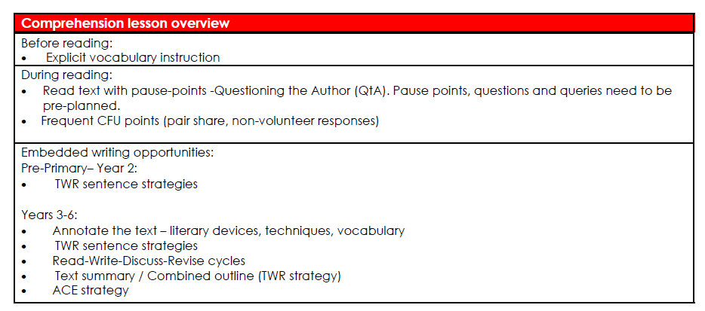

Slide 3
Knowledge Unit: KU1 Kings and Queens Year 1
Lesson # | Lesson Title | Learning Objective | Big Question | Vocabulary | Embedded Writing Task
1 | What are Kings and Queens? Part 1 | I can describe what a king or queen does. | What does a king or queen do? | servants | Statements and questions
2 | What are Kings and Queens? Part 2 | I can identify and describe some royal objects. | What are some objects that are linked to royalty? | royal | Statements and questions
3 | The Royal Family Part 1 | I can describe a royal family. | What is a royal family? | reign | Statements and questions
4 | The Royal Family Part 2 | I can identify things that make a royal family successful. | What makes a royal family successful? | prosperity | Statements and questions
5 | King Midas and the Golden Touch Part 1 | I can describe that kings and queens usually have gold or other treasures. | Are kings and queens likely to have treasures? | spoiled | Expand simple sentences with when and where
6 | King Midas and the Golden Touch Part 2 | I can discuss the difference between valuing people or valuing money. | What are some differences between valuing people or valuing money? | fond
7 | Old King Cole Part 1 | I can describe the behaviours that show that kings and queens are royal. | What kinds of behaviours show that kings and queens are royal? | satisfied
8 | Old King Cole Part 2 | I can recite Old King Cole. | What are the words for the nursery rhyme Old King Cole? | merry
9 | Pause Point | I will revisit what we know so far about kings and queens. | What have we learnt about kings and queens so far? | -
10 | Sing a Song of Sixpence Part 1 | I can recall details from Sing a Song of Sixpence. | What are some details in Sing a Song of Sixpence? | dainty | Expand simple sentences with when, who/what and where
11 | Sing a Song of Sixpence Part 2 | I can recite Sing a Song of Sixpence. | What are the words for the nursery rhyme Sing a Song of Sixpence? | delicate
12 | The Princess and the Pea Part 1 | I can identify the characters in the Princess and the Pea. | Who are the characters in the Princess and the Pea? | graceful
13 | The Princess and the Pea Part 2 | I can identify the setting of the Princess and the Pea. | What is the setting of the Princess and the Pea? | howled
14 | Cinderella Part 1 | I can describe the characters in Cinderella. | Who are the characters in Cinderella and what are they like? | merriment | Adjectives
15 | Cinderella Part 2 | I can retell the plot of Cinderella. | What happens in the story of Cinderella? | stumbled
16 | Snow White and the Seven Miners Part 1 | I can describe the setting and characters of Snow White and the Seven Miners. | What is the setting and who are the characters in Snow White and the Seven Miners? | pity
17 | Snow White and the Seven Miners Part 2 | I can retell the plot of Snow White and the Seven Miners. | What happens in the story of Snow White and the Seven Miners? | rage
18 | Assessment

Slide 4
Lesson 1
What are Kings and Queens? Part 1
The Big Question: What does a king or queen do?

Slide 5
Vocabulary
servants

Slide 6
Track with me
Vocabulary
Read with me
Choral Reversal
definition:
Read to your partner
Servants are people who are paid to work for a king or queen.

Slide 7
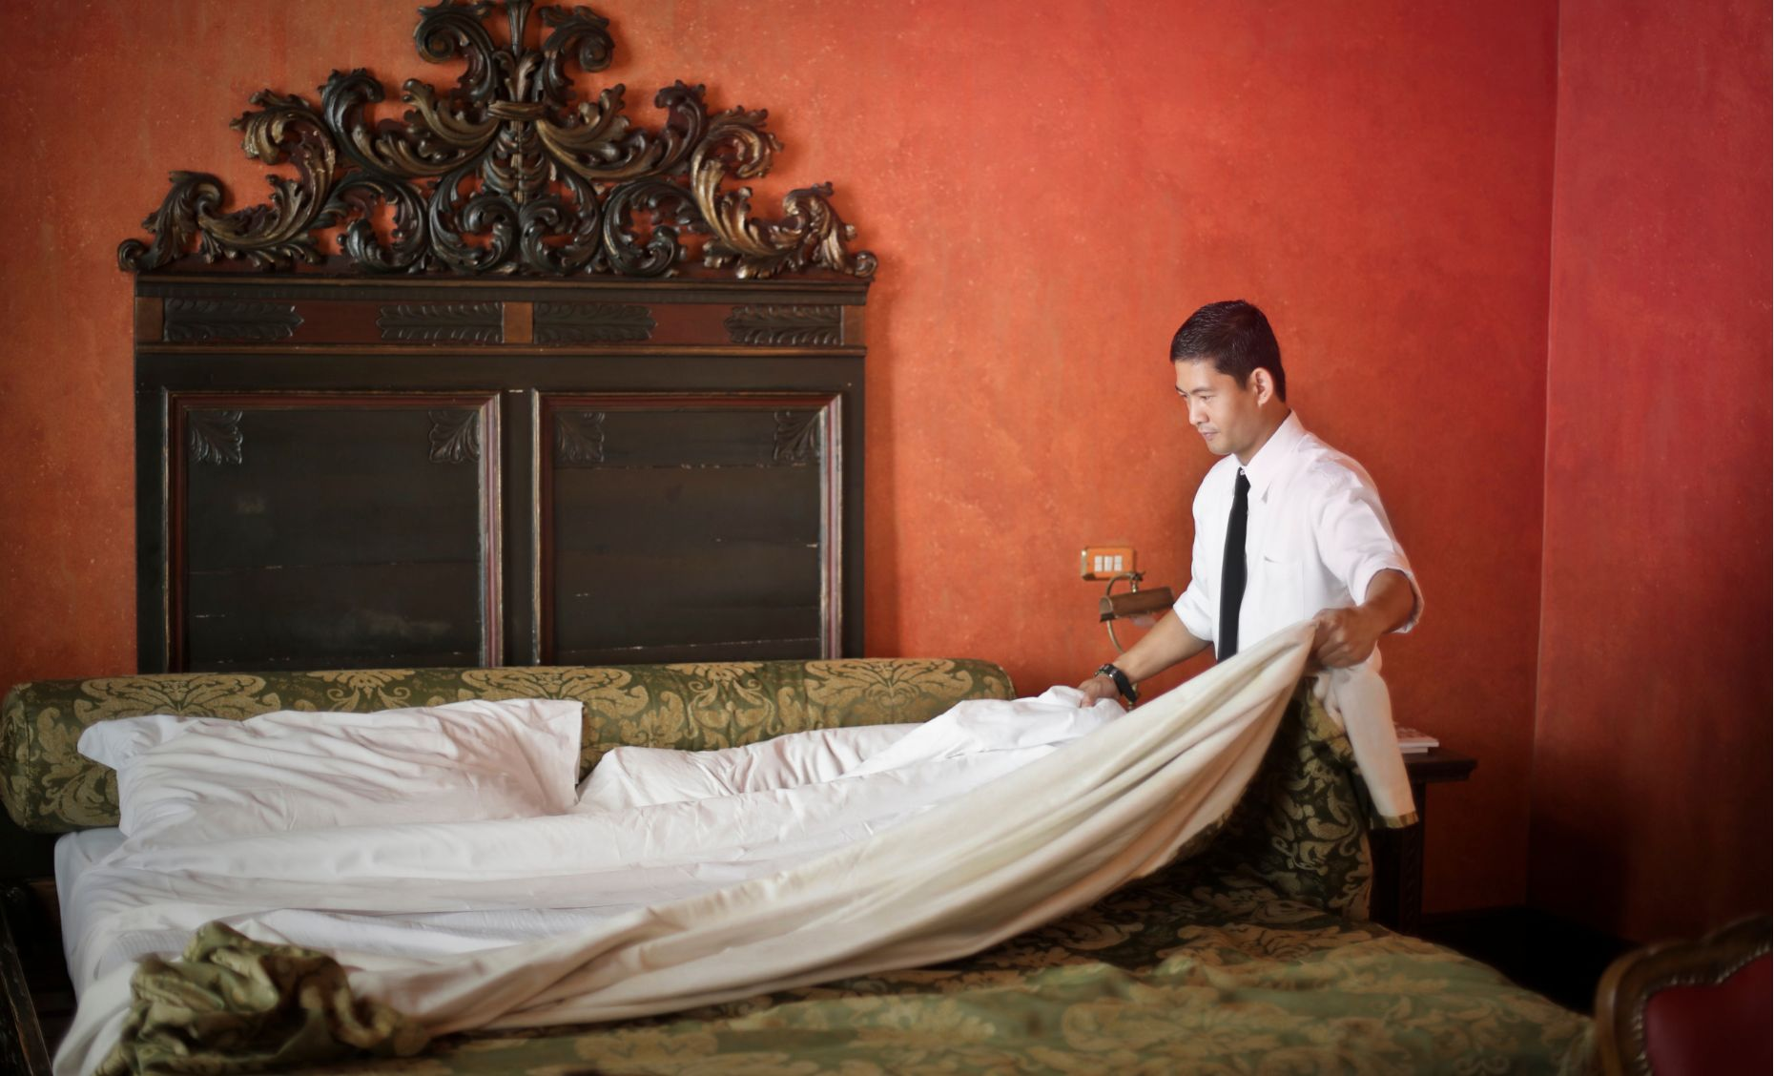
Why is this picture an example/not an example of servants? How do you know?
Vocabulary
is/is not an example of servants because .
servant
not servant
Notes:
Junior - I do

Slide 8
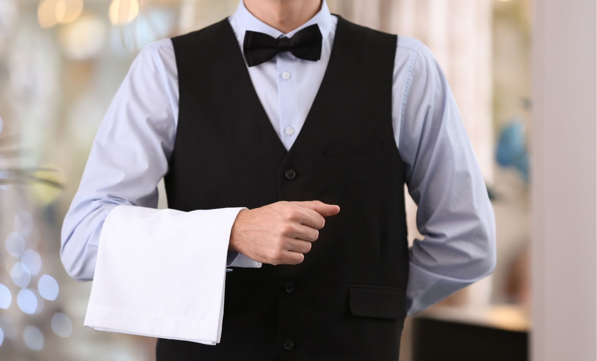
Why is this picture an example/not an example of servants? How do you know?
Vocabulary
is/is not an example of servants because .
Example or Non-Example?
Notes:
Junior – We Do

Slide 9
Why is this picture an example/not an example of servants? How do you know?
Vocabulary
is/is not an example of servants because .
Example or Non-Example?
Notes:
Junior – We Do

Slide 10
Track with me
Vocabulary
Read with me
sentence:
Read to your partner
The servants made the king’s bed.
Notes:
*vocab word in red
simple

Slide 11
Track with me
Vocabulary
Read with me
sentence:
Read to your partner
The floor was dirty, so the servants cleaned it.
Notes:
*vocab word in red
compound

Slide 12
Track with me
Vocabulary
Read with me
sentence:
Read to your partner
Before they brought up the dinner, the servants set the table.
Notes:
*vocab word in red
complex

Slide 13
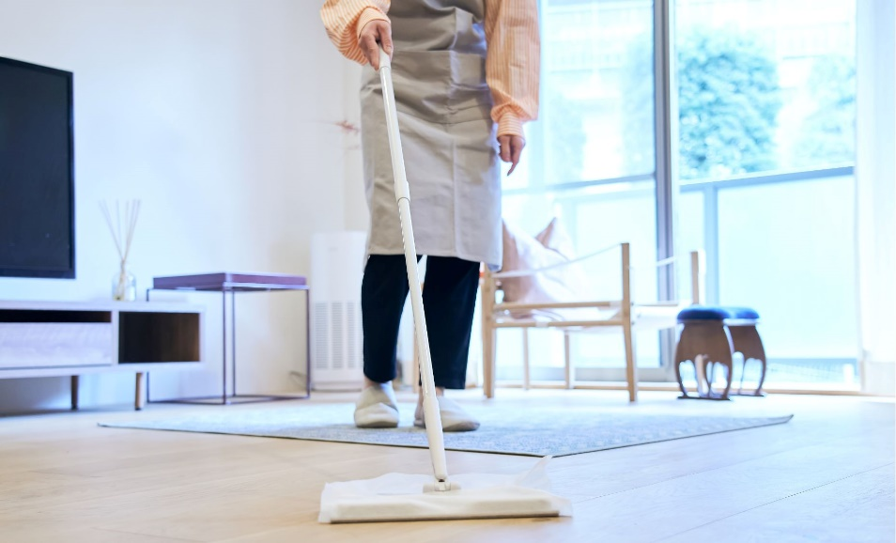
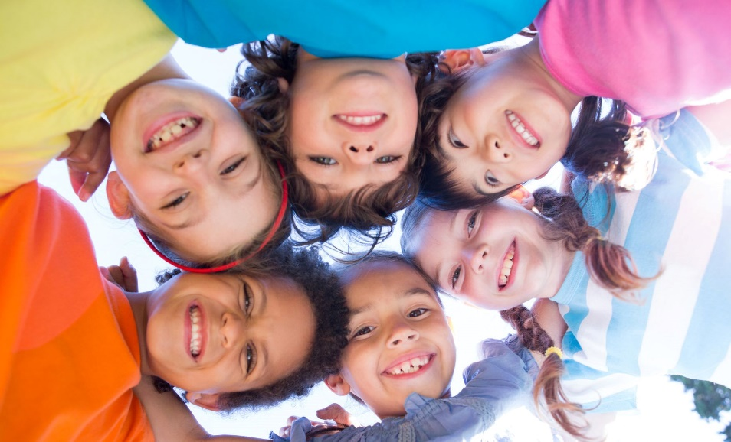
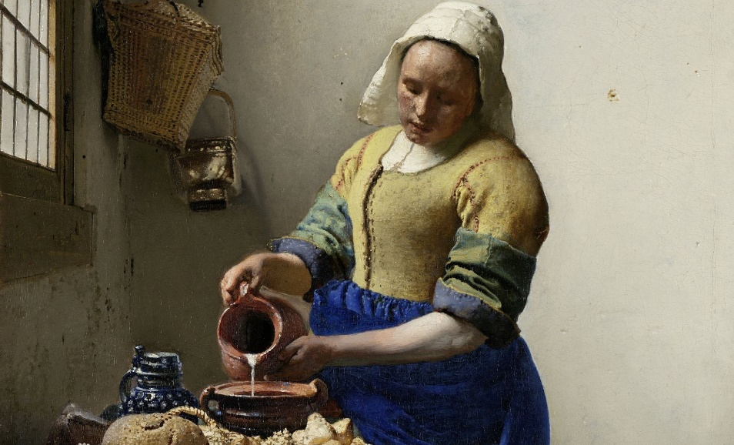
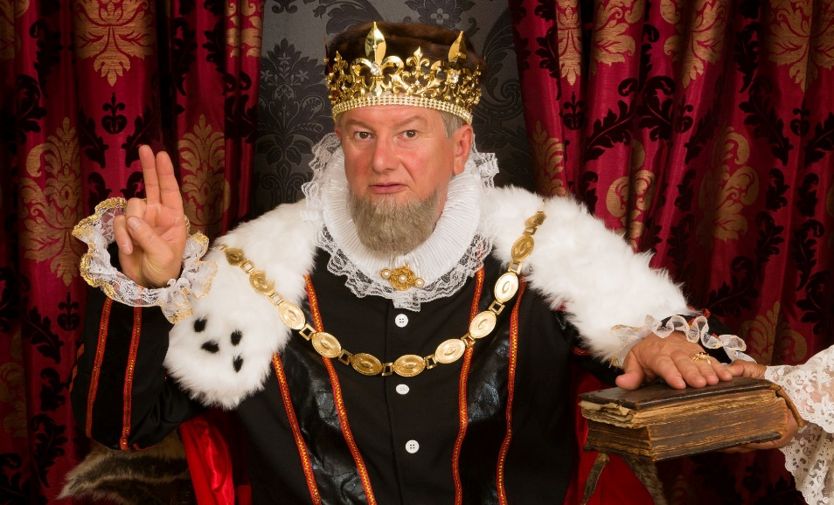
Why is this picture an example/not an example of servants? How do you know?
Vocabulary
Insert image
Insert image
is/is not an example of servants because .
A
B
Insert image
Insert image
C
D
Notes:
Senior You do

Slide 14
Tell your partner a sentence with the word servants.
Vocabulary Review
Insert image
servants
Servants are people who are paid to work for a king or queen.
Notes:
Junior Review Slide for Daily Review

Slide 15
Read Passage
Discuss and Read Question
Teacher and students read together.
APK
What is a king or queen?
Kings and Queens
Just like the teacher is the leader of the classroom, some countries have leaders called kings and queens. Kings and queens are different from teachers because they are born into special families called royal families. A king is a man from a royal family who is the leader of a country, while a queen is a woman from a royal family who is the leader of a country. Their children are called princes and princess. Kings, queens and their royal families live quite differently than other people do.
Australia is part of the Commonwealth. We have a king, King Charles III. King Charles III became king when his mother, Queen Elizabeth II, died.
A king or queen is _________________.
A king or queen is a leader of a country.

Slide 16
I can describe what a king or queen does.
Teacher and students read together.
TODAY’S LEARNING OBJECTIVE

Slide 17
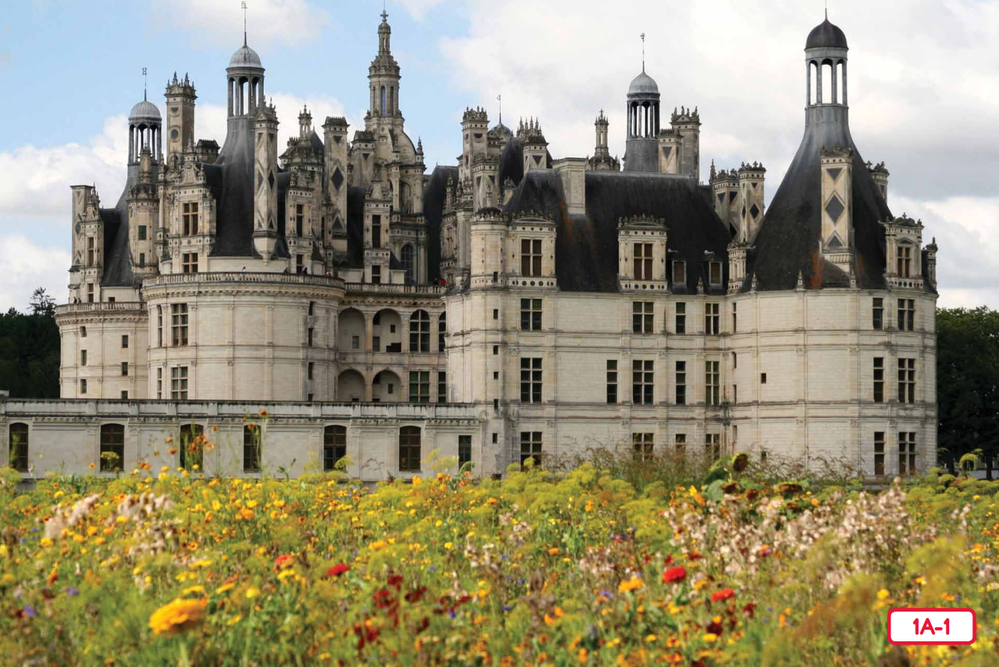
Read Vocabulary
Read Passage
Discuss and Read Question
Teacher and students read together.
Body
What do you call the place where a king or queen live?
What Are Kings and Queens?
The place where a king or queen lives is called a ________.
The place where a king or queen lives is called a palace
Vocabulary
rules (verb) when a king or queen leads and makes decisions
kingdom (noun) a place ruled or governed by a king or queen
Notes:
Read from Kings and Queens Read-Aloud Anthology 1A: What Are Kings and Queens? Page 13

Slide 18
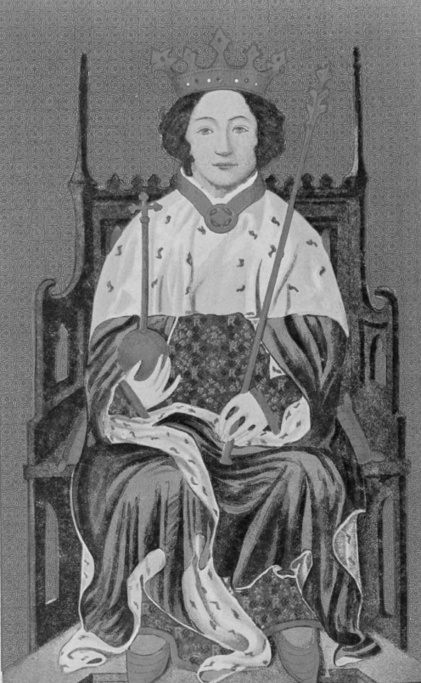
Read Vocabulary
Read Passage
Discuss and Read Question
Teacher and students read together.
Body
Why was it good to be a king or queen?
It was good to be a king or queen because they are powerful, have the best of everything and have people to do work for them.
It was good to be a king or queen because _________.
Vocabulary
servants (noun) men or women who are paid to work for a king or queen
royal (adjective) anything belonging to a king or queen
Notes:
Read from Kings and Queens Read-Aloud Anthology 1A: What Are Kings and Queens? Page 13

Slide 19
Pair share and discuss
Lesson Closure
Ask question
Discuss answers
Our Big Question:
What do kings and queens do?
Kings and queens rule kingdoms. They make decisions and rules for their land and people.
INITIATING QUERIES
FOLLOW-UP QUERIES
SUMMARISING
PREDICTING
Notes:
Learning Objective: I can describe what a king or queen does.
INITIATING QUERIES
What have we discussed today?
What was this all about?
What do we know so far?
FOLLOW-UP QUERIES
How does this relate to what we have learnt before?
SUMMARISING
What is the job of a king or queen do?
PREDICTING
What do you think we will be learning about next lesson?

Slide 20
In your workbook
Activity
Identifying statements and questions
Read the sentence.
Label each sentence with a Q for question or a S for statement.
kings and queens are the rulers of a kingdom
what is a female ruler of a kingdom called
who is the king of Australia
the royal family live in a palace
S
Q
Q
S
Notes:
Statements are sentences that tell you an idea. They start with a capital letter and end with a full stop.
A question is a sentence that asks us something. They start with a capital letter and end with a question mark. They often begin with what, when, how, why, who, do, can or where.

Slide 21
Lesson 2
What are Kings and Queens? Part 2
The Big Question: What are some objects that are linked to royalty?

Slide 22
Vocabulary
royal

Slide 23
Track with me
Vocabulary
Read with me
Choral Reversal
definition:
Read to your partner
Royal is anything belonging to a king or queen.

Slide 24
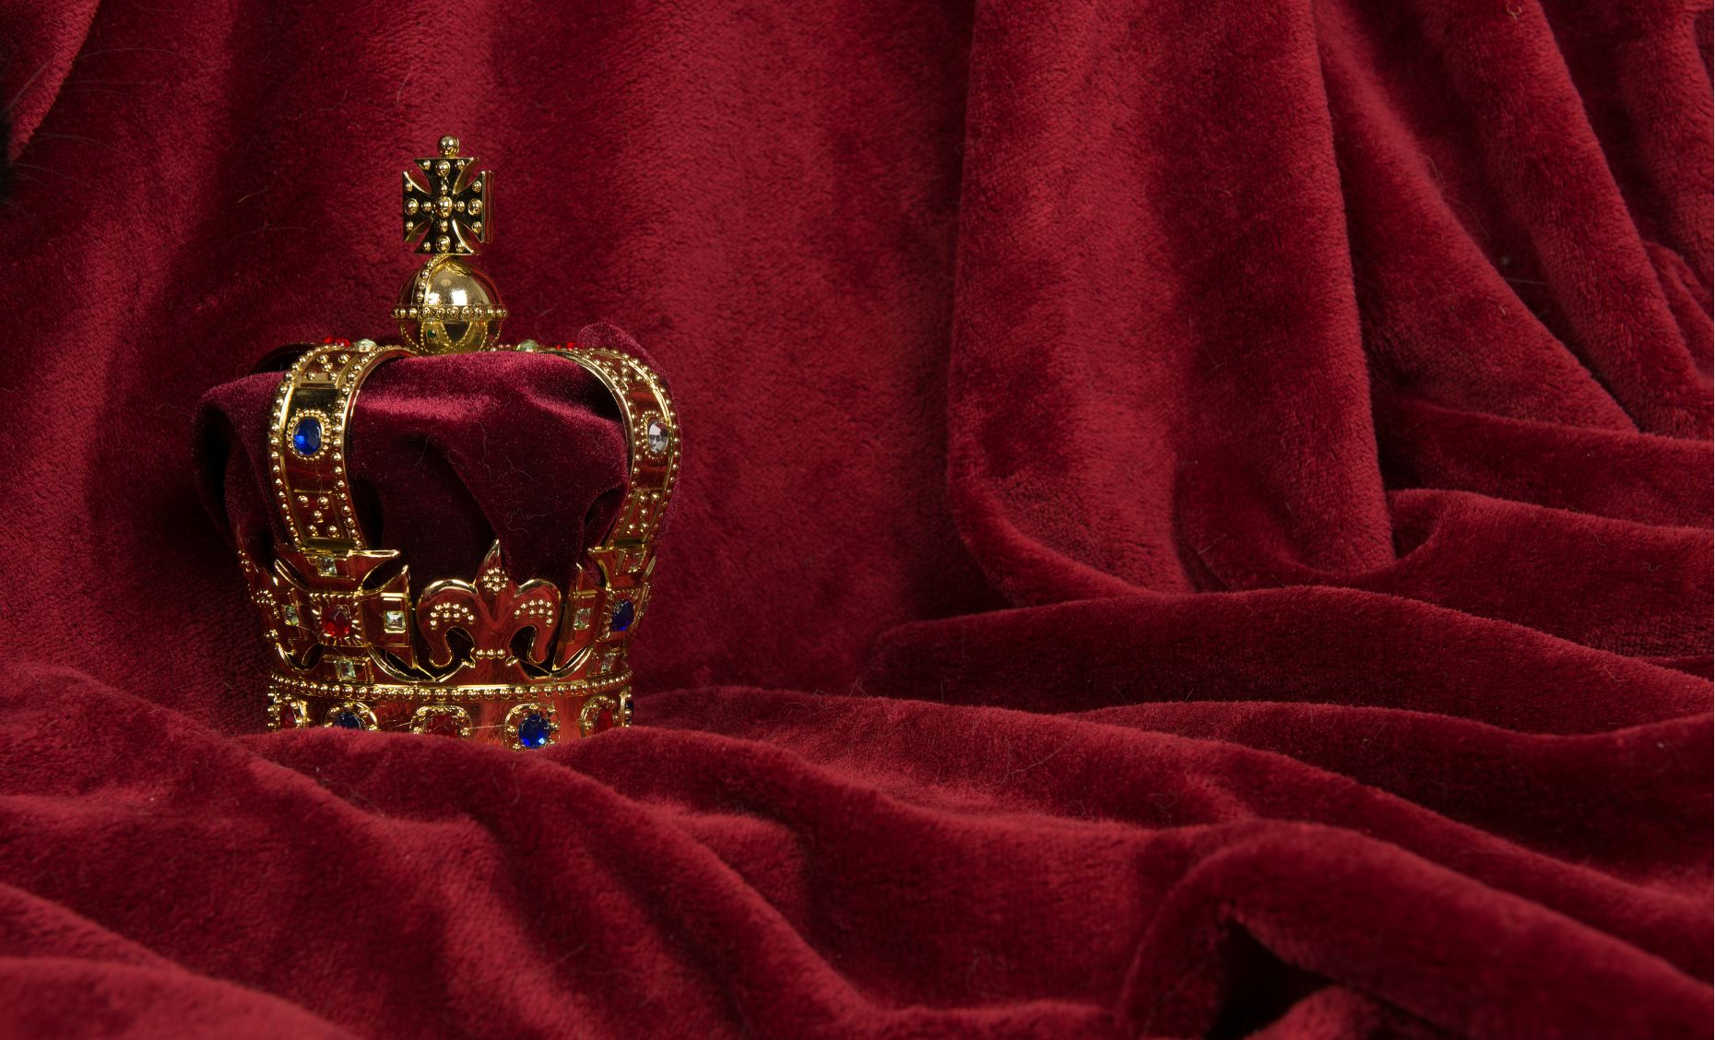
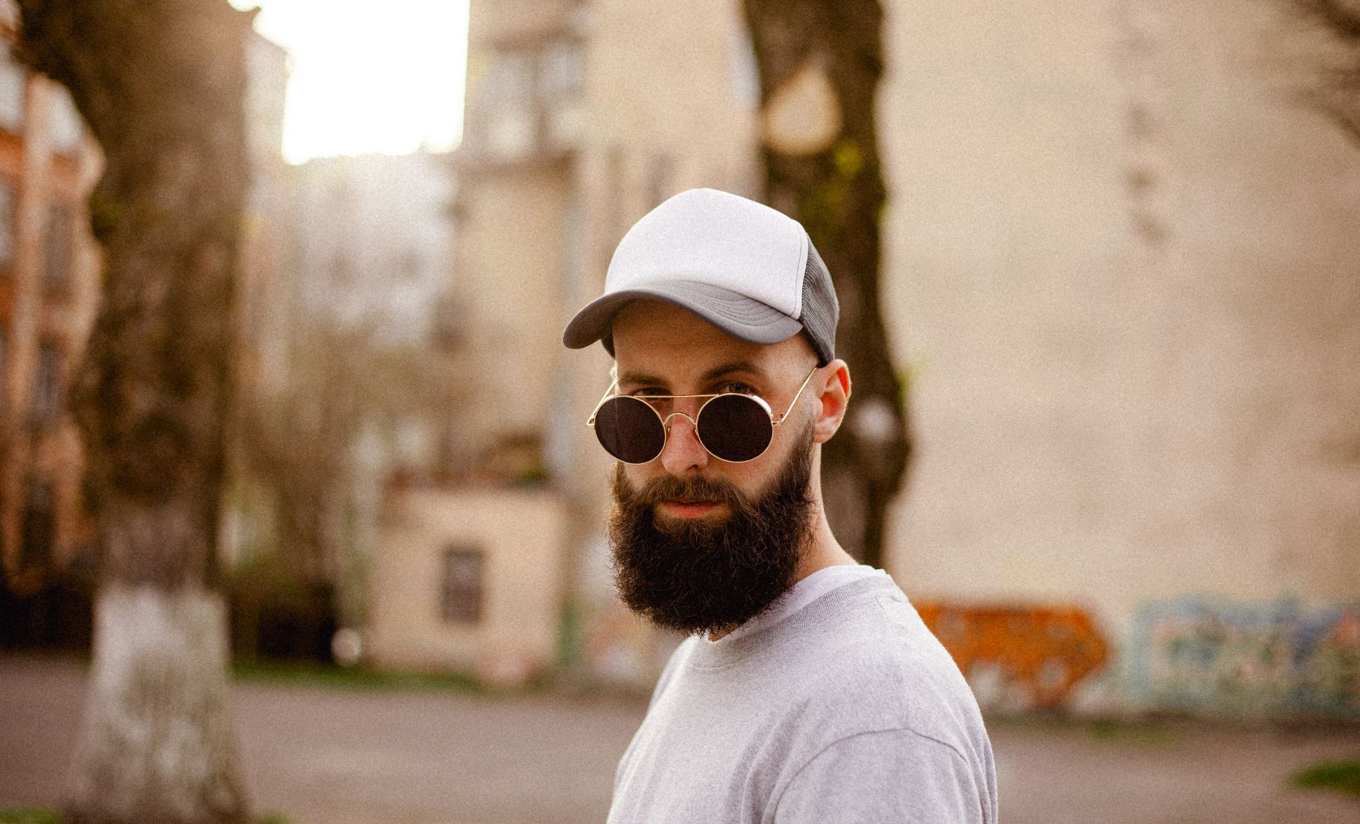
Why is this picture an example/not an example of royal? How do you know?
Vocabulary
is/is not an example of royal because .
royal
not royal
Notes:
Junior - I do

Slide 25
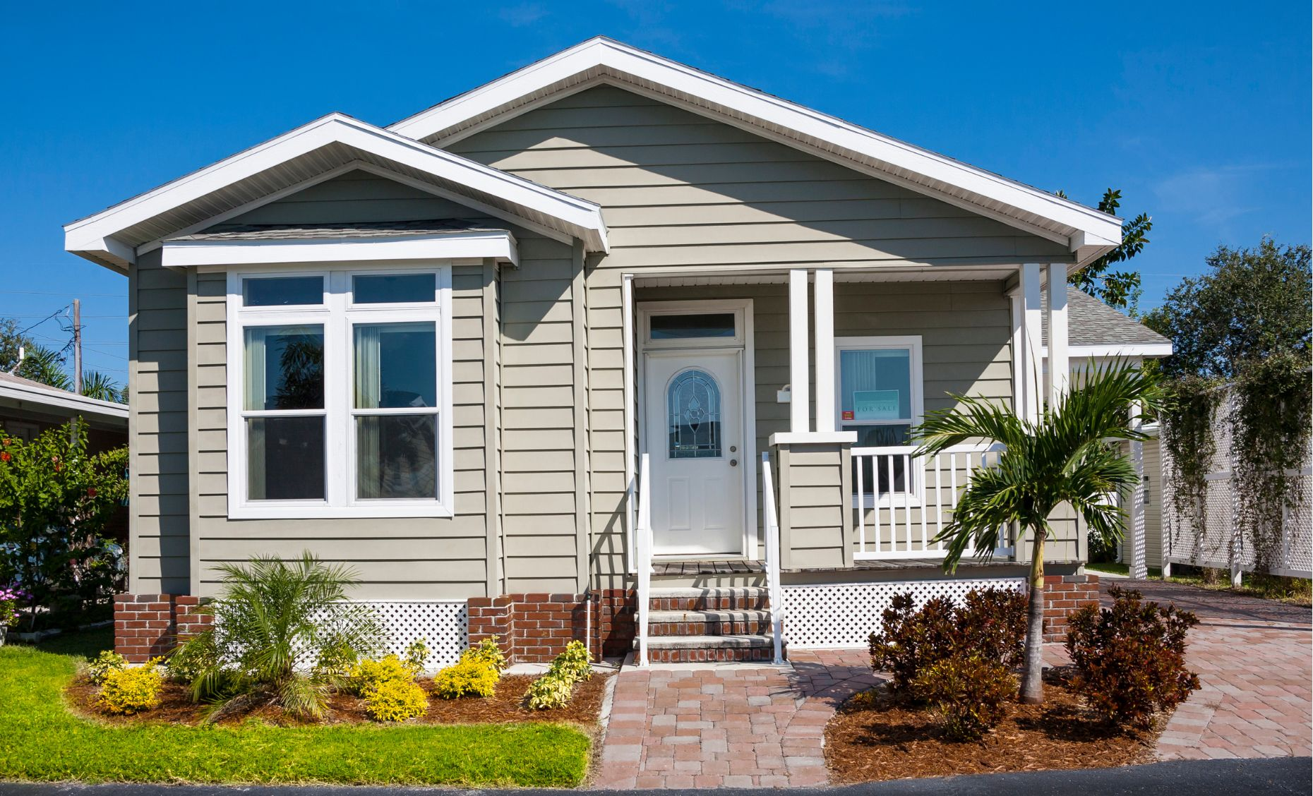
Why is this picture an example/not an example of royal? How do you know?
Vocabulary
is/is not an example of royal because .
Example or Non-Example?
Notes:
Junior – We Do

Slide 26
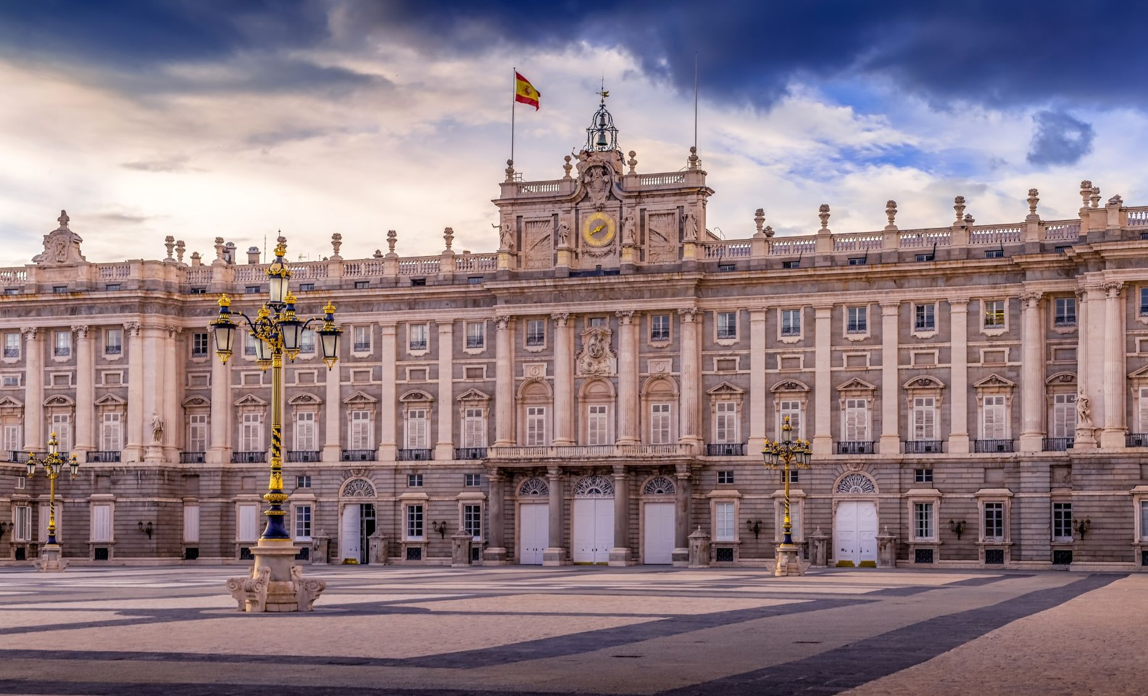
Why is this picture an example/not an example of royal? How do you know?
Vocabulary
is/is not an example of royal because .
Example or Non-Example?
Notes:
Junior – We Do

Slide 27
Track with me
Vocabulary
Read with me
sentence:
Read to your partner
The royal family attended the parade.
Notes:
*vocab word in red
simple

Slide 28
Track with me
Vocabulary
Read with me
sentence:
Read to your partner
The royal crown was beautiful, but it was heavy.
Notes:
*vocab word in red
compound

Slide 29
Track with me
Vocabulary
Read with me
sentence:
Read to your partner
By the time the royal dinner was served, the guests were very hungry.
Notes:
*vocab word in red
complex

Slide 30
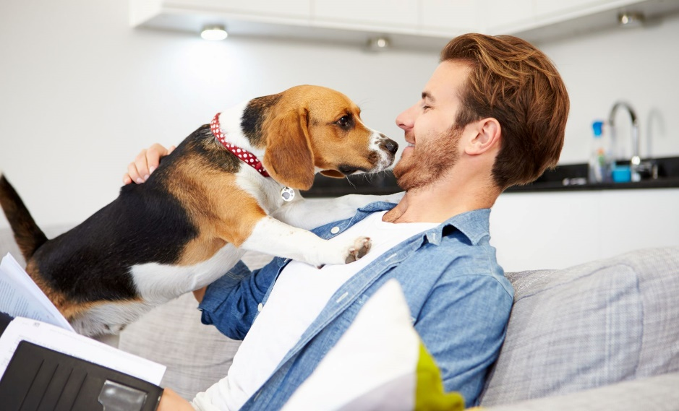
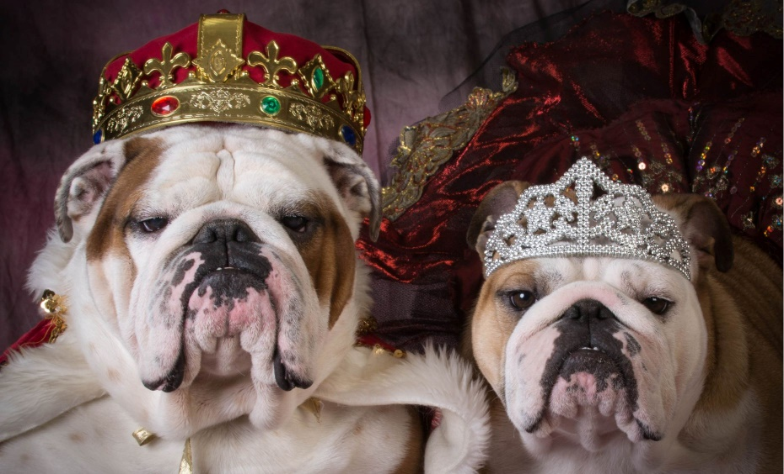
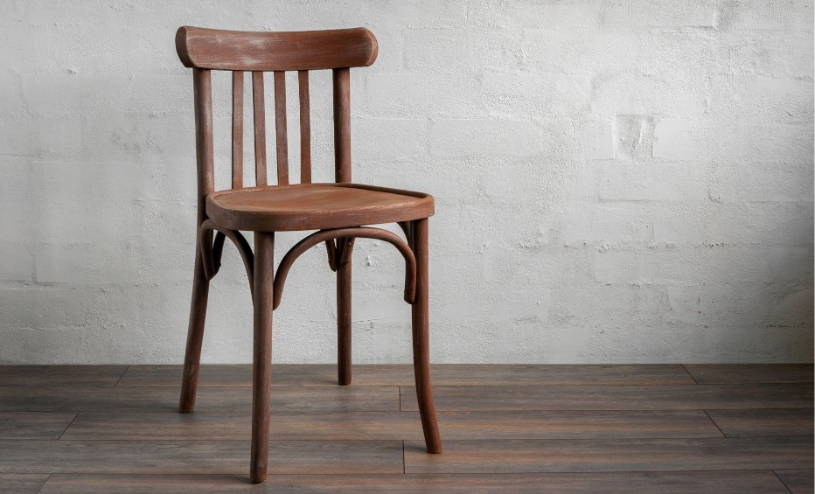
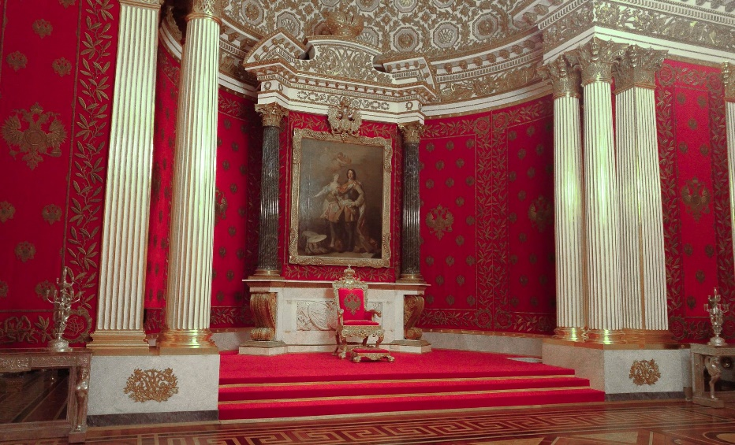
Why is this picture an example/not an example of royal? How do you know?
Vocabulary
Insert image
Insert image
is/is not an example of royal because .
A
B
Insert image
Insert image
C
D
Notes:
Senior You do

Slide 31
Tell your partner a sentence with the word royal.
Vocabulary Review
Insert image
royal
Royal is anything belonging to a king or queen.
Notes:
Junior Review Slide for Daily Review

Slide 32
Read Passage
Discuss and Read Question
Teacher and students read together.
APK
What do kings and queens do?
Kings and queens rule kingdoms. They make decisions and rules for their land and people.
Kings and queens .
What Are Kings and Queens?
Kings and queens are rulers of land and people, known as kingdoms. They become leaders because they are born into royal families. They also have important work to do making decisions and rules, and they have a lot of responsibilities. Things that belong to them are called ‘royal’.
In this picture, King Richard is holding a royal orb and a royal sceptre. These objects remind people that he is in charge.

Slide 33
I can identify and describe some royal objects.
Teacher and students read together.
TODAY’S LEARNING OBJECTIVE

Slide 34
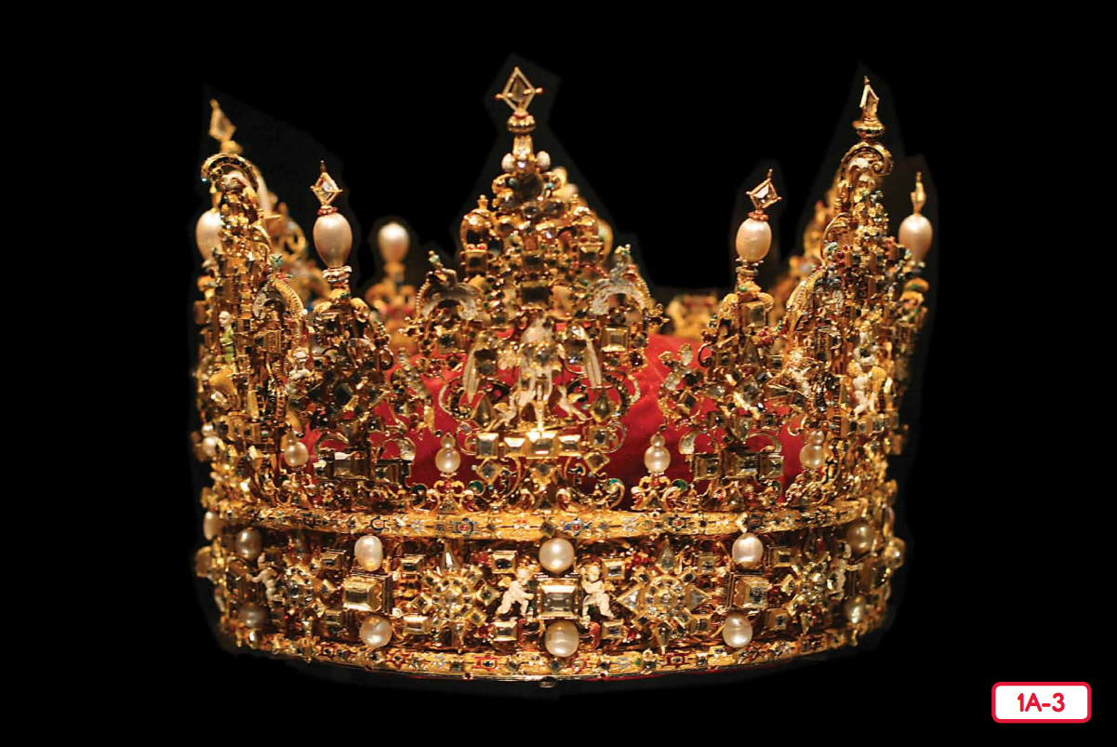
Read Vocabulary
Read Passage
Discuss and Read Question
Teacher and students read together.
Body
What is the name of a fancy hat worn by a king or queen?
A hat worn by a king or queen is called a .
A hat worn by a king or queen is called a crown.
Vocabulary
royal (adjective) anything belonging to a king or queen
Notes:
Read from Kings and Queens Read-Aloud Anthology 1A: What Are Kings and Queens? Page 14

Slide 35
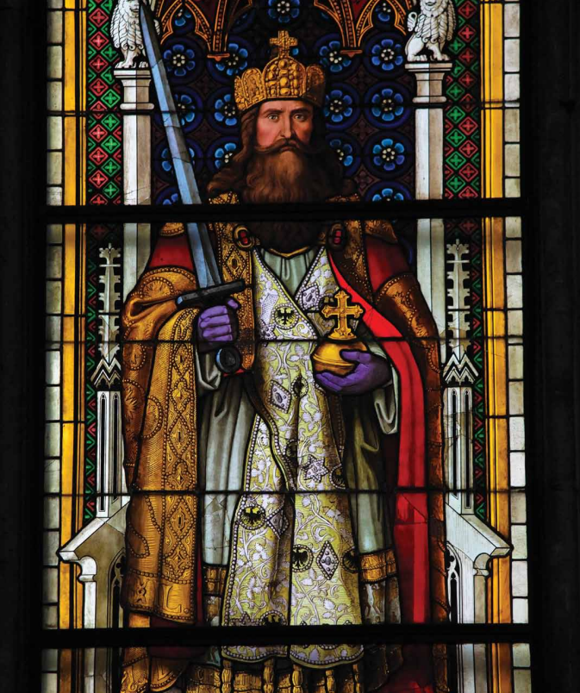
Read Vocabulary
Read Passage
Discuss and Read Question
Teacher and students read together.
Body
Why was it difficult to be a king or queen?
It was difficult to be a king or queen because rulers have to make a lot of important decisions and have a lot or responsibility.
It was difficult to be a king or queen because __________.
Notes:
Read from Kings and Queens Read-Aloud Anthology 1A: What Are Kings and Queens? Page 14

Slide 36
Pair share and discuss
Lesson Closure
Ask question
Discuss answers
Our Big Question:
What are some objects that are linked to royalty?
Crown
Palace
Royal sceptre
Throne
Royal orb
Sword
Royal objects remind people of the ruler’s power and importance.
INITIATING QUERIES
FOLLOW-UP QUERIES
SUMMARISING
PREDICTING
Notes:
Learning Objective: I can identify and describe some royal objects.
INITIATING QUERIES
What have we discussed today?
What was this all about?
What do we know so far?
FOLLOW-UP QUERIES
How does this relate to what we have learnt before?
SUMMARISING
Why do kings and queens have royal objects?
PREDICTING
What do you think we will be learning about next lesson?

Slide 37
In your workbook
Activity
Identifying statements and questions
Read the sentence.
Label each sentence with a Q for question or a S for statement.
Hint: these sentences do not have punctuation, so you need to think about whether it is telling you something (statement) or asking something (question)
why do kings and queens have royal objects
kings sit on fancy chairs called thrones
the king holds the royal orb
where does the king keep his crown
Q
S
S
Q
Notes:
Statements are sentences that tell you an idea. They start with a capital letter and end with a full stop.
A question is a sentence that asks us something. They start with a capital letter and end with a question mark. They often begin with what, when, how, why, who, do, can or where.

Slide 38
Lesson 3
The Royal Family Part 1
The Big Question: What is a royal family?

Slide 39
Vocabulary
reign

Slide 40
Track with me
Vocabulary
Read with me
Choral Reversal
definition:
Read to your partner
A reign is the period of time when a king or queen ruled.

Slide 41
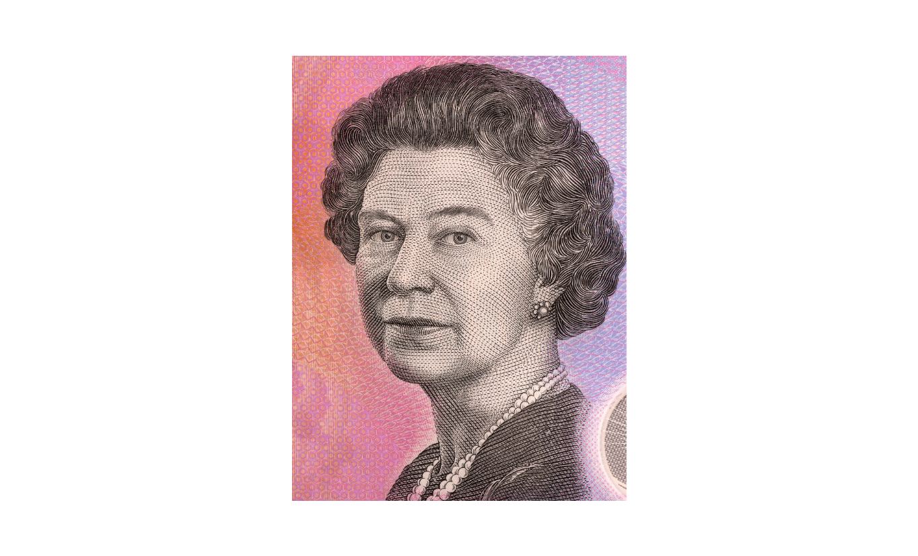
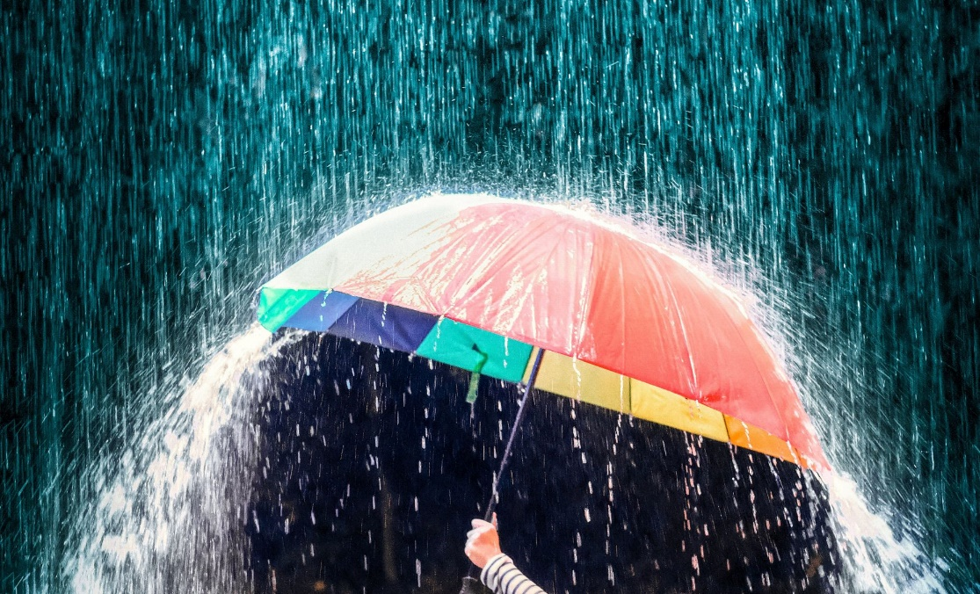
Why is this picture an example/not an example of reign? How do you know?
Vocabulary
is/is not an example of reign because .
1952 – 2022: The Reign of Queen Elizabeth II
Rain - water falling from the sky
reign
not reign
Notes:
Junior - I do

Slide 42
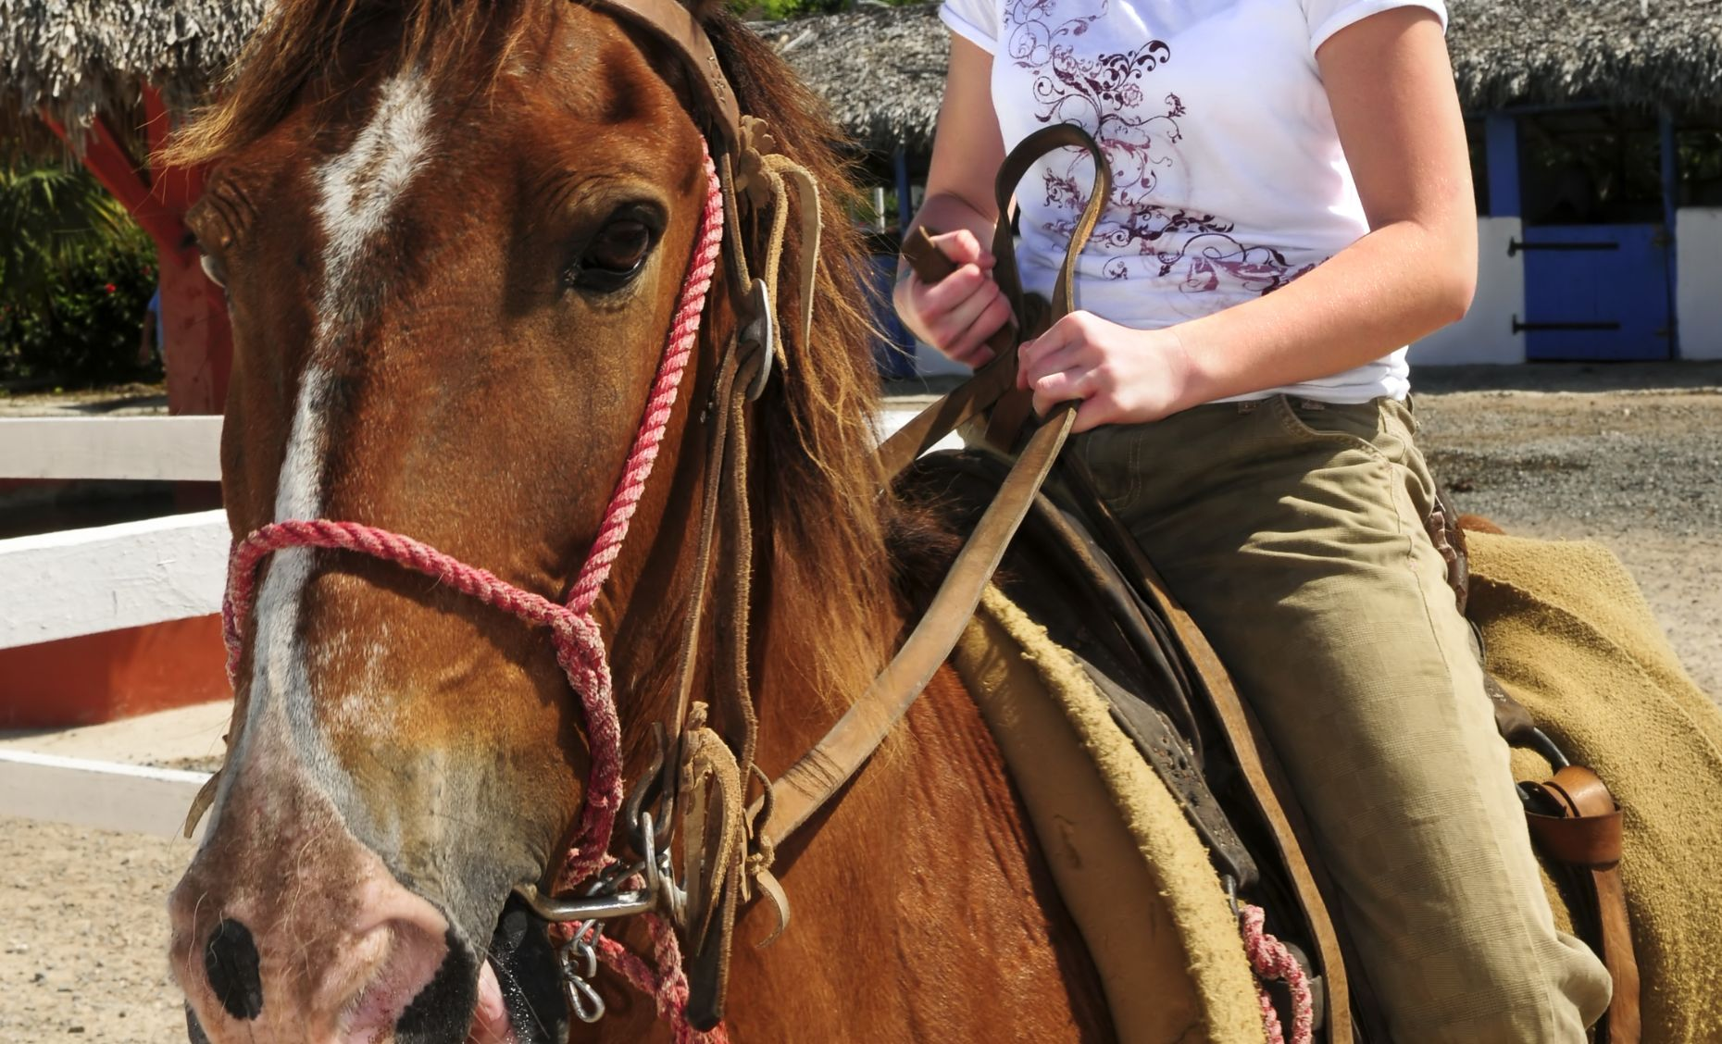
Why is this picture an example/not an example of reign? How do you know?
Vocabulary
is/is not an example of reign because .
Example or Non-Example?
Notes:
Junior – We Do

Slide 43
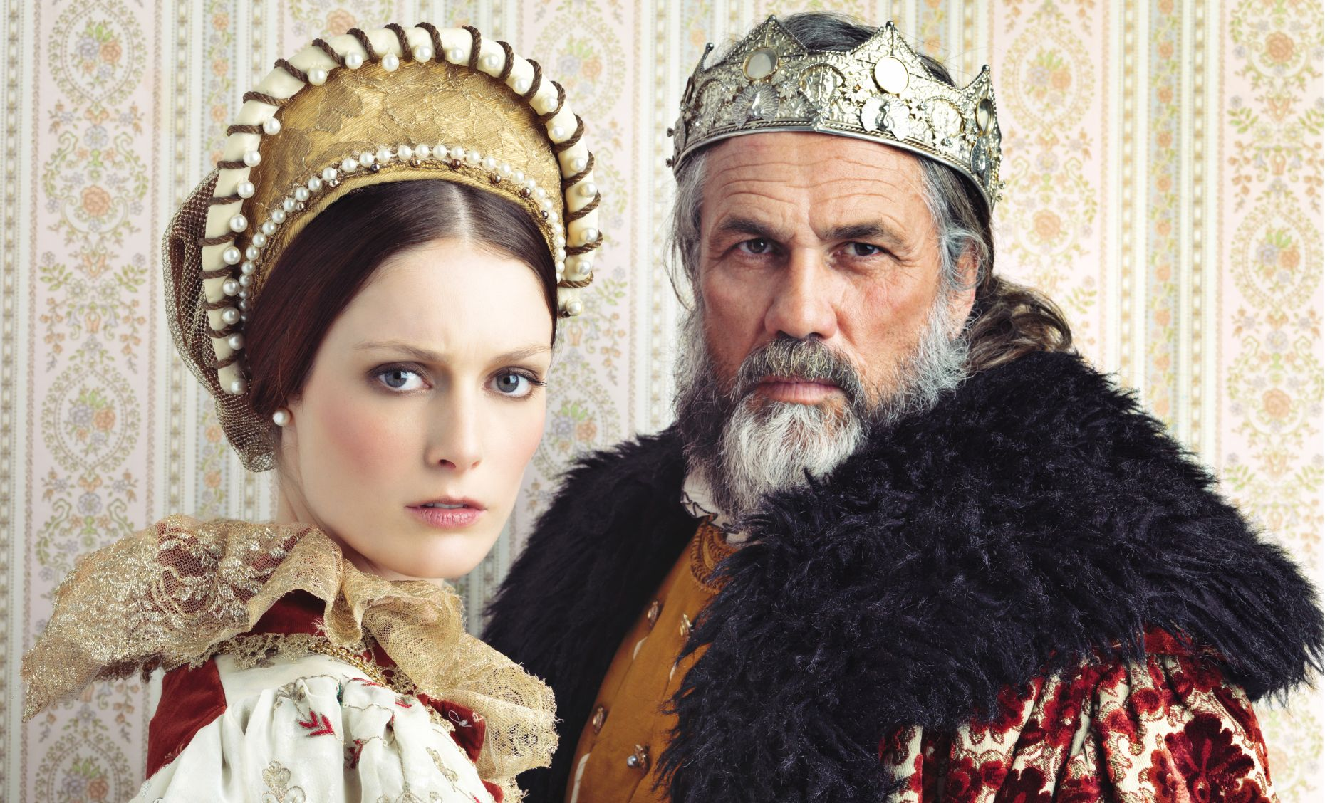
Why is this picture an example/not an example of reign? How do you know?
Vocabulary
is/is not an example of reign because .
Example or Non-Example?
Notes:
Junior – We Do

Slide 44
Track with me
Vocabulary
Read with me
sentence:
Read to your partner
The queen had a long, peaceful reign.
Notes:
*vocab word in red
simple

Slide 45
Track with me
Vocabulary
Read with me
sentence:
Read to your partner
The king had a short reign, but he achieved a lot for his country.
Notes:
*vocab word in red
compound

Slide 46
Track with me
Vocabulary
Read with me
sentence:
Read to your partner
After his reign had ended, the people remembered the king fondly.
Notes:
*vocab word in red
complex

Slide 47
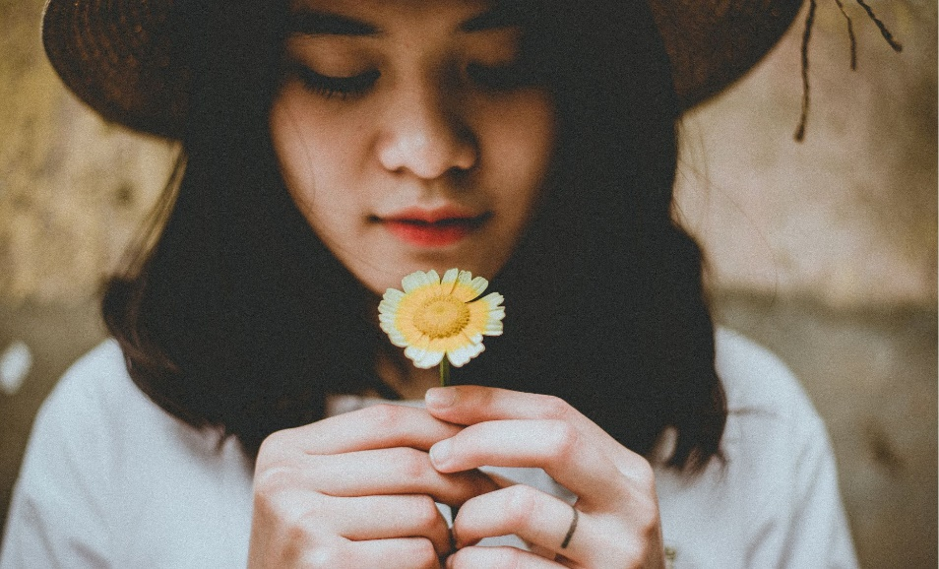
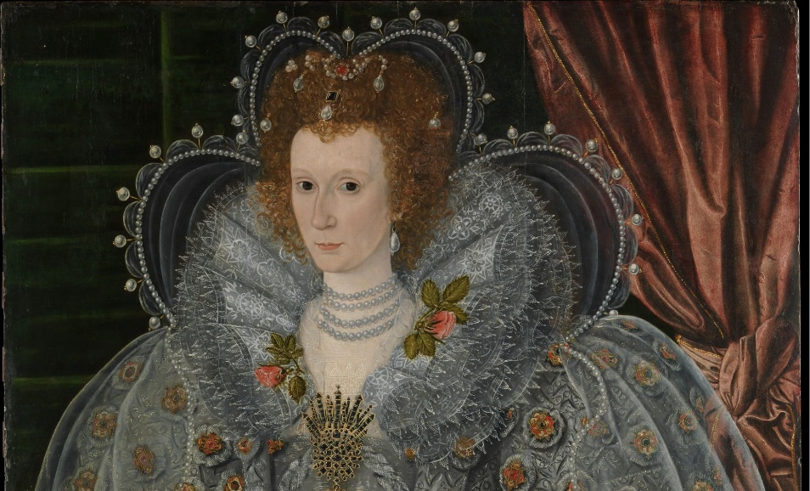
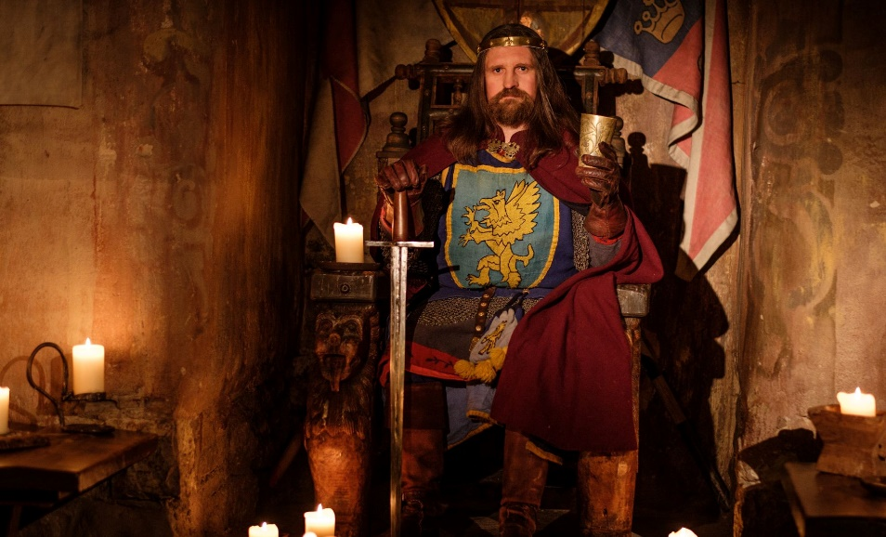
Why is this picture an example/not an example of reign? How do you know?
Vocabulary
Insert image
Insert image
is/is not an example of reign because .
A
B
Insert image
Insert image
C
D
Notes:
Senior You do

Slide 48
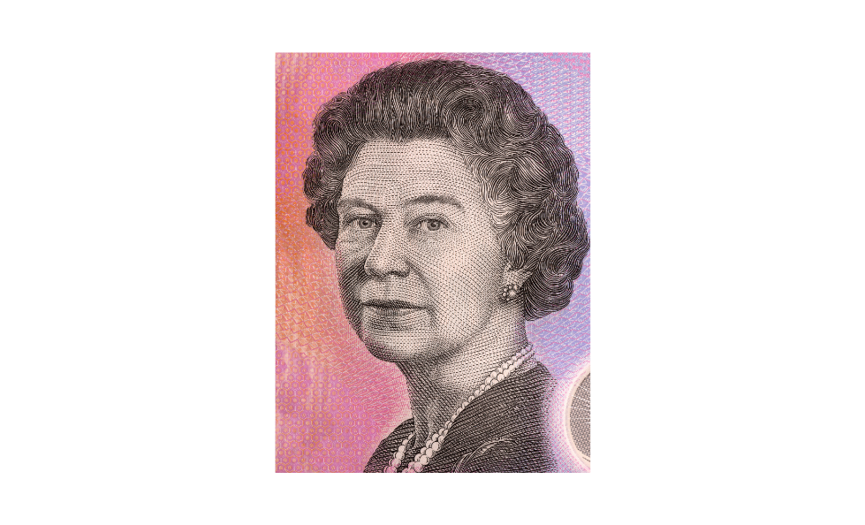
Tell your partner a sentence with the word reign.
Vocabulary Review
1952 – 2022: The Reign of Queen Elizabeth II
reign
A reign is the period of time when a king or queen ruled.
Notes:
Junior Review Slide for Daily Review

Slide 49
Read Passage
Discuss and Read Question
Teacher and students read together.
APK
What are some royal objects that a king or queen might have?
An example of a royal object is .
An example of a royal object is a
palace
throne
crown
royal orb
royal sceptre
sword
What Are Kings and Queens?
Kings and queens are rulers of land and people, known as kingdoms. They become leaders because they are born into royal families. They have a lot of fancy things, like palaces, crowns and thrones. They also have important work to do making decisions and rules, and they have a lot of responsibilities.

Slide 50
I can describe a royal family.
Teacher and students read together.
TODAY’S LEARNING OBJECTIVE

Slide 51
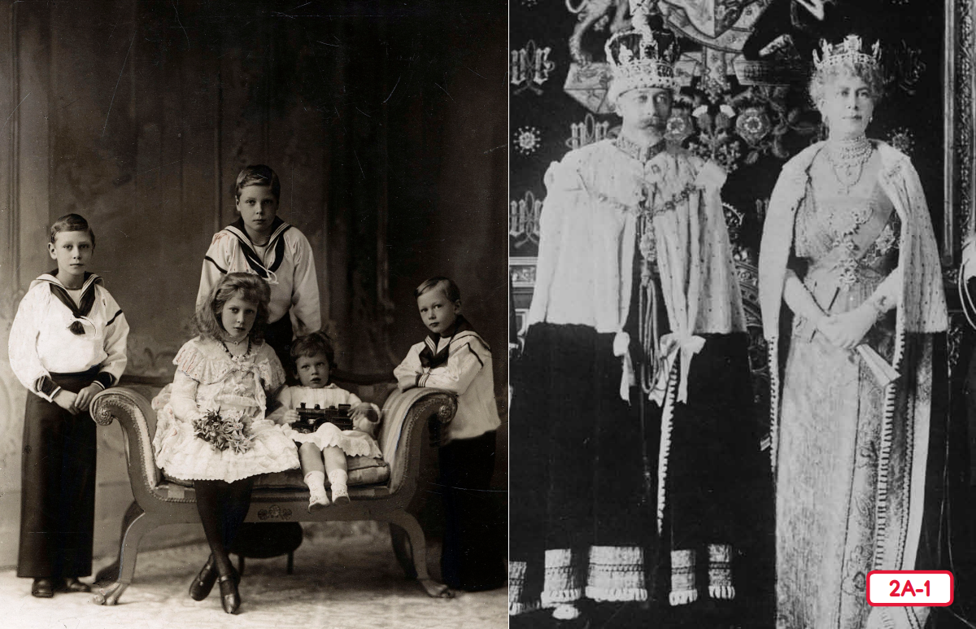
Read Vocabulary
Read Passage
Discuss and Read Question
Teacher and students read together.
Body
Why were the children of royal families important?
The Royal Family
Children of royal families were important because .
Children of royal families were important because the kingdom was passed on to them when the king or queen died.
Vocabulary
advantages (noun) things that are good about a situation
disadvantages (noun) things that are not good about a situation
prosperity (noun) having a lot of money, success or good luck
prosperity (noun) having a lot of money, success or good luck
reign(noun) the period of time when a king or queen ruled
crown prince (noun) the king's oldest son who is next in line to be king
Notes:
Read from Kings and Queens Read-Aloud Anthology 2A: The Royal Family Page 22

Slide 52
Pair share and discuss
Lesson Closure
Ask question
Discuss answers
Our Big Question:
What is a royal family?
A royal family is the family of the king and queen. The children in the family are called princes and princesses. The royal children take over ruling the kingdom when the king or queen die.
INITIATING QUERIES
FOLLOW-UP QUERIES
SUMMARISING
PREDICTING
Notes:
Learning Objective: I can describe a royal family.
INITIATING QUERIES
What have we discussed today?
What was this all about?
What do we know so far?
FOLLOW-UP QUERIES
How does this relate to what we have learnt before?
SUMMARISING
What are some advantages and disadvantages about being in the royal family?
PREDICTING
What do you think we will be learning about next lesson?

Slide 53
In your workbook
Activity
Writing statements and questions
Look at the picture
Write a statement based on the picture prompt.
Remember: a statement starts with a capital letter, ends with a full stop and tells your reader something.
The princess is holding ___________________________________.
The king is wearing _______________________________________.
The queen has ___________________________________________.
Notes:
Statements are sentences that tell you an idea. They start with a capital letter and end with a full stop.
A question is a sentence that asks us something. They start with a capital letter and end with a question mark. They often begin with what, when, how, why, who, do, can or where.

Slide 54
Lesson 4
The Royal Family Part 2
The Big Question: What makes a royal family successful?

Slide 55
Vocabulary
prosperity

Slide 56
Track with me
Vocabulary
Read with me
Choral Reversal
definition:
Read to your partner
Prosperity means having a lot of money, success, or good luck.

Slide 57
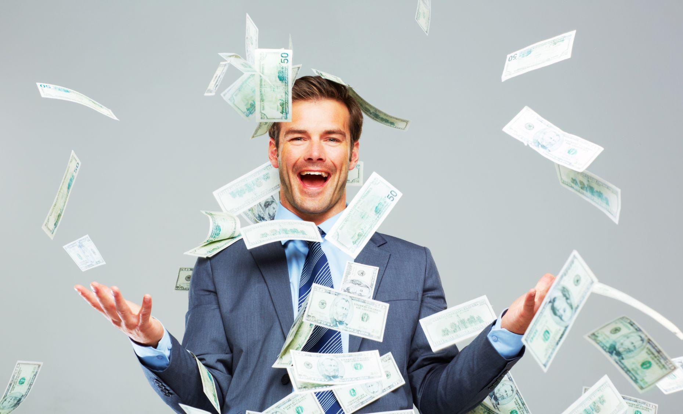
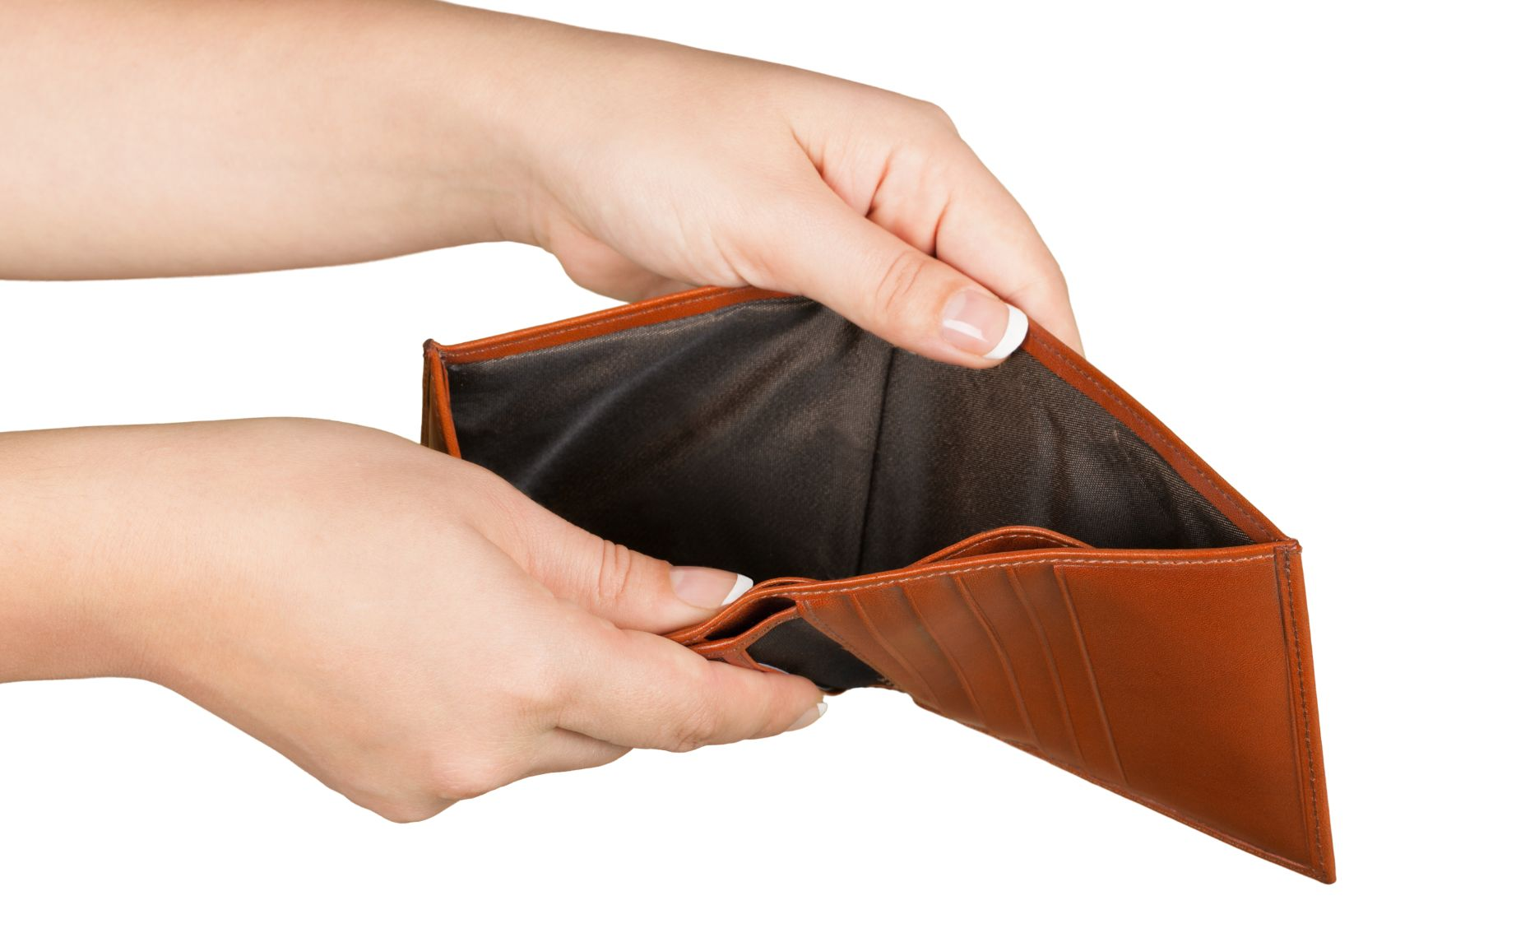
Why is this picture an example/not an example of prosperity? How do you know?
Vocabulary
is/is not an example of prosperity because .
prosperity
not prosperity
Notes:
Junior - I do

Slide 58
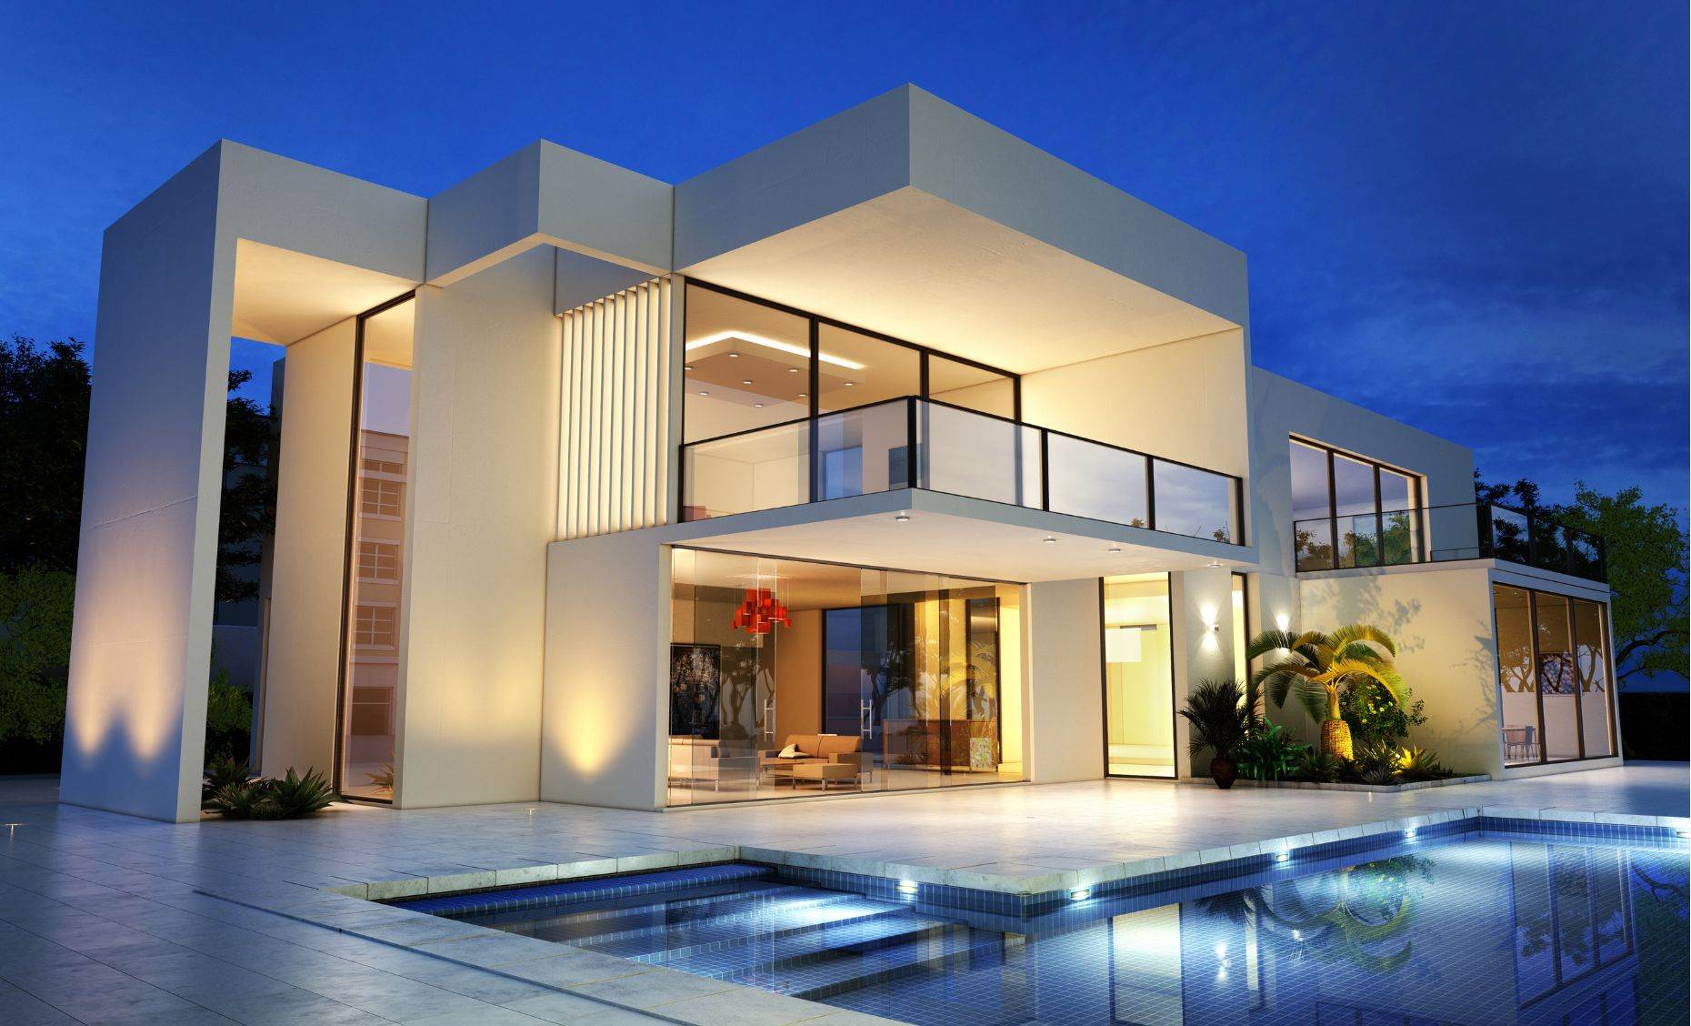
Why is this picture an example/not an example of prosperity? How do you know?
Vocabulary
is/is not an example of prosperity because .
Example or Non-Example?
Notes:
Junior – We Do

Slide 59
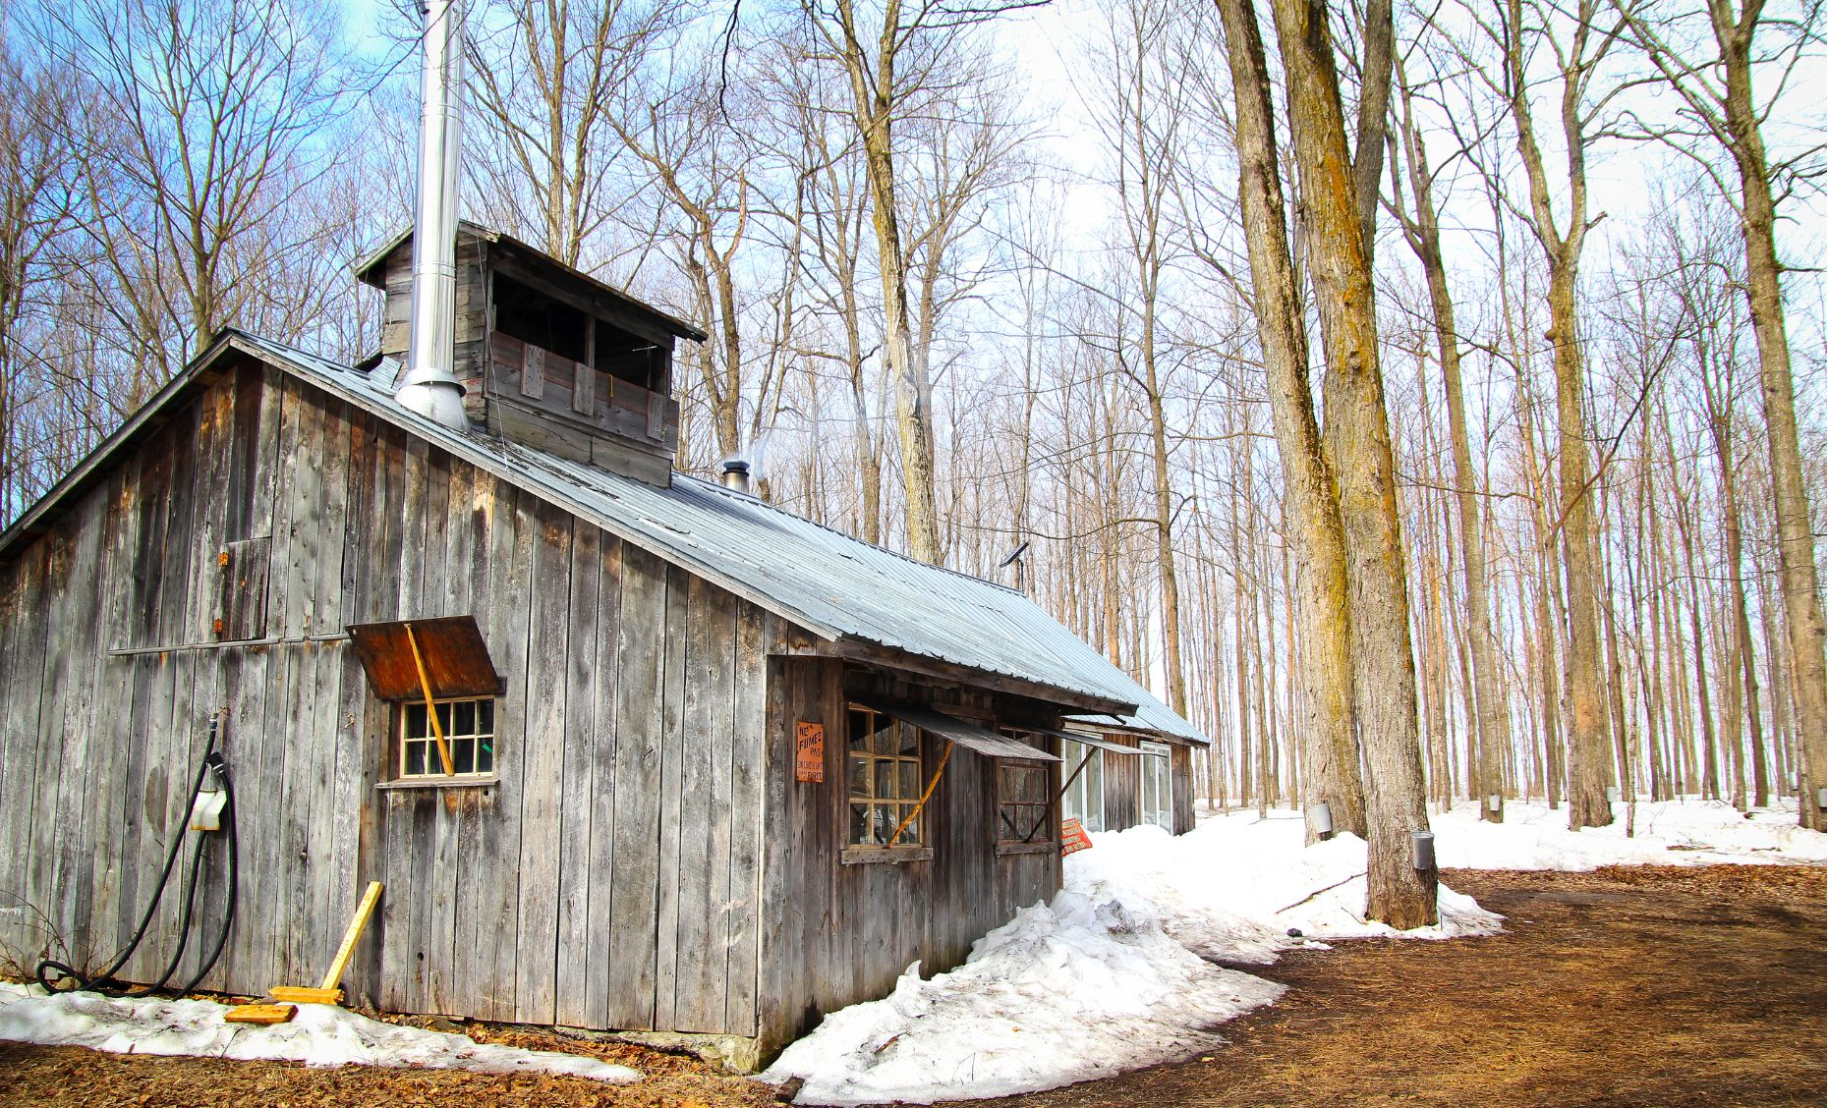
Why is this picture an example/not an example of prosperity? How do you know?
Vocabulary
is/is not an example of prosperity because .
Example or Non-Example?
Notes:
Junior – We Do

Slide 60
Track with me
Vocabulary
Read with me
sentence:
Read to your partner
The kingdom enjoyed peace and prosperity.
Notes:
*vocab word in red
simple

Slide 61
Track with me
Vocabulary
Read with me
sentence:
Read to your partner
The farmers had a good harvest, so the village experienced prosperity.
Notes:
*vocab word in red
compound

Slide 62
Track with me
Vocabulary
Read with me
sentence:
Read to your partner
As the community helped each other, they learned that true prosperity was about kindness.
Notes:
*vocab word in red
complex

Slide 63
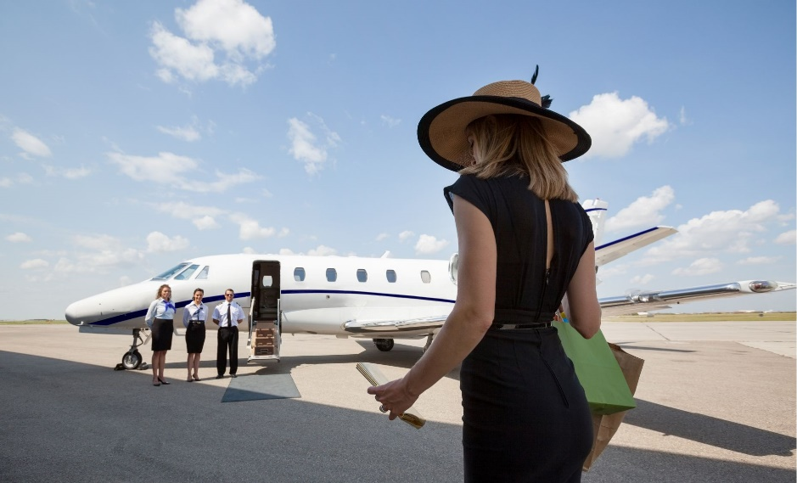
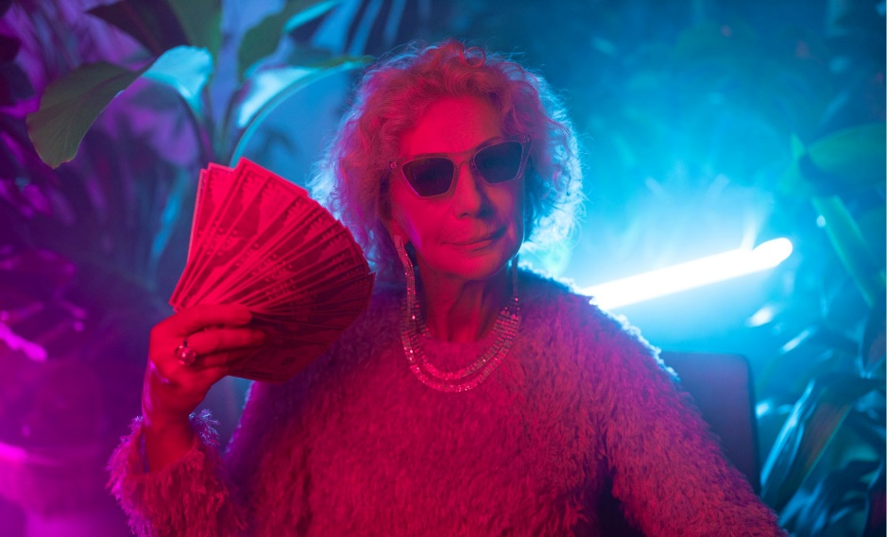
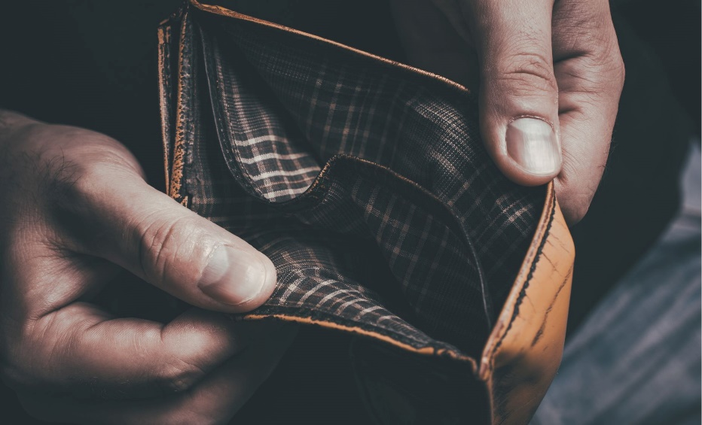
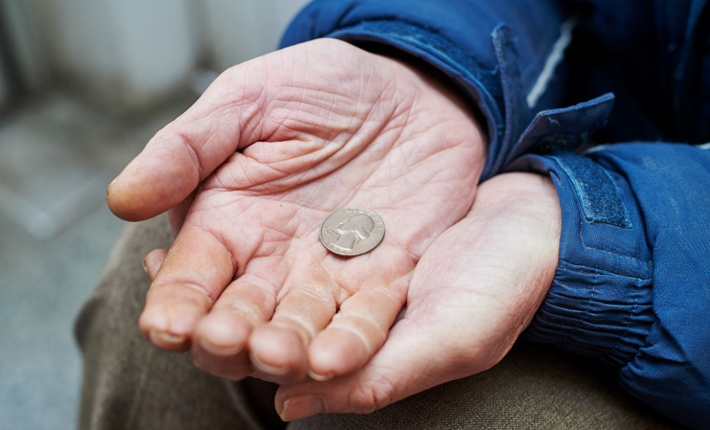
Why is this picture an example/not an example of prosperity? How do you know?
Vocabulary
Insert image
Insert image
is/is not an example of prosperity because .
A
B
Insert image
Insert image
C
D
Notes:
Senior You do

Slide 64
Tell your partner a sentence with the word prosperity.
Vocabulary Review
prosperity
Prosperity means having a lot of money, success, or good luck.
Notes:
Junior Review Slide for Daily Review

Slide 65
Read Vocabulary
Read Passage
Discuss and Read Question
Teacher and students read together.
APK
Why were the children of royal families important?
Children of royal families were important because .
Children of royal families were important because the kingdom was passed on to them when the king or queen died.
The Royal Family
The family of the king or queen is called the royal family. Children in the royal family are important, because they inherit the kingdom. The oldest son of the king is called the crown prince.
Notes:
Read from Kings and Queens Read-Aloud Anthology: 2A The Royal Family

Slide 66
I can identify things that make a royal family successful.
Teacher and students read together.
TODAY’S LEARNING OBJECTIVE

Slide 67
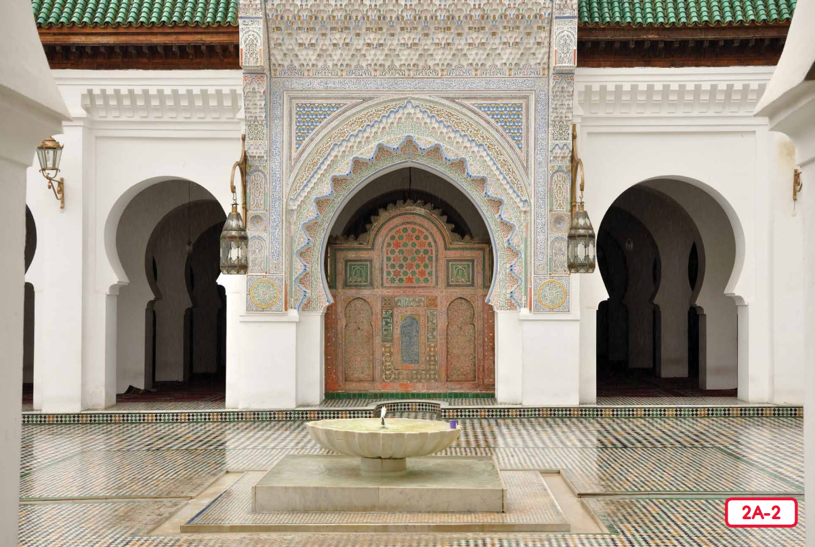
Read Vocabulary
Read Passage
Discuss and Read Question
Teacher and students read together.
Body
What is the king’s oldest called?
The king’s oldest son is called the .
The king’s oldest son is called the crown prince.
Notes:
Read from Kings and Queens Read-Aloud Anthology 2A: The Royal Family Page 23

Slide 68
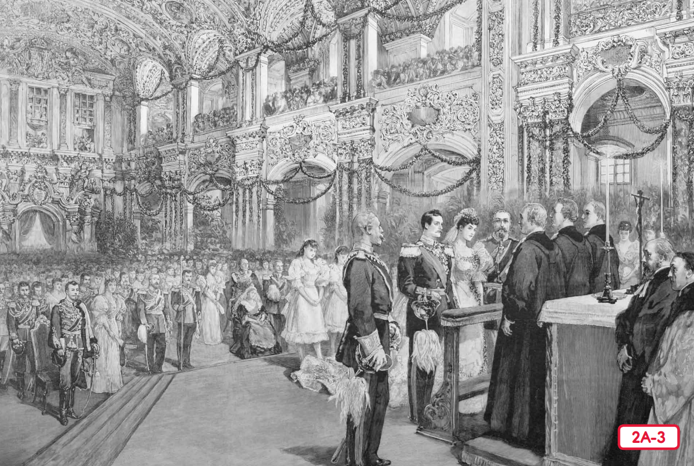
Read Vocabulary
Read Passage
Discuss and Read Question
Teacher and students read together.
Body
What is one disadvantage of being a prince or princess?
A disadvantage of being a prince or princess is
they might not be able to choose who to marry
everything they do is watched
they had to behave themselves all the time
A disadvantage of being a prince or princess is
.
Vocabulary
advantages (noun) things that are good about a situation
disadvantages (noun) things that are not good about a situation
Notes:
Read from Kings and Queens Read-Aloud Anthology 2A: The Royal Family Page 23

Slide 69
Pair share and discuss
Lesson Closure
Ask question
Discuss answers
Our Big Question:
What makes a royal family successful?
Having children to inherit the throne when the king or queen died made sure the kingdom stayed in the royal family and didn’t go to another family.
Arranging marriages to other royal families made the kingdom more powerful, because it meant that it would have friends to help.
INITIATING QUERIES
FOLLOW-UP QUERIES
SUMMARISING
PREDICTING
Notes:
Learning Objective: I can identify things that make a royal family successful.
INITIATING QUERIES
What have we discussed today?
What was this all about?
What do we know so far?
FOLLOW-UP QUERIES
How does this relate to what we have learnt before?
Have you ever seen a royal wedding on TV?
SUMMARISING
Why was a royal wedding an important event?
PREDICTING
What do you think we will be learning about next lesson?

Slide 70
In your workbook
Activity
Writing statements and questions
Look at the picture
Write a question based on the picture prompt.
Remember: a question starts with a capital letter, ends with a question mark and asks something.
Who ________________________________________?
When _______________________________________?
Where _______________________________________?
Notes:
Statements are sentences that tell you an idea. They start with a capital letter and end with a full stop.
A question is a sentence that asks us something. They start with a capital letter and end with a question mark. They often begin with what, when, how, why, who, do, can or where.

Slide 71
Lesson 5
King Midas and the Golden Touch Part 1
The Big Question: Are kings and queens likely to have treasures?

Slide 72
Vocabulary
spoiled

Slide 73
Track with me
Vocabulary
Read with me
Choral Reversal
definition:
Read to your partner
Spoiled means ruined.

Slide 74
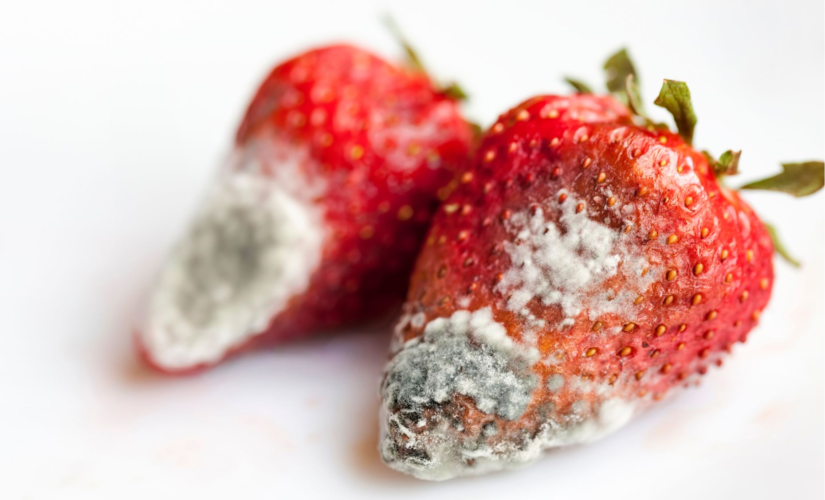
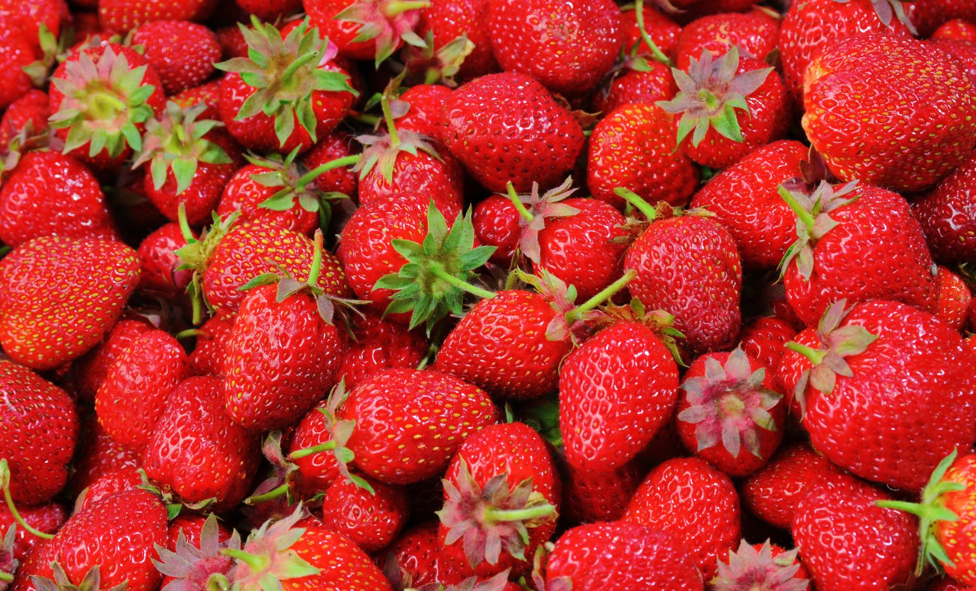
Why is this picture an example/not an example of spoiled? How do you know?
Vocabulary
is/is not an example of spoiled because .
spoiled
not spoiled
Notes:
Junior - I do

Slide 75
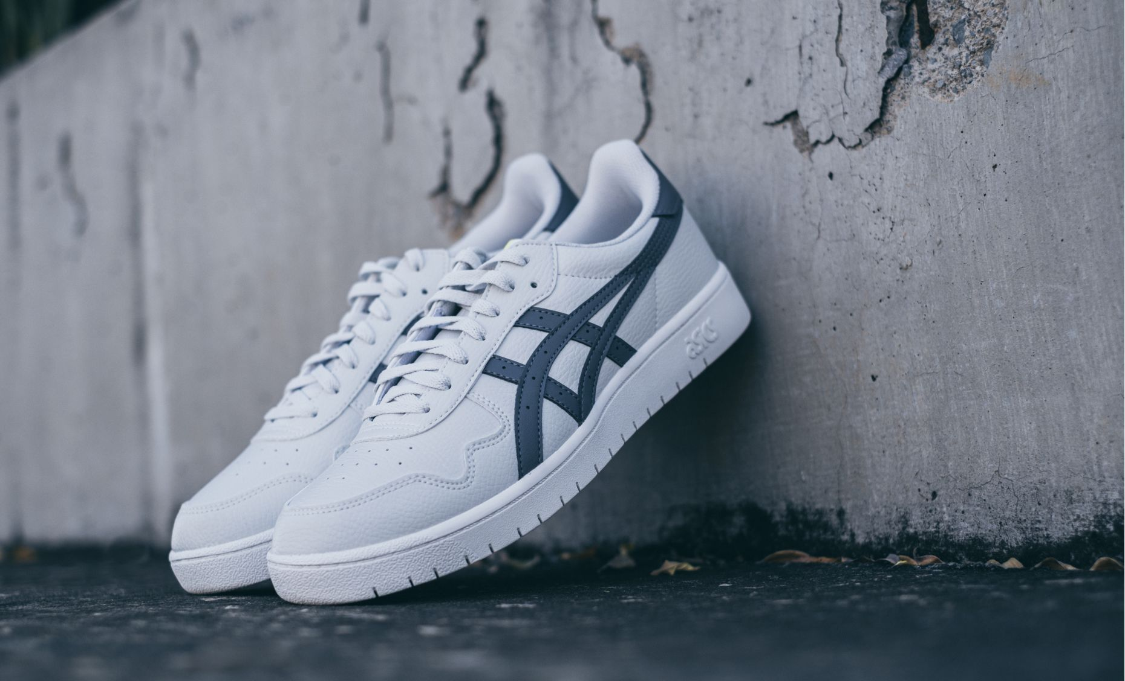
Why is this picture an example/not an example of spoiled? How do you know?
Vocabulary
is/is not an example of spoiled because .
Example or Non-Example?
Notes:
Junior – We Do

Slide 76
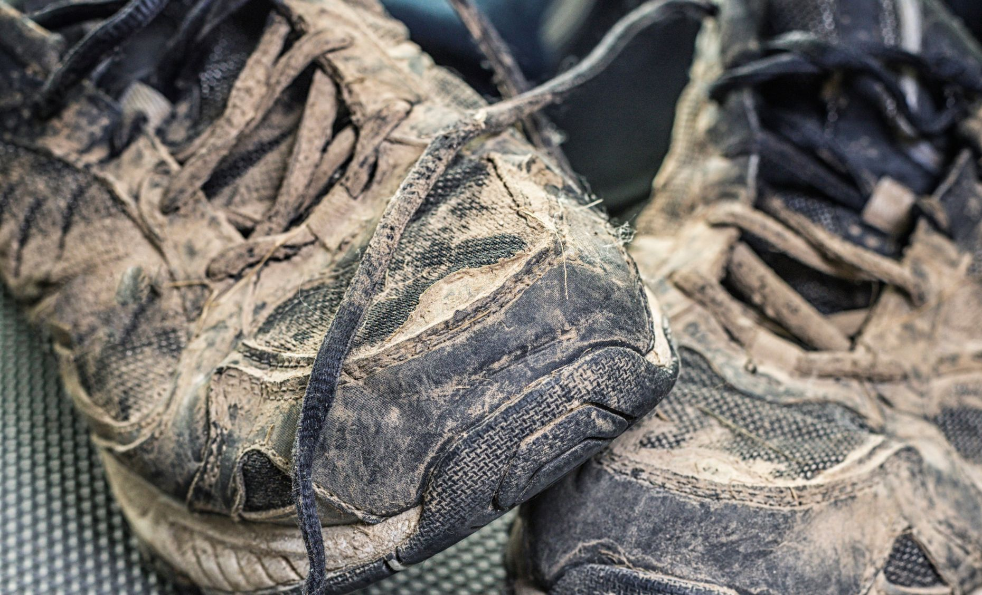
Why is this picture an example/not an example of spoiled? How do you know?
Vocabulary
is/is not an example of spoiled because .
Example or Non-Example?
Notes:
Junior – We Do

Slide 77
Track with me
Vocabulary
Read with me
sentence:
Read to your partner
The teddy bear got spoiled in the rain.
Notes:
*vocab word in red
simple

Slide 78
Track with me
Vocabulary
Read with me
sentence:
Read to your partner
The cat knocked over the milk, and the boy’s cookies were spoiled.
Notes:
*vocab word in red
compound

Slide 79
Track with me
Vocabulary
Read with me
sentence:
Read to your partner
Even though the birthday cake was spoiled when it was dropped, the children still had a fun party.
Notes:
*vocab word in red
complex

Slide 80
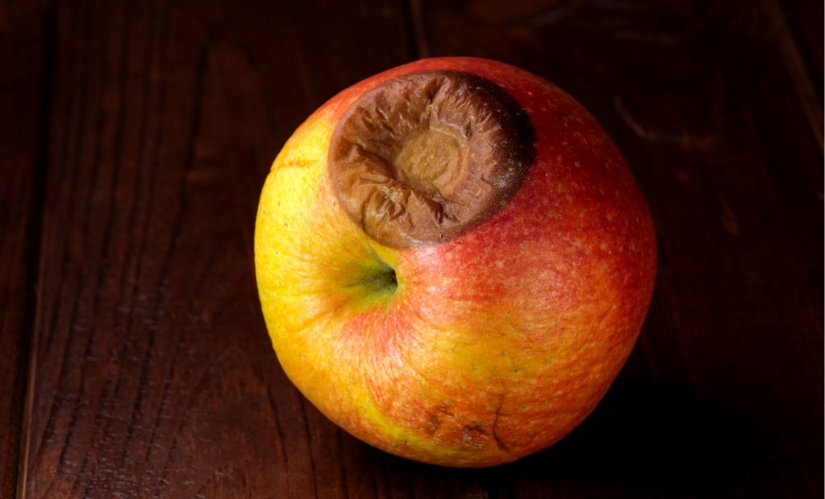
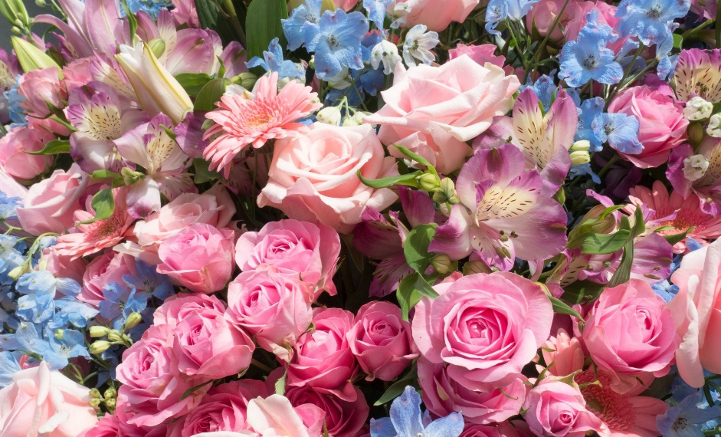
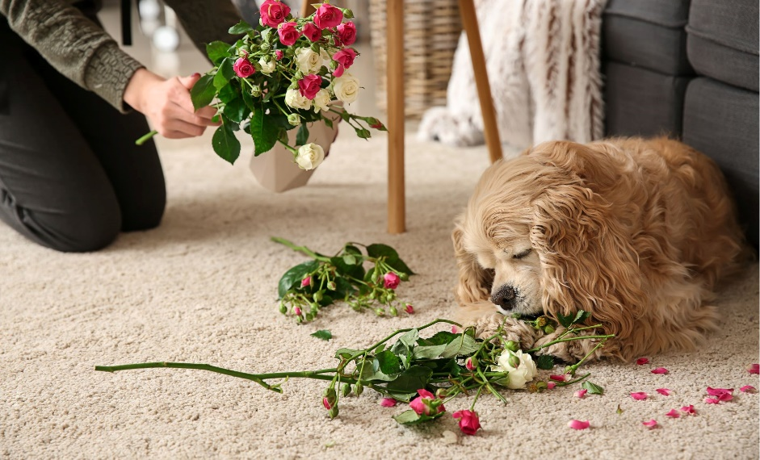
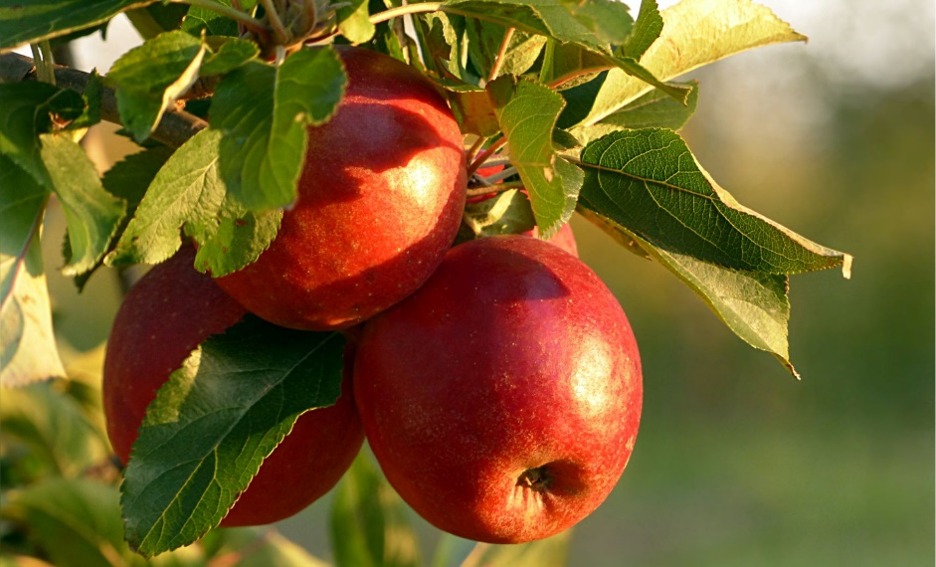
Why is this picture an example/not an example of spoiled? How do you know?
Vocabulary
Insert image
Insert image
is/is not an example of spoiled because .
A
B
Insert image
Insert image
C
D
Notes:
Senior You do

Slide 81
Tell your partner a sentence with the word spoiled.
Vocabulary Review
spoiled
Spoiled means ruined.
Notes:
Junior Review Slide for Daily Review

Slide 82
Read Passage
Discuss and Read Question
Teacher and students read together.
APK
Can you think of any other stories you have heard that have a lesson in them?
Where Are We?
The story of has a lesson.
The story of the Boy Who Cried Wolf has a lesson.
Greece is here
Today we are we going to be listening to a story from Greece. Greece is a country in Europe. Many years ago, this story was made up and told aloud to teach the listeners a lesson.
We live here in Australia
Notes:
Prompt students to find where we live. Help them to find Greece.

Slide 83
I can describe that kings and queens usually have gold or other treasures.
Teacher and students read together.
TODAY’S LEARNING OBJECTIVE

Slide 84
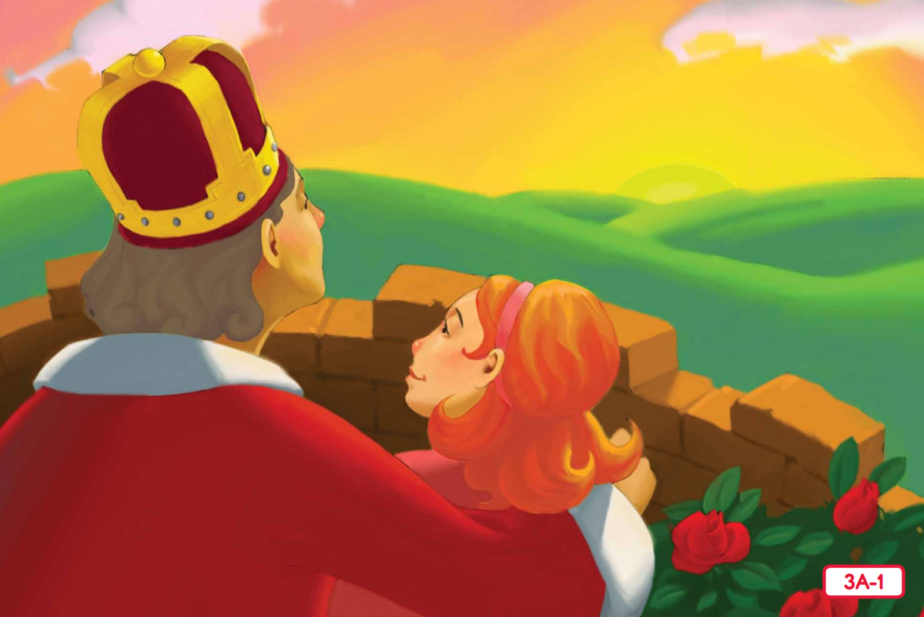
Read Vocabulary
Read Passage
Discuss and Read Question
Teacher and students read together.
Body
King Midas and the Golden Touch
What were the two things that King Midas loved most in the world?
King Midas loved .
King Midas loved gold and his daughter, Marygold
Vocabulary
fond (adjective) having a strong liking
gazed (verb) looked at something for a period of time
Notes:
Read from Kings and Queens Read-Aloud Anthology 3: King Midas and the Golden Touch Page 33

Slide 85
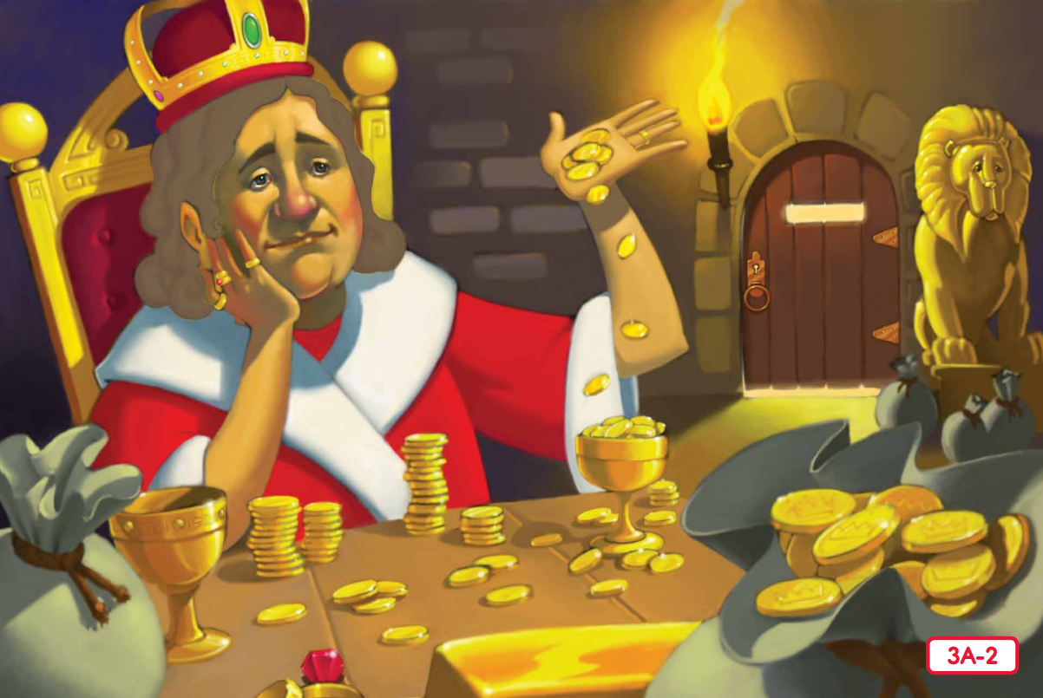
Read Vocabulary
Read Passage
Discuss and Read Question
Teacher and students read together.
Body
What did King Midas have but always want more of?
King Midas had lots of gold or treasures, but he always wanted more.
King Midas had lots of , but he always wanted more.
Vocabulary
treasures (noun) things that are valuable because they cost a lot or because they have a special meaning for someone
Notes:
Read from Kings and Queens Read-Aloud Anthology 3: King Midas and the Golden Touch Page 33

Slide 86
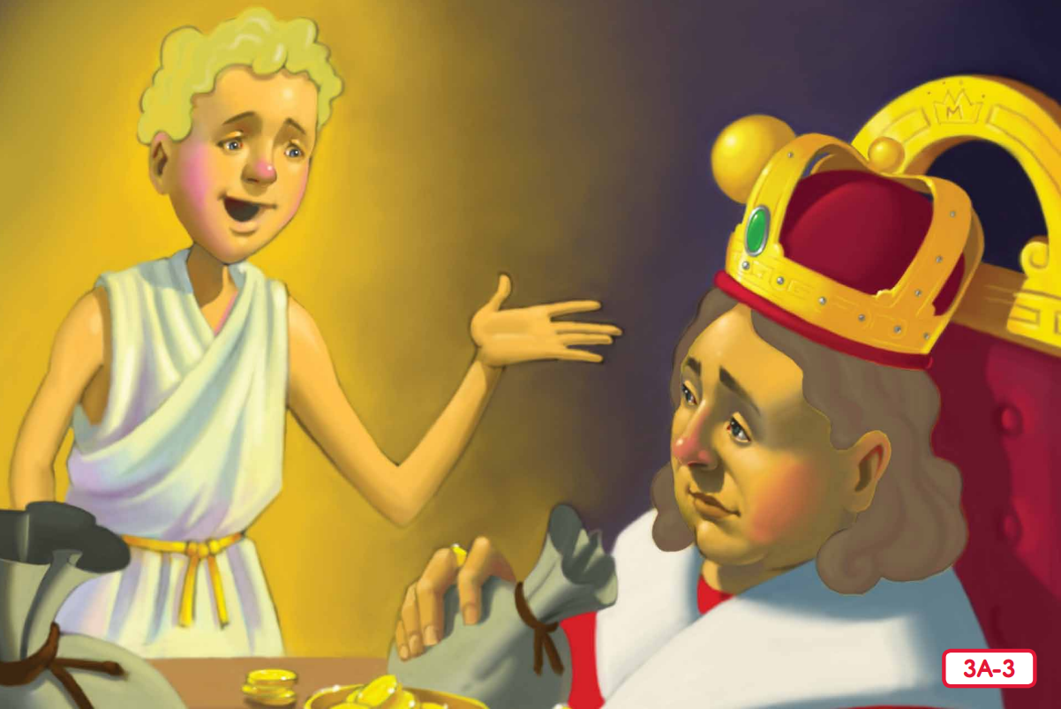
Read Vocabulary
Read Passage
Discuss and Read Question
Teacher and students read together.
Body
Why did King Midas wish that everything he touched would turn to gold?
King Midas wished that everything he touched would turn to gold because he loved gold more than anything.
King Midas wished that everything he touched would turn to gold because .
Vocabulary
satisfied (adjective) happy, pleased or content
Notes:
Read from Kings and Queens Read-Aloud Anthology 3: King Midas and the Golden Touch Page 33

Slide 87
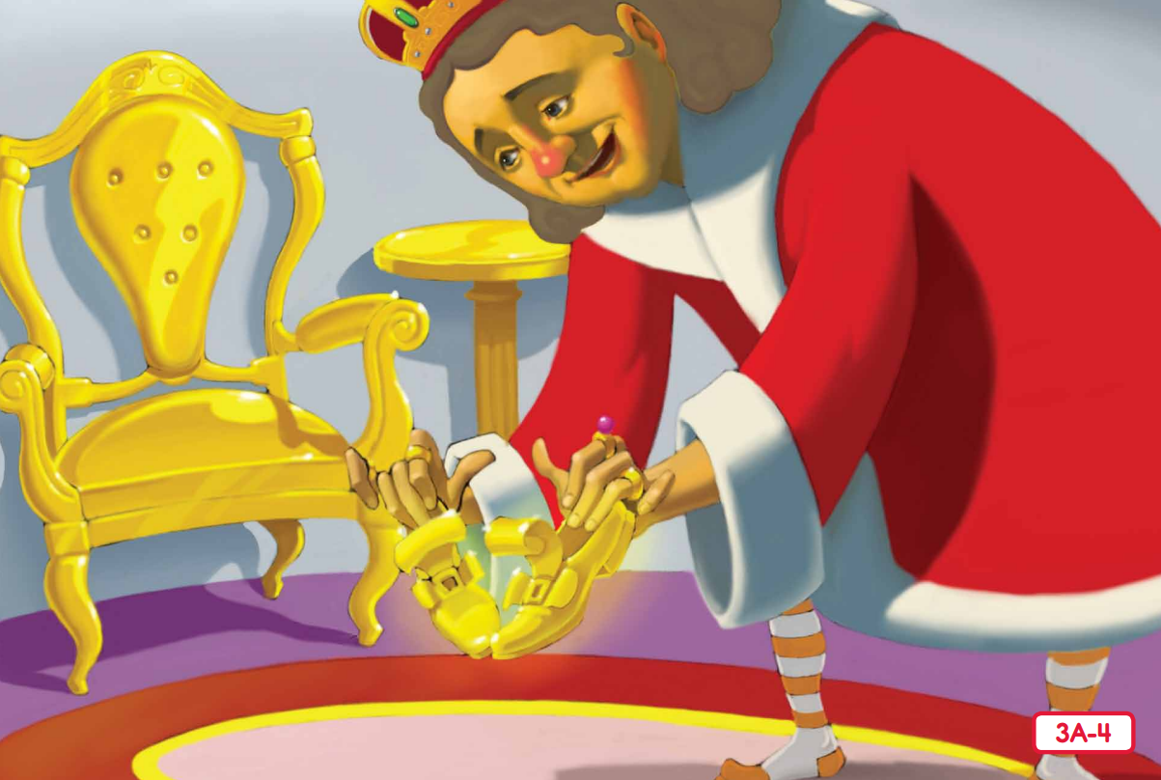
Read Vocabulary
Read Passage
Discuss and Read Question
Teacher and students read together.
Body
What were some things that King Midas turned to gold?
King Midas turned ________, _________ and _______ to gold.
King Midas turned a chair, a table and his shoes to gold.
Notes:
Read from Kings and Queens Read-Aloud Anthology 3: King Midas and the Golden Touch Page 34

Slide 88
Pair share and discuss
Lesson Closure
Ask question
Discuss answers
Our Big Question:
Are kings and queens likely to have treasures?
Yes, kings and queens are likely to have treasures. They have the best of everything. They may have gold, jewels, crowns and expensive things.
INITIATING QUERIES
FOLLOW-UP QUERIES
SUMMARISING
PREDICTING
Notes:
Learning Objective: I can describe that kings and queens usually have gold or other treasures.
INITIATING QUERIES
What have we discussed today?
What was this all about?
What do we know so far?
FOLLOW-UP QUERIES
How does this relate to what we have learnt before?
SUMMARISING
What kinds of treasures did the king in the story have?
PREDICTING
What do you will happen next in the story?

Slide 89
In your workbook
Activity
Expand simple sentences by adding when and where
Answer the questions in note form
Use the notes to say the sentence, in this order:
When, who/what (did) what where.
3. Write your sentence using correct punctuation.
When, who/what (did) what where.
4. Read your sentence – does it sound right?
The king felt the gold.
When:
Where:
In the morning,
in the basement
In the morning, the king felt the gold in the basement.

Slide 90
In your workbook
Activity
Expand simple sentences by adding when and where
Answer the questions in note form
Use the notes to say the sentence, in this order:
When, who/what (did) what where.
3. Write your sentence using correct punctuation.
When, who/what (did) what where.
4. Read your sentence – does it sound right?
The king felt the gold.
When:
Where:
, the king felt the gold .

Slide 91
Lesson 6
King Midas and the Golden Touch Part 2
The Big Question: What are some differences between valuing people or valuing money?

Slide 92
Vocabulary
fond

Slide 93
Track with me
Vocabulary
Read with me
Choral Reversal
definition:
Read to your partner
Fond means to have a strong liking.

Slide 94
Why is this picture an example/not an example of fond? How do you know?
Vocabulary
is/is not an example of fond because .
fond
not fond
Notes:
Junior - I do

Slide 95
Why is this picture an example/not an example of fond? How do you know?
Vocabulary
is/is not an example of fond because .
Example or Non-Example?
Notes:
Junior – We Do

Slide 96
Why is this picture an example/not an example of fond? How do you know?
Vocabulary
is/is not an example of fond because .
Example or Non-Example?
Notes:
Junior – We Do

Slide 97
Track with me
Vocabulary
Read with me
sentence:
Read to your partner
Sam was fond of his puppy.
Notes:
*vocab word in red
simple

Slide 98
Track with me
Vocabulary
Read with me
sentence:
Read to your partner
The king was very fond of pie, for it was tasty.
Notes:
*vocab word in red
compound

Slide 99
Track with me
Vocabulary
Read with me
sentence:
Read to your partner
If Bess is fond of her doll, she will play with it often.
Notes:
*vocab word in red
complex

Slide 100
Why is this picture an example/not an example of fond? How do you know?
Vocabulary
Insert image
Insert image
is/is not an example of fond because .
A
B
Insert image
Insert image
C
D
Notes:
Senior You do

Slide 101
Tell your partner a sentence with the word fond.
Vocabulary Review
fond
Fond means to have a strong liking.
Notes:
Junior Review Slide for Daily Review

Slide 102
Read Passage
Discuss and Read Question
Teacher and students read together.
APK
How did King Midas feel when he turned his things to gold?
King Midas felt .
King Midas felt happy and excited.
King Midas and the Golden Touch
King Midas was a very rich king who had a daughter, Marygold. King Midas loved gold and treasures so much that he was not happy with what he had, he wanted more. A stranger appeared an offered to grant him a wish. King Midas wished that everything he touched would turn to gold. When he woke up the next day, he turned some things in his room to gold by touching them.

Slide 103
I can discuss the difference between valuing people or valuing money.
Teacher and students read together.
TODAY’S LEARNING OBJECTIVE

Slide 104
Read Vocabulary
Read Passage
Discuss and Read Question
Teacher and students read together.
Body
Why couldn’t King Midas eat his breakfast?
King Midas couldn’t eat his breakfast because .
King Midas couldn’t eat his breakfast because it turned to gold, and people can’t eat gold.
Notes:
Read from Kings and Queens Read-Aloud Anthology 3: King Midas and the Golden Touch Page 34

Slide 105
Read Vocabulary
Read Passage
Discuss and Read Question
Teacher and students read together.
Body
Why is Marygold upset?
Marygold is upset because .
Marygold is upset because she liked her flowers the way they were before they were turned to gold.
Vocabulary
spoiled (adjective) ruined
Notes:
Read from Kings and Queens Read-Aloud Anthology 3: King Midas and the Golden Touch Page 35

Slide 106
Read Vocabulary
Read Passage
Discuss and Read Question
Teacher and students read together.
Body
Would King Midas rather hug his daughter or gold?
King Midas would rather hug .
King Midas would rather hug his daughter.
Notes:
Read from Kings and Queens Read-Aloud Anthology 3: King Midas and the Golden Touch Page 35

Slide 107
Read Vocabulary
Read Passage
Discuss and Read Question
Teacher and students read together.
Body
Did how King Midas felt about his Golden Touch change after he turned Marygold into a statue?
How King Midas felt about his Golden Touch .
How King Midas felt about his Golden Touch changed after he turned Marygold into his statue. He wasn’t excited or happy about it anymore.
Notes:
Read from Kings and Queens Read-Aloud Anthology 3: King Midas and the Golden Touch Page 35

Slide 108
Read Vocabulary
Read Passage
Discuss and Read Question
Teacher and students read together.
Body
Do you think that King Midas made a wise or foolish choice when he told the stranger that he wanted the Golden Touch?
King Midas made a choice.
King Midas made a foolish choice.
Notes:
Read from Kings and Queens Read-Aloud Anthology 3: King Midas and the Golden Touch Page 36
Discuss why King Midas’ choice was wise or foolish.

Slide 109
Pair share and discuss
Lesson Closure
Ask question
Discuss answers
Our Big Question:
What are some differences between valuing people or valuing money?
When you value gold, you want more and more. You can have it and use it to buy things. It can’t keep you company or talk to you. When you value people, you care about your family and friends. You can be happy by making the people you care about happy.
INITIATING QUERIES
FOLLOW-UP QUERIES
SUMMARISING
PREDICTING
Notes:
Learning Objective: I can discuss the difference between valuing people and valuing money.
INITIATING QUERIES
What have we discussed today?
What was this all about?
What do we know so far?
FOLLOW-UP QUERIES
How does this relate to what we have learnt before?
SUMMARISING
What did King Midas value at the beginning of the story? What did he value at the end?
PREDICTING
What do you think we will be learning about next lesson?

Slide 110
In your workbook
Activity
Expand simple sentences by adding when and where
Answer the questions in note form
Use the notes to say the sentence, in this order:
When, who/what (did) what where.
3. Write your sentence using correct punctuation.
When, who/what (did) what where.
4. Read your sentence – does it sound right?
Marygold cried.
When:
Where:
At breakfast time,
in the dining room
At breakfast time, Marygold cried in the dining room.

Slide 111
In your workbook
Activity
Expand simple sentences by adding when and where
Answer the questions in note form
Use the notes to say the sentence, in this order:
When, who/what (did) what where.
3. Write your sentence using correct punctuation.
When, who/what (did) what where.
4. Read your sentence – does it sound right?
Marygold cried.
When:
Where:
, Marygold cried .

Slide 112
Lesson 7
Old King Cole Part 1
The Big Question: What kinds of behaviours show that kings and queens are royal?

Slide 113
Vocabulary
satisfied

Slide 114
Track with me
Vocabulary
Read with me
Choral Reversal
definition:
Read to your partner
Satisfied means happy, pleased, or content.

Slide 115
Why is this picture an example/not an example of satisfied? How do you know?
Vocabulary
is/is not an example of satisfied because .
satisfied
not satisfied
Notes:
Junior - I do

Slide 116
Why is this picture an example/not an example of satisfied? How do you know?
Vocabulary
is/is not an example of satisfied because .
Example or Non-Example?
Notes:
Junior – We Do

Slide 117
Why is this picture an example/not an example of satisfied? How do you know?
Vocabulary
is/is not an example of satisfied because .
Example or Non-Example?
Notes:
Junior – We Do

Slide 118
Track with me
Vocabulary
Read with me
sentence:
Read to your partner
Kim was satisfied with her dinner.
Notes:
*vocab word in red
simple

Slide 119
Track with me
Vocabulary
Read with me
sentence:
Read to your partner
The teacher was not satisfied with the work, so the student had to try again.
Notes:
*vocab word in red
compound

Slide 120
Track with me
Vocabulary
Read with me
sentence:
Read to your partner
After Matt played on the oval, he felt satisfied.
Notes:
*vocab word in red
complex

Slide 121
Why is this picture an example/not an example of satisfied? How do you know?
Vocabulary
Insert image
Insert image
is/is not an example of satisfied because .
A
B
Insert image
Insert image
C
D
Notes:
Senior You do

Slide 122
Tell your partner a sentence with the word satisfied.
Vocabulary Review
satisfied
Satisfied means happy, pleased, or content.
Notes:
Junior Review Slide for Daily Review

Slide 123
Read Passage
Discuss and Read Question
Teacher and students read together.
APK
What is one advantage and disadvantage of being a king or queen?
One advantages is having a lot of money, and one disadvantage is having a lot of important decisions to make.
One advantages is , and one disadvantage is .
Kings and Queens
Kings and queens wore crowns and lived in palaces. They had the best of everything, but also had a lot of responsibility. The children of kings and queen are called princes and princess. The oldest son is called the crown prince, and he will be the next king. The members of the royal family were the most powerful people in the kingdom.

Slide 124
I can describe the behaviours that show that kings and queens are royal.
Teacher and students read together.
TODAY’S LEARNING OBJECTIVE

Slide 125
Read Vocabulary
Read Passage
Discuss and Read Question
Teacher and students read together.
Body
What is the name of the main character in the rhyme?
The name of the main character in the rhyme is .
The name of the main character in the rhyme is King Cole.
Vocabulary
bowl (noun) a large cup or goblet used for drinking
fiddlers (noun) people who play stringed musical instruments like the violin
merry (adjective) happy
soul (noun) person
Notes:
Read from Kings and Queens Read-Aloud Anthology 4: Old King Cole Page 45
First read through – show picture and read aloud to students

Slide 126
Read Vocabulary
Read Passage
Discuss and Read Question
Teacher and students read together.
Body
What three things did Old King Cole ask for?
Old King Cole
Old King Cole was a merry old soul,
And a merry old soul was he;
He called for his pipe, and he called for his bowl,
And he called for his fiddlers three.
Old King Cole asked for , and .
Old King Cole asked for his pipe, his bowl and his fiddlers.
Vocabulary
bowl (noun) a large cup or goblet used for drinking
fiddlers (noun) people who play stringed musical instruments like the violin
merry (adjective) happy
soul (noun) person
Notes:
Read from Kings and Queens Read-Aloud Anthology 4: Old King Cole
Second read through – Show text and read together

Slide 127
Read Vocabulary
Read Passage
Discuss and Read Question
Teacher and students read together.
Body
Did the fiddlers have good fiddles or bad fiddles?
The fiddlers had good fiddles, because fine is another way of saying very good.
Every fiddler had a very fine fiddle,
And a very fine fiddle had he.
Oh, there’s none so rare as can compare
With King Cole and his fiddlers three.
The fiddlers had fiddles, because .
Vocabulary
bowl (noun) a large cup or goblet used for drinking
fiddlers (noun) people who play stringed musical instruments like the violin
merry (adjective) happy
soul (noun) person
Notes:
Read from Kings and Queens Read-Aloud Anthology 4: Old King Cole
Second read through – Show text and read together

Slide 128
Reading Fluency Passage
Old King Cole
Old King Cole was a merry old soul,
And a merry old soul was he;
He called for his pipe, and he called for his bowl,
And he called for his fiddlers three.
Every fiddler had a very fine fiddle,
And a very fine fiddle had he.
Oh, there’s none so rare as can compare
With King Cole and his fiddlers three.
Notes:
Reading Fluency Passage for Daily Review

Slide 129
Pair share and discuss
Lesson Closure
Ask question
Discuss answers
Our Big Question:
What kinds of behaviours show that kings and queens are royal?
Sitting on a throne and wearing a crown show that you are royal. Ordering people around and getting the best of everything shows that you are a king or queen.
Notes:
Learning Objective: I can describe the behaviours that show that kings and queens are royal
INITIATING QUERIES
What does Old King Cole do in the story that shows that he is a king?
What was this all about?
What do we know so far?
FOLLOW-UP QUERIES
How does this relate to what we have learnt before?
SUMMARISING
What happened in the rhyme?
PREDICTING
What do you think we will be learning about next lesson?

Slide 130
In your workbook
Activity
Expand simple sentences by adding when and where
Answer the questions in note form
Use the notes to say the sentence, in this order:
When, who/what (did) what where.
3. Write your sentence using correct punctuation.
When, who/what (did) what where.
4. Read your sentence – does it sound right?
King Cole sat.
When:
Where:
In the afternoon,
on his throne.
In the afternoon, King Cole sat on his throne.

Slide 131
In your workbook
Activity
Expand simple sentences by adding when and where
Answer the questions in note form
Use the notes to say the sentence, in this order:
When, who/what (did) what where.
3. Write your sentence using correct punctuation.
When, who/what (did) what where.
4. Read your sentence – does it sound right?
King Cole sat.
When:
Where:
, King Cole sat .

Slide 132
Lesson 8
Old King Cole Part 2
The Big Question: What are the words for the nursery rhyme Old King Cole?

Slide 133
Vocabulary
merry

Slide 134
Track with me
Vocabulary
Read with me
Choral Reversal
definition:
Read to your partner
Merry means happy.

Slide 135
Why is this picture an example/not an example of merry? How do you know?
Vocabulary
is/is not an example of merry because .
merry
not merry
Notes:
Junior - I do

Slide 136
Why is this picture an example/not an example of merry? How do you know?
Vocabulary
is/is not an example of merry because .
Example or Non-Example?
Notes:
Junior – We Do

Slide 137
Why is this picture an example/not an example of merry? How do you know?
Vocabulary
is/is not an example of merry because .
Example or Non-Example?
Notes:
Junior – We Do

Slide 138
Track with me
Vocabulary
Read with me
sentence:
Read to your partner
Santa gave a merry chuckle.
Notes:
*vocab word in red
simple

Slide 139
Track with me
Vocabulary
Read with me
sentence:
Read to your partner
Pam was feeling merry, and she smiled.
Notes:
*vocab word in red
compound

Slide 140
Track with me
Vocabulary
Read with me
sentence:
Read to your partner
When he felt merry, Ben sang a song.
Notes:
*vocab word in red
complex

Slide 141
Why is this picture an example/not an example of merry? How do you know?
Vocabulary
Insert image
Insert image
is/is not an example of merry because .
A
B
Insert image
Insert image
C
D
Notes:
Senior You do

Slide 142
Tell your partner a sentence with the word merry.
Vocabulary Review
merry
Merry means happy.
Notes:
Junior Review Slide for Daily Review

Slide 143
Read Passage
Discuss and Read Question
Teacher and students read together.
APK
How could you tell if someone was a king or queen in a picture or story?
I could tell that someone was a king or queen because
they live in a castle
they are wearing a crown
they have servants
they have a lot of treasures
they are sitting on a throne
I could tell that someone was a king or queen because .
How kings and queens behave
Kings and queens have a lot of money and power. They have people who work in their houses called servants. When they ask for something, they get it right away. They live in big houses called palaces, sit on decorated chairs called thrones and wear fancy hats called crowns.

Slide 144
I can recite Old King Cole.
Teacher and students read together.
TODAY’S LEARNING OBJECTIVE

Slide 145
Read Vocabulary
Read Passage
Discuss and Read Question
Teacher and students read together.
Body
Was King Cole a happy king or a sad king? How do you know?
Old King Cole
Old King Cole was a merry old soul,
And a merry old soul was he;
He called for his pipe, and he called for his bowl,
And he called for his fiddlers three.
Every fiddler had a very fine fiddle,
And a very fine fiddle had he.
Oh, there’s none so rare as can compare
With King Cole and his fiddlers three.
King Cole was a king because .
King Cole was a happy king because merry means happy.
Vocabulary
bowl (noun) a large cup or goblet used for drinking
fiddlers (noun) people who play stringed musical instruments like the violin
merry (adjective) happy
soul (noun) person
Notes:
Read with students.

Slide 146
Read Vocabulary
Read Passage
Discuss and Read Question
Teacher and students read together.
Body
What does bowl mean in this rhyme?
Old King Cole
Old King Cole was a merry old soul,
And a merry old soul was he;
He called for his pipe, and he called for his bowl,
And he called for his fiddlers three.
Bowl means .
Bowl means a large cup.
Vocabulary
bowl (noun) a large cup or goblet used for drinking
fiddlers (noun) people who play stringed musical instruments like the violin
merry (adjective) happy
soul (noun) person
Notes:
Read with students.

Slide 147
Read Vocabulary
Read Passage
Discuss and Read Question
Teacher and students read together.
Body
How do you think the fiddlers felt playing for the king?
The fiddlers might have felt .
Every fiddler had a very fine fiddle,
And a very fine fiddle had he.
Oh, there’s none so rare as can compare
With King Cole and his fiddlers three.
The fiddlers might have felt
lucky
grateful
excited
happy
Vocabulary
bowl (noun) a large cup or goblet used for drinking
fiddlers (noun) people who play stringed musical instruments like the violin
merry (adjective) happy
soul (noun) person
Notes:
Read with students.

Slide 148
Reading Fluency Passage
Old King Cole
Old King Cole was a merry old soul,
And a merry old soul was he;
He called for his pipe, and he called for his bowl,
And he called for his fiddlers three.
Every fiddler had a very fine fiddle,
And a very fine fiddle had he.
Oh, there’s none so rare as can compare
With King Cole and his fiddlers three.
Notes:
Reading Fluency Passage for Daily Review

Slide 149
Pair share and discuss
Lesson Closure
Ask question
Discuss answers
Our Big Question:
What are they words for the nursery rhyme Old King Cole?
Old King Cole was a merry old soul,
And a merry old soul was he;
He called for his pipe, and he called for his bowl,
And he called for his fiddlers three.
Every fiddler had a very fine fiddle,
And a very fine fiddle had he.
Oh, there’s none so rare as can compare
With King Cole and his fiddlers three.
INITIATING QUERIES
FOLLOW-UP QUERIES
SUMMARISING
PREDICTING
Notes:
Learning Objective: I can recite Old King Cole.
INITIATING QUERIES
What have we discussed today?
What was this all about?
What do we know so far?
FOLLOW-UP QUERIES
How does this relate to what we have learnt before?
SUMMARISING
What is the story in Old King Cole?
PREDICTING
What do you think we will be learning about next lesson?

Slide 150
In your workbook
Activity
Expand simple sentences by adding when and where
Answer the questions in note form
Use the notes to say the sentence, in this order:
When, who/what (did) what where.
3. Write your sentence using correct punctuation.
When, who/what (did) what where.
4. Read your sentence – does it sound right?
The fiddlers play.
When:
Where:
At night,
in the palace
At night, the fiddlers play in the palace.

Slide 151
In your workbook
Activity
Expand simple sentences by adding when and where
Answer the questions in note form
Use the notes to say the sentence, in this order:
When, who/what (did) what where.
3. Write your sentence using correct punctuation.
When, who/what (did) what where.
4. Read your sentence – does it sound right?
The fiddlers play.
When:
Where:
, the fiddlers play .

Slide 152
Lesson 9
Pause Point
What have we learnt so far?
The Big Question:
What have we learnt about kings and queens so far?

Slide 153
Tell your partner a sentence with the word servants.
Vocabulary Review
Insert image
servants
Servants are people who are paid to work for a king or queen.
Notes:
Junior Review Slide for Daily Review

Slide 154
Tell your partner a sentence with the word royal.
Vocabulary Review
Insert image
royal
Royal is anything belonging to a king or queen.
Notes:
Junior Review Slide for Daily Review

Slide 155
Tell your partner a sentence with the word reign.
Vocabulary Review
1952 – 2022: The Reign of Queen Elizabeth II
reign
A reign is the period of time when a king or queen ruled.
Notes:
Junior Review Slide for Daily Review

Slide 156
Tell your partner a sentence with the word prosperity.
Vocabulary Review
prosperity
Prosperity means having a lot of money, success, or good luck.
Notes:
Junior Review Slide for Daily Review

Slide 157
Tell your partner a sentence with the word spoiled.
Vocabulary Review
spoiled
Spoiled means ruined.
Notes:
Junior Review Slide for Daily Review

Slide 158
Tell your partner a sentence with the word fond.
Vocabulary Review
fond
Fond means to have a strong liking.
Notes:
Junior Review Slide for Daily Review

Slide 159
Tell your partner a sentence with the word satisfied.
Vocabulary Review
satisfied
Satisfied means happy, pleased, or content.
Notes:
Junior Review Slide for Daily Review

Slide 160
Tell your partner a sentence with the word merry.
Vocabulary Review
merry
Merry means happy.
Notes:
Junior Review Slide for Daily Review

Slide 161
I will revisit what we know so far about kings and queens.
Teacher and students read together.
TODAY’S LEARNING OBJECTIVE

Slide 162
Read Vocabulary
Read Passage
Discuss and Read Question
Teacher and students read together.
Review
What is one difference between your life and the life of a king or queen?
Kings and Queens
Kings and queens are the leaders of kingdoms. They make rules and decisions for their lands and people. They live in palaces and have servants who work for them.
Kings and queens have special objects that show that they are important. Some of these things are crowns, royal sceptres, royal orbs and swords.
My life is different from a king or queen’s because I live in a house, not a palace.
My life is different from a king or queen’s because .
Vocabulary
rules (verb) when a king or queen leads and makes decisions
kingdom (noun) a place ruled or governed by a king or queen
servants (noun) men or women who are paid to work for a king or queen
royal (adjective) anything belonging to a king or queen

Slide 163
Read Vocabulary
Read Passage
Discuss and Read Question
Teacher and students read together.
Review
What is a royal family?
A royal family is .
The Royal Family
A royal family is the family of the king and queen. The children are called princes and princess. The oldest son is called the crown prince, and he is in line to be the next king.
Princes and princesses are important in royal families. Their marriages can mean that kingdoms are friends who help each other. Princes and princess have the best of everything, but they also might not get to choose who they marry.
A royal family is the family of the king and queen.
Vocabulary
crown prince (noun) the king's oldest son who is next in line to be king

Slide 164
Read Vocabulary
Read Passage
Discuss and Read Question
Teacher and students read together.
Review
What did King Midas realise was more important than gold?
King Midas and the Golden Touch
This story is about a king who loved money and treasures. Even though he was very rich, he was not satisfied. A stranger appeared who granted him a wish; anything he touched would turn to gold. King Midas accidentally turned his daughter into a golden statue. This helped him realise that there were more important things than gold. With the help of the stranger, he reversed the spell on his daughter.
King Midas realised that was more important than gold.
King Midas realised that his daughter was more important than gold.
Vocabulary
treasures (noun) things that are valuable because they cost a lot or because they have a special meaning for someone
satisfied (adjective) happy, pleased or content

Slide 165
Read Vocabulary
Read Passage
Discuss and Read Question
Teacher and students read together.
Review
Was King Cole a happy king or a sad king? How do you know?
Old King Cole
Old King Cole was a merry old soul,
And a merry old soul was he;
He called for his pipe, and he called for his bowl,
And he called for his fiddlers three.
Every fiddler had a very fine fiddle,
And a very fine fiddle had he.
Oh, there’s none so rare as can compare
With King Cole and his fiddlers three.
King Cole was a king because .
King Cole was a happy king because merry means happy.
Vocabulary
bowl (noun) a large cup or goblet used for drinking
fiddlers (noun) people who play stringed musical instruments like the violin
merry (adjective) happy
soul (noun) person

Slide 166
Pair share and discuss
Lesson Closure
Ask question
Discuss answers
Our Big Question:
What have we learned about kings and queens so far?
We have learned about what kings and queens do and their royal families. We have studied the story of King Midas and his Golden Touch. We have recited the rhyme Old King Cole.
Notes:
Learning Objective: I can review what I have learned about kings and queens.

Slide 167
In your workbook
Activity
Expand simple sentences by adding when and where
Answer the questions in note form
Use the notes to say the sentence, in this order:
When, who/what (did) what where.
3. Write your sentence using correct punctuation.
When, who/what (did) what where.
4. Read your sentence – does it sound right?
The king rode.
When:
Where:
At sunset,
on the hill
At sunset, the king rode on the hill.

Slide 168
In your workbook
Activity
Expand simple sentences by adding when and where
Answer the questions in note form
Use the notes to say the sentence, in this order:
When, who/what (did) what where.
3. Write your sentence using correct punctuation.
When, who/what (did) what where.
4. Read your sentence – does it sound right?
The king rode.
When:
Where:
, the king rode .

Slide 169
Lesson 10
Sing a Song of Sixpence Part 1
The Big Question: What are some details from Sing a Song of Sixpence?

Slide 170
Vocabulary
dainty

Slide 171
Track with me
Vocabulary
Read with me
Choral Reversal
definition:
Read to your partner
Dainty means fancy, small, and pretty.

Slide 172
Why is this picture an example/not an example of dainty? How do you know?
Vocabulary
is/is not an example of dainty because .
dainty
not dainty
Notes:
Junior - I do

Slide 173
Why is this picture an example/not an example of dainty? How do you know?
Vocabulary
is/is not an example of dainty because .
Example or Non-Example?
Notes:
Junior – We Do

Slide 174
Why is this picture an example/not an example of dainty? How do you know?
Vocabulary
is/is not an example of dainty because .
Example or Non-Example?
Notes:
Junior – We Do

Slide 175
Track with me
Vocabulary
Read with me
sentence:
Read to your partner
The little blue flower was dainty.
Notes:
*vocab word in red
simple

Slide 176
Track with me
Vocabulary
Read with me
sentence:
Read to your partner
The spider web is dainty, but it is very strong.
Notes:
*vocab word in red
compound

Slide 177
Track with me
Vocabulary
Read with me
sentence:
Read to your partner
After the dainty fairy landed on the grass, she waved her wand.
Notes:
*vocab word in red
complex

Slide 178
Why is this picture an example/not an example of dainty? How do you know?
Vocabulary
Insert image
Insert image
is/is not an example of dainty because .
A
B
Insert image
Insert image
C
D
Notes:
Senior You do

Slide 179
Tell your partner a sentence with the word dainty.
Vocabulary Review
dainty
Dainty means fancy, small, and pretty.
Notes:
Junior Review Slide for Daily Review

Slide 180
Read Passage
Discuss and Read Question
Teacher and students read together.
APK
What things might be different in England than in Australia?
Where Are We?
England has different than Australia.
England has different weather, wildlife, landscape and people than Australia.
England is here
Today we are we going to be learning a new nursery rhyme. It is from the country of England.
We live here in Australia
Notes:
Prompt students to find where we live. Help them to find England.

Slide 181
I can recall details from Sing a Song of Sixpence.
Teacher and students read together.
TODAY’S LEARNING OBJECTIVE

Slide 182
Read Vocabulary
Read Passage
Discuss and Read Question
Teacher and students read together.
Body
How can we tell the man in the picture is a king?
We can tell he is a king because .
We can tell he is a king because he is wearing a crown and sitting on a throne.
Vocabulary
dainty (adjective) fancy, small, and pretty
Notes:
Read from Kings and Queens Read-Aloud Anthology 5: Sing a Song of Sixpence Page 53
First read through – show pictures and read aloud to students

Slide 183
Read Vocabulary
Read Passage
Discuss and Read Question
Teacher and students read together.
Body
Who are the characters in the story so far?
The characters are .
The characters are the king and queen.
Notes:
Read from Kings and Queens Read-Aloud Anthology 5: Sing a Song of Sixpence Page 53
First read through – show pictures and read aloud to students

Slide 184
Read Vocabulary
Read Passage
Discuss and Read Question
Teacher and students read together.
Body
What was the maid doing in the garden?
The maid was .
The maid was hanging out the clothes.
Vocabulary
maid (noun) a person who cleans the inside of a house
pecked (verb) bitten, struck, or poked by a bird’s beak
Notes:
Read from Kings and Queens Read-Aloud Anthology 5: Sing a Song of Sixpence Page 53
First read through – show pictures and read aloud to students

Slide 185
Reading Fluency Passage
Sing a Song of Sixpence
Sing a song of sixpence,
A pocket full of rye,
Four and twenty blackbirds
Baked in a pie.
When the pie was opened,
The birds began sing;
Now wasn’t that a dainty dish
To set before the king?
The king was in his counting house
Counting out his money;
The queen was in the parlour,
Eating breading and honey.
The maid was in the garden,
Hanging out the clothes,
When down came a blackbird
And pecked at her toes!
Notes:
Reading Fluency Passage for Daily Review

Slide 186
Pair share and discuss
Lesson Closure
Ask question
Discuss answers
Our Big Question:
What are the details in Sing a Song of Sixpence?
blackbirds sang in a pie
the king counted his money
the queen ate bread and honey
a blackbird pecked the maid
INITIATING QUERIES
FOLLOW-UP QUERIES
SUMMARISING
PREDICTING
Notes:
Learning Objective: I can recall details from Sing a Song of Sixpence.
INITIATING QUERIES
What have we discussed today?
What was this all about?
What do we know so far?
FOLLOW-UP QUERIES
How does this relate to what we have learnt before?
SUMMARISING
What are the main events from the rhyme?
PREDICTING
What do you think we will be learning about next lesson?

Slide 187
In your workbook
Activity
Expand simple sentences by adding when and where
Answer the questions in note form
Use the notes to say the sentence, in this order:
When, who, what, and where.
3. Write your sentence using correct punctuation.
When, who what where.
4. Read your sentence – does it sound right?
She ate.
Who:
When:
Where:
the queen
at dawn
in the parlour
At dawn, the queen ate in the parlour.

Slide 188
In your workbook
Activity
Expand simple sentences by adding when and where
Answer the questions in note form
Use the notes to say the sentence, in this order:
When, who, what, and where.
3. Write your sentence using correct punctuation.
When, who what where.
4. Read your sentence – does it sound right?
She ate.
Who:
When:
Where:
, ate .

Slide 189
Lesson 11
Sing a Song of Sixpence Part 2
The Big Question: What are the words for the nursery rhyme Sing a Song of Sixpence?

Slide 190
Vocabulary
delicate

Slide 191
Track with me
Vocabulary
Read with me
Choral Reversal
definition:
Read to your partner
Delicate means fragile and easily broken.

Slide 192
Why is this picture an example/not an example of delicate? How do you know?
Vocabulary
is/is not an example of delicate because .
delicate
not delicate
Notes:
Junior - I do

Slide 193
Why is this picture an example/not an example of delicate? How do you know?
Vocabulary
is/is not an example of delicate because .
Example or Non-Example?
Notes:
Junior – We Do

Slide 194
Why is this picture an example/not an example of delicate? How do you know?
Vocabulary
is/is not an example of delicate because .
Example or Non-Example?
Notes:
Junior – We Do

Slide 195
Track with me
Vocabulary
Read with me
sentence:
Read to your partner
The tea cup is delicate.
Notes:
*vocab word in red
simple

Slide 196
Track with me
Vocabulary
Read with me
sentence:
Read to your partner
The necklace is delicate, so you need to be careful.
Notes:
*vocab word in red
compound

Slide 197
Track with me
Vocabulary
Read with me
sentence:
Read to your partner
After the delicate plate fell off the bench, it smashed.
Notes:
*vocab word in red
complex

Slide 198
Why is this picture an example/not an example of delicate? How do you know?
Vocabulary
Insert image
Insert image
is/is not an example of delicate because .
A
B
Insert image
Insert image
C
D
Notes:
Senior You do

Slide 199
Tell your partner a sentence with the word delicate.
Vocabulary Review
delicate
Delicate means fragile and easily broken.
Notes:
Junior Review Slide for Daily Review

Slide 200
Read Passage
Discuss and Read Question
Teacher and students read together.
APK
What can we look for in pictures to show us who is royal?
Objects Lined to Royalty
We have learned about some objects that are linked to kings, queens and the royal family. They show how important and powerful the members of the royal family are. When something is royal, it belongs to a member of the royal family.
We can look for .
We can look for crowns, royal orbs, royal sceptres, thrones and palaces.
Crown
Royal sceptre
Throne
Royal orb
Sword
Palace

Slide 201
I can recite Sing a Song of Sixpence.
Teacher and students read together.
TODAY’S LEARNING OBJECTIVE

Slide 202
Read Vocabulary
Read Passage
Discuss and Read Question
Teacher and students read together.
Body
What is special about the pie in the rhyme?
Sing a Song of Sixpence
Sing a song of sixpence,
A pocket full of rye,
Four and twenty blackbirds
Baked in a pie.
When the pie was opened,
The birds began sing;
Now wasn’t that a dainty dish
To set before the king?
The pie is special because .
The pie is special because it has blackbirds inside it that sing.
Vocabulary
dainty (adjective) fancy, small, and pretty
Notes:
Read with students.

Slide 203
Read Vocabulary
Read Passage
Discuss and Read Question
Teacher and students read together.
Body
What are the king and queen doing in the story?
The king is counting money, and the queen is eating bread and honey.
The king is , and the queen is .
The king was in his counting house
Counting out his money;
The queen was in the parlour,
Eating breading and honey.
Notes:
Read with students.

Slide 204
Read Vocabulary
Read Passage
Discuss and Read Question
Teacher and students read together.
Body
How might the maid have felt when the blackbird pecked her?
The maid might have felt scared, annoyed, angry or upset.
The maid was in the garden,
Hanging out the clothes,
When down came a blackbird
And pecked at her toes!
The maid might have felt .
Vocabulary
maid (noun) a person who cleans the inside of a house
pecked (verb) bitten, struck, or poked by a bird’s beak
Notes:
Read with students.

Slide 205
Reading Fluency Passage
Sing a Song of Sixpence
Sing a song of sixpence,
A pocket full of rye,
Four and twenty blackbirds
Baked in a pie.
When the pie was opened,
The birds began sing;
Now wasn’t that a dainty dish
To set before the king?
The king was in his counting house
Counting out his money;
The queen was in the parlour,
Eating breading and honey.
The maid was in the garden,
Hanging out the clothes,
When down came a blackbird
And pecked at her toes!
Notes:
Reading Fluency Passage for Daily Review

Slide 206
Pair share and discuss
Lesson Closure
Ask question
Discuss answers
Our Big Question:
What are the words for the nursery rhyme Sing a Song of Sixpence?
Sing a Song of Sixpence
Sing a song of sixpence,
A pocket full of rye,
Four and twenty blackbirds
Baked in a pie.
When the pie was opened,
The birds began sing;
Now wasn’t that a dainty dish
To set before the king?
The king was in his counting house
Counting out his money;
The queen was in the parlour,
Eating breading and honey.
The maid was in the garden,
Hanging out the clothes,
When down came a blackbird
And pecked at her toes!
INITIATING QUERIES
FOLLOW-UP QUERIES
SUMMARISING
PREDICTING
Notes:
Learning Objective: I can recite Sing a Song of Sixpence.
INITIATING QUERIES
What have we discussed today?
What was this all about?
What do we know so far?
FOLLOW-UP QUERIES
How does this relate to what we have learnt before?
SUMMARISING
What are the main events in Sing a Song of Sixpence?
PREDICTING
What do you think we will be learning about next lesson?

Slide 207
In your workbook
Activity
Expand simple sentences by adding when and where
Answer the questions in note form
Use the notes to say the sentence, in this order:
When, who, what, and where.
3. Write your sentence using correct punctuation.
When, who what where.
4. Read your sentence – does it sound right?
It pecked.
Who:
When:
Where:
the cheeky bird
on a cloudy day
in the garden
On a cloudy day, the cheeky bird pecked in the garden.

Slide 208
In your workbook
Activity
Expand simple sentences by adding when and where
Answer the questions in note form
Use the notes to say the sentence, in this order:
When, who, what, and where.
3. Write your sentence using correct punctuation.
When, who what where.
4. Read your sentence – does it sound right?
It pecked.
Who:
When:
Where:
, pecked .

Slide 209
Lesson 12
The Princess and the Pea Part 1
The Big Question: Who are the characters in the Princess and the Pea?

Slide 210
Vocabulary
graceful

Slide 211
Track with me
Vocabulary
Read with me
Choral Reversal
definition:
Read to your partner
Graceful means moving, speaking or acting in a beautiful way.

Slide 212
Why is this picture an example/not an example of graceful? How do you know?
Vocabulary
is/is not an example of graceful because .
graceful
not graceful
Notes:
Junior - I do

Slide 213
Why is this picture an example/not an example of graceful? How do you know?
Vocabulary
is/is not an example of graceful because .
Example or Non-Example?
Notes:
Junior – We Do

Slide 214
Why is this picture an example/not an example of graceful? How do you know?
Vocabulary
is/is not an example of graceful because .
Example or Non-Example?
Notes:
Junior – We Do

Slide 215
Track with me
Vocabulary
Read with me
sentence:
Read to your partner
The swan on the lake is graceful.
Notes:
*vocab word in red
simple

Slide 216
Track with me
Vocabulary
Read with me
sentence:
Read to your partner
The runner was fast, yet graceful.
Notes:
*vocab word in red
compound

Slide 217
Track with me
Vocabulary
Read with me
sentence:
Read to your partner
When they twirled and jumped, the dancer was graceful.
Notes:
*vocab word in red
complex

Slide 218
Why is this picture an example/not an example of graceful? How do you know?
Vocabulary
Insert image
Insert image
is/is not an example of graceful because .
A
B
Insert image
Insert image
C
D
Notes:
Senior You do

Slide 219
Tell your partner a sentence with the word graceful.
Vocabulary Review
graceful
Graceful means moving, speaking or acting in a beautiful way.
Notes:
Junior Review Slide for Daily Review

Slide 220
Read Passage
Discuss and Read Question
Teacher and students read together.
APK
What royal characters have we learned about so far?
The Royal Family
A royal family is the family of the king and queen. The children are called princes and princess. The oldest son is called the crown prince, and he is in line to be the next king.
Princes and princesses are important in royal families. Their marriages can mean that kingdoms are friends who help each other. Princes and princess have the best of everything, but they also might not get to choose who they marry.
We have learned about .
We have learned about King Midas and his daughter, Marygold, Old King Cole and the king and queen from Sing a Song of Sixpence.
Vocabulary
crown prince (noun) the king's oldest son who is next in line to be king

Slide 221
I can identify the characters in the Princess and the Pea.
Teacher and students read together.
TODAY’S LEARNING OBJECTIVE

Slide 222
Read Vocabulary
Read Passage
Discuss and Read Question
Teacher and students read together.
Body
The Princess and the Pea
What problem is the prince having?
The problem the prince is having is he can’t find a real princess.
The problem the prince is having is .
Vocabulary
graceful (adjective) moving, speaking, or acting in a beautiful way
Notes:
Read from Kings and Queens Read-Aloud Anthology 6: The Princess and the Pea Page 65

Slide 223
Read Vocabulary
Read Passage
Discuss and Read Question
Teacher and students read together.
Body
How do you think the prince will know if he has met a real princess?
He will know she’s a real princess because .
He will know she’s a real princess because he will feel sure.
Notes:
Read from Kings and Queens Read-Aloud Anthology 6: The Princess and the Pea Page 65

Slide 224
Read Vocabulary
Read Passage
Discuss and Read Question
Teacher and students read together.
Body
Does she look like a real princess?
She look like a real princess because .
She doesn’t look like a real princess because she is in torn clothes and is covered in mud.
Vocabulary
howled (verb) made a long, loud, and sad sound
Notes:
Read from Kings and Queens Read-Aloud Anthology 6: The Princess and the Pea Page 65

Slide 225
Pair share and discuss
Lesson Closure
Ask question
Discuss answers
Our Big Question:
Who are the characters in the Princess and the Pea.
The characters in the Princess and the Pea are the prince, the queen and the princess.
INITIATING QUERIES
FOLLOW-UP QUERIES
SUMMARISING
PREDICTING
Notes:
Learning Objective: I can identify the characters in the Princess and the Pea.
INITIATING QUERIES
What have we discussed today?
What was this all about?
What do we know so far?
FOLLOW-UP QUERIES
How does this relate to what we have learnt before?
SUMMARISING
What events have happened in the story so far?
PREDICTING
What do you think will happen next in the story?

Slide 226
In your workbook
Activity
Expand simple sentences by adding when and where
Answer the questions in note form
Use the notes to say the sentence, in this order:
When, who, what, and where.
3. Write your sentence using correct punctuation.
When, who what where.
4. Read your sentence – does it sound right?
He stood.
Who:
When:
Where:
the prince
one sunny day
on the hill
One sunny day, the prince stood on the hill.

Slide 227
In your workbook
Activity
Expand simple sentences by adding when and where
Answer the questions in note form
Use the notes to say the sentence, in this order:
When, who, what, and where.
3. Write your sentence using correct punctuation.
When, who what where.
4. Read your sentence – does it sound right?
He stood.
Who:
When:
Where:
, stood .

Slide 228
Lesson 13
The Princess and the Pea Part 2
The Big Question: What is the setting of the Princess and the Pea?

Slide 229
Vocabulary
howled

Slide 230
Track with me
Vocabulary
Read with me
Choral Reversal
definition:
Read to your partner
Howled means made a long, loud, and sad sound.

Slide 231
Why is this picture an example/not an example of howled? How do you know?
Vocabulary
is/is not an example of howled because .
howled
not howled
Notes:
Junior - I do

Slide 232
Why is this picture an example/not an example of howled? How do you know?
Vocabulary
is/is not an example of howled because .
Example or Non-Example?
Notes:
Junior – We Do

Slide 233
Why is this picture an example/not an example of howled? How do you know?
Vocabulary
is/is not an example of howled because .
Example or Non-Example?
Notes:
Junior – We Do

Slide 234
Track with me
Vocabulary
Read with me
sentence:
Read to your partner
The wolf howled at the moon.
Notes:
*vocab word in red
simple

Slide 235
Track with me
Vocabulary
Read with me
sentence:
Read to your partner
The little boy dropped his ice-cream, so he howled.
Notes:
*vocab word in red
compound

Slide 236
Track with me
Vocabulary
Read with me
sentence:
Read to your partner
When Dad stepped on the Lego, he howled.
Notes:
*vocab word in red
complex

Slide 237
Why is this picture an example/not an example of howled? How do you know?
Vocabulary
Insert image
Insert image
is/is not an example of howled because .
A
B
Insert image
Insert image
C
D
Notes:
Senior You do

Slide 238
Tell your partner a sentence with the word howled.
Vocabulary Review
howled
Howled means made a long, loud, and sad sound.
Notes:
Junior Review Slide for Daily Review

Slide 239
Read Passage
Discuss and Read Question
Teacher and students read together.
APK
Who are the characters in the Princess and the Pea?
The characters in the story are , and .
The characters in the story are the prince, the queen and the princess.
The Princess and the Pea
A prince was searching for a real princess. Though he had visited many kingdoms, he hadn’t found anyone who felt right. One stormy night, a lady arrives wearing torn, muddy clothes. She says that she is a real princess.

Slide 240
I can identify the setting of the Princess and the Pea.
Teacher and students read together.
TODAY’S LEARNING OBJECTIVE

Slide 241
Read Vocabulary
Read Passage
Discuss and Read Question
Teacher and students read together.
Body
Does this bed look comfortable to sleep in?
The Princess and the Pea
The bed doesn’t look comfortable because it is very tall and might be scary.
The bed look comfortable because .
Notes:
Read from Kings and Queens Read-Aloud Anthology 6: The Princess and the Pea Page 65

Slide 242
Read Vocabulary
Read Passage
Discuss and Read Question
Teacher and students read together.
Body
What test did the queen use to see if the visitor is a real princess?
The queen tested the princess by putting a pea under mattresses to see if she could feel it.
The queen tested the princess by .
Vocabulary
delicate (adjective) fragile and easily broken
Notes:
Read from Kings and Queens Read-Aloud Anthology 6: The Princess and the Pea Page 66

Slide 243
Read Vocabulary
Read Passage
Discuss and Read Question
Teacher and students read together.
Body
What parts of this story could really happen?
The parts of the story that could really happen are a prince could be looking for a princess to marry and a queen might try to help her son.
The parts of the story that could really happen are .
Notes:
Read from Kings and Queens Read-Aloud Anthology 6: The Princess and the Pea Page 66
Answers may vary.

Slide 244
Pair share and discuss
Lesson Closure
Ask question
Discuss answers
Our Big Question:
What is the setting of the Princess and the Pea?
The setting of the Princess and the Pea is a kingdom a long time ago.
INITIATING QUERIES
FOLLOW-UP QUERIES
SUMMARISING
PREDICTING
Notes:
Learning Objective: I can identify the setting of the Princess and the Pea.
INITIATING QUERIES
What have we discussed today?
What was this all about?
What do we know so far?
FOLLOW-UP QUERIES
How does this relate to what we have learnt before?
SUMMARISING
What are the main events in the Princess and the Pea?
PREDICTING
What do you think we will be learning about next lesson?

Slide 245
In your workbook
Activity
Expand simple sentences by adding when and where
Answer the questions in note form
Use the notes to say the sentence, in this order:
When, who, what, and where.
3. Write your sentence using correct punctuation.
When, who what where.
4. Read your sentence – does it sound right?
She slept.
Who:
When:
Where:
the princess
that night
on the pile of mattresses
That night, the princess slept on the pile of mattresses.

Slide 246
In your workbook
Activity
Expand simple sentences by adding when and where
Answer the questions in note form
Use the notes to say the sentence, in this order:
When, who, what, and where.
3. Write your sentence using correct punctuation.
When, who what where.
4. Read your sentence – does it sound right?
She slept.
Who:
When:
Where:
, slept .

Slide 247
Lesson 14
Cinderella Part 1
The Big Question: Who are the characters in Cinderella and what are they like?

Slide 248
Vocabulary
merriment

Slide 249
Track with me
Vocabulary
Read with me
Choral Reversal
definition:
Read to your partner
Merriment means fun.

Slide 250
Why is this picture an example/not an example of merriment? How do you know?
Vocabulary
is/is not an example of merriment because .
merriment
not merriment
Notes:
Junior - I do

Slide 251
Why is this picture an example/not an example of merriment? How do you know?
Vocabulary
is/is not an example of merriment because .
Example or Non-Example?
Notes:
Junior – We Do

Slide 252
Why is this picture an example/not an example of merriment? How do you know?
Vocabulary
is/is not an example of merriment because .
Example or Non-Example?
Notes:
Junior – We Do

Slide 253
Track with me
Vocabulary
Read with me
sentence:
Read to your partner
There was much merriment at the party.
Notes:
*vocab word in red
simple

Slide 254
Track with me
Vocabulary
Read with me
sentence:
Read to your partner
The movie was full of merriment, so I wanted to watch it again.
Notes:
*vocab word in red
compound

Slide 255
Track with me
Vocabulary
Read with me
sentence:
Read to your partner
Because the family is together, there was much merriment in the house.
Notes:
*vocab word in red
complex

Slide 256
Why is this picture an example/not an example of merriment? How do you know?
Vocabulary
Insert image
Insert image
is/is not an example of merriment because .
A
B
Insert image
Insert image
C
D
Notes:
Senior You do

Slide 257
Tell your partner a sentence with the word merriment.
Vocabulary Review
merriment
Merriment means fun.
Notes:
Junior Review Slide for Daily Review

Slide 258
Read Passage
Discuss and Read Question
Teacher and students read together.
APK
What things might be different three hundred years ago?
Where Are We?
Technology, traditions, food and clothing might be different three hundred years ago.
might be different three hundred years ago.
France is here
Today we are we going to be learning about a fairy tale from the country of France. It was written the author Charles Perrault in 1697, over three hundred years ago.
We live here in Australia
Notes:
Prompt students to find where we live. Help them to find France. Discuss what technology we have now that people three hundred years ago might not have had.

Slide 259
I can describe the characters in Cinderella.
Teacher and students read together.
TODAY’S LEARNING OBJECTIVE

Slide 260
Read Vocabulary
Read Passage
Discuss and Read Question
Teacher and students read together.
Body
How did Cinderella get her name?
Cinderella
Cinderella got her name because she would sit near the fireplace with the ashes and cinders after a hard day’s works.
Cinderella got her name because .
Vocabulary
hearth (noun) the floor area in front of a fireplace
cinders (noun) small bits of burned wood from the fireplace
Notes:
Read from Kings and Queens Read-Aloud Anthology 7: Cinderella Page 74

Slide 261
Read Vocabulary
Read Passage
Discuss and Read Question
Teacher and students read together.
Body
What other word does ‘merriment’ remind you of?
Merriment is like the word merry. Merry means happy.
Merriment is like the word .
Vocabulary
merriment (noun) fun
Notes:
Read from Kings and Queens Read-Aloud Anthology 7: Cinderella Page 74
Merry is the base word for merriment. If relevant to your students – show on whiteboard how to modify merry to make merriment.
merry → (change the y to an i) merri → (add the suffix ment – noun, result of an action) merriment
As a result of being merry (happy), people have merriment (fun)

Slide 262
Read Vocabulary
Read Passage
Discuss and Read Question
Teacher and students read together.
Body
How does Cinderella feel? Why?
Cinderella feels because .
Cinderella feels sad because she can’t go to the ball.
Notes:
Read from Kings and Queens Read-Aloud Anthology 7: Cinderella Page 74

Slide 263
Read Vocabulary
Read Passage
Discuss and Read Question
Teacher and students read together.
Body
Notes:
Read from Kings and Queens Read-Aloud Anthology 7: Cinderella Page 75

Slide 264
Read Vocabulary
Read Passage
Discuss and Read Question
Teacher and students read together.
Body
Notes:
Read from Kings and Queens Read-Aloud Anthology 7: Cinderella Page 75

Slide 265
Read Vocabulary
Read Passage
Discuss and Read Question
Teacher and students read together.
Body
Notes:
Read from Kings and Queens Read-Aloud Anthology 7: Cinderella Page 75

Slide 266
Read Vocabulary
Read Passage
Discuss and Read Question
Teacher and students read together.
Body
Who suddenly appears to help Cinderella?
suddenly appears to help Cinderella.
Her fairy godmother suddenly appears to help Cinderella.
Notes:
Read from Kings and Queens Read-Aloud Anthology 7: Cinderella Page 75

Slide 267
Pair share and discuss
Lesson Closure
Ask question
Discuss answers
Our Big Question:
Who are the characters in Cinderella and what are they like?
Cinderella | Stepmother | Stepsisters | Fairy Godmother
hard working
kind
patient
mean
bossy
cruel
mean
selfish
nasty
kind
helpful
magical
INITIATING QUERIES
FOLLOW-UP QUERIES
SUMMARISING
PREDICTING
Notes:
Learning Objective: I can describe the character of Cinderella.
INITIATING QUERIES
What have we discussed today?
What was this all about?
What do we know so far?
FOLLOW-UP QUERIES
How does this relate to what we have learnt before?
SUMMARISING
What has happened in the story so far?
PREDICTING
What do you think will happen next in the story?

Slide 268
In your workbook
Activity
Adjectives describe a noun. They make writing more interesting by giving the reader more information. Choose an adjective that matches the noun to complete the sentence.
Cinderella is .
Her stepsisters are .
sad
happy
purple
sad
fast
mean
green
kind
helpful
mean

Slide 269
Lesson 15
Cinderella Part 2
The Big Question: What happens in the story of Cinderella?

Slide 270
Vocabulary
stumbled

Slide 271
Track with me
Vocabulary
Read with me
Choral Reversal
definition:
Read to your partner
Stumbled means tripped.

Slide 272
Why is this picture an example/not an example of stumbled? How do you know?
Vocabulary
is/is not an example of stumbled because .
stumbled
not stumbled
Notes:
Junior - I do

Slide 273
Why is this picture an example/not an example of stumbled? How do you know?
Vocabulary
is/is not an example of stumbled because .
Example or Non-Example?
Notes:
Junior – We Do
*Replace stumbled with vocab word

Slide 274
Why is this picture an example/not an example of stumbled? How do you know?
Vocabulary
is/is not an example of stumbled because .
Example or Non-Example?
Notes:
Junior – We Do

Slide 275
Track with me
Vocabulary
Read with me
sentence:
Read to your partner
Liz stumbled on the rug.
Notes:
*vocab word in red
simple

Slide 276
Track with me
Vocabulary
Read with me
sentence:
Read to your partner
The pony stumbled over the log, but he was able to jump the next one.
Notes:
*vocab word in red
compound

Slide 277
Track with me
Vocabulary
Read with me
sentence:
Read to your partner
Even though she stumbled at the start, Meg came third.
Notes:
*vocab word in red
complex

Slide 278
Why is this picture an example/not an example of stumbled? How do you know?
Vocabulary
Insert image
Insert image
is/is not an example of stumbled because .
A
B
Insert image
Insert image
C
D
Notes:
Senior You do

Slide 279
Tell your partner a sentence with the word stumbled.
Vocabulary Review
stumbled
Stumbled means tripped.
Notes:
Junior Review Slide for Daily Review

Slide 280
Read Passage
Discuss and Read Question
Teacher and students read together.
APK
How does Cinderella’s fairy godmother help her.
Cinderella’s fairy godmother helps her by making a carriage and horses for her to get to the ball.
Cinderella’s fairy godmother helps her by .
Cinderella
Cinderella’s stepmother and stepsisters are very mean to her and make her work very hard. An invitation for the prince’s royal ball arrives, but Cinderella isn’t allowed to go. Suddenly, her fairy godmother appears to help. She turns a pumpkin into a carriage and mice into horses to pull it.

Slide 281
I can retell the plot of Cinderella.
Teacher and students read together.
TODAY’S LEARNING OBJECTIVE

Slide 282
Read Vocabulary
Read Passage
Discuss and Read Question
Teacher and students read together.
Body
Cinderella
What will happen after midnight?
After midnight the magic will end. The carriage will turn back into a pumpkin, the horses will turn into mice and Cinderella’s dress will become rags again.
After midnight .
Vocabulary
tattered (adjective) torn; worn out
Notes:
Read from Kings and Queens Read-Aloud Anthology 7: Cinderella Page 76

Slide 283
Read Vocabulary
Read Passage
Discuss and Read Question
Teacher and students read together.
Body
Notes:
Read from Kings and Queens Read-Aloud Anthology 7: Cinderella Page 76

Slide 284
Read Vocabulary
Read Passage
Discuss and Read Question
Teacher and students read together.
Body
What did Cinderella lose as she ran out of the ball at midnight?
Cinderella lost .
Cinderella lost her glass slipper.
Vocabulary
stumbled (verb) tripped
Notes:
Read from Kings and Queens Read-Aloud Anthology 7: Cinderella Page 77

Slide 285
Read Vocabulary
Read Passage
Discuss and Read Question
Teacher and students read together.
Body
How did the prince decide to find Cinderella?
The prince sent servants throughout the kingdom so that every woman could try on the glass slipper.
The prince .
Notes:
Read from Kings and Queens Read-Aloud Anthology 7: Cinderella Page 77

Slide 286
Read Vocabulary
Read Passage
Discuss and Read Question
Teacher and students read together.
Body
Notes:
Read from Kings and Queens Read-Aloud Anthology 7: Cinderella Page 77

Slide 287
Read Vocabulary
Read Passage
Discuss and Read Question
Teacher and students read together.
Body
Why were the stepsisters surprised?
The stepsisters were surprised because Cinderella was the beautiful lady from the ball.
The stepsisters were surprised because .
Notes:
Read from Kings and Queens Read-Aloud Anthology 7: Cinderella Page 78

Slide 288
Pair share and discuss
Lesson Closure
Ask question
Discuss answers
Our Big Question:
What happens in the story of Cinderella?
Cinderella’s mother and stepsisters are very mean to her. With the help of her fairy godmother, she is able to go to the prince’s ball. At midnight she runs home, leaving behind a glass slipper. The prince finds her, and they live happily ever after.
INITIATING QUERIES
FOLLOW-UP QUERIES
SUMMARISING
PREDICTING
Notes:
Learning Objective: I can retell the plot of Cinderella.
INITIATING QUERIES
What have we discussed today?
What was this all about?
What do we know so far?
FOLLOW-UP QUERIES
How does this relate to what we have learnt before?
SUMMARISING
What were the most important things that happened in the story?
PREDICTING
What do you think we will be learning about next lesson?

Slide 289
In your workbook
Activity
Expand simple sentences by adding who, where and an adjective
Answer the questions in note form
Use the notes to say the sentence, in this order:
Who (did)what where.
3. Add an adjective to the ‘who’ or the ‘where’
3. Write your sentence using correct punctuation.
Who (did)what where.
4. Read your sentence – does it sound right?
It fit.
Who/what:
Where:
The dainty slipper
on Cinderella’s foot
The dainty slipper fit on Cinderella’s foot.
Notes:
Adjectives describe a noun. They make writing more interesting by giving the reader more information. Last lesson we chose an adjective to match a noun. This lesson we will be expanding a simple sentence by adding who, where and an adjective.

Slide 290
In your workbook
Activity
Expand simple sentences by adding who, where and an adjective
Answer the questions in note form
Use the notes to say the sentence, in this order:
Who (did)what where.
3. Add an adjective to the ‘who’ or the ‘where’
3. Write your sentence using correct punctuation.
Who (did)what where.
4. Read your sentence – does it sound right?
It fit.
Who/what:
Where:
The __________ slipper
on Cinderella’s foot
The _________ slipper fit on Cinderella’s foot.
Notes:
What other adjectives could we use to describe the slipper?

Slide 291
Lesson 16
Snow White and the Seven Miners Part 1
The Big Question: What is the setting and who are the characters in Snow White and the Seven Miners?

Slide 292
Vocabulary
pity

Slide 293
Track with me
Vocabulary
Read with me
Choral Reversal
definition:
Read to your partner
Pity means feeling sorry for someone.

Slide 294
Why is this picture an example/not an example of pity? How do you know?
Vocabulary
is/is not an example of pity because .
pity
not pity
Notes:
Junior - I do

Slide 295
Why is this picture an example/not an example of pity? How do you know?
Vocabulary
is/is not an example of pity because .
Example or Non-Example?
Notes:
Junior – We Do

Slide 296
Why is this picture an example/not an example of pity? How do you know?
Vocabulary
is/is not an example of pity because .
Example or Non-Example?
Notes:
Junior – We Do

Slide 297
Track with me
Vocabulary
Read with me
sentence:
Read to your partner
Luca felt pity for the hungry dog.
Notes:
*vocab word in red
simple

Slide 298
Track with me
Vocabulary
Read with me
sentence:
Read to your partner
Nan felt pity for the cold kitten, so she let her come inside.
Notes:
*vocab word in red
compound

Slide 299
Track with me
Vocabulary
Read with me
sentence:
Read to your partner
When Wendy missed out on the cake, Dan felt pity for her.
Notes:
*vocab word in red
complex

Slide 300
Why is this picture an example/not an example of pity? How do you know?
Vocabulary
Insert image
Insert image
is/is not an example of pity because .
A
B
Insert image
Insert image
C
D
Notes:
Senior You do

Slide 301
Tell your partner a sentence with the word pity.
Vocabulary Review
pity
Pity means feeling sorry for someone.
Notes:
Junior Review Slide for Daily Review

Slide 302
Read Passage
Discuss and Read Question
Teacher and students read together.
APK
What is another fairy tale you can remember?
Where Are We?
is also a fairy tale.
Cinderella is also a fairy tale.
Germany is here
Today we are we going to be learning about a fairy tale from the country of Germany. It was collected by two brothers, known as the Brothers Grimm. They lived in the 1800s, and they collected many fairy tales.
We live here in Australia
Notes:
Prompt students to find where we live. Help them to find England.

Slide 303
I can describe the setting and characters of Snow White and the Seven Miners.
Teacher and students read together.
TODAY’S LEARNING OBJECTIVE

Slide 304
Read Vocabulary
Read Passage
Discuss and Read Question
Teacher and students read together.
Body
Snow White and the Seven Miners
Vocabulary
fairest (adjective) most beautiful
Notes:
Read from Kings and Queens Read-Aloud Anthology 8: Snow White and the Seven Miners Page 86

Slide 305
Read Vocabulary
Read Passage
Discuss and Read Question
Teacher and students read together.
Body
Why is the queen jealous of Snow White?
The queen is jealous of Snow White because .
The queen is jealous of Snow White because Snow White is more beautiful than she is.
Notes:
Read from Kings and Queens Read-Aloud Anthology 8: Snow White and the Seven Miners Page 86

Slide 306
Read Vocabulary
Read Passage
Discuss and Read Question
Teacher and students read together.
Body
Vocabulary
pity(noun) feeling sorry for someone
Notes:
Read from Kings and Queens Read-Aloud Anthology 8: Snow White and the Seven Miners Page 87

Slide 307
Read Vocabulary
Read Passage
Discuss and Read Question
Teacher and students read together.
Body
How many people do you think might live in this house?
I think people might live in this house because .
I think seven people might live in this house because there is seven of everything inside.
Notes:
Read from Kings and Queens Read-Aloud Anthology 8: Snow White and the Seven Miners Page 87

Slide 308
Read Vocabulary
Read Passage
Discuss and Read Question
Teacher and students read together.
Body
Notes:
Read from Kings and Queens Read-Aloud Anthology 8: Snow White and the Seven Miners Page 87

Slide 309
Read Vocabulary
Read Passage
Discuss and Read Question
Teacher and students read together.
Body
Where does the queen think that Snow White is?
The queen thinks that Snow White is lost in the woods.
The queen thinks that Snow White is .
Notes:
Read from Kings and Queens Read-Aloud Anthology 8: Snow White and the Seven Miners Page 87

Slide 310
Read Vocabulary
Read Passage
Discuss and Read Question
Teacher and students read together.
Body
What answer did the queen expect to hear from the mirror?
The queen expected the mirror to say .
The queen expected the mirror to say that she was the fairest of them all.
Notes:
Read from Kings and Queens Read-Aloud Anthology 8: Snow White and the Seven Miners Page 88

Slide 311
Pair share and discuss
Lesson Closure
Ask question
Discuss answers
Our Big Question:
What is the setting and who are the characters in Snow White and the Seven Miners?
The setting of Snow White is a kingdom a long time ago.
The characters are Snow White, the queen, the huntsman and the seven miners.
INITIATING QUERIES
FOLLOW-UP QUERIES
SUMMARISING
PREDICTING
Notes:
Learning Objective: I can describe the setting and characters of Snow White and the Seven Miners.
INITIATING QUERIES
What have we discussed today?
What was this all about?
What do we know so far?
FOLLOW-UP QUERIES
How does this relate to what we have learnt before?
SUMMARISING
What has happened in the story so far?
PREDICTING
What do you think will happen next in the story?

Slide 312
In your workbook
Activity
Expand simple sentences by adding who, where and an adjective
Answer the questions in note form
Use the notes to say the sentence, in this order:
Who (did)what where.
3. Add an adjective to the ‘who’ or the ‘where’
3. Write your sentence using correct punctuation.
Who (did)what where.
4. Read your sentence – does it sound right?
She sat.
Who/what:
Where:
Snow White
on the tiny bed
Snow White sat on the tiny bed.
Notes:
Adjectives describe a noun. They make writing more interesting by giving the reader more information. Last lesson we chose an adjective to match a noun. This lesson we will be expanding a simple sentence by adding who, where and an adjective.

Slide 313
In your workbook
Activity
Expand simple sentences by adding who, where and an adjective
Answer the questions in note form
Use the notes to say the sentence, in this order:
Who (did)what where.
3. Add an adjective to the ‘who’ or the ‘where’
3. Write your sentence using correct punctuation.
Who (did)what where.
4. Read your sentence – does it sound right?
She sat.
Who/what:
Where:
Snow White
on the ___________ bed
Snow White sat on the ____________ bed.
Notes:
What other adjectives could we use to describe the bed?

Slide 314
Lesson 17
Snow White and the Seven Miners Part 2
The Big Question: What happens in Snow White and the Seven Miners?

Slide 315
Vocabulary
rage

Slide 316
Track with me
Vocabulary
Read with me
Choral Reversal
definition:
Read to your partner
Rage means anger.

Slide 317
Why is this picture an example/not an example of rage? How do you know?
Vocabulary
is/is not an example of rage because .
rage
not rage
Notes:
Junior - I do

Slide 318
Why is this picture an example/not an example of rage? How do you know?
Vocabulary
is/is not an example of rage because .
Example or Non-Example?
Notes:
Junior – We Do

Slide 319
Why is this picture an example/not an example of rage? How do you know?
Vocabulary
is/is not an example of rage because .
Example or Non-Example?
Notes:
Junior – We Do

Slide 320
Track with me
Vocabulary
Read with me
sentence:
Read to your partner
I felt rage when the boy stole my toy.
Notes:
*vocab word in red
simple

Slide 321
Track with me
Vocabulary
Read with me
sentence:
Read to your partner
Dave felt rage, but he took some deep breaths to calm down.
Notes:
*vocab word in red
compound

Slide 322
Track with me
Vocabulary
Read with me
sentence:
Read to your partner
After she felt rage, Sal clenched her fists and shouted.
Notes:
*vocab word in red
complex

Slide 323
Why is this picture an example/not an example of rage? How do you know?
Vocabulary
Insert image
Insert image
is/is not an example of rage because .
A
B
Insert image
Insert image
C
D
Notes:
Senior You do

Slide 324
Tell your partner a sentence with the word rage.
Vocabulary Review
rage
Rage means anger.
Notes:
Junior Review Slide for Daily Review

Slide 325
Read Passage
Discuss and Read Question
Teacher and students read together.
APK
How do you think the queen felt when she found out that Snow White was living with the seven miners?
The queen felt .
Snow White
A beautiful queen with a magic mirror was jealous of her stepdaughter, Snow White. She sent her to the woods, where Snow White found a cottage and met seven miners. The queen’s magic mirror told her where Snow White was.
The queen felt surprised and angry.

Slide 326
I can retell the plot of Snow White and the Seven Miners.
Teacher and students read together.
TODAY’S LEARNING OBJECTIVE

Slide 327
Read Vocabulary
Read Passage
Discuss and Read Question
Teacher and students read together.
Body
Snow White and the Seven Miners
Why did the miners tell Snow White to be careful?
The miners told Snow White to be careful because .
The miners told Snow White to be careful because the queen might be looking for her.
Vocabulary
peddler (noun) a person who travels around selling goods
Notes:
Read from Kings and Queens Read-Aloud Anthology 8: Snow White and the Seven Miners Page 88

Slide 328
Read Vocabulary
Read Passage
Discuss and Read Question
Teacher and students read together.
Body
Notes:
Read from Kings and Queens Read-Aloud Anthology 8: Snow White and the Seven Miners Page 89

Slide 329
Read Vocabulary
Read Passage
Discuss and Read Question
Teacher and students read together.
Body
What has happened to Snow White?
Snow White .
Snow White has been poisoned by the apple.
Notes:
Read from Kings and Queens Read-Aloud Anthology 8: Snow White and the Seven Miners Page 89

Slide 330
Read Vocabulary
Read Passage
Discuss and Read Question
Teacher and students read together.
Body
Notes:
Read from Kings and Queens Read-Aloud Anthology 8: Snow White and the Seven Miners Page 89

Slide 331
Read Vocabulary
Read Passage
Discuss and Read Question
Teacher and students read together.
Body
Was Snow White really dead?
Snow White .
Snow White was not really dead. When the apple came out of her throat, she woke up.
Notes:
Read from Kings and Queens Read-Aloud Anthology 8: Snow White and the Seven Miners Page 89
Consider protective behaviours –
“She was so beautiful that he felt he had to kiss her.”
Option to rephrase – the prince can check to see if she is okay rather than kissing.

Slide 332
Read Vocabulary
Read Passage
Discuss and Read Question
Teacher and students read together.
Body
What happened to Snow White at the end of the story?
At the end of the story, Snow White marries the prince.
At the end of the story, Snow White .
Vocabulary
rage (noun) anger
stomped (verb) walked heavily
Notes:
Read from Kings and Queens Read-Aloud Anthology 8: Snow White and the Seven Miners Page 90

Slide 333
Pair share and discuss
Lesson Closure
Ask question
Discuss answers
Our Big Question:
What happens in the story of Snow White and the Seven Miners?
The queen sent Snow White to the woods because she was jealous of how beautiful she was. Snow White found the home of the seven miners. The queen poisoned Snow White with an apple. The prince kissed Snow White, the apple came out of her throat, and she woke up. The queen was very angry. Snow White and the prince lived happily ever after.
INITIATING QUERIES
FOLLOW-UP QUERIES
SUMMARISING
PREDICTING
Notes:
Learning Objective: I can retell the plot of Snow White and the Seven Miners.
INITIATING QUERIES
What have we discussed today?
What was this all about?
What do we know so far?
FOLLOW-UP QUERIES
How does this relate to what we have learnt before?
SUMMARISING
- What are the main events in Snow White and the Seven Miners?

Slide 334
In your workbook
Activity
Expand simple sentences by adding who, where and an adjective
Answer the questions in note form
Use the notes to say the sentence, in this order:
Who (did)what where.
3. Add an adjective to the ‘who’ or the ‘where’
3. Write your sentence using correct punctuation.
Who (did)what where.
4. Read your sentence – does it sound right?
She married.
Who/what:
Where:
Snow White
at the tall castle
Snow White married at the tall castle.
Notes:
Adjectives describe a noun. They make writing more interesting by giving the reader more information. Last lesson we chose an adjective to match a noun. This lesson we will be expanding a simple sentence by adding who, where and an adjective.

Slide 335
In your workbook
Activity
Expand simple sentences by adding who, where and an adjective
Answer the questions in note form
Use the notes to say the sentence, in this order:
Who (did)what where.
3. Add an adjective to the ‘who’ or the ‘where’
3. Write your sentence using correct punctuation.
Who (did)what where.
4. Read your sentence – does it sound right?
She married.
Who/what:
Where:
Snow White
at the ___________ castle
Snow White married at the _____________ castle.
Notes:
What other adjectives could we use to describe the bed?

Slide 336
Lesson 18
Assessment

Slide 337
Tell your partner a sentence with the word servants.
Vocabulary Review
Insert image
servants
Servants are people who are paid to work for a king or queen.
Notes:
Junior Review Slide for Daily Review

Slide 338
Tell your partner a sentence with the word royal.
Vocabulary Review
Insert image
royal
Royal is anything belonging to a king or queen.
Notes:
Junior Review Slide for Daily Review

Slide 339
Tell your partner a sentence with the word reign.
Vocabulary Review
1952 – 2022: The Reign of Queen Elizabeth II
reign
A reign is the period of time when a king or queen ruled.
Notes:
Junior Review Slide for Daily Review

Slide 340
Tell your partner a sentence with the word prosperity.
Vocabulary Review
prosperity
Prosperity means having a lot of money, success, or good luck.
Notes:
Junior Review Slide for Daily Review

Slide 341
Tell your partner a sentence with the word spoiled.
Vocabulary Review
spoiled
Spoiled means ruined.
Notes:
Junior Review Slide for Daily Review

Slide 342
Tell your partner a sentence with the word fond.
Vocabulary Review
fond
Fond means to have a strong liking.
Notes:
Junior Review Slide for Daily Review

Slide 343
Tell your partner a sentence with the word satisfied.
Vocabulary Review
satisfied
Satisfied means happy, pleased, or content.
Notes:
Junior Review Slide for Daily Review

Slide 344
Tell your partner a sentence with the word merry.
Vocabulary Review
merry
Merry means happy.
Notes:
Junior Review Slide for Daily Review

Slide 345
Tell your partner a sentence with the word dainty.
Vocabulary Review
dainty
Dainty means fancy, small, and pretty.
Notes:
Junior Review Slide for Daily Review

Slide 346
Tell your partner a sentence with the word delicate.
Vocabulary Review
delicate
Delicate means fragile and easily broken.
Notes:
Junior Review Slide for Daily Review

Slide 347
Tell your partner a sentence with the word graceful.
Vocabulary Review
graceful
Graceful means moving, speaking or acting in a beautiful way.
Notes:
Junior Review Slide for Daily Review

Slide 348
Tell your partner a sentence with the word howled.
Vocabulary Review
howled
Howled means made a long, loud, and sad sound.
Notes:
Junior Review Slide for Daily Review

Slide 349
Tell your partner a sentence with the word merriment.
Vocabulary Review
merriment
Merriment means fun.
Notes:
Junior Review Slide for Daily Review

Slide 350
Tell your partner a sentence with the word stumbled.
Vocabulary Review
stumbled
Stumbled means tripped.
Notes:
Junior Review Slide for Daily Review

Slide 351
Tell your partner a sentence with the word pity.
Vocabulary Review
pity
Pity means feeling sorry for someone.
Notes:
Junior Review Slide for Daily Review

Slide 352
Tell your partner a sentence with the word rage.
Vocabulary Review
rage
Rage means anger.
Notes:
Junior Review Slide for Daily Review

Slide 353
Read Vocabulary
Read Passage
Discuss and Read Question
Teacher and students read together.
Review
What is one difference between your life and the life of a king or queen?
Kings and Queens
Kings and queens are the leaders of kingdoms. They make rules and decisions for their lands and people. They live in palaces and have servants who work for them.
Kings and queens have special objects that show that they are important. Some of these things are crowns, royal sceptres, royal orbs and swords.
My life is different from a king or queen’s because I live in a house, not a palace.
My life is different from a king or queen’s because .
Vocabulary
rules (verb) when a king or queen leads and makes decisions
kingdom (noun) a place ruled or governed by a king or queen
servants (noun) men or women who are paid to work for a king or queen
royal (adjective) anything belonging to a king or queen

Slide 354
Read Vocabulary
Read Passage
Discuss and Read Question
Teacher and students read together.
Review
What is a royal family?
A royal family is .
The Royal Family
A royal family is the family of the king and queen. The children are called princes and princess. The oldest son is called the crown prince, and he is in line to be the next king.
Princes and princesses are important in royal families. Their marriages can mean that kingdoms are friends who help each other. Princes and princess have the best of everything, but they also might not get to choose who they marry.
A royal family is the family of the king and queen.
Vocabulary
crown prince (noun) the king's oldest son who is next in line to be king

Slide 355
Read Vocabulary
Read Passage
Discuss and Read Question
Teacher and students read together.
Review
What did King Midas realise was more important than gold?
King Midas and the Golden Touch
This story is about a king who loved money and treasures. Even though he was very rich, he was not satisfied. A stranger appeared who granted him a wish; anything he touched would turn to gold. King Midas accidentally turned his daughter into a golden statue. This helped him realise that there were more important things than gold. With the help of the stranger, he reversed the spell on his daughter.
King Midas realised that his daughter was more important than gold.
King Midas realised that was more important than gold.
Vocabulary
treasures (noun) things that are valuable because they cost a lot or because they have a special meaning for someone
satisfied (adjective) happy, pleased or content

Slide 356
Read Vocabulary
Read Passage
Discuss and Read Question
Teacher and students read together.
Review
Was King Cole a happy king or a sad king? How do you know?
Old King Cole
Old King Cole was a merry old soul,
And a merry old soul was he;
He called for his pipe, and he called for his bowl,
And he called for his fiddlers three.
Every fiddler had a very fine fiddle,
And a very fine fiddle had he.
Oh, there’s none so rare as can compare
With King Cole and his fiddlers three.
King Cole was a king because .
King Cole was a happy king because merry means happy.
Vocabulary
bowl (noun) a large cup or goblet used for drinking
fiddlers (noun) people who play stringed musical instruments like the violin
merry (adjective) happy
soul (noun) person

Slide 357
Read Vocabulary
Read Passage
Discuss and Read Question
Teacher and students read together.
Review
What are the king and queen doing in the story?
The king is counting money, and the queen is eating bread and honey.
The king is , and the queen is .
Sing a Song of Sixpence
Sing a song of sixpence,
A pocket full of rye,
Four and twenty blackbirds
Baked in a pie.
When the pie was opened,
The birds began sing;
Now wasn’t that a dainty dish
To set before the king?
The king was in his counting house
Counting out his money;
The queen was in the parlour,
Eating breading and honey.
The maid was in the garden,
Hanging out the clothes,
When down came a blackbird
And pecked at her toes!
Vocabulary
dainty (adjective) fancy, small, and pretty
maid (noun) a person who cleans the inside of a house
pecked (verb) bitten, struck, or poked by a bird’s beak

Slide 358
Read Vocabulary
Read Passage
Discuss and Read Question
Teacher and students read together.
Review
How do you think the lives of the ladies changed when they become princesses?
The Princess and the Pea, Cinderella & Snow White and the Seven Miners
The Princess and the Pea, Cinderella & Snow White and the Seven Miners are all stories about ladies who marry a prince. They face problems in their lives, overcome challenges and their lives change when they become princesses.
When they became princesses,
.
When they became princesses, they moved to live in a castle, got fancy clothes and became very important.

Slide 359
In your workbook
Assessment
Complete the unit assessment
Questions: Teacher reads out questions. Students answer on answer sheet (with pictures).
Sentence Expansion: Students expand simple sentences by adding when, who/what and where.

