Slide 1
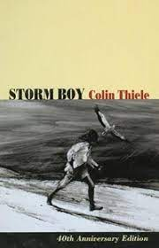
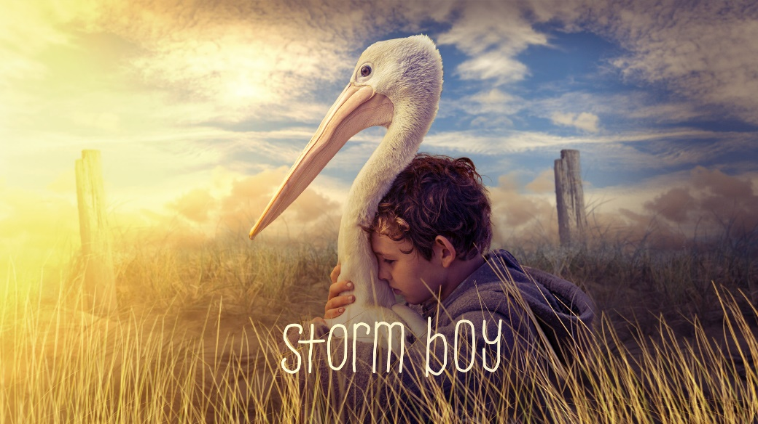
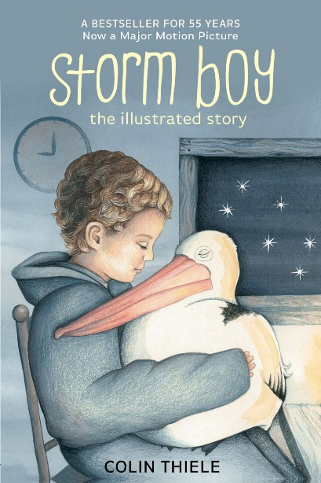
Storm Boy Novel Study Slide deck made by Lauren Van Dongen Serpentine Primary School
Year 4
Insert Image
Acknowledgements:
This slide deck has used /adapted content from the following sources:
‘English Text Unit Grade 4 Storm Boy’ created by Emina McLean
‘Storm Boy Lesson Slides’ created by Simon L. King
‘Storm Boy’ created by Corrine Meers
'Figurative Language Version’ created by Kathleen O’Rourke
Engagement icons by Brad Nguyen and Nathaniel Swain

Slide 2
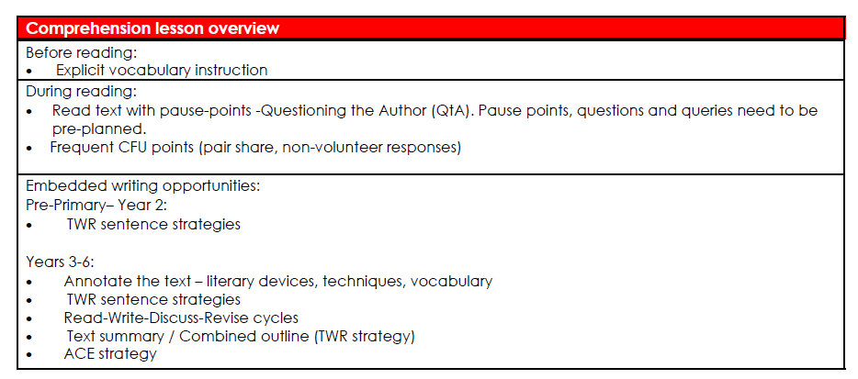

Slide 3
Knowledge Unit: Storm Boy (Novel Study) Year: 4
Lesson # | Lesson Title | Learning Objective | Big Question | Vocabulary | Embedded Writing Task
1 | Introduction | I can recall who wrote Storm Boy and when and describe where the story is set. | Who wrote Storm Boy (and when)? Where is Storm Boy set? | sanctuary | Sentence summary and SPO (short)
2 | Chapter 1 Part 1 | I can describe the two main characters of Storm Boy, where they live and how they got their names? | Who are the two main characters of Storm Boy, where do they live and how did they get their names? | seldom | Co-ordinating conjunctions
3 | Chapter 1 Part 2 | I can infer details about the relationship between two characters from their actions. | What can the reader infer about the relationship between Fingerbone and Storm Boy from their actions? | sedately | Because, but, so
4 | Chapter 1 Part 3 | I can identify how the author uses personification to bring inanimate objects to life. ​ | How has the author used personification to bring inanimate objects to life in this chapter? Give some examples. ​ | furiously | Correct run-on sentences
5 | Chapter 2 | I can infer traits about a character because of their actions | What traits can you infer about Storm Boy and Hide-Away because of their actions? | feeble | Generate sentences using subordinating conjunctions showing reason or purpose
6 | Pelicans (information text) | I can recall key facts about pelicans | What are some key facts about penguins? | adequate | SPO
7 | Chapter 3 | I can identify the important events in this chapter and describe them in my own words. | What are the key events in this chapter? | glared | Sentence summary x 3
8 | Chapter 4 | I can describe how Storm Boy and Mr Percival’s relationship has developed through the story so far. | How has Storm Boy and Mr Percival’s relationship developed through the story so far? | reunion | Generate sentences using subordinating conjunctions showing time, place and manner
9 | Pause Point | I can generate questions about pictures related to the text | What questions can you generate about pictures related to the text? | review of words done so far | Question generation

Slide 4
Knowledge Unit: Storm Boy (Novel Study) Year: 4
Lesson # | Lesson Title | Learning Objective | Big Question | Vocabulary | Embedded Writing Task
10 | Chapter 5 Part 1 | I can explain the progression used by an author to develop the skills of a character. | What are the key events that led to Mr Percival being able to carry out the fishing line? | sly | SPO
11 | Chapter 5 Part 2 | I can identify some of the language choices, that have been used by the author, to set the scene of the storm. | What are some of the language choices, that have been used by the author, to set the scene of the storm? | frenzy | Sentence expansion
12 | Chapter 5 Part 3 | I can identify the ways the author created suspense in the text. | How has the author created suspense as the rescue of the crew of the tugboat begins? | fasten | Read-write-discuss cycle Convert fragments to sentence
13 | Chapter 5 Part 4 | I can identify upgraded verbs in the text and explain why the author has used these | What are some of the upgraded verbs in the text and why has the author has used these? | exhausted | Upgrading verbs in sentence
I suggest reading Chapter 6 uninterrupted with your class prior to Lesson 14. Part of the magic of Storm Boy is the writing and emotion in this chapter. I will be reading it with my students so they can feel that, and we will talk about it, with no specific learning objective in mind. Then go back in another session and do the 2 lessons individually. | Chapter 6 Lesson 1 No learning objective for this lesson No learning objective for this lesson | No learning objective for this lesson | No learning objective for this lesson
14 | Chapter 6 Part 1 | I can identify similes and explain why the author has chosen to use these. | What similes can you find in the text and why has the author chosen to use them? | awkwardly | Sentence combining
15 | Chapter 6 Part 2 | I can explain how the author finishes the text answering all the readers' questions. | Why does the author need to wrap up the text? | ashamed | Because, but, so
16 | Assessment

Slide 5
Lesson 1
Introduction
The Big Question:
Who wrote Storm Boy (and when)?
Where is Storm Boy set?

Slide 6
Vocabulary
sanctuary

Slide 7
Track with me
Vocabulary
Read with me
Choral Reversal
definition of sanctuary:
Read to your partner
an area of land where birds and wildlife can breed, live and be safe from hunters (noun)
If people break these rules (e.g. hunt the animals) they will get in trouble.

Slide 8
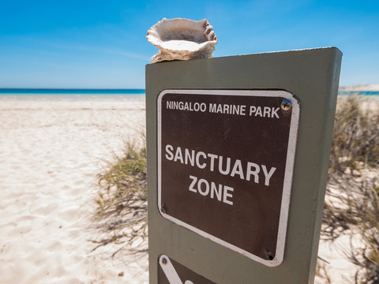
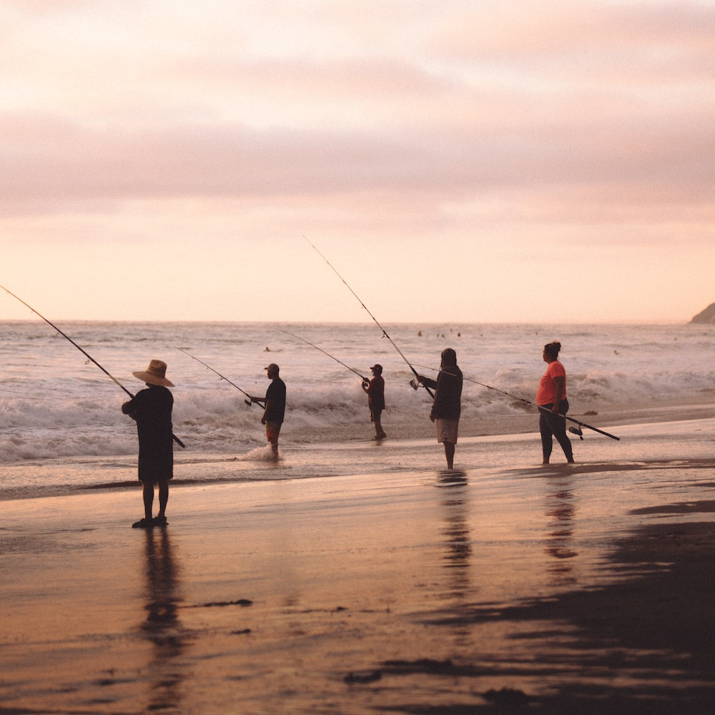
Why is this picture an example/not an example of sanctuary? How do you know?
Vocabulary
is/is not an example of sanctuary because .
Insert image
Insert image
sanctuary
not sanctuary
Notes:
I do
*Replace happy with vocab word

Slide 9
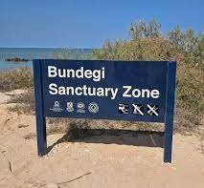
Why is this picture an example/not an example of sanctuary? How do you know?
Vocabulary
is/is not an example of sanctuary because .
Example or Non-Example?
Insert image
Notes:
We Do
*Replace happy with vocab word

Slide 10
Track with me
Vocabulary
sentences:
Read with me
Ningaloo Reef in Exmouth is a sanctuary.
We visited a beautiful sanctuary in Africa where elephants and tigers roam freely, protected and happy.
Volunteers help take care of the sanctuary, looking after flowers and creating a wonderful environment for animals.
Notes:
Senior
*vocab word in red

Slide 11
Which sentence is a correct example of sanctuary? How do you know?
Vocabulary
is an example of sanctuary because .
A
The sanctuary is a quiet and peaceful place, where animals can rest and enjoy their lives.
B
When I visited the ocean sanctuary, I went fishing and caught 6 fish!
C
The sanctuary has tall trees and cozy nests, providing a perfect place for birds to build their homes.
Notes:
Senior You do
*Replace happy with vocab word

Slide 12
Put sanctuary in a sentence.
Vocabulary
Word Origin & Morphographs
sanctuary
sanc/tu/ar/y
First originated in1560s; as "land set aside for wild plants or animals to breed and live" First recorded by 1879 in reference to the American bison.
Adjective a protected area of land
Synonyms: nature reserve, wildlife reserve
Notes:
Senior Review Slide
*Include synonyms where appropriate
Word Origin information (https://www.etymonline.com/)

Slide 13
I can recall who wrote Storm Boy (and when) and describe where is Storm Boy set.
Teacher and students read together.
TODAY’S LEARNING OBJECTIVE

Slide 14
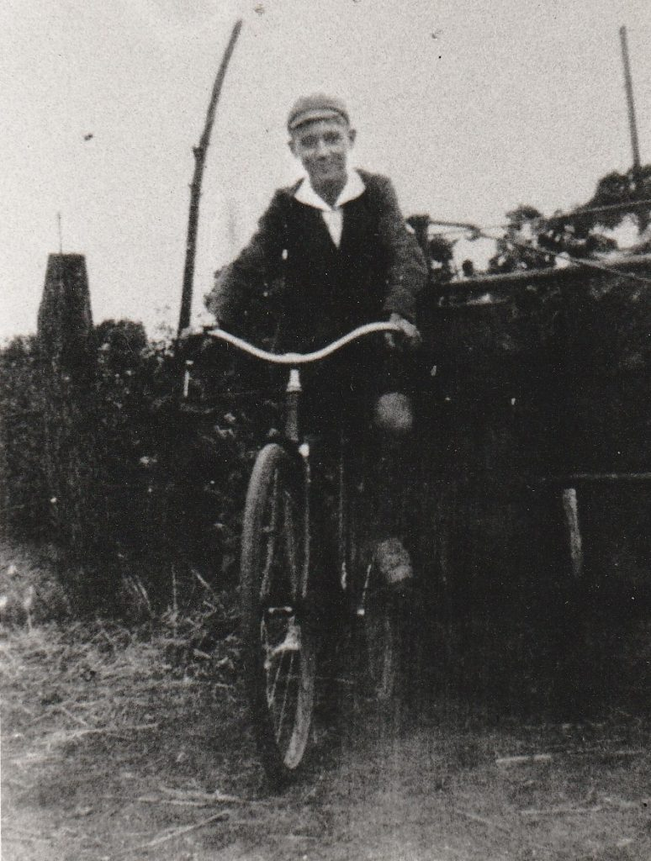
Read Passage
Discuss and Read Question
Teacher and students read together.
Body
What two languages did Colin Thiele speak?
Who wrote Storm Boy?
Storm Boy was written by Colin Thiele.
Colin Milton Thiele AC was born the 16th of November 1920 in South Australia. He had one brother and three sisters. As a boy Colin only spoke German at home. When he started school in 1925, he began learning English. Both languages fascinated Colin and he had a lifelong love of stories.
From 1936, he studied the Arts at the University of Adelaide. In 1939 he worked as a junior teacher at Robertstown Primary School. A year later, he returned to Adelaide, where he completed a Diploma in Secondary Education.
This text was adapted from ColinThiele.com, Colin’s Life, (2023). https://colinthiele.com/?page_id=302
Colin Thiele spoke .
Colin Thiele spoke English and German.
School-aged Colin
Vocabulary
fascinate (verb) cause to be very interested

Slide 15
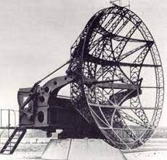
Read Passage
Discuss and Read Question
Teacher and students read together.
Body
Why was a radar technician important in the war?
The bombing of Darwin in early 1942 put an end to Colin’s further studies. This was during World War 2. After training as a radar technician, he was stationed firstly in Metung Victoria, then at Melville Island north of Darwin and later along Australia’s northern coast as a mobile radar maintenance officer. He married while on leave in early 1945.
This text was adapted from ColinThiele.com, Colin’s Life, (2023). https://colinthiele.com/?page_id=302
A radar technician was important in the war because .
A radar technician was important in the war because they made sure that the radars were working which meant that soldiers could be warned about enemy activity and people could be safe.
What was a radar technician?
During World War II, a radar technician played a crucial role in helping keep people safe. A radar is a device that can detect things far away, like airplanes or ships. The radar technician was the person who made sure these machines worked perfectly. They fixed and maintained the radar machines so that they could warn soldiers if enemy planes or ships were approaching. This helped protect towns and cities from surprise attacks.
Vocabulary
crucial (adjective) of great importance
maintain (verb) allow something to continue like normal
A radar in World War 2

Slide 16
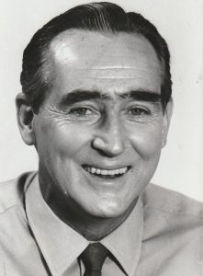
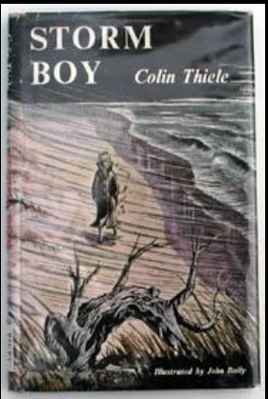
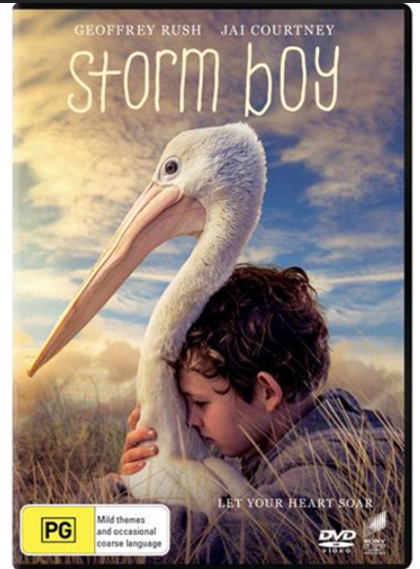
Read Passage
Discuss and Read Question
Teacher and students read together.
Body
In what year did Colin Thiele write Storm Boy?
After the war
After returning from the war, Colin resumed his teaching career. He taught at secondary schools and universities, becoming a vice-principal and principal over this time. Whilst he was teaching, Colin wrote stories and poetry. Once he retired, he became a full-time writer. Colin died on 4th September 2006.
This text was adapted from ColinThiele.com, Colin’s Life, (2023). https://colinthiele.com/?page_id=302
Colin Thiele wrote Storm Boy in .
Colin Thiele wrote Storm Boy in 1963.
When was Storm Boy written?
Colin wrote Storm Boy in 1963. It has since won numerous awards and accolades. It has also been made into 2 movies and a play.

Slide 17
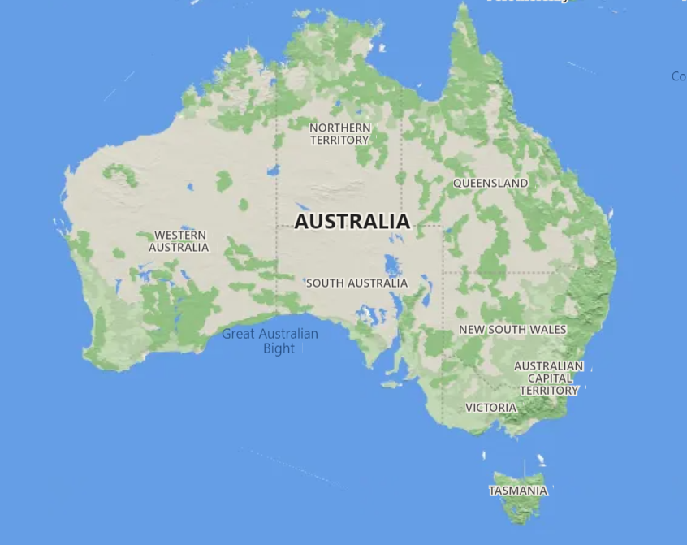
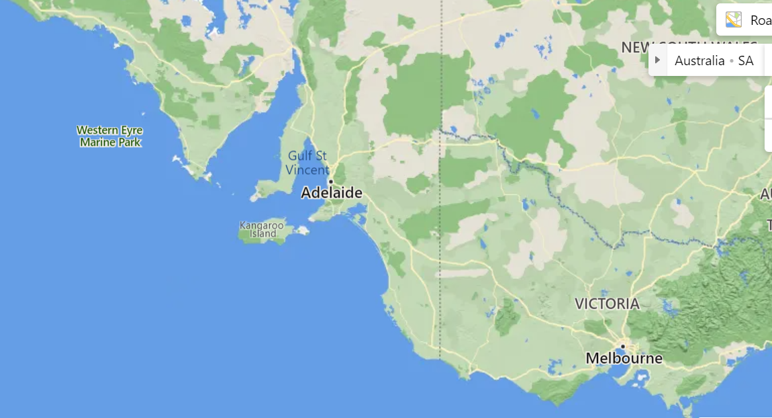
Read Passage
Discuss and Read Question
Teacher and students read together.
APK
Where is the story set?
The story is set in Coorong National Park. This is located on the coast of South Australia

Slide 18
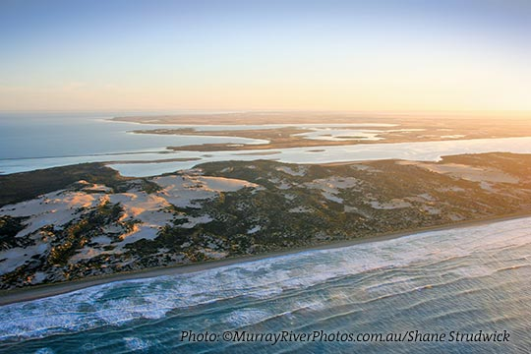
Read Passage
Discuss and Read Question
Teacher and students read together.
Body
Coorong National Park
Established in 1966, the Coorong National Park is a spectacular saline lagoon stretching 140 kilometres. It is separated from the Southern Ocean by sand dunes or the Younghusband Peninsula, and it is internationally significant under the Ramsar agreement as a migratory water and waterfowl refuge. It is a sanctuary for many species of birds, animals and fish.
Adapted from: https://coorongcountry.com.au/coorong-national-park/
Vocabulary
saline (noun) containing salt
lagoon (noun) a pool or lake of relatively shallow, quiet water that is normally connected to the sea but separated from it by sandbars, barrier islands, or coral reefs.
refuge (noun) a place that provides shelter or protection.

Slide 19
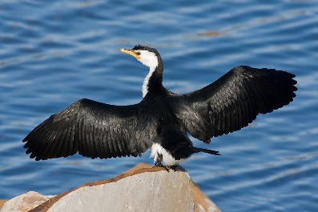
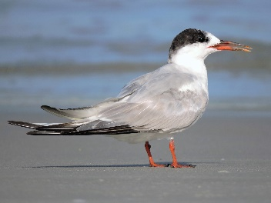
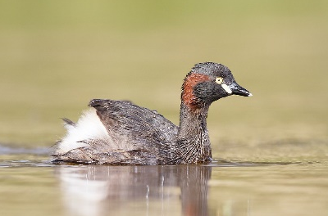
Read Passage
Discuss and Read Question
Teacher and students read together.
APK
Who are the traditional custodians of The Coorong?
Derived from an Aboriginal word ‘karangk’ meaning narrow neck, it is one of the most breathtaking national parks in Australia. You will also be a guest of the Ngarrindjeri people, the traditional custodians of these lands and waters for thousands of years. It is a place of Aboriginal significance.
The Coorong is ideal for birdwatching and photography with its distinctive landscape in an important breeding area for the Australian pelican and a refuge for ducks, swans, cormorants, terns, grebes and over 230 migratory birds that travel annually from Siberia, Alaska, Japan and China.
Adapted from: https://coorongcountry.com.au/coorong-national-park/
The traditional custodians of The Coorong are _____.
The traditional custodians of The Coorong are the Ngarrindjeri people.
This is a link to a very short video with some landscape shots of The Coorong.
Australia - Coorong National Park - YouTube
Cormorant
Tern
Grebe

Slide 20
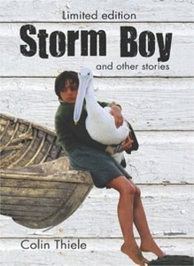
Pair share and discuss
Lesson Closure
Ask question
Discuss answers
Our Big Question:
Who wrote Storm Boy (and when)?
Where is Storm Boy set?
INITIATING QUERIES
FOLLOW-UP QUERIES
SUMMARISING
PREDICTING
Notes:
Learning Objective: I can define and describe plastic pollution.
INITIATING QUERIES
What have we discussed today?
What was this all about?
What do we know so far?
FOLLOW-UP QUERIES
How does this relate to what we have learnt before?
What can we learn about the middle ages?
SUMMARISING
What are some of the big events that led to the middle ages?
PREDICTING
What do you think we will be learning about

Slide 21
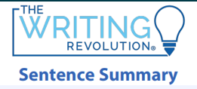
In your workbook
Activity
In this lesson, there are two main topics – who wrote Storm Boy and when, and the setting of Storm Boy. We will write a sentence summary for the first topic and a short SPO for the second topic.
Slides 1 & 2
Sentence summary on who wrote Storm Boy and when (Slide 2 – extension as has no detail)
Slides 3-6
SPO on where Storm Boy is set

Slide 22
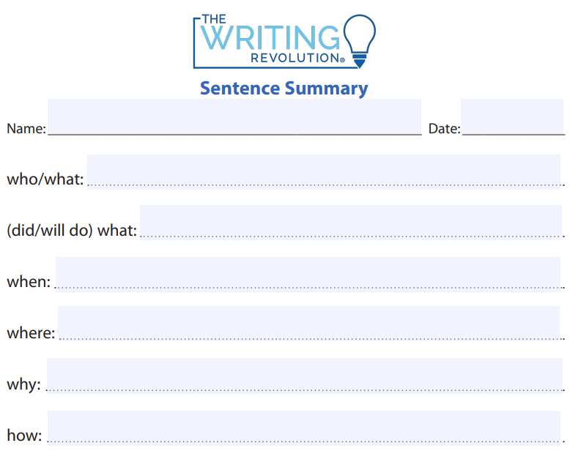
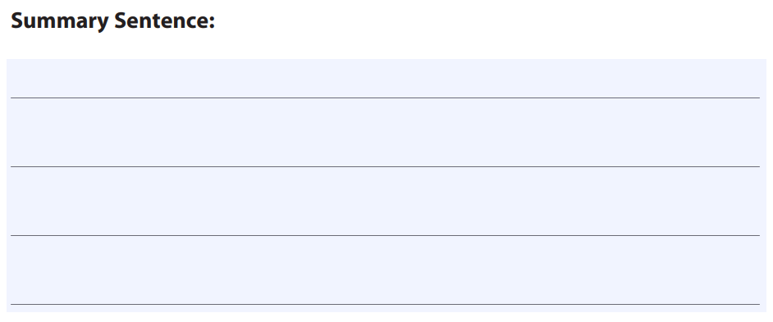
Slide 1: Who wrote Storm Boy and when (with scaffolding)
In your workbook
Activity
Write a summary sentence using the notes provided.
Colin Thiele
wrote Storm Boy
in 1963
South Australia
he enjoyed writing

Slide 23
Slide 1: Who wrote Storm Boy and when (no scaffolding)
In your workbook
Activity
Write a summary sentence using the notes provided.
wrote Storm Boy

Slide 24
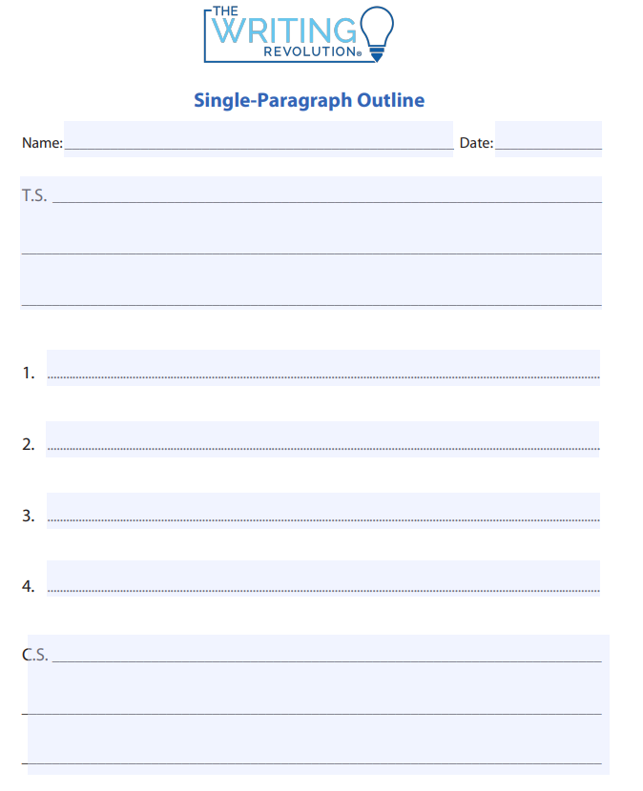
SKILL/CONCEPT CLOSURE
Where is Storm Boy set?
YOUR BIG QUESTION
Identify the best topic sentence.
Storm Boy is set in the Coorong National Park.
Storm Boy is a book.
Storm Boy is set in the Coorong National Park.
Storm Boy was written by Colin Thiele in 1963.
Storm Boy is set at the beach.
Notes:
INITIATING QUERIES
What is being discussed here
What is this all about
What do we know so far
FOLLOW-UP QUERIES
What do they really mean here?
Why did the author/filmmaker say/show that?
How does this relate to what we have learnt?

Slide 25
SKILL/CONCEPT CLOSURE
Where is Storm Boy set?
YOUR BIG QUESTION
What 3 supporting details could we use?
Storm Boy is set in the Coorong National Park.
saline lagoon 140km long
Colin Thiele was in the war
saline lagoon 140km long
sanctuary = birds & animals protected
sanctuary = birds and animals protected
he wrote the book in 1963
important to Aboriginal people
part of the book
important to Aboriginal people
Notes:
INITIATING QUERIES
What is being discussed here
What is this all about
What do we know so far
FOLLOW-UP QUERIES
What do they really mean here?
Why did the author/filmmaker say/show that?
How does this relate to what we have learnt?

Slide 26
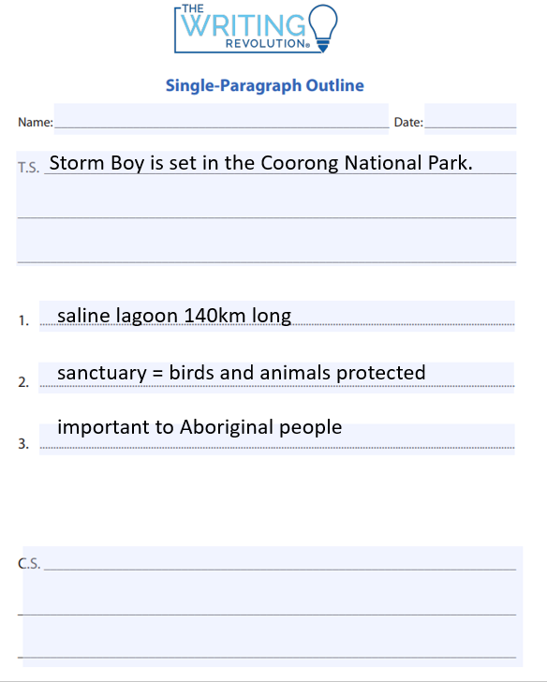
SKILL/CONCEPT CLOSURE
Where is Storm Boy set?
YOUR BIG QUESTION
Concluding statements in paragraphs
Look at your topic sentence and supporting details, as well as the kind of topic sentence you have used.
Select a different sentence type for your concluding sentence. Command, question, exclamation and statement.
Select your sentence type based on the kind of information that you will be writing about.
Coorong National Park is an interesting place!
Coorong National Park is an interesting place!
Notes:
INITIATING QUERIES
What is being discussed here
What is this all about
What do we know so far
FOLLOW-UP QUERIES
What do they really mean here?
Why did the author/filmmaker say/show that?
How does this relate to what we have learnt?

Slide 27
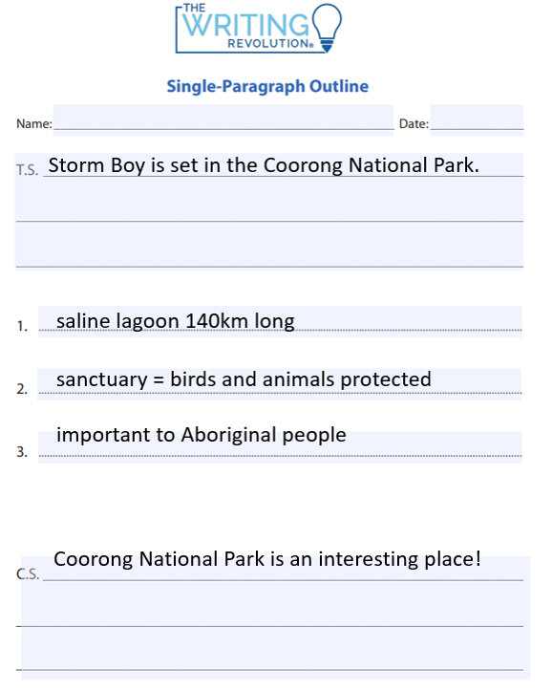
SKILL/CONCEPT CLOSURE
A mountain is a geological landform that rises above the surrounding land.
made from rocks and earth
steep sloping sides, sharp or rounded ridges
High point: a peak or summit. Low point: base
Generally higher then 600m or it is a hill
It is amazing how different mountains can look, depending on their height and location!
Notes:
INITIATING QUERIES
What is being discussed here
What is this all about
What do we know so far
FOLLOW-UP QUERIES
What do they really mean here?
Why did the author/filmmaker say/show that?
How does this relate to what we have learnt?

Slide 28
Lesson 2
Chapter 1 Part 1
For this lesson, we will be reading part of Chapter 1
From page 5: ‘Storm Boy lived between the Coorong and the sea’
To page 9: ‘And from then on everyone called him Storm Boy’ (4 sentences on the page only)
The Big Question:
Who are the two main characters of Storm Boy, where do they live and how did they get their names?

Slide 29
Vocabulary
seldom

Slide 30
Track with me
Vocabulary
Read with me
Choral Reversal
definition of seldom:
Read to your partner
not often, rarely (adverb)

Slide 31
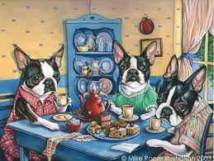
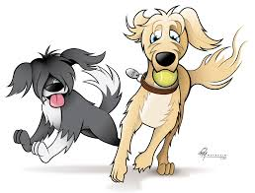
Why is this picture an example/not an example of seldom? How do you know?
Vocabulary
is/is not an example of seldom because .
Insert image
Insert image
seldom
not seldom
Notes:
I do
*Replace happy with vocab word

Slide 32
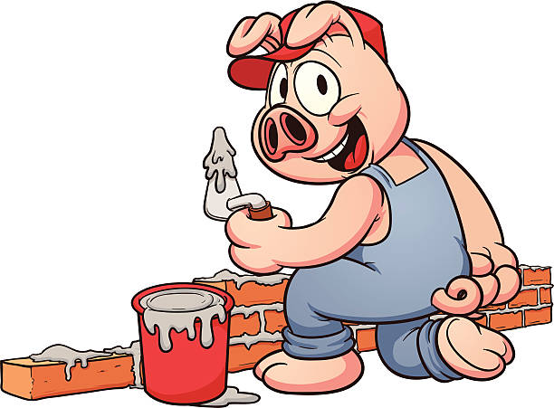
Why is this picture an example/not an example of seldom? How do you know?
Vocabulary
is/is not an example of seldom because .
Example or Non-Example?
Insert image
Notes:
We Do
*Replace happy with vocab word

Slide 33
Track with me
Vocabulary
sentences:
Read with me
Timmy seldom forgets to feed his pet fish every morning.
Last week, Jenny seldom left her house because she had COVID.
Ethan values punctuality and teamwork, so he seldom arrives late to soccer practice.
Notes:
Senior
*vocab word in red

Slide 34
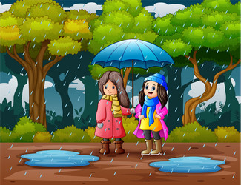
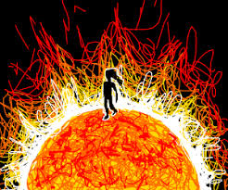
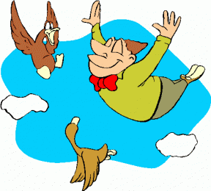
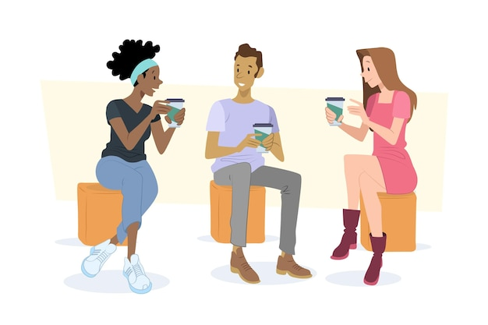
Why is this picture an example/not an example of seldom? How do you know?
Vocabulary
Insert image
Insert image
is/is not an example of seldom because .
A
B
Insert image
Insert image
C
D
Notes:
Senior You do
*Replace happy with vocab word

Slide 35
Which sentence is a correct example of seldom? How do you know?
Vocabulary
is an example of seldom because .
A
Jake seldom misses a chance to play his favourite video game after finishing his homework.
B
After school, the children seldom played outside because the weather was so lovely.
Since Zoey loves sketching, she seldom leaves her room without her favourite notebook where she records her creative ideas.
C
Notes:
Senior You do
*Replace happy with vocab word

Slide 36
Put seldom in a sentence.
Vocabulary
Word Origin & Morphographs
seldom
sel/dom
"rarely, not often, infrequently, from Old English and early Middle English seldum, a word of uncertain etymology. Perhaps ultimately from the base of self.
Adverb not often, hardly ever
Synonyms: rarely, infrequently
Notes:
Senior Review Slide
*Include synonyms where appropriate
Word Origin information (https://www.etymonline.com/)

Slide 37
Read Passage
Discuss and Read Question
Teacher and students read together.
APK
What is a sanctuary?
Who wrote Storm Boy?
Storm Boy was written by Colin Thiele. He was born on the 16th of November 1920 in South Australia. After finishing school, Colin studied at university and went to World War 2 as a radar technician. After returning from the war, he started teaching. Colin died on the 4th September 2006.
This text was adapted from ColinThiele.com, Colin’s Life, (2023). https://colinthiele.com/?page_id=302
A sanctuary is .
A sanctuary is a place of safety and protection.
When was Storm Boy written?
Colin wrote Storm Boy in 1963. It has since won numerous awards and accolades. It has also been made into 2 movies and a play.
Coorong National Park
Established in 1966, the Coorong National Park is a spectacular saline lagoon stretching 140 kilometres. It is a sanctuary for many species of birds, animals and fish.
Adapted from: https://coorongcountry.com.au/coorong-national-park/

Slide 38
Teacher and students read together.
TODAY’S LEARNING OBJECTIVE
For this lesson, we will be reading part of Chapter 1
From page 5: ‘Storm Boy lived between the Coorong and the sea’
To page 9: ‘And from then on everyone called him Storm Boy’ (4 sentences on the page only)

Slide 39
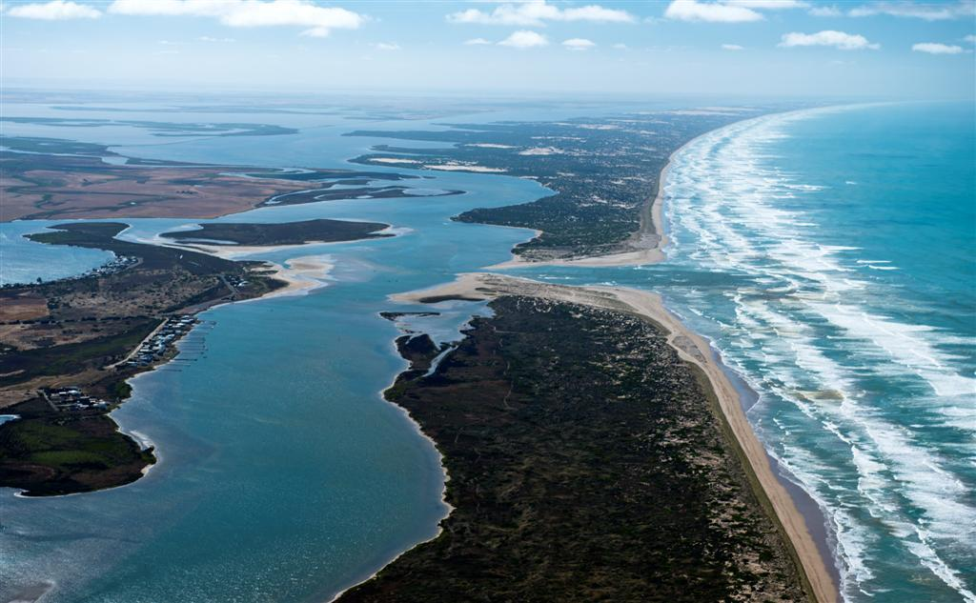
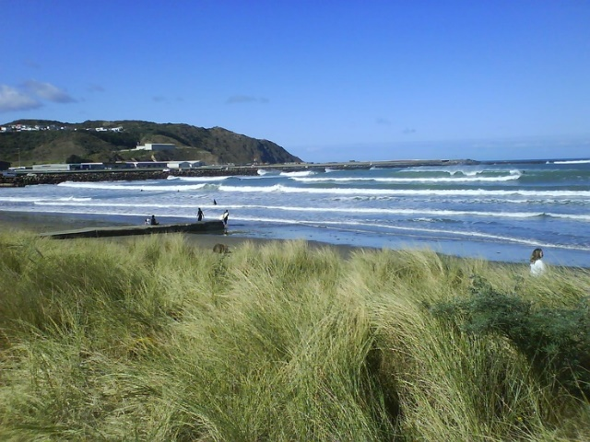
Read Vocabulary
Read Passage
Discuss and Read Question
Teacher and students read together.
Page 5
Why do you think the author has chosen to describe Storm Boy’s home as ‘wild’, ‘windswept’ and ‘cold’?
Vocabulary
windswept (adjective) a place with no shelter that is exposed to the winds
tussocky (noun) a clump of growing grass
I think the author has chosen this description because .
I think the author has chosen this description because he wants us to know that Storm Boy lives in a place very different to us.
Answers will vary.
Murray mouth – where the river meets the sea. This is an aerial shot of the real-life Murray mouth.
Tussocks near the water
There is a picture in the middle of the book with a caption from this page:
‘A wild strip it is, windswept and tussocky, with the flat shallow water of the South Australian Coorong on one side and the endless slam of the Southern Ocean on the other.’

Slide 40
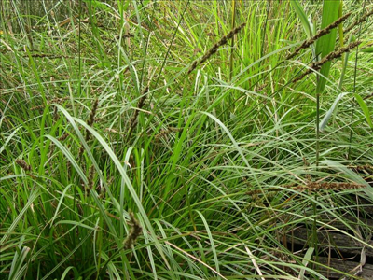
Read Vocabulary
Read Passage
Discuss and Read Question
Teacher and students read together.
Page 6
How is the humpy different to a modern house? Give at least one comparison
Vocabulary
writhes (verb) to twist about or squirm
humpy (noun) a small, usually temporary, shelter
sedges (noun) plants found in wet areas that look like grasses.
shriek (verb) to make a sharp, shrill sound
hermit (noun) a person who lives alone, away from other people.
beachcomber (noun) a person who searches for things along the shore.
The humpy is different to a modern house because a humpy ________, whereas a modern house _______ .
Answers will vary
Sedges
There is a picture in the middle of the book with the caption from this page:
‘Storm Boy lived with Hide-Away Tom, his father. Their home was a rough little humpy made of wood and brush and flattened sheets of iron from old tins.’

Slide 41
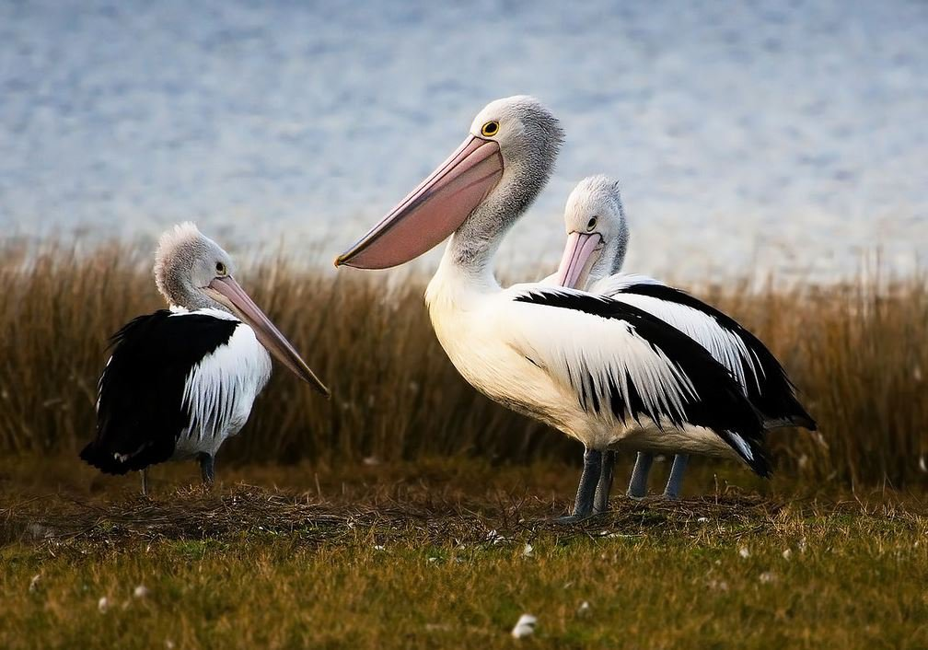
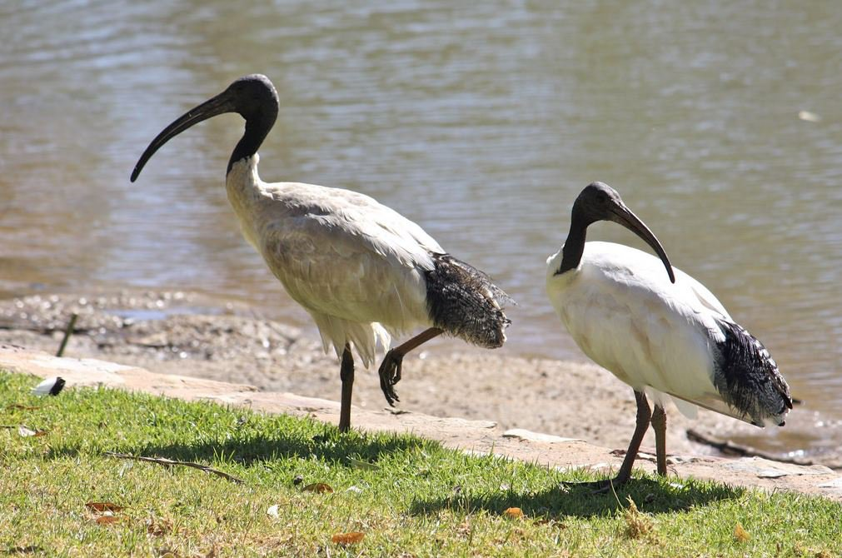
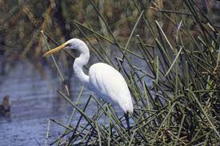
Read Vocabulary
Read Passage
Discuss and Read Question
Teacher and students read together.
Page 7
How did Hide-Away get his name?
Vocabulary
kerosene (noun) a type of fuel
wonderingly (adverb) in a wondering manner
nudged (verb) to touch or push gently.
Hide-Away got his name because .
Hide-Away got his name because when he was in town, people would say to each other that he’d come out of his hideaway for a change.
Pelican
Ibis
‘White crane’

Slide 42
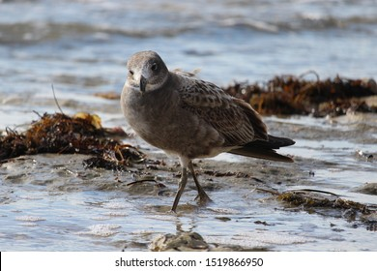
Read Vocabulary
Read Passage
Discuss and Read Question
Teacher and students read together.
Pages 8 & 9
(first 4 lines of 9 only)
How did Storm Boy get his name?
Vocabulary
gloom (noun) darkness
mist (noun) tiny droplets of water hanging in the air.
forlornly (adverb) sadly and lonely due to isolation
postmaster (noun) the person in charge of the post office
Storm Boy got his name because .
Storm Boy got his name because he was happy and calm on the beach during a storm. This amazed the townspeople who called him Storm Boy.
Molly-hawk

Slide 43
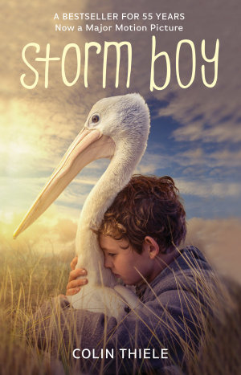
Pair share and discuss
Lesson Closure
Ask question
Discuss answers
Insert image
Our Big Question:
Who are the two main characters of Storm Boy, where do they live and how did they get their names?
INITIATING QUERIES
FOLLOW-UP QUERIES
SUMMARISING
PREDICTING
Notes:
Learning Objective: I can define and describe plastic pollution.
INITIATING QUERIES
What have we discussed today?
What was this all about?
What do we know so far?
FOLLOW-UP QUERIES
How does this relate to what we have learnt before?
What can we learn about the middle ages?
SUMMARISING
What are some of the big events that led to the middle ages?
PREDICTING
What do you think we will be learning about

Slide 44
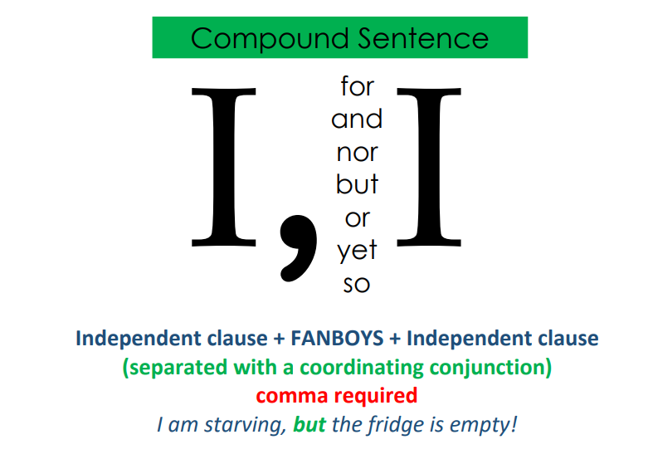
In your workbook
Activity
Complete the sentence stems that use coordinating conjunctions on the following slides.

Slide 45
Skill development: I do
Select the appropriate coordinating conjunction
Write the first independent clause and the conjunction
Punctuate with a comma
Write the remainder of the sentence
CFU:
Which conjunction is most suitable?
People said it was bad of Hide-Away to take Storm Boy to such a wild, lonely place, _______ they were both happy.
or
but
so
People said it was bad of Hide-Away to take Storm Boy to such a wild, lonely place but they were both happy.
F | A | N | B | O | Y | S
For | And | Nor | But | Or | Yet | So

Slide 46
Skill development: We do
Select the appropriate coordinating conjunction
Write the first independent clause and the conjunction
Punctuate with a comma
Write the remainder of the sentence
The only time people saw Hide-Away was when he came into town, _____ he needed supplies.
but
for
nor
The only time people saw Hide-Away was when he came into town, for he needed supplies.
F | A | N | B | O | Y | S
For | And | Nor | But | Or | Yet | So

Slide 47
Skill development: You do
Select the appropriate coordinating conjunction to complete the sentence.
F | A | N | B | O | Y | S
For | And | Nor | But | Or | Yet | So
1. The people townspeople expected Storm Boy to be scared in the storm, ______ he wasn’t.
but/yet
so
2. Storm Boy wasn’t scared in the storm , ____ the townspeople started calling him Storm Boy.
and
3. At 90 Mile Beach, the waves crash on the shore _____ cause white water and spray to form.
4. The humpy got hot in the summer and cold in the winter _______ Storm Boy was happy there.
but/yet

Slide 48
Skill development: I do
Read the first independent clause and conjunction.
Finish the sentence with a second independent clause that matches with the meaning of the conjunction.
CFU:
Which second independent clause matches best with the conjunction and the first independent clause so the sentence makes complete sense?
The Coorong has flat shallow water on one side, and ...
they went into town for supplies.
the Southern Ocean on the other.
Storm Boy was Hide-Away’s son.
The Coorong has flat shallow water on one side, and the Southern Ocean on the other.

Slide 49
Skill development: We do
Read the first independent clause and conjunction.
Finish the sentence with a second independent clause that matches with the meaning of the conjunction.
It is clear that the post-master knew Storm Boy, for…
he bought him lunch.
there were storms all the time.
he told the people not to worry about him.
It is clear that the post-master knew Storm Boy, for he told the people not to worry about him.

Slide 50
Skill development: You do
Read the sentence stem (subordinating conjunction with dependent clause)
Select the appropriate independent clause
Use this to complete the sentence.
The humpy was roughly made, yet_______.
it was home for Storm Boy.
there was a mansion next door.
the towns-people often visited.
Hide-Away didn’t leave his home much, so _______.
he used social media a lot.
people didn’t like him.
he got the nickname Hide-Away
Hide-Away was nicknamed Hide-Away, but ___
his real name was Tom.
he was the father of Storm Boy.
he hated it.

Slide 51
Skill development: You do - extension
Read the first independent clause and conjunction.
Finish the sentence with a second independent clause that matches with the meaning of the conjunction.
1. We know Storm Boy was happy in the storm, for _______
2. Hide-Away and Storm Boy needed supplies, so ________
3. Storm Boy was 4 years old when his mother died, and ________________
4. The townspeople thought they had to save Storm Boy in the storm, yet _____________

Slide 52
Lesson 3
Chapter 1 Part 2
For this lesson, we will be reading part of Chapter 1
From page 9: ‘The only other man who lived anywhere near them was Fingerbone Bill, the Aboriginal.
To page 12: ‘Instead of pecking and hissing at him she sat back sedately on her tail and looked at him gently with mild eyes.
The Big Question:
What can the reader infer about the relationship between Fingerbone and Storm Boy from their actions?

Slide 53
Vocabulary
sedately

Slide 54
Track with me
Vocabulary
Read with me
Choral Reversal
definition of sedately:
Read to your partner
in a quiet, relaxed, or slow way without excitement or risk (adverb)

Slide 55
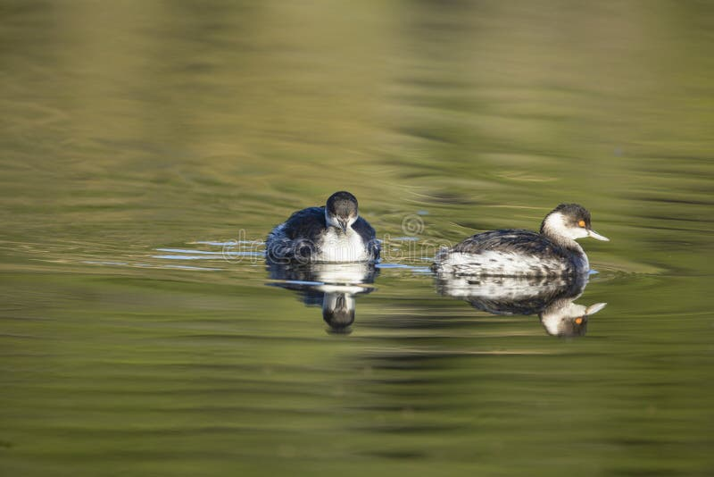
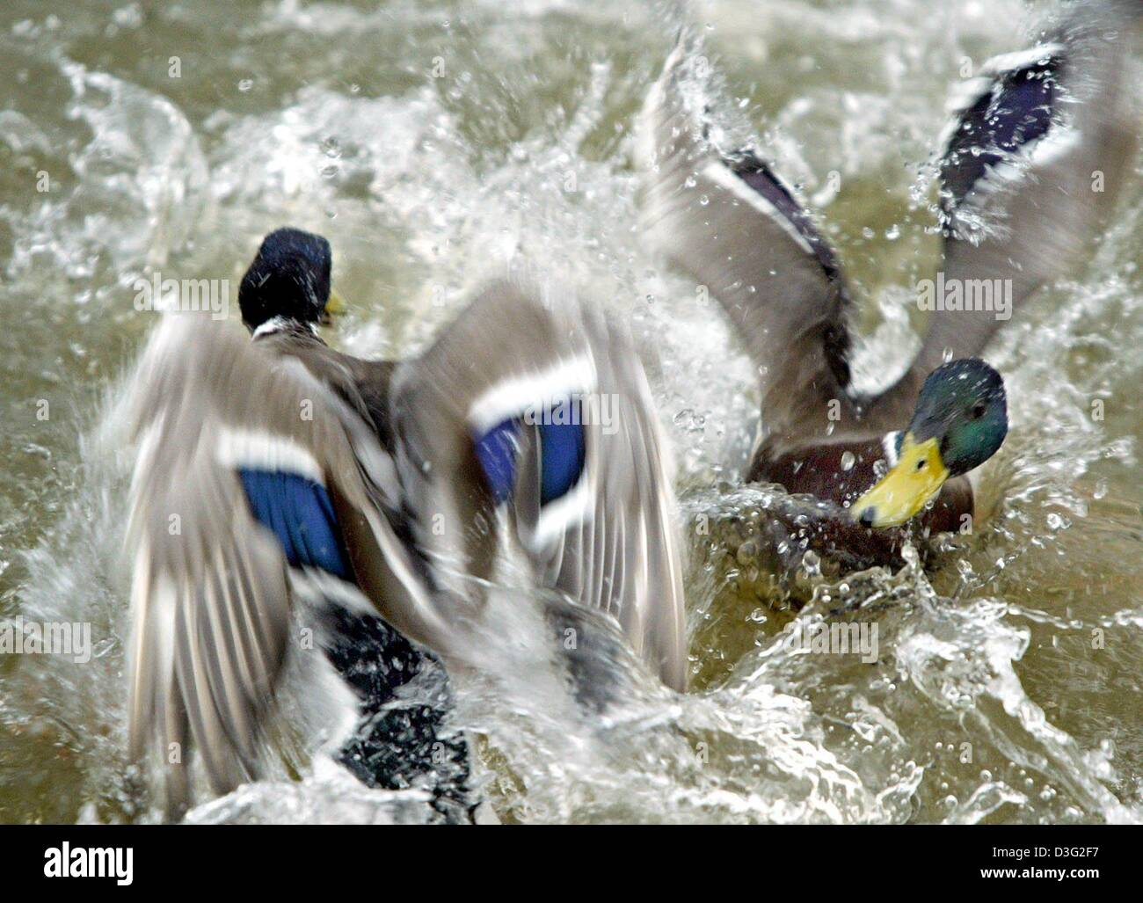
Why is this picture an example/not an example of sedately? How do you know?
Vocabulary
is/is not an example of sedately because .
Insert image
Insert image
sedately
not sedately
Notes:
I do
*Replace happy with vocab word

Slide 56
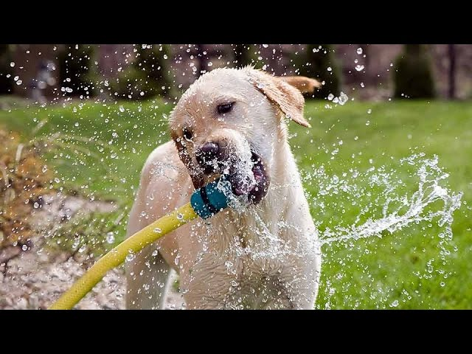
Why is this picture an example/not an example of sedately? How do you know?
Vocabulary
is/is not an example of sedately because .
Example or Non-Example?
Insert image
Notes:
We Do
*Replace happy with vocab word

Slide 57
Track with me
Vocabulary
sentences:
Read with me
The turtle moved sedately across the grass, taking its time to explore the backyard.
The fluffy clouds floated sedately across the bright blue sky on a calm and sunny day.
The wise old owl perched on the branch, observing the world sedately with its keen eyes.
Notes:
Senior
*vocab word in red

Slide 58
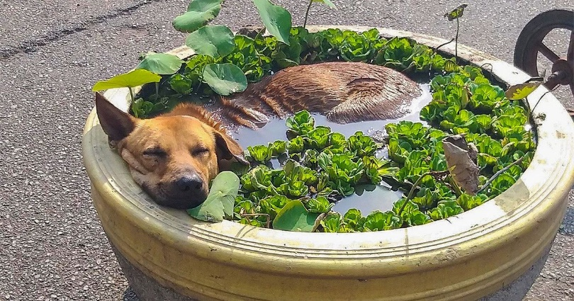
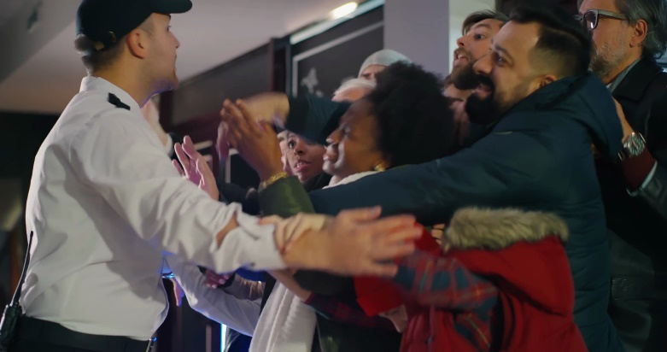
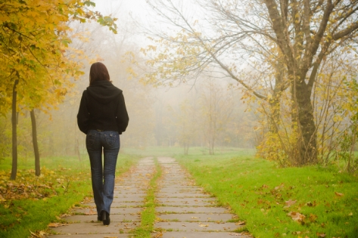
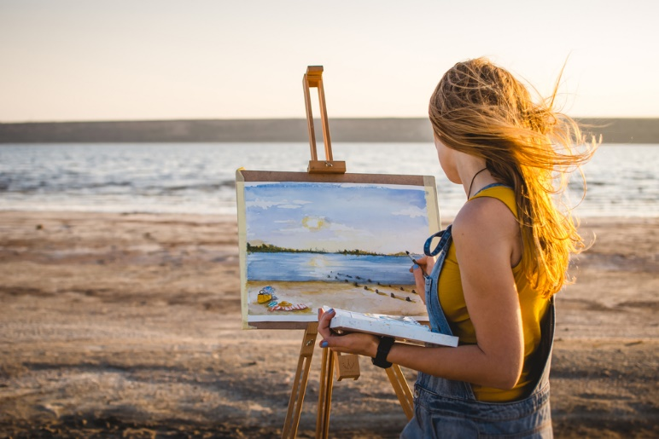
Why is this picture an example/not an example of sedately? How do you know?
Vocabulary
Insert image
Insert image
is/is not an example of sedately because .
A
B
Insert image
Insert image
C
D
Notes:
Senior You do
*Replace happy with vocab word

Slide 59
Which sentence is a correct example of sedately? How do you know?
Vocabulary
is an example of sedately because .
A
Grandma rocked in her favourite chair, knitting sedately as she hummed a gentle tune.
B
I was going to be late for school, so I sedately grabbed my backpack and sprinted out the door.
C
The sleepy puppy curled up on the soft blanket and breathed sedately, dreaming of playful adventures.
Notes:
Senior You do
*Replace happy with vocab word

Slide 60
Put sedately in a sentence.
Vocabulary
Word Origin & Morphographs
sedate + ly
se/date/ly
1660s, from Latin sedatus "composed, moderate, quiet, tranquil,"
in a manner denoted by,
forms an adverb
Adverb do something in a quiet, relaxed, or slow way
Synonyms: calmly, quietly
Notes:
Senior Review Slide
*Include synonyms where appropriate
Word Origin information (https://www.etymonline.com/)

Slide 61
APK
Read Passage
Discuss and Read Question
Quick Quiz for Review
Q: Who are the two main characters of Storm Boy?
A: The two main characters of Storm Boy are...
A: The two main characters of Storm Boy are Storm Boy and Hide Away.
Q: How are Storm Boy and Hide-Away related?
A: Storm Boy is related to Hide-Away because...
A: Storm Boy is related to Hide-Away because he is Hide-Away’s son.
Wording of answers may vary

Slide 62
APK
Read Passage
Discuss and Read Question
Quick Quiz for Review
Q: What do Storm Boy and Hide-Away live in?
A: Storm Boy and Hide-Away live in...
A: Storm Boy and Hide-Away live in an old humpy on the beach (what details do you remember about the humpy?
Q: How did Hide-Away get his name?
A: Hide-Away got his name because...
A: Hide-Away got his name because he rarely came out of his ‘hideaway, except to go to town, so the people called him that.
Wording of answers may vary

Slide 63
APK
Read Passage
Discuss and Read Question
Quick Quiz for Review
Q: How did Storm Boy get his name?
A: Storm Boy got his name because...
A: Storm Boy got his name because there was a big storm, and while all the other people were worried, Storm Boy was happily collecting shells and talking to a bird.
Wording of answers may vary

Slide 64
I can infer details about the relationship between two characters from their actions
Teacher and students read together.
TODAY’S LEARNING OBJECTIVE
For this lesson, we will be reading part of Chapter 1
From page 9: ‘The only other man who lived anywhere near them was Fingerbone Bill, the Aboriginal.
To page 12: ‘Instead of pecking and hissing at him she sat back sedately on her tail and looked at him gently with mild eyes.

Slide 65
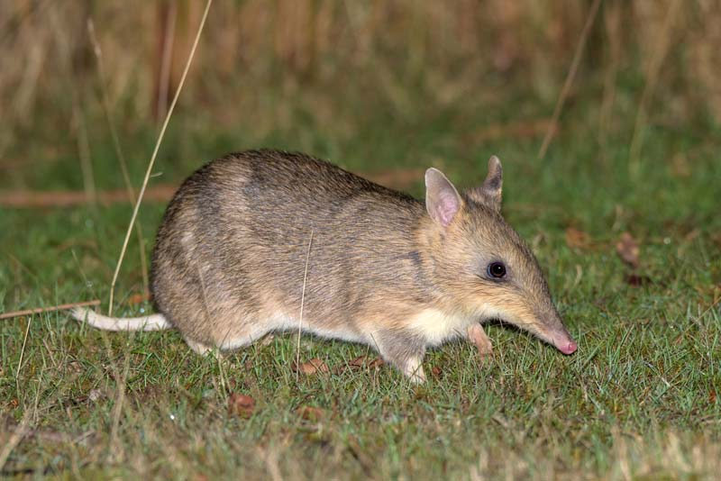
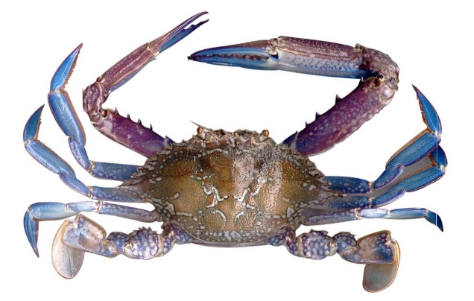
Read Vocabulary
Read Passage
Discuss and Read Question
Teacher and students read together.
Page 9
Storm Boy has “learned enough to fill a hundred books”. What does the author mean by this? Why do you think they used this phrase?
Vocabulary
wiry (adjective) someone who is thin, but strong.
wizened (adjective) wrinkled as a result of aging
jolly (adjective) happy
The author means by this _____. I think the author used this phrase because __________
Bandicoot
The author means by this that Storm Boy had learned lots of information from Fingerbone. I think the author used this phrase because it shows that even though Storm Boy didn’t read any books, he was as smart as someone who had.
‘Anteater’
Crab
(there are many species of crab, this is just to give you an idea what they generally look like)
There is a picture in the middle of the book with the caption from this page:
‘He knew all the signs of the wind and weather in the clouds and sea. And he could read all the strange writings on the sandhills and beaches – the scribbly stories made by beetles and mice and bandicoots and anteaters and crabs and birds’ toes’.
Answers will vary for the second part of this question

Slide 66
Read Vocabulary
Read Passage
Discuss and Read Question
Teacher and students read together.
Page 10
Blunderbass
muzzle
‘For days afterwards, every stick he saw melted slowly into black glass and slid away.’ What does this sentence mean?
Vocabulary
muzzle-loader (noun) a gun that is loaded through its muzzle
muzzle (adverb) the open circular bit where the gun goes off through.
driftwood (noun) pieces of wood floating in the sea that have been washed ashore.
This sentence means that .
This sentence means that after Fingerbone killed the snake, every time Storm Boy saw a stick, at first, he thought it was a snake, until he realised it was a stick and he had nothing to be scared of.
Tiger snake
Driftwood
There is a picture in the middle of the book with the caption from this page:
‘In his humpy Fingerbone kept a collection of iron hooks, wire netting, driftwood, leather, bits of crass, boat-oars, tins, rope, torn shirts, and an old blunderbass.’

Slide 67
Read Vocabulary
Read Passage
Discuss and Read Question
Teacher and students read together.
Page 11
Why did Hide-Away and Fingerbone make a Lookout Post for Storm Boy?
Vocabulary
landmark (noun) an object or feature that is easily recognised
notches (noun) a small cut on the surface
Hide-Away and Fingerbone made a Lookout Post for Storm Boy because ________ .
Hide-Away and Fingerbone made a Lookout Post for Storm Boy because Hide-Away was worried about Storm Boy getting lost and the post meant that he would know where home was.
Pile of a jetty
There is a picture in the middle of the book with the caption from this page:
‘The shore stretched on and on for ninety miles, with every sandhill and bush and tussock like the last one...’

Slide 68
Read Vocabulary
Read Passage
Discuss and Read Question
Teacher and students read together.
Page 12
1. ‘All living creatures were his friends – all, that is except the long, narrow fellows who poured themselves through the sand and sedge like glass’. What are the ‘long narrow fellows’ and how do you know this?
2. Why do you think Fairy Penguin wasn’t scared of Storm Boy?
Vocabulary
burrow (noun) a hole or tunnel dug by an animal
shyly (adverb) in a nervous manner
sedately (adverb) do something in a quiet, relaxed, or slow way
I think Fairy Penguin wasn’t scared of Storm Boy because .
The long narrow fellows are _______. I know this because ______.
The long narrow fellows are tiger snakes. I know this because the description matches the tiger snake described earlier in the book that Fingerbone killed.
I think Fairy Penguin wasn’t scared of Storm Boy because Storm Boy regarded the animals as his friends and therefore would have been kind to them.
Answers will vary
Fairy Penguin
Thistledown

Slide 69
Pair share and discuss
Lesson Closure
Ask question
Discuss answers
Insert image
Our Big Question:
What can the reader infer about the relationship between Fingerbone and Storm Boy from their actions?
INITIATING QUERIES
FOLLOW-UP QUERIES
SUMMARISING
PREDICTING
Notes:
Learning Objective: I can define and describe plastic pollution.
INITIATING QUERIES
What have we discussed today?
What was this all about?
What do we know so far?
FOLLOW-UP QUERIES
How does this relate to what we have learnt before?
What can we learn about the middle ages?
SUMMARISING
What are some of the big events that led to the middle ages?
PREDICTING
What do you think we will be learning about

Slide 70
In your workbook
Activity
In your book, complete because, but, so sentence stems.
Fingerbone shared his knowledge with Storm Boy because .
Fingerbone shared his knowledge with Storm Boy, but .
Fingerbone shared his knowledge with Storm Boy, so .
Storm Boy listened to Fingerbone because ______________________ .
Storm Boy listened to Fingerbone, but __________________________.
Storm Boy listened to Fingerbone, so ____________________________.

Slide 71
In your workbook
Activity
Fingerbone cared about Storm Boy because .
Fingerbone cared about Storm Boy, but .
Fingerbone cared about Storm Boy, so .
Extension
Storm Boy felt all living creatures were his friend because ______________________ .
Storm Boy felt all living creatures were his friend , but __________________________.
Storm Boy felt all living creatures were his friend , so ____________________________.

Slide 72
Lesson 4
Chapter 1 Part 3
For this lesson, we will be reading the last part of Chapter 1
From page 12: ‘Sometimes, in the hollows behind the sandhills where the wind had been scooping and sifting...
To page 17: ‘Sometimes he wished he’s been born an ibis or a pelican’ (end of chapter)
The Big Question:
How has the author used personification to bring inanimate objects to life in this chapter? Give some examples. ​

Slide 73
Vocabulary
furiously

Slide 74
Track with me
Vocabulary
Read with me
Choral Reversal
definition of furiously:
Read to your partner
in an extremely angry, energetic or hurried way

Slide 75
Why is this picture an example/not an example of furiously? How do you know?
Vocabulary
is/is not an example of furiously because .
Insert image
Insert image
furiously
not furiously
Notes:
I do
*Replace happy with vocab word

Slide 76
Why is this picture an example/not an example of furiously? How do you know?
Vocabulary
is/is not an example of furiously because .
Example or Non-Example?
Insert image
Notes:
We Do
*Replace happy with vocab word

Slide 77
Track with me
Vocabulary
sentences:
Read with me
Alex pedalled furiously on his bike, racing against his friends down the street.
The wind blew furiously, making the trees sway and leaves dance in the air.
Sarah was furiously scribbling her homework in the notebook, determined to finish it before dinner.
Notes:
Senior
*vocab word in red

Slide 78
Why is this picture an example/not an example of furiously? How do you know?
Vocabulary
Insert image
Insert image
is/is not an example of furiously because .
A
B
Insert image
Insert image
C
D
Notes:
Senior You do
*Replace happy with vocab word

Slide 79
Which sentence is a correct example of furiously? How do you know?
Vocabulary
is an example of furiously because .
A
After dinner, the lady furiously curled up on the couch and relaxed.
B
Timmy furiously worked on his Lego masterpiece, trying to build the tallest tower ever.
C
As the rain poured furiously, the children ran giggling into the house, soaking wet but happy.
Notes:
Senior You do
*Replace happy with vocab word

Slide 80
Put furiously in a sentence.
Vocabulary
Word Origin & Morphographs
furyi + ous + ly
fu/ri/ous/ly
fierce passion, rage or frenzy
word-forming element making adjectives from nouns
forms an adverb
Adverb in an extremely angry, energetic or hurried way
Synonyms: madly, energetically, wildly
Notes:
Senior Review Slide
*Include synonyms where appropriate
Word Origin information (https://www.etymonline.com/)

Slide 81
APK
Read sentence starter
Students indicate response
Read full sentence
Fingerbone Bill is...
a type of bird that Storm Boy meets on his travels.
an Aboriginal man that lives in a humpy near Storm Boy and Hide-Away.
a bone that has fingers.
the name of the Lookout Post.
Fingerbone Bill is an Aboriginal man that lives in a humpy near Storm Boy and Hide-Away.

Slide 82
APK
Read sentence starter
Students indicate response
Read full sentence
Fingerbone Bill taught Storm Boy...
how to make a humpy.
how to read and write.
what he would need to do if there was a storm.
all the things he knew about the land, plants and animals.
Fingerbone Bill taught Storm Boy all the things he knew about the land, plants and animals.

Slide 83
APK
Read sentence starter
Students indicate response
Read full sentence
The author refers to the tiger snake as...
a long narrow fellow who poured himself through the sand and sledge like glass.
a big piece of timber.
screwed up and wrinkled as an old boot.
little bundles of dark down as soft as dusk.
The author refers to the tiger snake as a long narrow fellow who poured himself through the sand and sledge like glass.

Slide 84
APK
Read sentence starter
Students indicate response
Read full sentence
Decide if each statement is true or false
Storm Boy built the Lookout Post.
A blunder-bass is a type of fish.
A blunderbass is a type of gun.
Fingerbone used the blunderbass to kill a fish.
Hide-Away and Fingerbone made the Lookout Post using a bit of timber they found on the beach.
True False
True False
True False
True False
True False

Slide 85
I can identify how the author uses personification to bring inanimate objects to life.
Teacher and students read together.
This first 4 slides of this lesson give a quick overview about what personification is as this knowledge is required to achieve the learning objective.
TODAY’S LEARNING OBJECTIVE
For this lesson, we will be reading the last part of Chapter 1
From page 12: ‘Sometimes, in the hollows behind the sandhills where the wind had been scooping and sifting...
To page 17: ‘Sometimes he wished he’s been born an ibis or a pelican’ (end of chapter)

Slide 86
Track with me
Vocabulary
Read with me
Choral Reversal
Personification is…
Read to your partner
giving a human-like quality to an object or animal.
Adapted from ‘Figurative Language SLI_Sharing Version’ created by Tenacious Kat.
Freely available on the Reading Science in School Facebook page

Slide 87
Why is this an example/not an example of personification? How do you know?
Vocabulary
is/is not an example of personification because .
Insert image
Insert image
The trees sighed in unison
The trees swayed in the wind
personification
(figurative)
not personification
(literal)
Adapted from ‘Figurative Language SLI_Sharing Version’ created by Tenacious Kat. Freely available on the Reading Science in School Facebook page
Notes:
I do
*Replace happy with vocab word

Slide 88
Track with me
Vocabulary
sentences:
Read with me
The cereal swam circles in the milk.
The story jumped off the page.
My computer yelled at me when I pressed the wrong key.
Adapted from ‘Figurative Language SLI_Sharing Version’ created by Tenacious Kat.
Freely available on the Reading Science in School Facebook page
Notes:
Senior
*vocab word in red

Slide 89
Why is this an example/not an example of personification? How do you know?
Vocabulary
is/is not an example of personification because .
The headlights shone brightly.
The camera loves her.
A
B
The flowers begged for water.
The headlights winked.
C
D
Adapted from ‘Figurative Language SLI_Sharing Version’ created by Tenacious Kat. Freely available on the Reading Science in School Facebook page
Notes:
Senior You do
*Replace happy with vocab word

Slide 90
Read Vocabulary
Read Passage
Discuss and Read Question
Teacher and students read together.
Page 12
‘the wind had been scooping and sifting’ is an example of personification. What is being personified and how?
Vocabulary
hollow (noun) a hole or depression in something
ancient (adjective) belonging to the very distant past; extremely old
whorls (noun) a pattern of spirals or circles.
_______ is being personified. It is being personified by _____________.
The wind is being personified. It is being personified by making it sound like the wind is scooping and sifting the sand, rather than just blowing it.
Mussels
Answers will vary for the second part of this question
Note: this is an old book. It is no longer appropriate to refer to Aboriginal Peoples as aborigines.
Cockles

Slide 91
Read Vocabulary
Read Passage
Discuss and Read Question
Teacher and students read together.
Page 13
Why would Storm Boy want to sell cockles to the fishermen and tourists?
Vocabulary
piccaninnies (noun) small Aboriginal children (old language, not appropriate for today)
gazing (verb) staring at with intent
roused (verb) woken, caused to stop sleeping
Storm Boy would want to sell cockles to the fisherman and tourists because .
Storm Boy would want to sell cockles to the fisherman and tourists because it would give them money to buy other supplies.
Aboriginal shell middens are distinct concentrations of shell. They contain evidence of past Aboriginal hunting, gathering and food processing.
These middens consist primarily of concentrations of discarded shell and bone, botanical remains, ash and charcoal.

Slide 92
Read Vocabulary
Read Passage
Discuss and Read Question
Teacher and students read together.
Page 14
1. What is a ‘big blow’ and why do you think this?
2. There are lots of specific shells named in this chapter. Why do you think the author chose to include this detail and not just write ‘lots of shells’.
Vocabulary
backward wash (noun) the wave going back out to sea.
bristling (adjective) short, stiff and spiky
frail (adjective) weak or delicate
porcelain (noun) hard, but delicate and shiny ceramic material
A big blow is ______. I think this because _________.
A big blow is a big storm. I know this because the author talks about lots of things being washed up on the beach which would happen after a big storm.
I think the author chose to include this detail because .
Answers to the second part of this questions will vary.
I think the author chose to include this detail because it shows how much Storm Boy knows about the land and how familiar he is with everything there.
Example of porcelain
dried cuttlefish
kelp
Answers will vary
sea urchin
There is a picture in the middle of the book with the caption from this page:
‘Storm Boy liked best of all to wander along the beach after what Hide-Away called a Big Blow. For then all kinds of treasure had been thrown up by the wind and the wild waves.

Slide 93
Read Vocabulary
Read Passage
Discuss and Read Question
Teacher and students read together.
Page 15
‘But when the winter wind came sweeping up from Antarctica with ice on its tongue, licking and smoothing his cheeks into cold flat pebbles...’
What is being personified in this sentence?
3. Why do you think the author choose to describe this wind this way?
Vocabulary
puckered (verb) gather into wrinkles or folds
scuff (verb) scrape or brush against the surface of something
supple (adjective) flexible; bend and move easily
battered (adjective) damaged by being old and used often
snug (adjective) comfortable, warm and cosy.
I think the author chose to describe the wind this way because ________ .
The _______ is being personified in this sentence.
The winter wind is being personified in this sentence.
I think the author chose to describe the wind this way because it makes the wind sound like it is alive and adds more detail to the story.
2. How is the wind ‘made human’ in this sentence?
The wind is ‘made human’ in this sentence by ________.
Answers will vary
The wind is ‘made human’ in this sentence by the author saying it has ice on its tongue, and that it licks and smooths Storm Boy’s cheeks.
rucked and puckered sand

Slide 94
Read Vocabulary
Read Passage
Discuss and Read Question
Teacher and students read together.
Page 16
‘In the early morning the tall birds stood up and clapped and cheered the rising sun’.
What is being personified in this sentence?
3. Why do you think the author choose to describe the tall birds this way?
Vocabulary
sanctuary (noun) a nature reserve meaning humans cannot hunt here.
decoys (noun) an imitation of an animal used by hunters
sousing (verb) soak with liquid
webbed (adjective) having toes connected by a membrane
The _______ are being personified in this sentence.
I think the author chose to describe the tall birds this way because ________ .
The tall birds are being personified in this sentence.
2. How are the tall ‘made human’ in this sentence?
I think the author chose to describe the tall birds this way because it makes them sound like they are happy and excited as clapping and cheering is something humans do when they feel this way.
The tall birds are ‘made human’ in this sentence by ________.
The tall birds are ‘made human’ in this sentence by the author describing them as clapping and cheering, something that humans do.
Answers will vary
There are two pictures in the middle of the book with the caption from this page:
‘The whole stretch of the Coorong and the land around it had been turned into a sanctuary, No one was allowed to hunt the birds there.’
‘And so the water and the shore rippled and flapped with wings. In the early morning the birds stood up and clapped and cheered the rising sun.’

Slide 95
Read Vocabulary
Read Passage
Discuss and Read Question
Teacher and students read together.
Page 17
Why do you think Storm Boy sometimes wished he’d been born an ibis or a pelican?
Vocabulary
criss-crossing (adjective) containing a number of straight lines which cross each other.
I think Storm Boy sometimes wished he’d been born an ibis or a pelican because _______ .
I think Storm Boy sometimes wished he’d been born an ibis or a pelican because they were free to explore, they seemed happy, there were many of them etc.
Answers will vary

Slide 96
Pair share and discuss
Lesson Closure
Ask question
Discuss answers
Insert image
Our Big Question:
How has the author used personification to bring inanimate objects to life in this chapter? Give some examples. ​
INITIATING QUERIES
FOLLOW-UP QUERIES
SUMMARISING
PREDICTING
Notes:
Learning Objective: I can define and describe plastic pollution.
INITIATING QUERIES
What have we discussed today?
What was this all about?
What do we know so far?
FOLLOW-UP QUERIES
How does this relate to what we have learnt before?
What can we learn about the middle ages?
SUMMARISING
What are some of the big events that led to the middle ages?
PREDICTING
What do you think we will be learning about

Slide 97
Concept Development
A run-on sentence is two or more clauses that are joined incorrectly in one sentence.
CFU:
What is a run-on sentence?
Why is this an example of a run-on sentence?
How are clauses joined incorrectly?
1. Not separated by a full stop
2. Not separated by a conjunction (and, because, but, so…)
Example:
Sally was feeling breathless and she rested by a tree with lots of shade and she decided to stay there until she recovered.
This sentence contains four clauses that have not been joined together properly. It’s a run-on sentence that needs to be shortened into two shorter sentences to make it readable.
Sally was feeling breathless, so she rested by a tree with lots of shade. She decided to stay there until she recovered.

Slide 98
Skill development: You Do
Highlight the example of personification in each sentence.
These are all run on sentences. Use the steps to correct the run on sentences:
Read the sentence aloud.
Add punctuation or a conjunction to make it a complete sentence.
Separate the clauses into more than one sentence.
The Lookout Post waved to Storm Boy he never got lost he could always see it.
After a Big Blow the waves threw up treasure Storm Boy liked to wander on the beach.
The wind scooped and sifted the sand and Storm Boy found a midden and he asked Fingerbone Bill about it.
In the mornings Storm Boy would watch the birds chatting to each other he sometimes wished he could be a bird too.
The wind was angry it picked up the soft white sand and smashed it against the rocks and tossed it in the eyes of onlookers.
The beach stretched for miles and invited people to come and walk and the people shouldn’t harm the wildlife.

Slide 99
Lesson 5
Chapter 2
For this lesson, we will be reading all of Chapter 2
Pages 18 - 23
The Big Question:
What traits can you infer about Storm Boy and Hide-Away because of their actions?

Slide 100
Vocabulary
feeble

Slide 101
Track with me
Vocabulary
Read with me
Choral Reversal
definition of feeble:
Read to your partner
lacking in physical strength (adjective)

Slide 102
Why is this picture an example/not an example of feeble? How do you know?
Vocabulary
is/is not an example of feeble because .
Insert image
Insert image
feeble
not feeble
Notes:
I do
*Replace happy with vocab word

Slide 103
Why is this picture an example/not an example of feeble? How do you know?
Vocabulary
is/is not an example of feeble because .
Example or Non-Example?
Insert image
Notes:
We Do
*Replace happy with vocab word

Slide 104
Track with me
Vocabulary
sentences:
Read with me
The feeble puppy wagged its tail, trying to show excitement despite its small size.
During the game, Tim made a feeble shot at the basketball hoop, but he promised to practice and get better.
The feeble sound of rain tapping on the window made the day feel cozy and calm.
Notes:
Senior
*vocab word in red

Slide 105
Why is this picture an example/not an example of feeble? How do you know?
Vocabulary
Insert image
Insert image
is/is not an example of feeble because .
A
B
Insert image
Insert image
C
D
Notes:
Senior You do
*Replace happy with vocab word

Slide 106
Which sentence is a correct example of feeble? How do you know?
Vocabulary
is an example of feeble because .
A
As I was training lots for the cross-country, I was feeling more feeble every day.
B
The feeble kitten meowed softly, looking for someone to cuddle and care for it.
C
The feeble light of the flashlight barely lit up the dark room, casting shadows on the walls.
Notes:
Senior You do
*Replace happy with vocab word

Slide 107
Put feeble in a sentence.
Vocabulary
Word Origin & Morphographs
feeble
fee/ble
from Old French ‘feble’ meaning weak
Adjective lacking in physical strength
Synonyms: weak, frail
Notes:
Senior Review Slide
*Include synonyms where appropriate
Word Origin information (https://www.etymonline.com/)

Slide 108
APK
Read sentence starter
Students indicate response
Read full sentence
A midden is...
the name Storm Boy gave the Lookout Post.
a camping place where Aboriginal people used to crack shellfish.
something to do with cricket.
the middle of something.
A midden is a camping place where Aboriginal people used to crack shellfish.

Slide 109
APK
Read sentence starter
Students indicate response
Read full sentence
Storm Boy liked to wander after a Big Blow because
he hoped to bump into people from town.
Hide-Away told him it would be fun.
he liked to find different bits and pieces on the shore.
it was when he talked with Fingerbone.
Storm Boy liked to wander after a Big Blow because he liked to find different bits and pieces on the shore.

Slide 110
APK
Read sentence starter
Students indicate response
Read full sentence
Which sentence shows personification?
No-one was allowed to hunt birds in the Coorong.
Storm Boy liked best to wander along the beach after what Hide-Away called a Big Blow.
Storm Boy looked at the big heaps of shell and wondered how long ago it must have been.
In the early morning the tall birds stood up and clapped and cheered the rising sun.

Slide 111
APK
Read sentence starter
Students indicate response
Read full sentence
Decide if each statement is true or false
Storm Boy already knew what a midden was.
A Big Blow described a disappointing event.
Storm Boy liked to sit and watch the birds.
The Coorong was a sanctuary.
A sanctuary is a place that anyone can come and do whatever they like.
True False
True False
True False
True False
True False

Slide 112
I can infer traits about a character because of their actions.
Teacher and students read together.
TODAY’S LEARNING OBJECTIVE
For this lesson, we will be reading all of Chapter 2
Pages 18 - 23

Slide 113
Read Vocabulary
Read Passage
Discuss and Read Question
Teacher and students read together.
Page 18
The shooters “sneaked” into the sanctuary during the night and “crept” out again “quickly and secretly” at daybreak. Why would someone need to sneak and creep? What does this tell us about the shooters/what the shooters are doing?
Vocabulary
wounded (adjective) injured
trampling (verb) tread on and crush
Someone would need to sneak and creep if __________. This tells us the shooters________
Someone would need to sneak and creep if they were doing something they didn’t want other people to know about. This tells us the shooters knew they shouldn’t be in the sanctuary, but they went in anyway. This is dishonest.

Slide 114
Read Vocabulary
Read Passage
Discuss and Read Question
Teacher and students read together.
Page 19
‘Neither of them liked seeing Storm Boy looking sad.’ What does this tell you about how Fingerbone and Hide-Away feel about Storm Boy? How do you know this?
Vocabulary
innocently (adverb) in a way that doesn’t involve doing anything wrong.
muttered (verb) say something in a low voice that is barely able to be heard.
paunch (noun) a large belly
It tells us that they . I know this because ______.
It tells us that thye care about /love Storm Boy. I know this because if you care about somebody, you don’t like seeing them sad.
Egret
Moorhen
Heron

Slide 115
Read Vocabulary
Read Passage
Discuss and Read Question
Teacher and students read together.
Page 20
Why do you think the author included the detail ‘Then they had gone off laughing’ when talking about the actions of the men in the sanctuary.
Vocabulary
dignity (noun) composed and serious style
uproar (noun) a large noise and disturbance
turkey quills (noun) turkey feathers
ruin (verb) physically destroy something
destruction (noun) the action of causing so much damage to something that it may not longer be able to be repaired.
I think the author included this detail because ________ .
I think the author included this detail because it shows how little the men cared about the effect of their actions. It makes the reader hate them even more.
Answers will vary
Blue Crane

Slide 116
Read Vocabulary
Read Passage
Discuss and Read Question
Teacher and students read together.
Page 21
Why do you think Hide-Away and Fingerbone have a different reaction to the weak baby pelican than Storm Boy?
Vocabulary
desperately (adverb) do something in a way that shows you are frightened and willing to try anything.
feebly (adverb) in a way that lack physical strength
I think they have a different reaction than Storm Boy because ________ .
I think they have a different reaction than Storm Boy because they are older and have more knowledge and experience. They have probably seen this before.
Answers will vary

Slide 117
Read Vocabulary
Read Passage
Discuss and Read Question
Teacher and students read together.
Page 22
Hide-Away would’ve heard Storm Boy getting up in the night. Why didn’t he tell him off? What does this tell us about the character of Hide-Away.
Vocabulary
trickle (verb) flow in a small, slow stream
creels (noun) large baskets used for holding fish
I think Hide-Away didn’t tell Storm Boy off because . This tells us that Hide-Away is ________.
I Hide-Away didn’t tell Storm Boy off because he knew Storm Boy was worried about the pelican and just wanted to save him.
This tell us that Hide-Away is a kind-hearted character because he understands Storm Boy is worried.
There is a picture in the middle of the book with the caption from this page:
‘Again and again through the night he slipped out of bed and tip-toed across the dirt floor to the fireplace to make sure the baby pelican was warm enough.’
Answers will vary

Slide 118
Read Vocabulary
Read Passage
Discuss and Read Question
Teacher and students read together.
Page 23
1. What are the names of the three pelicans?
2. Why do you think Hide-Away referred to himself as Grandfather Pelican?
Vocabulary
wise (adjective) having experience and knowledge
The three pelicans are ___________.
I think Hide-Away referred to himself as Grandfather Pelican because .
The three pelicans are Mr Proud, Mr Ponder and Mr Percival.
I think Hide-Away referred to himself as Grandfather Pelican because the pelicans have lost their parents and Storm Boy has become their parent, making Hide-Away the grandfather.
Answers will vary

Slide 119
Pair share and discuss
Lesson Closure
Ask question
Discuss answers
Insert image
Our Big Question:
What traits can you infer about Storm Boy and Hide-Away because of their actions?
Notes:
Learning Objective: I can define and describe plastic pollution.

Slide 120
In your workbook
Activity
In your book, complete the subordinating conjunction stems on the following slides.
Slide 1
Select an independent clause, to add to a sentence stem beginning with a subordinating conjunction, to create a complex sentence.
Slide 2
Generate an independent clause, to add to a sentence stem beginning with a subordinating conjunction, to create a complex sentence.
Teachers to use discretion as to which slide is more appropriate for your students

Slide 121
As we are focusing on inferring character traits, we will create sentences using sub-ordinating conjunctions that show reason or purpose

Slide 122
Skill development: You do
Read the sentence stem (subordinating conjunction with dependent clause)
Select the appropriate independent clause
Use this to complete the sentence.
Since Storm-Boy rescues the pelicans,__________________.
we know he is a nasty character.
we know he is disobedient.
we know he is a caring character.
Because Storm-Boy continually checks on the pelicans ___ .
we know he is responsible.
we know he is being naughty.
we know he doesn’t care.
As Hide-Away helped Storm-Boy save the penguins,____.
we know he is impatient.
we know he is unsure of what to do.
we know he has a caring heart.

Slide 123
Skill development: You do
Read the sentence stem (subordinating conjunction with dependent clause)
Generate an independent clause that relates to the dependent clause
Use this to complete the sentence.
1. Since Storm Boy was so worried about the pelicans,___.
2. Because Storm Boy named the pelicans,_____________.
3. Since Storm Boy is so familiar with the animals,_________.
4. Because Hide-Away is a kind person, ___________.

Slide 124
Lesson 6
Pelicans
The Big Question:
What are some key facts about pelicans?

Slide 125
Vocabulary
adequate

Slide 126
Track with me
Vocabulary
Read with me
Choral Reversal
definition of adequate
Read to your partner
suitable or enough for a requirement (adjective)

Slide 127
Why is this picture an example/not an example of adequate? How do you know?
Vocabulary
is/is not an example of adequate because .
In
adequate
not adequate
Notes:
I do
*Replace happy with vocab word

Slide 128
Why is this picture an example/not an example of adequate? How do you know?
Vocabulary
is/is not an example of adequate because .
Example or Non-Example?
Insert image
Notes:
We Do
*Replace happy with vocab word

Slide 129
Track with me
Vocabulary
sentences:
Read with me
Bobby made sure to get an adequate amount of sleep before the big soccer game.
Tommy watered his plants an adequate amount, ensuring they would grow healthy and strong.
Sarah packed an adequate lunch for school, making sure she had sandwiches, fruit, and a drink.
Notes:
Senior
*vocab word in red

Slide 130
Why is this picture an example/not an example of adequate? How do you know?
Vocabulary
Insert image
Insert image
is/is not an example of adequate because .
A
B
Insert image
Insert image
C
D
Notes:
Senior You do
*Replace happy with vocab word

Slide 131
Which sentence is a correct example of adequate? How do you know?
Vocabulary
is an example of adequate because .
A
The library had an adequate collection of books for the students to choose from.
B
Emily wore an adequate amount of sunscreen to protect her skin during the sunny day at the beach.
C
Amy had an adequate supply of textas so she had to borrow some from her classmates, or she wouldn’t be able to finish her art.
Notes:
Senior You do
*Replace happy with vocab word

Slide 132
Put adequate in a sentence.
Vocabulary
Word Origin & Morphographs
ad + equate
ad/e/quate
toward, in addition to
make level, equal, even
Adjective suitable or enough for a requirement
Synonyms: enough, suitable, sufficient
Notes:
Senior Review Slide
*Include synonyms where appropriate
Word Origin information (https://www.etymonline.com/)

Slide 133
APK
Read sentence starter
Students indicate response
Read full sentence
We will answer these 5 questions as a class and then do the quiz again at the end to see if our answers have changed from what we have learned.
Pelicans have a very heavy skeleton.
Pelicans may travel to the dry inland of Australia.
Pelicans can stay in the air for 24 hours.
Pelicans mostly use their bills for drinking
Pelicans only live alone.
True False
True False
True False
True False
True False

Slide 134
I can recall key facts about pelicans
Teacher and students read together.
TODAY’S LEARNING OBJECTIVE
For this lesson we will not be reading the book. Students will need to follow on the slides.

Slide 135
Read Vocabulary
Read Passage
Discuss and Read Question
Teacher and students read together.
Body
Vocabulary
least concern they are not vulnerable, endangered or extinct. Their population numbers are stable.
Adapted from information from Birdlife Australia
Available at: https://birdlife.org.au/bird-profiles/australian-pelican/

Slide 136
Read Vocabulary
Read Passage
Discuss and Read Question
Teacher and students read together.
Body
What does having a light skeleton help pelicans to do and why?
Bird Overview
The Pelican’s pouched bill can hold 13 litres of water, but mostly it’s used to catch fish. They have an extremely light skeleton, weighing less than 10% of their total body weight.
Their light skeleton helps pelicans to ______ because .
Their light skeleton helps pelicans to fly because they don’t have to try to carry a heavy skeleton in the air.
Bird Group
Water birds
Risks to this species
Climate change,
Habitat destruction
Predation by introduced species Fishing injuries
Distinctive features
Bill prominent, curved and/or long
Vocabulary
prominent (adjective) projecting from something
habitat (noun) their natural home
extremely (adverb) very
Adapted from information from Birdlife Australia
Available at: https://birdlife.org.au/bird-profiles/australian-pelican/

Slide 137
Read Vocabulary
Read Passage
Discuss and Read Question
Teacher and students read together.
Body
From the previous slide, can you recall what the pelican’s long bill is used to hold? ?
Identification
The Australian Pelican, like all but one of the world’s the seven species of pelicans, is primarily white.
The most characteristic feature of pelicans is their long bill with its large pouch. The bill is 40–50 cm long and is larger in males. Pelicans have a wingspan of up to 2.5 m.
Their average size is 170 cm.
The pelican’s long bill is used to hold .
The pelican’s long bill is used to hold fish.
Adapted from information from Birdlife Australia
Available at: https://birdlife.org.au/bird-profiles/australian-pelican/

Slide 138
Read Vocabulary
Read Passage
Discuss and Read Question
Teacher and students read together.
Body
Why do you think pelicans need to live near wetlands and waterways?
Location
The Australian Pelican is found throughout Australia, New Guinea and eastern Indonesia, with occasional reports in New Zealand and western Pacific islands.
I think pelicans need to live near wetlands and waterways because .
I think pelicans need to live near wetlands and waterways because they need to find food.
Habitat
Australian Pelicans are widespread on freshwater, estuarine and marine wetlands and waterways, including lakes, swamps, rivers, coastal islands and shores.
Vocabulary
occasional (adjective) sometimes
estuarine (noun) where the river meets the sea
Adapted from information from Birdlife Australia
Available at: https://birdlife.org.au/bird-profiles/australian-pelican/

Slide 139
Read Vocabulary
Read Passage
Discuss and Read Question
Teacher and students read together.
Body
Why don’t pelicans stay in the arid interior when it dries out?
Behaviour
The Australian Pelican often lives in coastal areas, roosting on sandbanks, rock platforms and reefs, or swimming in shallow waters.
After monsoonal rains flood salt lakes in Australia’s arid interior, pelicans sometimes flock there in their thousands to breed. When it dries out again, they head for more permanent wetlands or the coast. However, some studies indicate that there may be less movement between the coast and inland wetlands than previously thought.
Pelicans are highly mobile, searching out suitable areas of water and adequate food. They can remain aloft for 24 hours, covering hundreds of kilometres, using thermals to soar to heights of up to 3,000 m.
Pelicans don’t stay in the arid interior when it dries out because .
Pelicans don’t stay in the arid interior when it dries out because there is no food or water for them here.
Vocabulary
roosting (verb) when a bird settles for rest or sleep
monsoonal (adjective) heavy rain
arid (adjective) dry
flock (verb) fly together
mobile (adjective) move around freely
adequate (adjective) enough
aloft (adverb) up in the air
thermals (noun) an upward movement of warm air
Adapted from information from Birdlife Australia Available at: https://birdlife.org.au/bird-profiles/australian-pelican/

Slide 140
Read Vocabulary
Read Passage
Discuss and Read Question
Teacher and students read together.
Body
How would the pelican’s sensitive bill help it to catch fish in murky water?
Feeding
The Australian Pelican feeds primarily by dipping its large bill into the water to catch fish. Its sensitive bill helps it locate fish in murky water.
Once something is caught, the pelican draws its pouch to its chest to empty the water, then whatever prey is left is manoeuvred so that its head is pointing towards the pelican’s throat, before it is swallowed.
Pelicans have also been seen drinking by opening their bills to collect rainwater.
The Australian Pelican feeds singly or in groups, often cooperatively. The flock works together to drive fish into a concentrated mass, then they herd the fish into shallow water or surround them in ever-decreasing circles.
The pelican’s sensitive bill would help it to catch fish in murky water because _____.
The pelican’s sensitive bill would help it to catch fish in murky water because it would have trouble seeing the fish, but its sensitive bill would feel them moving around.
Vocabulary
sensitive (adjective) feels slight changes
manoeuvred (verb) carefully guided
singly (adverb) one at a time
cooperatively (adverb) work together
herd (verb) move in a group
Adapted from information from Birdlife Australia Available at: https://birdlife.org.au/bird-profiles/australian-pelican/

Slide 141
Read Vocabulary
Read Passage
Discuss and Read Question
Teacher and students read together.
Body
Why do you think breeding depends on environmental conditions?
Breeding
Breeding depends on environmental conditions, particularly rainfall, and can occur at any time of year.
The female prepares the nest, a scrape in the ground lined with scraps of vegetation or feathers. Two or three eggs are laid two or three days apart. Both parents share incubation for 32–35 days. The first-hatched chick is substantially larger than its siblings and receives most of the food. Mottling on the face of the chick allows the parents to recognise it from hundreds of others.
The chicks leave the nest to form groups of up to 100 birds for about two months.
I think breeding depends on environmental conditions because _____.
I think breeding depends on environmental conditions because the pelicans would only breed if they have enough food and water.
Vocabulary
vegetation (noun) plants
incubation (noun) the time that the egg develops a baby bird in the egg
substantially (adverb) to a great extent
mottling (verb) mark with spots or smears of colour
creches (verb) move in a groupvege
Adapted from information from Birdlife Australia Available at: https://birdlife.org.au/bird-profiles/australian-pelican/

Slide 143
Body
Read sentence starter
Students indicate response
Read full sentence
Have your answers changed????
Pelicans have a very heavy skeleton.
Pelicans may travel to the dry inland of Australia.
Pelicans can stay in the air for 24 hours.
Pelicans mostly use their bills for drinking
Pelicans only live alone.
True False
True False
True False
True False
True False

Slide 144
Pair share and discuss
Lesson Closure
Ask question
Discuss answers
Insert image
Our Big Question:
What are some key facts about pelicans?
INITIATING QUERIES
FOLLOW-UP QUERIES
SUMMARISING
PREDICTING
Notes:
Learning Objective: I can define and describe plastic pollution.
INITIATING QUERIES
What have we discussed today?
What was this all about?
What do we know so far?
FOLLOW-UP QUERIES
How does this relate to what we have learnt before?
What can we learn about the middle ages?
SUMMARISING
What are some of the big events that led to the middle ages?
PREDICTING
What do you think we will be learning about

Slide 145
Your task today: Today we will be deciding on which sentences to use if we wanted to create a paragraph about the key facts about penguins.
SKILL/CONCEPT CLOSURE
What are some key facts about penguins?
YOUR BIG QUESTION
Notes:
INITIATING QUERIES
What is being discussed here
What is this all about
What do we know so far
FOLLOW-UP QUERIES
What do they really mean here?
Why did the author/filmmaker say/show that?
How does this relate to what we have learnt?

Slide 146
SKILL/CONCEPT CLOSURE
What are some key facts about pelicans?
YOUR BIG QUESTION
Identify the best topic sentence.
A pelican is waterbird that lives in Australia.
A pelican is cool!
A pelican is waterbird that lives in Australia.
Pelican's breeding depends on their environmental conditions.
Pelicans are mainly white.
Notes:
INITIATING QUERIES
What is being discussed here
What is this all about
What do we know so far
FOLLOW-UP QUERIES
What do they really mean here?
Why did the author/filmmaker say/show that?
How does this relate to what we have learnt?

Slide 147
SKILL/CONCEPT CLOSURE
What are some key facts about pelicans?
YOUR BIG QUESTION
What 4 supporting details could we use?
A pelican is waterbird that lives in Australia.
long bill & large pouch → catch fish to eat
look pretty
long bill and large pouch = catch fish
like to fly
live on wetlands & waterways
live on wetlands & waterways
highly mobile = look for food and water
highly mobile = look for food and water
can breed anytime if the environment suits
eat fish
can breed anytime if the environment suits
interesting
Notes:
INITIATING QUERIES
What is being discussed here
What is this all about
What do we know so far
FOLLOW-UP QUERIES
What do they really mean here?
Why did the author/filmmaker say/show that?
How does this relate to what we have learnt?

Slide 148
SKILL/CONCEPT CLOSURE
What are some key facts about pelicans?
YOUR BIG QUESTION
Concluding statements in paragraphs
Medieval towns had several features that were common across all locations.
Look at your topic sentence and supporting details, as well as the kind of topic sentence you have used.
Select a different sentence type for your concluding sentence. Command, question, exclamation and statement.
Select your sentence type based on the kind of information that you will be writing about.
walled → entry through gate
curfew bell = gates closing
overcrowding → disease
Don’t you agree that pelicans are fascinating?
house fires spread quickly
Don’t you agree that pelicans are fascinating?
Would you want to live in a medieval town?
Notes:
INITIATING QUERIES
What is being discussed here
What is this all about
What do we know so far
FOLLOW-UP QUERIES
What do they really mean here?
Why did the author/filmmaker say/show that?
How does this relate to what we have learnt?

Slide 149
SKILL/CONCEPT CLOSURE
A mountain is a geological landform that rises above the surrounding land.
made from rocks and earth
steep sloping sides, sharp or rounded ridges
High point: a peak or summit. Low point: base
Generally higher then 600m or it is a hill
It is amazing how different mountains can look, depending on their height and location!
Notes:
INITIATING QUERIES
What is being discussed here
What is this all about
What do we know so far
FOLLOW-UP QUERIES
What do they really mean here?
Why did the author/filmmaker say/show that?
How does this relate to what we have learnt?

Slide 150
Lesson 7
Chapter 3
For this lesson, we will be reading all of Chapter 3
Pages 24 - 28
The Big Question:
What are the key events in this chapter?

Slide 151
Vocabulary
glare

Slide 152
Track with me
Vocabulary
Read with me
Choral Reversal
definition of glare:
Read to your partner
stare in an angry or fierce way (verb)

Slide 153
Why is this picture an example/not an example of glare? How do you know?
Vocabulary
is/is not an example of glare because .
Insert image
Insert image
glare
not glare
Notes:
I do
*Replace happy with vocab word

Slide 154
Why is this picture an example/not an example of glare? How do you know?
Vocabulary
is/is not an example of glare because .
Example or Non-Example?
Insert image
Notes:
We Do
*Replace happy with vocab word

Slide 155
Track with me
Vocabulary
sentences:
Read with me
The cat glared at the bird outside the window, wishing it could go outside and play.
The teacher glared at the noisy students, reminding them to keep the classroom quiet.
When Tim’s mother told him to finish his vegetables, he tried to glare at the broccoli on his plate.
Notes:
Senior
*vocab word in red

Slide 156
Why is this picture an example/not an example of glare? How do you know?
Vocabulary
Insert image
Insert image
is/is not an example of glare because .
A
B
Insert image
Insert image
C
D
Notes:
Senior You do
*Replace happy with vocab word

Slide 157
Which sentence is a correct example of glare? How do you know?
Vocabulary
is an example of glare
A
Once he finished all his chores, Pat had a big glare of happiness on his fact.
B
When the dog chewed up his favourite book, Alex couldn't help but glare at the mischievous pup.
C
Jake tried to glare at his little sister when she took his toy, but he couldn't stay mad for long.
Notes:
Senior You do
*Replace happy with vocab word

Slide 158
Put glare in a sentence.
Vocabulary
Word Origin & Morphographs
glare
glare
late 13c. "to shine brightly"
Verb stare at in an angry or fierce way
Synonyms: stare angrily, scowl
Notes:
Senior Review Slide
*Include synonyms where appropriate
Word Origin information (https://www.etymonline.com/)

Slide 159
APK
Read sentence starter
Students indicate response
Read full sentence
Storm Boy found the three orphaned pelicans...
because Hide-Away told him to look for them.
hiding in the humpy.
after some young men had caused destruction in the sanctuary.
when they got back after one of their trips to town.
Storm Boy found the three orphaned pelicans after some young men had caused destruction in the sanctuary.

Slide 160
APK
Read sentence starter
Students indicate response
Read full sentence
One of the pelicans was weaker than the rest so...
the other pelicans picked on him.
Fingerbone Bill and Hide-Away told Storm Boy he couldn’t stay.
Hide-Away took him to the vet.
Storm Boy took extra special care of him
One of the pelicans was weaker than the rest so Storm Boy took extra special care of him.

Slide 161
APK
Read sentence starter
Students indicate response
Read full sentence
Hide-Away refers to himself as Grandfather Pelican because ...
the pelicans look to him for food.
he is older than them.
Storm Boy gives him that name.
Fingerbone Bill gives him that name.
Hide-Away refers to himself as Grandfather Pelican because the pelicans look to him for food.

Slide 162
APK
Read sentence starter
Students indicate response
Read full sentence
Decide if each statement is true or false
Shooters were welcome at the sanctuary.
Hide-Away and Fingerbone Bill hated the shooters.
Storm Boy feed Mr Percival using a bottle
Mr Peep is the name Storm Boy gives to a pelican.
Storm Boy names the three pelicans Mr Proud, Mr Ponder and Mr Percival.
True False
True False
True False
True False
True False

Slide 163
I can identify the important events in this chapter and describe them in my own words.
Teacher and students read together.
TODAY’S LEARNING OBJECTIVE
For this lesson, we will be reading all of Chapter 3
Pages 24 - 28

Slide 164
Read Vocabulary
Read Passage
Discuss and Read Question
Teacher and students read together.
Page 24
Why do you think the author has described the pelican’s wings as ‘bold’?
Vocabulary
bold (adjective) having a strong, clear appearance
creel (noun) large baskets used for holding fish In this case, the creel is referring to the pouch of the pelician
dignified (adjective) having or showing a serious manner that is worthy of respect.
I think the author described the pelican’s wings as bold because __________
I think the author described the pelican’s wings as bold because it shows that the pelicans are getting stronger and healthier.

Slide 165
Read Vocabulary
Read Passage
Discuss and Read Question
Teacher and students read together.
Page 25
What does ‘the three gentlemen standing there on parade’ mean? Why did the author use this description?
Vocabulary
disapproval (noun) having a negative opinion of someone or something
grumbled (verb) complain about something in a bad-tempered way
sternly (adverb) doing something in a way that shows you expect somebody to obey you
This means _____. I think the author used this description because _______
This means that the pelicans think they are very important. I think the author used this description because it makes the pelicans sound like they are respectable and dignified.
Answers will vary

Slide 166
Read Vocabulary
Read Passage
Discuss and Read Question
Teacher and students read together.
Page 26
Storm Boy was ‘hanging his head’. Why do you think the author used this description?
Vocabulary
glared (verb) stare at in an angry or fierce way
offended (adjective) annoyed or insulted, had their feelings hurt
I think the author used this description because ________ .
I think the author used this description because it shows that Storm Boy is sad about the pelicans leaving, but knows that he must listen to his father. He feels a bit helpless.
Basket made out of wicker
Answers will vary

Slide 167
Read Vocabulary
Read Passage
Discuss and Read Question
Teacher and students read together.
Page 27
1. Why was Mr Percival Storm Boy’s favourite?
2. Why do you think Hide-Away let Storm Boy hold Mr Percival?
Vocabulary
arc (noun) part of a curve
Mr Percival was Storm Boy’s favourite because ______.
I think Hide-Away let Storm Boy hold Mr Percival because .
Mr Percival was Storm Boy’s favourite because he was quieter, more gentle and more trusting than the other two pelicans. Also, Storm Boy looked affer him when he was sick.
I think Hide-Away let Storm Boy hold Mr Percival because he knew that Mr Percival wouldn’t try to fly away because he loved Storm Boy.
Answers will vary

Slide 168
Read Vocabulary
Read Passage
Discuss and Read Question
Teacher and students read together.
Page 28
1. When Storm Boy put Mr Percival in the water, why do you think he looked pained and surprised for a minute?
Why do you think Storm Boy didn’t want to let his father see his face?
Vocabulary
pained (adjective) affected by pain
I think Mr Percival looked pained and surprised because ______.
I think Storm Boy didn’t want to let his father see his face because____.
I think Mr Percival looked pained and surprised because he trusted Storm Boy and couldn’t understand why he was putting him in the water to live in the sanctuary.
I think Storm Boy didn’t want to let his father see his face because he didn’t want to show how upset he was, although he understood why is father said the pelicans needed to go.
Answers will vary

Slide 169
Pair share and discuss
Lesson Closure
Ask question
Discuss answers
Insert image
Our Big Question:
What are the key events in this chapter?
INITIATING QUERIES
FOLLOW-UP QUERIES
SUMMARISING
PREDICTING
Notes:
Learning Objective: I can define and describe plastic pollution.
INITIATING QUERIES
What have we discussed today?
What was this all about?
What do we know so far?
FOLLOW-UP QUERIES
How does this relate to what we have learnt before?
What can we learn about the middle ages?
SUMMARISING
What are some of the big events that led to the middle ages?
PREDICTING
What do you think we will be learning about

Slide 170
In your workbook
Activity
In this lesson, we have looked at the key events of this chapter. We will write a sentence summary for each of these.
Slides 1 & 2
Sentence summary on the pelicans wanting to be fed (Slide 2 – extension as has less detail)
Slides 3 & 4
Sentence summary on Hide-Away deciding the pelicans need to go back to the sanctuary (Slide 4 – extension as has no detail)
Slide 5 & 6
Sentence summary on Hide-Away and Storm Boy releasing the pelicans. (Slide 6 – extension as has no detail)
Teachers to use discretion as to which slide is more appropriate for your students

Slide 171
Slide 1: Pelicans want to be fed
(with scaffolding)
In your workbook
Activity
Write a summary sentence using the notes provided.
The three pelicans
woke up Storm-Boy and Hide-Away
in the morning
outside the humpy
they wanted to be fed
by rattling their beaks nosily.

Slide 172
Slide 2: Pelicans want to be fed
(less scaffolding)
In your workbook
Activity
Write a summary sentence using the notes provided.
The three pelicans
woke up Storm-Boy and Hide-Away

Slide 173
Slide 3: The pelicans need to go
(with scaffolding)
In your workbook
Activity
Write a summary sentence using the notes provided.
Hide-Away
said the pelicans need to go
After a period of time
back to the sanctuary
Hide-Away couldn’t afford to feed them anymore
in big fish baskets in the boat

Slide 174
Slide 4: The pelicans need to go
(with less scaffolding)
In your workbook
Activity
Write a summary sentence using the notes provided.
Hide-Away
said the pelicans need to go
After a period of time

Slide 175
Slide 5: Release the pelicans
(with scaffolding)
In your workbook
Activity
Write a summary sentence using the notes provided.
Storm Boy and Hide-Away
released the pelicans
later that day
five miles up the sanctuary
so they could look after themselves

Slide 176
Slide 6: Release the pelicans
(less scaffolding)
In your workbook
Activity
Write a summary sentence using the notes provided.
released the pelicans
later that day

Slide 177
Lesson 8
Chapter 4
For this lesson, we will be reading all of Chapter 4
Pages 29-32
The Big Question:
How has Storm Boy and Mr Percival’s relationship developed through the story so far?

Slide 178
Vocabulary
reunion

Slide 179
Track with me
Vocabulary
Read with me
Choral Reversal
definition of reunion:
Read to your partner
when two or more people come together again after a period of separation (noun)

Slide 180
Why is this picture an example/not an example of reunion? How do you know?
Vocabulary
is/is not an example of reunion because .
Insert image
Insert image
reunion
not reunion
Notes:
I do
*Replace happy with vocab word

Slide 181
Why is this picture an example/not an example of reunion? How do you know?
Vocabulary
is/is not an example of reunion because .
Example or Non-Example?
Insert image
Notes:
We Do
*Replace happy with vocab word

Slide 182
Track with me
Vocabulary
sentences:
Read with me
After COVID, there were many reunions between family and friends.
The lost kitten had a heart-warming reunion with its owner, who had been searching for it everywhere.
Tommy had a sweet reunion with his favourite teddy bear that he thought he had lost.
Notes:
Senior
*vocab word in red

Slide 183
Why is this picture an example/not an example of reunion? How do you know?
Vocabulary
Insert image
Insert image
is/is not an example of reunion because .
A
B
Insert image
Insert image
C
D
Notes:
Senior You do
*Replace happy with vocab word

Slide 184
Which sentence is a correct example of reunion? How do you know?
Vocabulary
is an example of reunion because .
A
The puppy wagged its tail happily at the reunion with its siblings, happy to see them after a long time.
B
After Jimmy smashed his mother’s vase, he has a reunion with his mother and was sent to his room.
C
At the playground, there was a reunion of friends who hadn't played together for weeks.
Notes:
Senior You do
*Replace happy with vocab word

Slide 185
Put reunion in a sentence.
Vocabulary
Word Origin & Morphographs
re + union
re/un/ion
prefix – back again
French. Meaning "a meeting of persons of previous connection“ (1820)
Noun when people come together after a period of separation
Synonyms: home-coming, gathering
Notes:
Senior Review Slide
*Include synonyms where appropriate
Word Origin information (https://www.etymonline.com/)

Slide 186
APK
Read sentence starter
Students indicate response
Read full sentence
The pelicans woke Storm Boy and Hide-Away up because...
they were worried about something.
they thought it would be fun.
they wanted to go out exploring.
they were hungry.
The pelicans woke Storm Boy and Hide-Away up because they were hungry.

Slide 187
APK
Read sentence starter
Students indicate response
Read full sentence
Hide-Away said the pelicans had to go back to the sanctuary because ...
he didn’t like them.
he said they were causing damage to the humpy.
he couldn’t afford to feed them anymore.
Fingerbone Bill told to.
Hide-Away said the pelicans had to go back to the sanctuary because

Slide 188
APK
Read sentence starter
Students indicate response
Read full sentence
Storm Boy is sad to say goodbye to Mr Percival because...
he loves Mr Percival very much.
Hide-Away tells him he should be sad.
Mr Percival has been naughty.
he knows he will see Mr Percival again tomorrow.
Storm Boy is sad to say goodbye to Mr Percival because he loves him very much.

Slide 189
APK
Read sentence starter
Students indicate response
Read full sentence
Decide if each statement is true or false
The pelicans grew up strong and healthy.
Hide-Away said the pelicans could stay.
To move, Mr Ponder and Mr Proud were put into baskets.
Hide-Away said Storm Boy couldn’t hold Mr Percival.
Storm Boy didn’t mind if his father saw him sad.
True False
True False
True False
True False
True False

Slide 190
I can describe how Storm Boy and Mr Percival’s relationship has developed through the story so far.
Teacher and students read together.
TODAY’S LEARNING OBJECTIVE
For this lesson, we will be reading all of Chapter 4
Pages 29-32

Slide 191
Read Vocabulary
Read Passage
Discuss and Read Question
Teacher and students read together.
Page 29
1. It was fine and sunny, but somehow it seemed cold.’ What is the author talking about? Why might this be the case?
‘Storm Boy knew that his father knew what he was thinking’. What is Storm Boy thinking and how does this father know this?
Vocabulary
strangely (adverb) in an unusual or surprising way
gazed (verb) looked at steadily
The author is saying _______. This is the case because ______.
Storm Boy is thinking _______. His father knows this because ______.
The author is saying that even though the weather is nice, it feels cold and uncomfortable. This is the case because Storm Boy is sad about Mr Percival and doesn’t feel like talking.
Storm Boy is thinking about Mr Percival. His father knows this because his father knows him well and knows that Storm Boy loved Mr Percival and would be missing him.
Answers to the second part of this question will vary

Slide 192
Read Vocabulary
Read Passage
Discuss and Read Question
Teacher and students read together.
Page 30
1. Re-read the paragraph after the sentence ‘Towards evening they packed up and set off for home.’ The atmosphere was cold and sad before this paragraph. What are some of the details used in this paragraph to show a change in mood to hope and positivity?
2. What are two examples of personification in this paragraph?
Vocabulary
flinging (verb) throwing with force
column (noun) an upright pillar
chuckling (verb) laughing
Two examples of personification in this paragraph are .
Some of the details from this paragraph that show positivity and hope are ______
Some of the details in this paragraph that show positivity and hope are the sun flinging a million golden mirrors, glow on the bare patches of the sandhills, lighting up the bushes, shining with rosy fire, the chuckle of the ripples etc.
Two examples of personification in this paragraph are the sun flinging a million golden mirrors and the chuckling of the ripples.
Answers will vary
On pages 46-47, there is a picture with the caption from this page:
‘The little boat came gliding in to shore through the chuckle of the ripples.

Slide 193
Read Vocabulary
Read Passage
Discuss and Read Question
Teacher and students read together.
Page 31 & 32
1. Why do you think Hide-Away was secretly glad that Mr Percival had come back?
Why do you think Storm Boy hoped Mr Ponder and Mr Proud would stay away?
Vocabulary
startled (adjective) surprised or shocked
launched (verb) in a nervous manner
craning (verb) stretching out to see something
reunion (noun) when people come together after a period of separation
I think Hide-Away was secretly glad because ________.
I think Storm Boy hoped Mr Ponder and Mr Proud would stay away because .
I think Hide-Away was secretly glad because he didn’t like seeing Storm Boy so sad.
I think Storm Boy hoped Mr Ponder and Mr Proud would stay away because he wanted Mr Percival to be able to stay.

Slide 194
Pair share and discuss
Lesson Closure
Ask question
Discuss answers
Insert image
Our Big Question:
How has Storm Boy and Mr Percival’s relationship developed through the story so far?
INITIATING QUERIES
FOLLOW-UP QUERIES
SUMMARISING
PREDICTING
Notes:
Learning Objective: I can define and describe plastic pollution.
INITIATING QUERIES
What have we discussed today?
What was this all about?
What do we know so far?
FOLLOW-UP QUERIES
How does this relate to what we have learnt before?
What can we learn about the middle ages?
SUMMARISING
What are some of the big events that led to the middle ages?
PREDICTING
What do you think we will be learning about

Slide 195
In your workbook
Activity
In your book, complete the subordinating conjunction stems on the following slides.
Slide 1
Select an independent clause, to add to a sentence stem beginning with a subordinating conjunction, to create a complex sentence.
Slide 2
Generate an independent clause, to add to a sentence stem beginning with a subordinating conjunction, to create a complex sentence.
Teachers to use discretion as to which slide is more appropriate for your students

Slide 196
As we are focusing on the development of Storm Boy and Mr Percival’s relationship, we will create sentences using sub-ordinating conjunctions that show time, place and manner.

Slide 197
Skill development: You do
Read the sentence stem (subordinating conjunction with dependent clause)
Select the appropriate independent clause
Use this to complete the sentence.
When Storm Boy spotted the orphaned baby pelicans,___
he took them back to Hide-Away
he looked for their mother
he left them there
Since Mr Percival was very weak at first, ________.
Storm Boy didn’t like him.
the other pelicans picked on him.
Storm Boy took care of him.
After three days had passed, __________
Storm Boy got bored of Mr Percival.
Hide-Away said the pelicans had to go.
Mr Percival was able to sit up

Slide 198
Skill development: You do
Read the sentence stem (subordinating conjunction with dependent clause)
Decide what the subordinating conjunction is depicting.
Generate an independent clause that relates to the dependent clause
Use this to complete the sentence.
1. Now that Mr Percival was healthy, _______________.
2. Although Hide-Away told Storm Boy they had to release Mr Percival, ____________.
3. When Mr Percival returned to Storm Boy, _____________.
4. Wherever Storm Boy went, _____________.

Slide 199
In your workbook
Extension activity
Answer the following questions in FULL SENTENCE ANSWERS
1. It was fine and sunny, but somehow it seemed cold.’ What is the author talking about? Why might this be the case?
The author is saying ______________________. This is the case because _____________.
2. ‘Storm Boy knew that his father knew what he was thinking’. What is Storm Boy thinking and how does this father know this?
Storm Boy is thinking ______________. His father knows this because ______________.
As this chapter is quite short, if you have time left over, ask the students to write full sentence answers to the questions discussed through the reading of the text. This can be quite challenging!

Slide 200
Lesson 9
Pause Point
What have we learnt so far?
The Big Question:
What questions can you generate about pictures related to the text?

Slide 201
Put sanctuary in a sentence.
Vocabulary
Word Origin & Morphographs
sanctuary
sanc/tu/ar/y
First originated in1560s; as "land set aside for wild plants or animals to breed and live" First recorded by 1879 in reference to the American bison.
Adjective a protected area of land
Synonyms: nature reserve, wildlife reserve
Notes:
Senior Review Slide
*Include synonyms where appropriate
Word Origin information (https://www.etymonline.com/)

Slide 202
Put seldom in a sentence.
Vocabulary
Word Origin & Morphographs
seldom
sel/dom
"rarely, not often, infrequently, from Old English and early Middle English seldum, a word of uncertain etymology. Perhaps ultimately from the base of self.
Adverb not often, hardly ever
Synonyms: rarely, infrequently
Notes:
Senior Review Slide
*Include synonyms where appropriate
Word Origin information (https://www.etymonline.com/)

Slide 203
Put sedately in a sentence.
Vocabulary
Word Origin & Morphographs
sedate + ly
se/date/ly
1660s, from Latin sedatus "composed, moderate, quiet, tranquil,"
in a manner denoted by,
forms an adverb
Adverb do something in a quiet, relaxed, or slow way
Synonyms: calmly, quietly
Notes:
Senior Review Slide
*Include synonyms where appropriate
Word Origin information (https://www.etymonline.com/)

Slide 204
Put furiously in a sentence.
Vocabulary
Word Origin & Morphographs
furyi + ous + ly
fu/ri/ous/ly
fierce passion, rage or frenzy
word-forming element making adjectives from nouns
forms an adverb
Adverb in an extremely angry, energetic or hurried way
Synonyms: madly, energetically, wildly
Notes:
Senior Review Slide
*Include synonyms where appropriate
Word Origin information (https://www.etymonline.com/)

Slide 205
Put feeble in a sentence.
Vocabulary
Word Origin & Morphographs
feeble
fee/ble
from Old French ‘feble’ meaning weak
Adjective lacking in physical strength
Synonyms: weak, frail
Notes:
Senior Review Slide
*Include synonyms where appropriate
Word Origin information (https://www.etymonline.com/)

Slide 206
Put adequate in a sentence.
Vocabulary
Word Origin & Morphographs
ad + equate
ad/e/quate
toward, in addition to
make level, equal, even
Adjective suitable or enough for a requirement
Synonyms: enough, suitable, sufficient
Notes:
Senior Review Slide
*Include synonyms where appropriate
Word Origin information (https://www.etymonline.com/)

Slide 207
Put glare in a sentence.
Vocabulary
Word Origin & Morphographs
glare
glare
late 13c. "to shine brightly"
Verb stare at in an angry or fierce way
Synonyms: stare angrily, scowl
Notes:
Senior Review Slide
*Include synonyms where appropriate
Word Origin information (https://www.etymonline.com/)

Slide 208
Put reunion in a sentence.
Vocabulary
Word Origin & Morphographs
re + union
re/un/ion
prefix – back again
French. Meaning "a meeting of persons of previous connection“ (1820)
Noun when people come together after a period of separation
Synonyms: home-coming, gathering
Notes:
Senior Review Slide
*Include synonyms where appropriate
Word Origin information (https://www.etymonline.com/)

Slide 209
Match the definition and word
Definition | Word
lacking in physical strength
stare in an angry or fierce way
a protected area of land
do something in a quiet, relaxed or slow way
feeble
glare
sanctuary
sedately
Choose from these words
sanctuary | sedately
feeble | glare

Slide 210
Match the definition and word
Definition | Word
in an extremely angry, energetic or hurried way
not often, hardly ever
when people come together after a period of separation
suitable or enough for a requirement
furiously
seldom
reunion
adequate
Choose from these words
reunion | adequate
furiously | seldom

Slide 211
Apply
Vocab
Read with me
Whiteboards
seldom | sedately | glared
The cat moved quietly and ___________ across the room.
When Jenny accidentally bumped into her brother, he __________ at her with a fierce look.
Tommy ________ eats vegetables, unless he is forced to.
sedately
glared
seldom

Slide 212
Apply
Vocab
Read with me
Whiteboards
furiously | reunion | sanctuary
The family planned a joyful ___________.
Ningaloo Reef in Exmouth is a wildlife ________________.
The wind blew _____________, making the leaves dance and the trees sway in the park.
reunion
sanctuary
furiously

Slide 213
Apply
Vocab
Read with me
Whiteboards
feeble | adequate
The little kitten was too __________ to chase the string.
Hayley’s bike was old, but still ___________ for riding around the neighbourhood.
Although the older man was ________ he had _________ strength to open to jam jar.
feeble
adequate
feeble
adequate

Slide 214
Order these events from the text:
9
3
6
10
8
4
2
5
1
7
Storm Boy is sad because Mr Percival has gone.
Hide-Away and Fingerbone made Storm Boy a Lookout Post
Storm Boy named the pelicans Mr Percival, Mr Proud and Mr Ponder.
Mr Percival returns, and everyone is happy.
Storm Boy and Hide-Away release the pelicans in the sanctuary.
Storm Boy found the three orphaned pelicans
We learn Fingerbone Bill once shot a tiger snake.
Storm Boy nursed the pelicans back to health
We are introduced to Storm Boy and Hide-Away
Hide-Away says they can’t keep feeding the pelicans
Read with me
Notes:
Senior
*vocab word in red

Slide 215
The events in order:
We are introduced to Storm Boy and Hide-Away
We learn Fingerbone Bill once shot a tiger snake.
Hide-Away and Fingerbone made Storm Boy a Lookout Post
Storm Boy found the three orphaned pelicans
Storm Boy nursed the pelicans back to health
Storm Boy named the pelicans Mr Percival, Mr Proud and Mr Ponder.
Hide-Away says they can’t keep feeding the pelicans
Storm Boy and Hide-Away release the pelicans in the sanctuary.
Storm Boy is sad because Mr Percival has gone.
Mr Percival returns, and everyone is happy.
Read with me
Notes:
Senior
*vocab word in red

Slide 216
I can generate questions about pictures related to the text
Teacher and students read together.
TODAY’S LEARNING OBJECTIVE

Slide 217
Look at picture
Discuss
Generate questions
Turn to page 33
Review
I Do
Generating Questions
Turn to page 33.
Read the caption as a class.
Discuss what you see in the picture
Come up with a question about the picture
Insert image

Slide 218
Look at picture
Discuss
Generate questions
Turn to page 34 & 35
Review
We Do
Generating Questions
Turn to pages 34 & 35.
Read the caption as a class.
Discuss what you see in the picture
Come up with a question about the picture

Slide 219
Look at picture
Discuss
Generate questions
Turn to page 36 & 37
Review
We Do
Generating Questions
Turn to pages 36 & 37.
Read the caption as a class.
Discuss what you see in the picture
Come up with a question about the picture

Slide 220
Look at picture
Discuss
Generate questions
Turn to page 38 & 39
Review
We Do
Generating Questions
Turn to pages 38 & 39
Read the caption as a class.
Discuss what you see in the picture
Come up with a question about the picture

Slide 221
Pair share and discuss
Lesson Closure
Ask question
Discuss answers
Insert image
Our Big Question:
What questions can you generate about pictures related to the text?
Notes:
Learning Objective: I can define and describe plastic pollution.

Slide 222
Activity
In your workbook
You Do
Generating Questions
Come up with questions for the remaining pictures. Write these in your book as shown.
You need at least 1 question for each picture (2 questions for extension)

Slide 223
Lesson 10
Chapter 5 Part 1
For this lesson, we will be reading the start of Chapter 5
From page 49: ‘Wherever Storm Boy went, Mr Percival followed’
To page 54: ‘...he snickered and snackered happily for the rest of the day’ (2 lines on the page only)
The Big Question:
What are the key events that led to Mr Percival being able to carry out the fishing line?

Slide 224
Vocabulary
sly

Slide 225
Track with me
Vocabulary
Read with me
Choral Reversal
definition of sly:
Read to your partner
being clever or tricky in a sneaky way (adjective)
Note:
Someone can by sly in a nasty way (e.g. sneaking around to play a mean joke on someone) or they can be sly is a positive way (e.g. planning you a surprise party but telling you they’re organising what to have for dinner).

Slide 226
Track with me
Vocabulary
sentences:
Read with me
The sly fox tiptoed through the forest, trying to catch a glimpse of the rabbits playing nearby.
Emma gave a sly grin as she hid behind the tree, planning a surprise for her friend's birthday.
The mischievous kitten looked slyly at the yarn, ready to pounce and play.
Notes:
Senior
*vocab word in red

Slide 227
Which sentence is a correct example of sly? How do you know?
Vocabulary
is an example of sly because .
A
Billy's sly cat quietly stalked a butterfly, hoping to catch it with a quick pounce.
B
Jenny played a sly trick on her brother by placing a fake bug on his chair.
C
Father Christmas has a sly full of present to deliver on Christmas Eve.
Notes:
Senior You do
*Replace happy with vocab word

Slide 228
Put sly in a sentence.
Vocabulary
Word Origin & Morphographs
sly
sly
from Old Norse sloegr "cunning, crafty, sly“ (German)
Adjective being clever or tricky in a sneaky way
Synonyms: cunning, wily, sneaky
Notes:
Senior Review Slide
*Include synonyms where appropriate
Word Origin information (https://www.etymonline.com/)

Slide 229
APK
Read sentence starter
Students indicate response
Read full sentence
Storm Boy is sad at the start of Chapter 4 because ...
he couldn’t find his iPad.
he is missing Fingerbone Bill.
he is missing Mr Percival.
he is starting to get sick.
Storm Boy is sad at the start of Chapter 4 because he is missing Mr Percival.

Slide 230
APK
Read sentence starter
Students indicate response
Read full sentence
Storm Boy saw Mr Percival...
flying through the air.
sitting on top of the Lookout Post.
swimming with Mr Proud and Mr Ponder.
from a distance at the sanctuary.
Storm Boy saw Mr Percival sitting on top of the Lookout Post.

Slide 231
APK
Read sentence starter
Students indicate response
Read full sentence
Hide-Away said Mr Percival could stay if...
Mr Ponder and Mr Proud didn’t come back as well.
Storm Boy looked after him.
Fingerbone Bill said it was ok.
Storm Boy promised to behave.
Hide-Away said Mr Percival could stay if Mr Ponder and Mr Proud didn’t come back as well.

Slide 232
APK
Read sentence starter
Students indicate response
Read full sentence
Decide if each statement is true or false
Storm Boy was happy and chatty at the start.
Mr Percival landed on Hide-Away’s boat.
Hide-Away was secretly glad Mr Percival returned.
Storm Boy hoped Mr Proud and Mr Percival would stay away.
After visiting Storm Boy, Mr Percival returned to the sanctuary.
True False
True False
True False
True False
True False

Slide 233
I can explain the progression used by an author to develop the skills of a character.
Teacher and students read together.
TODAY’S LEARNING OBJECTIVE
For this lesson, we will be reading the start of Chapter 5
From page 49: ‘Wherever Storm Boy went, Mr Percival followed’
To page 54: ‘...he snickered and snackered happily for the rest of the day’ (2 lines on the page only)

Slide 234
Read Vocabulary
Read Passage
Discuss and Read Question
Teacher and students read together.
Page 49
Mr Percival waddled behind Storm Boy, flew above him, or sat to watch him doing things. What does this tell you about their relationship? Why do you think that?
Vocabulary
waddling (verb) walk with short steps in a clumsy, swaying motion
perched (verb) to be in a high position or in a position near the edge of something
cruised (verb) travel smoothly at a relaxed speed
This tells the reader _____. I think that because __________
This tells that readser Mr Percival loves Storm Boy very much. I think that because Mr Percival wants to be near Storm Boy all the time, so he much love him.

Slide 235
Read Vocabulary
Read Passage
Discuss and Read Question
Teacher and students read together.
Page 50
Storm Boy describes Mr Percival as a ‘grand old gentleman’. What does he suggest Mr Percival should be wearing? Why do you think he suggests this?
Vocabulary
skimming (verb) move quickly and lightly over the surface
serenely (adverb) in a calm, peaceful manner
spectacles (noun) pair of glasses.
sermon (noun) a lecture usually given in church
Sunday school (noun) a class held on Sundays to teach children about Christianity
merely (adverb) only; just
Storm Boy suggests Mr Percival should be wearing_______. I think he suggests this because _________.
Storm Boy suggests Mr Percival should be wearing a top hat or a back to front collar and a pair of spectacles. I think he suggests this because those are the items of clothing that a gentleman might wear.
Dragonship

Slide 236
Read Vocabulary
Read Passage
Discuss and Read Question
Teacher and students read together.
Page 51
Why do you think Mr Percival give Storm Boy a sly smile?
Vocabulary
horrified (adjective) extremely shocked
panting (verb) breathing with short, quick breaths
sly (adjective) being clever or tricky in a sneaky way
retriever (noun) a dog who retrieves (gets) things
I think Mr Percival gives Storm Boy a sly smile because ________ .
I think Mr Percival gives Storm Boy a sly smile because he knows not to eat the ball, he is just playing a game.

Slide 237
Read Vocabulary
Read Passage
Discuss and Read Question
Teacher and students read together.
Page 52
Why does Mr Percival keep trying to carry the sinker?
Vocabulary
sinker (noun) a weight used to sink a fishing line.
Mr Percival keeps trying to carry the sinker because .
Mr Percival keeps trying to carry the sinker because he keeps being rewarded for his efforts by Storm Boy and Hide-Away. They give him fish and rub his neck.
Answers will vary
Fishing line with sinker

Slide 238
Read Vocabulary
Read Passage
Discuss and Read Question
Teacher and students read together.
Page 53 & 54
What is a Chinese fishing bird?
A Chinese fishing bird, often called a cormorant, is a type of bird that helps people catch fish. These birds have a special skill – they can swim underwater to catch fish. Fishermen in China have been working with these birds for a very long time.
Here's how it works: The fishermen tie a small rope around the bird's neck, like a collar, but not too tight. The cormorant then dives into the water and catches fish with its beak. When the bird comes back to the boat, the fishermen can take the fish out of its beak. The rope around the bird's neck is loose enough for it to swallow small fish, but big enough to stop it from swallowing larger ones
Hide-Away was secretly glad when Mr Percival returned. Why does he like Mr Percival even more now?
Vocabulary
offshore wind (noun) a wind blowing from land to water
sullenly (adverb) in a gloomy way
Hide-Away likes Mr Percival even more now because .
Hide-Away likes Mr Percival even more now because he will be able to help him with his fishing.
Mulloway

Slide 239
Pair share and discuss
Lesson Closure
Ask question
Discuss answers
Insert image
Our Big Question:
What are the key events that led to Mr Percival being able to carry out the fishing line?
INITIATING QUERIES
FOLLOW-UP QUERIES
SUMMARISING
PREDICTING
Notes:
Learning Objective: I can define and describe plastic pollution.
INITIATING QUERIES
What have we discussed today?
What was this all about?
What do we know so far?
FOLLOW-UP QUERIES
How does this relate to what we have learnt before?
What can we learn about the middle ages?
SUMMARISING
What are some of the big events that led to the middle ages?
PREDICTING
What do you think we will be learning about

Slide 240
Your task today: Today we will be deciding on which sentences to use if we wanted to create a paragraph about the key events that led to Mr Percival being about to carry out the fishing line.
SKILL/CONCEPT CLOSURE
What are the key events that led to Mr Percival being able to carry out the fishing line?
YOUR BIG QUESTION
Notes:
INITIATING QUERIES
What is being discussed here
What is this all about
What do we know so far
FOLLOW-UP QUERIES
What do they really mean here?
Why did the author/filmmaker say/show that?
How does this relate to what we have learnt?

Slide 241
SKILL/CONCEPT CLOSURE
How did Mr Percival learn to carry out the fishing line?
YOUR BIG QUESTION
Identify the best topic sentence.
In this chapter, Storm Boy and Hide-Away teach Mr Percival to carry out a fishing line.
Mr Percival and Storm Boy are very close.
It would be helpful for Hide-Away if Mr Percival carried out a fishing line.
Hide-Away and Storm Boy often go fishing.
In this chapter, Storm Boy and Hide-Away teach Mr Percival to carry out a fishing line.
Notes:
INITIATING QUERIES
What is being discussed here
What is this all about
What do we know so far
FOLLOW-UP QUERIES
What do they really mean here?
Why did the author/filmmaker say/show that?
How does this relate to what we have learnt?

Slide 242
SKILL/CONCEPT CLOSURE
How did Mr Percival learn to carry out the fishing line?
YOUR BIG QUESTION
What 4 supporting details could we use IN ORDER?
In this chapter, Storm Boy and Hide-Away teach Mr Percival to carry out a fishing line.
Mr P waited for Storm Boy
SB and Mr P played together
SB and Mr P played together
HA told off Mr P
HA had an idea for Mr P
HA had an idea for Mr P
SB and HA taught Mr P to carry a small fishing line
SB and HA taught Mr P to carry a small fishing line
Mr P learned to carry out a long fishing line
Mr P gave up with the game
Mr P learned to carry out a long fishing line
SB and HA got upset with Mr P
Notes:
INITIATING QUERIES
What is being discussed here
What is this all about
What do we know so far
FOLLOW-UP QUERIES
What do they really mean here?
Why did the author/filmmaker say/show that?
How does this relate to what we have learnt?

Slide 243
SKILL/CONCEPT CLOSURE
How did Mr Percival learn to carry out the fishing line?
YOUR BIG QUESTION
Concluding statements in paragraphs
Before King John and his nobles ended up in conflict, several factors caused tension to build between them.
Look at your topic sentence and supporting details, as well as the kind of topic sentence you have used.
Select a different sentence type for your concluding sentence. Command, question, exclamation and statement.
Select your sentence type based on the kind of information that you will be writing about.
King John lost some land to France
King John ↑ nobles tax → pay for war
↓ church services in England = nobles unhappy
Mr P was a very clever pelican!
King John wanted nobles land & power
Mr P was a very clever pelican!
A conflict between the nobles and King John was inevitable.
Notes:
INITIATING QUERIES
What is being discussed here
What is this all about
What do we know so far
FOLLOW-UP QUERIES
What do they really mean here?
Why did the author/filmmaker say/show that?
How does this relate to what we have learnt?

Slide 244
SKILL/CONCEPT CLOSURE
Try to use some time conjunctions to link your sentences.
A mountain is a geological landform that rises above the surrounding land.
made from rocks and earth
steep sloping sides, sharp or rounded ridges
High point: a peak or summit. Low point: base
Generally higher then 600m or it is a hill
It is amazing how different mountains can look, depending on their height and location!
Notes:
INITIATING QUERIES
What is being discussed here
What is this all about
What do we know so far
FOLLOW-UP QUERIES
What do they really mean here?
Why did the author/filmmaker say/show that?
How does this relate to what we have learnt?

Slide 245
Lesson 11
Chapter 5 Part 2
For this lesson, we will be reading part of Chapter 5
From page 54: ‘As time went by people began to talk about Storm Boy and Mr Percival.’
To page 57: ‘He shook his head. ‘Poor fellows!’’
The Big Question:
What are some of the language choices, that have been used by the author, to set the scene of the storm?

Slide 246
Vocabulary
frenzy

Slide 247
Track with me
Vocabulary
Read with me
Choral Reversal
definition of frenzy:
Read to your partner
a state of great excitement or wild behavior (noun)

Slide 248
Why is this picture an example/not an example of frenzy? How do you know?
Vocabulary
is/is not an example of frenzy because .
Insert image
Insert image
frenzy
not frenzy
Notes:
I do
*Replace happy with vocab word

Slide 249
Why is this picture an example/not an example of frenzy? How do you know?
Vocabulary
is/is not an example of frenzy because .
Example or Non-Example?
Insert image
Notes:
We Do
*Replace happy with vocab word

Slide 250
Track with me
Vocabulary
sentences:
Read with me
The puppy ran around the yard in a frenzy, chasing its tail with joy.
The kids danced in a frenzy when they heard the ice cream truck music coming down the street.
When the teacher announced a pizza party, there was a frenzy as everyone rushed to line up for a slice.
Notes:
Senior
*vocab word in red

Slide 251
Why is this picture an example/not an example of frenzy? How do you know?
Vocabulary
Insert image
Insert image
is/is not an example of frenzy because .
A
B
Insert image
Insert image
C
D
Notes:
Senior You do
*Replace happy with vocab word

Slide 252
Which sentence is a correct example of frenzy? How do you know?
Vocabulary
is an example of frenzy because .
A
The library was a frenzy because everyone was so quiet and relaxed.
B
During the game, there was a frenzy of cheers every time someone scored a goal.
C
The garden was in a frenzy of growth during the spring, with flowers blooming and plants reaching for the sun.
Notes:
Senior You do
*Replace happy with vocab word

Slide 253
Put frenzy in a sentence.
Vocabulary
Word Origin & Morphographs
frenzy
fren/zy
from Old French word ‘frenesie’ meaning "frenzy, madness"
Adjective a state of great excitement or wild behaviour
Synonyms: hysteria, rampage
Notes:
Senior Review Slide
*Include synonyms where appropriate
Word Origin information (https://www.etymonline.com/)

Slide 254
APK
Read sentence starter
Students indicate response
Read full sentence
When Storm Boy would throw things...
Mr Percival would watch him.
Mr Percival would retrieve them.
Mr Percival thought he was silly.
Hide-Away told him off.
When Storm Boy would throw things, Mr Percival would retrieve them.

Slide 255
APK
Read sentence starter
Students indicate response
Read full sentence
Hide-Away had a great idea to...
make lots of money.
charge people to come and watch Mr Percival play with Storm Boy.
take photos of Mr Percival.
teach Mr Percival to carry out a fishing line.
Hide-Away had a great idea to teach Mr Percival to carry out a fishing line.

Slide 256
APK
Read sentence starter
Students indicate response
Read full sentence
Mr Percival kept trying to carry out the fishing line because...
he wanted fish and pats on the neck as a reward.
he was scared if he upset Hide-Away he would have to leave.
he wanted to impress Fingerbone Bill.
he didn’t want to get into trouble.
Mr Percival kept trying to carry out the fishing line because he wanted fish and pats on the neck as a reward.

Slide 257
APK
Read sentence starter
Students indicate response
Read full sentence
Decide if each statement is true or false
Mr Percival followed Storm Boy everywhere
Mr Percival swallowed the ball.
Mr Ponder and Mr Proud came back.
Mr Percival carried out the fishing line on his first try.
Storm Boy and Hide-Away rewarded Mr Percival by patting him on the neck and giving him fish.
True False
True False
True False
True False
True False

Slide 258
I can identify some of the language choices, that have been used by the author, to set the scene of the storm.
Teacher and students read together.
TODAY’S LEARNING OBJECTIVE
For this lesson, we will be reading part of Chapter 5
From page 54: ‘As time went by people began to talk about Storm Boy and Mr Percival.’
To page 57: ‘He shook his head. ‘Poor fellows!’’

Slide 259
Read Vocabulary
Read Passage
Discuss and Read Question
Teacher and students read together.
Page 54
‘Picnickers and game inspectors and passing fishermen saw them and began to spread the story.’ What does this mean?
Vocabulary
game inspectors (noun) people who check that other people are following the rules regarding hunting of animals
This means that __________
This means that the picnickers, game inspectors and passing fishermen told other people about Mr Percival therefore more and more people knew about him.

Slide 260
Read Vocabulary
Read Passage
Discuss and Read Question
Teacher and students read together.
Page 55
1. ‘Shrieking and raging out of the south, the Antarctic winds seemed to have lost themselves and come up howling in a frenzy to find the way.’ Why do you think the author has described the winds in this way?
2. ‘In July , the winds lost their senses’ What does this mean? Why do you think the author chosen this language?
Vocabulary
shrieking (verb) making a high-pitched piercing cry or sound.
raging (verb) continuing with great force and intensity
howling (verb) producing a long cry or wailing sound
railway embankment (noun) a thick wall of earth that is built to carry a road or railway over an area of low ground,
flattened (verb) to make or become flatter
lashed (verb) strike or beat with a whip or stick.
I think the author has described the winds in this way because ______.
‘The winds lost their senses’ means . I think the author chose this language because _________.
I think the author has described the winds in this way because they sound like they are crazy and uncontrolled. This makes the storm severe.
‘The winds lost their senses’ means that the winds were completely out of control . I think the author chose this language because it makes the storm sound unpredictable, which makes it even more scary.
Answers will vary
Answers will vary
Boobyalla bush

Slide 261
Read Vocabulary
Read Passage
Discuss and Read Question
Teacher and students read together.
Page 56 & 57
1. ‘The humpy shivered and shook’. This is an example of personification. Why do you think the author chose to describe the humpy in this way?
2. At daybreak, “the world in front was just a white roar”. What do you think this line is referring to and why?
Vocabulary
battened (verb) secure or fasten something
tugboat (noun) a small boat used for towing larger boats
aground (adjective) a ship lying on or touching the ground under shallow water
bellowed (verb) shout something with a deep loud roar
I think the author chose to describe the humpy like this because ___________
I think this line is referring to . I think this because ______.
I think the author chose to describe the humpy like this because it adds more detail. It makes the humpy sound like a human character, and this makes the reader more worried that it may get destroyed.
I think this line is referring to the sea in front of them. I think this because the waves are crashing in the storm and creating lots of foam and mist so everything looks white and the sound of the waves is like a roar.
Answers will vary
Answers will vary

Slide 262
Pair share and discuss
Lesson Closure
Ask question
Discuss answers
Insert image
Our Big Question:
What are some of the language choices, that have been used by the author, to set the scene of the storm?
INITIATING QUERIES
FOLLOW-UP QUERIES
SUMMARISING
PREDICTING
Notes:
Learning Objective: I can define and describe plastic pollution.
INITIATING QUERIES
What have we discussed today?
What was this all about?
What do we know so far?
FOLLOW-UP QUERIES
How does this relate to what we have learnt before?
What can we learn about the middle ages?
SUMMARISING
What are some of the big events that led to the middle ages?
PREDICTING
What do you think we will be learning about

Slide 263
In your workbook
Activity
Complete the sentence expansion activities on the following 3 slides to describe the storm. Try to use some figurative language (e.g. simile, personification, alliteration, onomatopoeia etc.) if you can!

Slide 264
Sentence expansion
Answer the questions in note form
Use the notes to write the sentence- the order may be different to the order of the notes!
3. Write your sentence using correct punctuation.
4. Read your sentence – does it sound right?
CFU:
Who is the subject?
What is the verb?
Where does it happen?
When does it happen?
How does it happen?
Why does it happen?
The wind howled
Who/what:
When:
Where:
How:
Why:

Slide 265
Sentence expansion
Answer the questions in note form
Use the notes to write the sentence- the order may be different to the order of the notes!
3. Write your sentence using correct punctuation.
4. Read your sentence – does it sound right?
CFU:
Who is the subject?
What is the verb?
Where does it happen?
When does it happen?
How does it happen?
Why does it happen?
The waves smashed
Who/what:
When:
Where:
How:
Why:

Slide 266
Sentence expansion
Answer the questions in note form
Use the notes to write the sentence- the order may be different to the order of the notes!
3. Write your sentence using correct punctuation.
4. Read your sentence – does it sound right?
CFU:
Who is the subject?
What is the verb?
Where does it happen?
When does it happen?
How does it happen?
Why does it happen?
The bushes snapped.
Who/what:
When:
Where:
How:
Why:

Slide 267
Sentence expansion
Answer the questions in note form
Use the notes to write the sentence- the order may be different to the order of the notes!
3. Write your sentence using correct punctuation.
4. Read your sentence – does it sound right?
CFU:
Who is the subject?
What is the verb?
Where does it happen?
When does it happen?
How does it happen?
Why does it happen?
The humpy shook.
Who/what:
When:
Where:
How:
Why:

Slide 268
In your workbook
Extension activity
Answer the following questions in FULL SENTENCE ANSWERS
1.‘Shrieking and raging out of the south, the Antarctic winds seemed to have lost themselves and come up howling in a frenzy to find the way.’ Why do you think the author has described the winds in this way?
I think the author has described the winds in this way because ______.
2. ‘In July , the winds lost their senses’ What does this mean? Why do you think the author chosen this language?
‘The winds lost their senses’ means _____. I think the author chose this language because ______
As this section is quite short, if you have time left over, ask the students to write full sentence answers to the questions discussed through the reading of the text. This can be quite challenging!

Slide 269
Lesson 12
Chapter 5 Part 3
For this lesson, we will be reading part of Chapter 5
From page 57: ‘When morning came over the world at last they could see the tugboat clearly...’
To page 62: ‘The rescue was ready to start.’’
The Big Question:
How has the author created suspense as the rescue of the crew of the tugboat begins?

Slide 270
Vocabulary
fasten

Slide 271
Track with me
Vocabulary
Read with me
Choral Reversal
definition of fasten:
Read to your partner
to close or join together two parts of something (verb)

Slide 272
Why is this picture an example/not an example of fasten? How do you know?
Vocabulary
is/is not an example of fasten because .
Insert image
Insert image
fasten
not fasten
Notes:
I do
*Replace happy with vocab word

Slide 273
Why is this picture an example/not an example of fasten? How do you know?
Vocabulary
is/is not an example of fasten because .
Example or Non-Example?
Insert image
Notes:
We Do
*Replace happy with vocab word

Slide 274
Track with me
Vocabulary
sentences:
Read with me
Bobby tried to quickly fasten his seatbelt in the car before the family drove to the park.
The astronaut had to fasten his helmet securely before going on a spacewalk outside the spaceship.
Timmy needed to fasten the straps on his backpack before heading off to school to make sure everything stayed inside.
Notes:
Senior
*vocab word in red

Slide 275
Why is this picture an example/not an example of fasten? How do you know?
Vocabulary
Insert image
Insert image
is/is not an example of fasten because .
A
B
Insert image
Insert image
C
D
Notes:
Senior You do
*Replace happy with vocab word

Slide 276
Which sentence is a correct example of fasten? How do you know?
Vocabulary
is an example of fasten because .
A
Emily asked her mum to help her fasten the buttons on her favourite jacket before going outside to play in the snow.
B
The superhero's cape was designed to fasten securely around his neck so it wouldn't fly away in the wind.
C
Usain Bolt, a sprinter from Jamacia, was once the fasten runner in the world.
Notes:
Senior You do
*Replace happy with vocab word

Slide 277
Put fasten in a sentence.
Vocabulary
Word Origin & Morphographs
fasten
fas/ten
From the Old English word fæstnian meaning "make fast, make firm, fix, secure"
Adjective to close or join together two parts of something
Synonyms: secure, tie, lock
Notes:
Senior Review Slide
*Include synonyms where appropriate
Word Origin information (https://www.etymonline.com/)

Slide 278
APK
Read sentence starter
Students indicate response
Read full sentence
After people saw Mr Percival and Storm Boy...
they thought Mr Percival was a robot.
they started planning ways to hunt Mr Percival.
they camped out wanting to see Mr Percival.
they began to spread the story about them.
After people saw Mr Percival and Storm Boy, they began to spread the story about them.

Slide 279
APK
Read sentence starter
Students indicate response
Read full sentence
In the storms, the winds from the Antarctic...
suddenly stopped blowing.
were shrieking, raging and howling in a frenzy.
started blowing in the wrong direction.
were like a soft, summer breeze.
In the storms, the winds from the Antarctic were shrieking, raging and howling in a frenzy.

Slide 280
APK
Read sentence starter
Students indicate response
Read full sentence
The winds from the storms were so bad...
that Mr Percival had to go right into the humpy or risk being blown away.
that Mr Percival thought it was a game and wanted to go out and play.
the people from town came out to check on Hide-Away.
Fingerbone Bill lost his humpy.
The winds from the storms were so bad that Mr Percival had to go right into the humpy or risk being blown away

Slide 281
APK
Read sentence starter
Students indicate response
Read full sentence
Decide if each statement is true or false
July was the worst month for the winds.
Storm Boy and Hide-Away’s humpy blew away.
Storm Boy first spotted the tugboat.
Mr Percival flew out to the tugboat.
Hide-Away and Fingerbone set out to rescue the tugboat as soon as they saw it.
True False
True False
True False
True False
True False

Slide 282
I can identify the ways the author created suspense in the text.
Teacher and students read together.
TODAY’S LEARNING OBJECTIVE
For this lesson, we will be reading part of Chapter 5
From page 57: ‘When morning came over the world at last they could see the tugboat clearly...’
To page 62: ‘The rescue was ready to start.’’

Slide 283
Read Vocabulary
Read Passage
Discuss and Read Question
Teacher and students read together.
Page 57
‘At last they could see the tugboat clearly, lying like a wounded whale, with huge waves leaping and crashing over it, throwing up white hands of spray in a devil dance.’ Why do you think the author used these words and phrases?
Vocabulary
wounded (adjective) hurt, injured
launch (verb) start or set in motion
lull (noun) a short quick moment of quiet or lack of activity.
clinging (verb) hold tightly to something
I think the author used these words and phrases because __________
I think the author used these words and phrases because (possible answers)
it makes the sea sound nasty, like it has trapped the tugboat
we feel sorry for the tugboat because we would feel sorry for a whale
it builds up drama and suspense
it makes the sea and the tugboat sound like people, so we have stronger feelings
Answers will vary

Slide 284
Read Vocabulary
Read Passage
Discuss and Read Question
Teacher and students read together.
Page 58
Why do you think the author chose to not allow the main characters to reach the boat easily?
Vocabulary
two or three hundred yards (noun) this is a unit of measurement
200 yards ≈ 183m
300 yards ≈ 274m
hurled (verb) throw something with great force
think the author chose to not allow the main characters to reach the boat easily because ____
think the author chose to not allow the main characters to reach the boat easily because it sets up the problem in the chapter and builds suspense.
A harpoon gun is a type of weapon or tool that is designed for fishing or hunting underwater creatures. It consists of a long, pointed spear called a harpoon attached to a gun-like device. The harpoon is launched from the gun. The purpose of a harpoon is to penetrate and secure a fish or other aquatic animal, allowing the person using it to retrieve the catch.

Slide 285
Read Vocabulary
Read Passage
Discuss and Read Question
Teacher and students read together.
Page 59
1. Even though he was puzzled and alarmed, Mr Percival tried to take the fishing line out. What can we infer about the relationship between Mr Percival and Storm Boy and Hide-Away from his actions?
2. Why do you think the author didn’t just allow Mr Percival to reach the boat? Why did he have to try so many times at first?
Vocabulary
coiled (noun) arrange something in a coil
disappointed (adjective) sad or displeased as you feel you have been let down
We can infer that _______.
I think the author wrote that Mr Percival had to try so many times because .
We can infer that Mr Percival trusts Storm Boy and Hide-Away because even though he is worried, he does it anyway as he knows they wouldn’t put him in danger.
I think the author wrote that Mr Percival had to try so many times because it helps to build up suspense.

Slide 286
Read Vocabulary
Read Passage
Discuss and Read Question
Teacher and students read together.
Page 60
1. ‘Storm Boy and Hide-Away were disappointed by they didn’t give up.’ Why do you think the author has included this line?
2. Why do you think Mr Percival didn’t understand what he’d done that was so wonderful?
Vocabulary
breathlessly (adverb) in a way that involves gasping for breath
gust of wind (noun) a sudden, brief increase in speed of wind
*banked (verb) when an aircraft tilts sideways when making a turn
*there are several meanings of banked, but this is the one that matches with what is happening in the book.
I think the author has included this line because ______.
I think Mr Percival didn’t understand because .
I think the author has included this line because it shows the determination of Hide-Away and Storm Boy to help. It also helps to build suspense ‘will they get there??’
I think Mr Percival didn’t understand because it wasn’t what he usually did, he usually dropped the fishing line into he water and now he dropped it to a boat.
Answers will vary

Slide 287
Read Vocabulary
Read Passage
Discuss and Read Question
Teacher and students read together.
Page 61
1. ‘But the struggle to save the men on the tugboat was only just beginning.’ Why do you think the author chose to include this line?
2. Why did the author not just write ‘the captain attached the rope to the line and Hide-Away pulled it to shore.’ Why include all the other detail about being careful and being lucky?
Vocabulary
seized (verb) take hold of something with force
snagged (verb) caught on a sharp projection
hauled (verb) to pull or drag with effort or force
I think the author chose to include this line because ______.
I think the author chose to include this line because it reminds the reader that although the line is now at the boat, the rescue isn’t complete as they have to bring the men to shore. It helps to build suspense.
I think the author included the other detail because .
I think the author included the other detail because it helps to build suspense and show the reader more clearly what is going on.

Slide 288
Read Vocabulary
Read Passage
Discuss and Read Question
Teacher and students read together.
Page 62
Why does the author finish the section with the sentence ‘The rescue was ready to start?’
Vocabulary
wound (verb) past tense of wind
Lookout Post butt (noun) the bottom of the Lookout Post
hitched (verb) fasten
lashed (verb) tied securely with a rope
The author finished the section with this sentence because .
The author finished the section with this sentence because it helps build up suspense for the reader, it leaves the section on a ‘cliff hanger’ and the reader wants to read on the see if the rescue is successful.
A bosun's chair is a special seat used by people when they need to climb up high on the ship. The bosun's chair is tied to a rope, and when someone needs to go up to the top of this ship, they sit in this chair.

Slide 289
Pair share and discuss
Lesson Closure
Ask question
Discuss answers
Insert image
Our Big Question:
How has the author created suspense as the rescue of the crew of the tugboat begins?
INITIATING QUERIES
FOLLOW-UP QUERIES
SUMMARISING
PREDICTING
Notes:
Learning Objective: I can define and describe plastic pollution.
INITIATING QUERIES
What have we discussed today?
What was this all about?
What do we know so far?
FOLLOW-UP QUERIES
How does this relate to what we have learnt before?
What can we learn about the middle ages?
SUMMARISING
What are some of the big events that led to the middle ages?
PREDICTING
What do you think we will be learning about

Slide 290
In your workbook
Activity

Slide 291
Concept Development
A sentence must contain at least one clause.
A clause must contain a subject and a verb.
Subject:
Tells WHO or WHAT the sentence is about.
Predicate:
Tells what the subject DOES or IS and contains the verb.

Slide 292
Skill development: You
Convert the fragment into a complete sentence.
Edit for correct punctuation
CFU:
Why is it a fragment? What’s missing?
the tugboat
the men couldn’t
snickering and snackering
fastened the rope
flew out
waved to Hide-Away

Slide 293
Lesson 13
Chapter 5 Part 4
For this lesson, we will be reading the last part of Chapter 5
From page 62: ‘The sea sprang and snatched at the man on the rope...’
To page 66: ‘He was glad Storm Boy hadn’t heard the captain’s words’
The Big Question:
What are some of the upgraded verbs in the text and why has the author has used these?

Slide 294
Vocabulary
exhausted

Slide 295
Track with me
Vocabulary
Read with me
Choral Reversal
definition of exhausted:
Read to your partner
very tired (adjective)

Slide 296
Why is this picture an example/not an example of exhausted? How do you know?
Vocabulary
is/is not an example of exhausted because .
Insert image
Insert image
exhausted
not exhausted
Notes:
I do
*Replace happy with vocab word

Slide 297
Why is this picture an example/not an example of exhausted? How do you know?
Vocabulary
is/is not an example of exhausted because .
Example or Non-Example?
Insert image
Notes:
We Do
*Replace happy with vocab word

Slide 298
Track with me
Vocabulary
sentences:
Read with me
Sarah worked on her drawing project all afternoon and was exhausted when it was finally finished.
The soccer team was exhausted but happy after winning their exciting match.
The puppy barked and played so much that it eventually flopped down, exhausted, for a nap.
Notes:
Senior
*vocab word in red

Slide 299
Why is this picture an example/not an example of exhausted? How do you know?
Vocabulary
Insert image
Insert image
is/is not an example of exhausted because .
A
B
Insert image
Insert image
C
D
Notes:
Senior You do
*Replace happy with vocab word

Slide 300
Which sentence is a correct example of exhausted? How do you know?
Vocabulary
is an example of exhausted because .
A
After playing chasey for hours, the kids were exhausted and decided to take a break.
B
Mia danced in her dance concert, and by the end, she was completely exhausted but proud.
C
When I woke up, I was exhausted and jumped out of bed with lots of energy!
Notes:
Senior You do
*Replace happy with vocab word

Slide 301
Put exhausted in a sentence.
Vocabulary
Word Origin & Morphographs
ex + haust + ed
ex/haust/ed
from Latin ex, meaning ‘out of’
from haurire meaning "to draw up"
suffix meaning past tense
Adjective very tired
Synonyms: tired, worn out, weary
Notes:
Senior Review Slide
*Include synonyms where appropriate
Word Origin information (https://www.etymonline.com/)

Slide 302
APK
Read sentence starter
Students indicate response
Read full sentence
When Mr Percival thought they were playing fetch-the-pebble...
the men on the boat watched in amazement.
Hide-Away and Fingerbone laughed.
Storm Boy told him off for wanting to play in the bad weather.
Storm Boy got the idea he could carry out the line to the men in the boat.
When Mr Percival thought they were playing fetch-the-pebble, Storm Boy got the idea he could carry out the line to the men in the boat

Slide 303
APK
Read sentence starter
Students indicate response
Read full sentence
Mr Percival carried the line out to the tugboat so ...
Hide-Away could catch fish.
the people on the boat could use it to catch fish.
he could play with Storm Boy.
the captain could tie a rope to it.
Mr Percival carried the line out to the tugboat so the captain could tie a rope to it.

Slide 304
APK
Read sentence starter
Students indicate response
Read full sentence
Once Fingerbone and Hide-Away hauled the rope ashore...
they did a celebratory dance.
Hide-Away secured it to the butt of the Lookout Post.
they immediately started pulling the crewmen in.
Mr Percival carried the rope back out again.
Once Fingerbone and Hide-Away hauled the rope ashore, Hide-Away secured it to the butt of the Lookout Post.

Slide 305
APK
Read sentence starter
Students indicate response
Read full sentence
Decide if each statement is true or false
The tugboat was described as a wounded whale.
It was Hide-Away’s idea for Mr Percival to take the rope.
Mr Percival reached the boat on the first try.
Mr Percival didn’t understand why he was being rewarded.
Once the rope reached the shore, the seas became much calmer.
True False
True False
True False
True False
True False

Slide 306
I can identify upgraded verbs in the text and explain why the author has used these.
Teacher and students read together.
TODAY’S LEARNING OBJECTIVE
For this lesson, we will be reading the last part of Chapter 5
From page 62: ‘The sea sprang and snatched at the man on the rope...’
To page 66: ‘He was glad Storm Boy hadn’t heard the captain’s words’

Slide 307
Concept Development
A verb is a word which describes an action, state, or occurrence.
It forms the main part of the predicate of a sentence
A physical or mental action:
She walked.
They thought about the answers.
There are more types of verbs, but for today we are just focusing on these.
When we upgrade a verb- we are making it more specific!

Slide 308
Concept Development
Upgraded verb:
An upgraded verb adds more specificity to writing. Some verbs are more powerful than others. Upgrading verbs makes your writing more interesting and engaging to the reader.
CFU:
What’s an upgraded verb for went?
For saw?
For said?
went: ran, jogged, scurried, dashed, meandered,
saw: spied, observed, spotted, witnessed
said: yelled, whispered, bellowed, muttered

Slide 309
Concept Development
Upgraded verb:
An upgraded verb adds more specificity to writing. Some verbs are more powerful than others. Upgrading verbs makes your writing more interesting and engaging to the reader.
The teacher asked them to return to class.
Upgraded speaking verb
The teacher yelled at them to return to class.
The student ran across the field to reach the canteen before it closed.
Upgraded action verb
The student bolted across the field to reach the canteen before it closed.

Slide 310
Read Vocabulary
Read Passage
Discuss and Read Question
Teacher and students read together.
Page 62
‘And so at last they were able to haul the man through the sea.’
Haul is an upgraded verb. Why has the author used the word ‘hauled’ and not ‘pulled.
2. ‘But the man managed to snatch a breath between waves.’
What is the upgraded verb in this sentence and why has the author used it?
Vocabulary
sagged (verb) to droop or sink
shudder (verb) to shake suddenly or briefly
haul (verb) to pull or drag with effort or force
exhausted (adjective) very tired
The author has used the word hauled because ___________________
The author has used the word hauled because it shows that Hide-Away and Fingerbone are working hard to pull the man it, that it isn’t easy.
The upgraded verb is _______. The author has used this because __________.
The upgraded verb is snatched. The author has used this because it sounds like the man is working hard to breathe and this helps show the reader how he is feeling.
Answers will vary

Slide 311
Read Vocabulary
Read Passage
Discuss and Read Question
Teacher and students read together.
Page 63
‘Suddenly the rope was tight and then went loose’ OR
‘Suddenly the rope grew taut, shuddered and slackened’.
Which one sounds better and why? What are the upgrade verbs being used?
2. What are some of the upgraded verbs on this page? Why has the author used these?
Vocabulary
staggered (verb) walk or move unsteadily, as if about to fall
feebly (adverb) weakly, with no strength
taut (adjective) tight
slackened (verb) become looser
seized (verb) take hold of something with force
Some of the upgraded verbs on this page are _____. I think the author chose these because ______
The think the _______ sounds better because ____________. The upgraded verbs being used are ___________.
The think the second sounds better because it is more descriptive and captures the reader’s attention. It makes the rope feel like it is alive. The upgraded verbs being used are shuddered and slackened.
Some of the upgraded verbs on this page are hauled, staggered, puffed, shuddered, slackened, seized etc. . I think the author chose these because it helps build the suspense of the situation and brings it to life for the reader.
Answers will vary

Slide 312
Read Vocabulary
Read Passage
Discuss and Read Question
Teacher and students read together.
Page 64
1. ‘Between them they all slowly hauled the captain ashore and dragged him...’
What are the 2 upgraded verb in this phrase and why has the author used them?
2. Why do you think Hide-Away was embarrassed when the captain tried to thank him?
Vocabulary
pale (adjective) light in colour
boarding school (noun) a school that provides housing and meals for pupils during term time.
The 2 upgraded verbs are _______. The author has used them because __________.
I think Hide-Away was embarrassed because ______.
The 2 upgraded verbs are hauled and dragged. The author has used them because it shows how hard Fingerbone and Hide-Away had to work to save the captain and how tired they now are. It paints a clearer picture for the reader about what is happening.
I think Hide-Away was embarrassed because he didn’t like being made a fuss of. He lived a quiet life and didn’t like the attention of people.
Answers will vary

Slide 313
Read Vocabulary
Read Passage
Discuss and Read Question
Teacher and students read together.
Page 65 & 66
1. Why do you think Hide-Away was glad Storm Boy hadn’t heard the captain talking about putting Mr Percival in a museum after he died?
2. Do you think Hide-Away should have made Storm Boy go away to school? Why or why not?
Vocabulary
especially (adverb) very much
ought (verb) should
horrified (adjective) very shocked
museum (noun) a building in which objects of historical, scientific, artistic, or cultural interest are stored and shown.
I think Hide-Away was glad Storm Boy hadn’t heard the captain because __________.
I think Hide-Away should/shouldn’t have made Storm Boy go away to school because .
I think Hide-Away was glad Storm Boy hadn’t heard the captain because he knew Storm Boy would get upset thinking about Mr Percival dying.
There is no right or wrong answer, we are just looking for you to justify your opinion.
Answers will vary

Slide 314
Pair share and discuss
Lesson Closure
Ask question
Discuss answers
Insert image
Our Big Question:
What are some of the upgraded verbs in the text and why has the author has used these?
INITIATING QUERIES
FOLLOW-UP QUERIES
SUMMARISING
PREDICTING
Notes:
Learning Objective: I can define and describe plastic pollution.
INITIATING QUERIES
What have we discussed today?
What was this all about?
What do we know so far?
FOLLOW-UP QUERIES
How does this relate to what we have learnt before?
What can we learn about the middle ages?
SUMMARISING
What are some of the big events that led to the middle ages?
PREDICTING
What do you think we will be learning about

Slide 315
In your workbook
Activity
The following slides contain sentences that students will need to write into their books, adding upgraded verbs to each sentence. There are three levels for this activity.
Level 1 – the verb is shown. Use one of the suggested verbs to improve the sentence.
e.g. Jane walked (tiptoed, ambled) down the street.
Level 2 – the verb is shown. The students will need to come up with their own upgraded verb.
e.g. Jane walked down the street.
Level 3 – students need to identify the verb and then come up with their own upgraded verb.
e.g. Jane walked down the street.

Slide 316
In your workbook
Activity
Level 1 – the verb is shown. Use one of the suggested verbs to improve the sentence.
Hide-Away and Fingerbone pulled (hauled, lugged) the men to shore.
The man tied (lashed, fastened) himself to the chair.
Mr Percival walked (waddled, shuffled) next to Storm Boy.
When Storm Boy played, Mr Percival sat (perched, rested) near him.
During the storms, the winds blew (howled, raged).

Slide 317
In your workbook
Activity
Re-write each sentence with an upgraded verb. There are three different levels for this activity.
Level 2 – the verb is shown. The students will need to come up with their own upgraded verb.
The wind threw the sea against the shore.
Hide-Away pulled the man onto the beach.
The waves hit the ship.
As it was so strong, the wind pushed Mr Percival sideways.
“The tugboat is aground,” said Hide-Away

Slide 318
In your workbook
Activity
Level 3 – students need to identify the verb and then come up with their own upgraded verb.
The wind hit the humpy.
“Quickly!” said Storm Boy.
The boobyalla branches broke in the wind.
The men took the rope.
After the captain was on shore, he walked up the beach.

Slide 319
Lesson 14
Chapter 6 (Part 1)
For this lesson, we will be re-reading the start of Chapter 6
From page 67: ‘For the rest of the year everyone was happy’
To page 70: ‘Mr Percival! Mr Percival’
The Big Question:
What similes can you find in the text and why has the author chosen to use them?

Slide 320
Vocabulary
awkwardly

Slide 321
Track with me
Vocabulary
Read with me
Choral Reversal
definition of awkwardly:
Read to your partner
moving in a clumsy or unskillful way (adverb)

Slide 322
Why is this picture an example/not an example of awkwardly? How do you know?
Vocabulary
is/is not an example of awkwardly because .
Insert image
Insert image
awkwardly
not awkwardly
Notes:
I do
*Replace happy with vocab word

Slide 323
Why is this picture an example/not an example of awkwardly? How do you know?
Vocabulary
is/is not an example of awkwardly because .
Example or Non-Example?
Insert image
Notes:
We Do
*Replace happy with vocab word

Slide 324
Track with me
Vocabulary
sentences:
Read with me
Sarah walked into the room awkwardly, unsure where to sit during the class party.
At the school play, Tim stood on the stage awkwardly as he didn’t like performing.
Jake tried to tie his shoelaces, but the loops ended up twisted, and he smiled awkwardly at his friends.
Notes:
Senior
*vocab word in red

Slide 325
Why is this picture an example/not an example of awkwardly? How do you know?
Vocabulary
Insert image
Insert image
is/is not an example of awkwardly because .
A
B
Insert image
Insert image
C
D
Notes:
Senior You do
*Replace happy with vocab word

Slide 326
Which sentence is a correct example of awkwardly? How do you know?
Vocabulary
is an example of awkwardly because .
A
The new student, Paige, introduced herself awkwardly, stumbling over her words as she made new friends.
B
Jane awkwardly swam as smooth as a dolphin through the water.
C
During the art class, Thomas held the paintbrush awkwardly, creating strange patterns on page.
Notes:
Senior You do
*Replace happy with vocab word

Slide 327
Put awkwardly in a sentence.
Vocabulary
Word Origin & Morphographs
awk + ward + ly
awkwardly
backhanded
turned toward
forms an adverb
Adjective moving in a clumsy or unskilful way
Synonyms: clumsily, unskilfully
Notes:
Senior Review Slide
*Include synonyms where appropriate
Word Origin information (https://www.etymonline.com/)

Slide 328
APK
Read sentence starter
Students indicate response
Read full sentence
Hide-Away and Fingerbone pulled the men in and...
they did it with ease.
they were exhausted after working so hard.
they yelled at them for getting stuck.
they called the police.
Hide-Away and Fingerbone pulled the men in and they were exhausted after working so hard.

Slide 329
APK
Read sentence starter
Students indicate response
Read full sentence
Once they were all rescued, the men...
phoned home.
tried to rescue their boat.
immediately left to go to town.
stayed at the humpy for a day.
Once they were all rescued, the men stayed at the humpy for a day.

Slide 330
APK
Read sentence starter
Students indicate response
Read full sentence
For saving them, the men wanted to thank Hide-Away by...
buying him a new humpy.
paying him lots of money.
paying for Storm Boy to go to boarding school.
making Fingerbone, Storm Boy, Hide-Away and Mr Percival famous.
For saving them, the men wanted to thank Hide-Away by paying for Storm Boy to go to boarding school.

Slide 331
APK
Read sentence starter
Students indicate response
Read full sentence
Decide if each statement is true or false
The captain was the last to be saved
They saved the tugboat as well
Storm Boy wanted to go to boarding school.
The men thought Mr Percival was a hero.
Hide-Away was embarrassed that the captain tried to thank him.
True False
True False
True False
True False
True False

Slide 332
I can identify similes and explain why the author has chosen to use these.
Teacher and students read together.
This first 4 slides of this lesson give a quick overview about what similes are as this knowledge is required to achieve the learning objective.
TODAY’S LEARNING OBJECTIVE
For this lesson, we will be re-reading the start of Chapter 6
From page 67: ‘For the rest of the year everyone was happy’
To page 70: ‘Mr Percival! Mr Percival’

Slide 333
Track with me
Vocabulary
Read with me
Choral Reversal
A simile is…
Read to your partner
a comparison between two things using ‘like’ or ‘as’.
Adapted from ‘Figurative Language SLI_Sharing Version’ created by Tenacious Kat.
Freely available on the Reading Science in School Facebook page

Slide 334
Adapted from ‘Figurative Language SLI_Sharing Version’ created by Tenacious Kat.
Freely available on the Reading Science in School Facebook page
Why is this an example/not an example of simile? How do you know?
Vocabulary
is/is not an example of simile because .
Insert image
Insert image
He eats like a bird
He eats like a bird
simile
(figurative)
not a simile
(literal)
Notes:
I do
*Replace happy with vocab word

Slide 335
Track with me
Vocabulary
sentences:
Read with me
Timothy was like a kid in a candy store.
The singer was as happy as a clam.
She is as proud as a peacock.
Adapted from ‘Figurative Language SLI_Sharing Version’ created by Tenacious Kat.
Freely available on the Reading Science in School Facebook page
Notes:
Senior
*vocab word in red

Slide 336
Why is this an example/not an example of simile? How do you know?
Vocabulary
is/is not an example of simile because .
My love is like a red rose.
I’m happy today.
A
B
He chatters like a monkey.
He talks a lot.
C
D
Notes:
Senior You do
*Replace happy with vocab word

Slide 337
Read Vocabulary
Read Passage
Discuss and Read Question
Teacher and students read together.
Page 68
‘...the stench of their gunpowder hanging on the still air like a black fog of rotting smoke.’
This is a simile.
What are the two things being compared and why do you think the author has used this description?
2. Why do you think the author chose to write ‘the blast on their guns’, rather than ‘the sound of their guns’?
Vocabulary
buds (noun) part of a plant that develops into a leaf or flower
stench (noun) strong and unpleasant smell
gun powder (noun) mixture used to create the explosion when a gun is shot
I think the author chose to use blast instead of sound because_________ .
The two things being compared are _______. I think the author has used this description because ____.
I think the author chose to use blast instead of sound because blast is an upgraded verb and it more specific. It shows how loud and noisy the sound is.
The two things being compared are the smell of the gunpowder and the black fog rotting smoke in the air. I think the author has used this description because the black fog of rotting smoke sounds disgusting, and the author wants us to know that the gunpowder is disgusting.

Slide 338
Read Vocabulary
Read Passage
Discuss and Read Question
Teacher and students read together.
Page 68
‘...he flew round and round their hiding places in wide circles like a cumbersome aeroplane on patrol.’
This is a simile.
What are the two things being compared and why do you think the author has used this description?
2. Mr Percival was trying to help the ducks. What can we infer about his personality from this and why?
Vocabulary
wounded (verb) hurt or injured
maimed (verb) wounded or injured
harried (adjective) worried because you have too many things to do
cumbersome (adjective) a large heavy thing that is difficult to carry or use
confounded (adjective) confused
We can infer Mr Percival is ________ because .
The two things being compared are _______. I think the author has used this description because ____.
We can infer Mr Percival is kind because he is trying to help the ducks by saving them so he must care about them.
The two things being compared are Mr Percival flying around the ducks and a cumbersome (heavy) plane on patrol. I think the author has used this description because a plane on patrol is protecting the people below, and it is showing that Mr Percival is protecting the ducks.
Answers will vary

Slide 339
Read Vocabulary
Read Passage
Discuss and Read Question
Teacher and students read together.
Page 69 & 70
‘...watching the sun slip up from the sea like a blazing penny.’
This is a simile.
What are the two things being compared and why do you think the author has used this description?
2. Re-read the paragraph that goes over pages 69 & 70, specifically how the author describes how Storm Boy is moving towards Mr Percival. It is full of verbs and ‘punchy’. Why do you think the author described his movements this way?
Vocabulary
penny (noun) an old coin
ponderous (adjective) slow and clumsy because of great weight
shudder (verb) shake suddenly or briefly
awkwardly (adverb) moving in a clumsy or unskilful way
gulping (verb) breathe in air quickly and deeply
The two things being compared are _______. I think the author has used this description because ____.
I think the author described his movements like this because .
The two things being compared are the sun and a blazing penny. I think the author has used this description because it helps the reader picture that the sun is very round and letting off lots of heat and light, just like a blazing penny would.
I think the author described his movements like this because it sounds hurried and panicked, which shows the stress and worry that Storm Boy feels.

Slide 340
Pair share and discuss
Lesson Closure
Ask question
Discuss answers
Insert image
Our Big Question:
What similes can you find in the text and why has the author chosen to use them?
INITIATING QUERIES
FOLLOW-UP QUERIES
SUMMARISING
PREDICTING
Notes:
Learning Objective: I can define and describe plastic pollution.
INITIATING QUERIES
What have we discussed today?
What was this all about?
What do we know so far?
FOLLOW-UP QUERIES
How does this relate to what we have learnt before?
What can we learn about the middle ages?
SUMMARISING
What are some of the big events that led to the middle ages?
PREDICTING
What do you think we will be learning about

Slide 341
In your workbook
Activity
Complete the sentence combining activities on the following slides.
Once you have written each sentence, underline or highlight the simile in it.

Slide 342
Skill development: I do
Identify the subject
Change the repeated subject to the appropriate pronoun
Combine these sentences using a conjunction (delete unneeded words)
Punctuate as needed
Underline the simile.
CFU:
What is the subject?
What pronoun would be appropriate?
What conjunction would be appropriate?
Mr Percival flew round like a cumbersome plane on patrol.
Mr Percival tried to warn the ducks.
he
Mr Percival flew round like a cumbersome plane on patrol when he tried to protect the ducks.
What other conjunction could you use? Could you order the sentence differently?

Slide 343
Skill development: We do
Identify the subject
Change the repeated subject to the appropriate pronoun
Combine these sentences using a conjunction (delete unneeded words)
Punctuate as needed
Underline the simile.
CFU:
What is the subject?
What pronoun would be appropriate?
What conjunction would be appropriate?
Storm Boy ran like a cheetah at top speed.
Storm Boy wanted to reach Mr Percival quickly.
he
Storm Boy ran like a cheetah at top speed because he wanted to reach Mr Percival quickly.
What other conjunction could you use? Could you order the sentence differently?

Slide 344
Skill development: You do
Identify the subject
Change the repeated subject to the appropriate pronoun
Combine these sentences using a conjunction (delete unnecessary words)
Punctuate as needed
Underline the simile
F | A | N | B | O | Y | S
For | And | Nor | But | Or | Yet | So
The sun hung in the sky like a radiant golden coin.
The sun shone the sunhills.

Slide 345
Skill development: You do
Identify the subject
Change the repeated subject to the appropriate pronoun
Combine these sentences using a conjunction (delete unnecessary words)
Punctuate as needed
Underline the simile
F | A | N | B | O | Y | S
For | And | Nor | But | Or | Yet | So
The storm smashed against the shore.
The storm roared like an angry lion.

Slide 346
Skill development: You do
Identify the subject
Change the repeated subject to the appropriate pronoun
Combine these sentences using a conjunction (delete unnecessary words)
Punctuate as needed
Underline the simile
F | A | N | B | O | Y | S
For | And | Nor | But | Or | Yet | So
Lightning flashed like a camera capturing snapshots.
Lightning could be seen from miles away.

Slide 347
Skill development: You do
Identify the subject
Change the repeated subject to the appropriate pronoun
Combine these sentences using a conjunction (delete unnecessary words)
Punctuate as needed
Underline the simile
F | A | N | B | O | Y | S
For | And | Nor | But | Or | Yet | So
The wind howled like a pack of wolves in the night.
The wind destroyed everything in its path.

Slide 348
Skill development: You do – Extension: Combine 3 sentences.
Identify the subject
Change the repeated subject to the appropriate pronoun
Combine these sentences using a conjunction (delete unnecessary words)
Punctuate as needed
Underline the simile
F | A | N | B | O | Y | S
For | And | Nor | But | Or | Yet | So
The waves gently kissed the shore.
The waves sparkled like diamonds.
The waves were silent as they moved.

Slide 349
Skill development: You do – Extension: Combine 3 sentences.
Identify the subject
Change the repeated subject to the appropriate pronoun
Combine these sentences using a conjunction (delete unnecessary words)
Punctuate as needed
Underline the simile
F | A | N | B | O | Y | S
For | And | Nor | But | Or | Yet | So
The sea roared like an angry giant.
The sea was turbulent and wild.
The sea crashed against the jagged rocks.

Slide 350
Lesson 15
Chapter 6 Part 2
For this lesson, we will be re-reading the end of Chapter 6
From page 70: ‘Poor Mr Percival’
To page 76: ‘For birds like Mr Percival do not really die’
The Big Question:
Why does the author need to wrap up the text?

Slide 351
Vocabulary
ashamed

Slide 352
Track with me
Vocabulary
Read with me
Choral Reversal
definition of ashamed:
Read to your partner
feeling embarrassed or guilty because of your actions (adjective)

Slide 353
Why is this sentence an example/not an example of ashamed? How do you know?
Vocabulary
is/is not an example of ashamed because .
Alex was caught telling a fib about finishing his chores, and he felt ashamed when his mom found out.
Alex didn’t finish his chores, but promised he would finish them tomorrow and his mother was happy he was honest.
ashamed
not ashamed
Notes:
I do
*Replace happy with vocab word

Slide 354
Why is this sentence an example/not an example of ashamed? How do you know?
Vocabulary
is/is not an example of ashamed because .
Example or Non-Example?
When Penny bumped into someone in the hallway as she was in a hurry, she felt ashamed and quickly said, "I'm sorry."
Notes:
We Do
*Replace happy with vocab word

Slide 355
Track with me
Vocabulary
sentences:
Read with me
Maya tore a page in her friend's colouring book and felt ashamed.
After knocking over the tower of blocks, Timmy felt ashamed and quickly apologised to his friend.
Emma felt ashamed when she realized she had taken her sister's toy without asking and quickly returned it.
Notes:
Senior
*vocab word in red

Slide 356
Which sentence is a correct example of ashamed? How do you know?
Vocabulary
is an example of ashamed because .
A
Sarah didn't complete her homework and she felt ashamed when the teacher asked for it.
B
Jenny spilled her juice at the table and looked around, feeling a bit ashamed, but her friends told her it was okay.
C
Hayley gave Jenny a birthday present and felt ashamed that she remember Jenny’s birthday.
Notes:
Senior You do
*Replace happy with vocab word

Slide 357
Put ashamed in a sentence.
Vocabulary
Word Origin & Morphographs
a + shame + ed
a/shamed
motion away from
state of disgrace
past tense
Adjective feeling embarrassed or guilty because of your actions
Synonyms: sorry, embarrassed, guilty,
Notes:
Senior Review Slide
*Include synonyms where appropriate
Word Origin information (https://www.etymonline.com/)

Slide 358
APK
Read sentence starter
Students indicate response
Read full sentence
When the duck shooting season started...
no-one came to the Coorong.
Hide-Away and Storm Boy left the Coorong and moved to town.
people came from all round to shoot at the ducks.
the storms started back up again, and the weather was wild.
When the duck shooting season started,people came from all round to shoot at the ducks.

Slide 359
APK
Read sentence starter
Students indicate response
Read full sentence
Since Mr Percival tried to warn the ducks about the shooters...
more and more people came to see Mr Percival.
the ducks thanked him.
the shooters stopped coming to the Coorong.
the shooters got angry that they couldn’t shoot anything.
Since Mr Percival tried to warn the ducks about the shooters, the shooters got angry that they couldn’t shoot anything.

Slide 360
APK
Read sentence starter
Students indicate response
Read full sentence
When Storm Boy saw the shooter aim at Mr Percival he...
went and got Hide-Away.
cried out to the shooter, “Don’t shoot!”
tried to fight with the shooters.
tried to call Mr Percival to come back to him.
When Storm Boy saw the shooter aim at Mr Percival he cried out to the shooter, “Don’t shoot!”

Slide 361
APK
Read sentence starter
Students indicate response
Read full sentence
Decide if each statement is true or false
Storm Boy was excited to see the shooters.
The ducks didn’t understand what Mr Percival was doing.
Fingerbone didn’t use his gun to shoot the birds.
When Mr Percival fell, Storm Boy ran to him.
When he was shot, Mr Percival fell heavily and awkwardly to the ground.
True False
True False
True False
True False
True False

Slide 362
I can explain how the author finishes the text answering all the readers' questions.
Teacher and students read together.
TODAY’S LEARNING OBJECTIVE
For this lesson, we will be re-reading the end of Chapter 6
From page 70: ‘Poor Mr Percival’
To page 76: ‘For birds like Mr Percival do not really die’

Slide 363
Read Vocabulary
Read Passage
Discuss and Read Question
Teacher and students read together.
Page 70
‘Mr Percival! Oh, Mr Percival’ was all that Storm Boy could say. Why do you think this was all that Storm Boy could say?
Vocabulary
splayed (adjective) spread out
moistening (verb) slight wet
sobbing (verb) noisy crying
startled (adjective) showing sudden shock or alarm
I think this is all that Storm Boy could say because __________
I think this is all the Storm Boy could say because he was upset, shocked and panicking.

Slide 364
Read Vocabulary
Read Passage
Discuss and Read Question
Teacher and students read together.
Page 71
1. Why do you think the shooters were ashamed and afraid?
2. Why do you think Hide-Away couldn’t bring himself to answer Storm Boy when he asked if Mr Percival would be alright?
Vocabulary
ashamed (adjective) feeling embarrassed or guilty because of your actions
examined (verb) looked closely
shattered (verb) broken into small parts
motionless (adjective) not moving
numb (adjective) having no feeling
I think the shooters were ashamed and afraid because ______.
I think the shooters were ashamed and afraid because they knew who Mr Percival was. They knew they had done the wrong thing in hurting him and they were afraid of being seen and getting in trouble.
I think Hide-Away couldn’t bring himself to answer Storm Boy because .
I think Hide-Away couldn’t bring himself to answer Storm Boy because he knew that Mr Percival was in trouble and he didn’t want to break Storm Boy’s heart.

Slide 365
Read Vocabulary
Read Passage
Discuss and Read Question
Teacher and students read together.
Page 72
‘But in his heart, he knew what was happening.’
What did Storm Boy know was happening? How do you think he knew this?
“And at nine o’clock Mr Percival died”.
Why do you think the author chose to write a short sentence for such a big moment in the story?
Vocabulary
drooping (verb) bend or hang downwards
dozing (verb) lightly sleeping, meaning you might be only a little bit asleep and wake up easily.
Storm Boy knew ______. I think he knew this because ________________.
I think the author used a short sentence here because .
Storm Boy knew that Mr Percival was dying. I think he knew this because he had seen other animals die. He knew Mr Percival so well and he knew that he wasn’t going to be ok. He knew that when Hide-Away couldn’t answer him that Mr Percival was in trouble.
I think the author used a short sentence here because it is such a big, tragic moment that the author doesn’t need to describe it, the reader already feels it.
Answers to the second part of this question will vary
Answers will vary

Slide 366
Read Vocabulary
Read Passage
Discuss and Read Question
Teacher and students read together.
Page 73
Why do you think Hide-Away doesn’t want Storm Boy to keep on brooding?
Vocabulary
firmly (adverb) done with strength
brooding (adjective) thinking a lot about something that makes you feel sad
clutching (verb) hold onto tightly
I think Hide-Away doesn’t want Storm Boy to keep on brooding because __________
I think Hide-Away doesn’t want Storm Boy to keep on brooding because he wants him to be happy again someday.
Answers will vary

Slide 367
Read Vocabulary
Read Passage
Discuss and Read Question
Teacher and students read together.
Page 74
1. Why did Storm Boy want to bury Mr Percival at the Lookout Post?
Vocabulary
tang (verb) a strong taste, flavour or smell
scrub (noun) small plants
Storm Boy wanted to bury Mr Percival at the Lookout Post because ______.
Storm Boy wanted to bury Mr Percival at the Lookout Post because it was Mr Percival’s place as he would sit there and watch Storm Boy.

Slide 368
Read Vocabulary
Read Passage
Discuss and Read Question
Teacher and students read together.
Page 75
1. Why did Storm Boy want to go to boarding school?
2. How do you think Hide-Away felt about Storm Boy going away to school and why?
Vocabulary
Storm Boy wanted to go to boarding school because ______.
I think Hide-Away felt _______ because .
Storm Boy wanted to go to boarding school because he didn’t want to be at home without Mr Percival.
I think Hide-Away felt happy and sad because he was happy for the opportunity that Storm Boy had to learn, but he was also sad because he missed him.
Answers will vary

Slide 369
Read Vocabulary
Read Passage
Discuss and Read Question
Teacher and students read together.
Page 76
‘For birds like Mr Percival do not really die’
What does the author mean by this line?
Vocabulary
scud (verb) most fast in a straight line, as if driven by the wind
The author means .
The author means the Mr Percival is very special and he will live on in the hearts of those that knew him.
Answers will vary

Slide 370
Pair share and discuss
Lesson Closure
Ask question
Discuss answers
Insert image
Our Big Question:
Why does the author need to wrap up the text?
INITIATING QUERIES
FOLLOW-UP QUERIES
SUMMARISING
PREDICTING
Notes:
Learning Objective: I can define and describe plastic pollution.
INITIATING QUERIES
What have we discussed today?
What was this all about?
What do we know so far?
FOLLOW-UP QUERIES
How does this relate to what we have learnt before?
What can we learn about the middle ages?
SUMMARISING
What are some of the big events that led to the middle ages?
PREDICTING
What do you think we will be learning about

Slide 371
In your workbook
Activity
In your book, complete because, but, so sentence stems.
Hide-Away couldn’t answer Storm Boy because .
Hide-Away couldn’t answer Storm Boy, but .
Hide-Away couldn’t answer Storm Boy, so .
Storm Boy went to boarding school because ______________________________________.
Storm Boy went to boarding school, but ___________________________________________.
Storm Boy went to boarding school, so _____________________________________________.

Slide 372
In your workbook
Activity
Hide-Away misses Storm Boy because ______________________________________.
Hide-Away misses Storm Boy, but ___________________________________________.
Hide-Away misses Storm Boy, so _____________________________________________.
Extension
The story has a sad ending because .
The story has a sad ending, but .
The story has a sad ending, so .

